Slide 1
Westlake writing & C.e.i
Ms. Thorne

Slide 2
Objective
To establish distinguished writing in the areas of argumentative, explanatory, and narrative essays.
To effectively use the Claim, Evidence, & Interpretation (CEI) model within our essays.
To build on prior knowledge from the years before by expanding our understanding of organization and content within our essays.

Slide 3
Types of Essays
According to OWL Purdue,
Argumentative: genre of writing that requires an investigation of a topic (research/read/prior knowledge use); collect, generate, and evaluation of evidence; establish a position on the topic in a concise manner.
Expository: genre of writing that requires the student to investigate an idea, evaluate evidence, expound on the idea, and set forth an argument concerning that idea in a clear and concise manner.
Narrative: genre of writing that one might think of as telling a story. These essays are often anecdotal, experimental, and personal—allowing students to express themselves in a creative, and quite often, moving way.
Story: Must include an introduction, plot, characters, setting, climax, and conclusion.
Essay: Must have a purpose, written in a clear point of view using clear and concise language, and be organized.

Slide 4
Types of Responses
Constructed Responses:
These are short answer essays that only require 8-11 sentences.
Your thesis statement must be the very FIRST sentence.
Extended Responses:
These are longer answer essays where the requirement will be:
Introduction
2 Body Paragraphs
Conclusion

Slide 5
Argumentative Essays
DO | DON’T
Use passionate language | Use “weak” qualifiers like “I believe,” “I feel,” or “I think” – just get to the POINT!
Cite experts who agree with you | Claim to be an expert if you are not one
Provide facts, evidence, statistics to support your position | Use strictly moral or religious claims as support for your argument
Provide reasons to support your claim | Assume the audience will agree with you about any aspect of your argument
Address the opposing side’s argument and refute their claims | Attempt to make others look bad (Jane Doe is ignorant!)

Slide 6
Argumentative Essays: Counter Argument
Addressing the Opposition you will…
Illustrate a well-rounded understanding of the topic
Demonstrate a lack of bias
Enhance the level of trust the reader/audience has for both you and your opinion
Give yourself the opportunity to refute any arguments the opposition may have
Strengthen your argument by diminishing the opposition
How do you accomplish this?
Jot down reasons why you support the argument
Look at the reasons and try to argue with yourself: why would someone disagree with these points?
Think carefully about your audience! What parts of this issue will concern my opposing audience the most?
Find the necessary facts, evidence, quotes from experts, etc to refute the points you will make

Slide 7
Expository Essays: 3 of 7 Types
Type of Essay | Description
Comparison and Contrast | Indicating similarities between two or more things (comparison); indicating differences (contrast). Basic elements of the process: (1) various objects being compared; (2) points of likeness or difference between the objects
Definition | Is the placing of the word to be defined in a general class and then showing how it differs from other members of the same class; it is meaningful and answers the question, “What is _____________?” fully.
Example/Illustration | Use of a particular member of a class to explain or dramatize a class, a type, a thing, a person, a method, an idea, or a condition. The use of illustrations, examples, and specific instances (CEI) enhances to the writing.

Slide 8
Narrative Essays
Narrative Essay: tell a story in such a way that the audience learns a lesson or gains insight.
Descriptive Essay: describes a person, object, or event so vividly that the readers feels like he/she could reach out and touch it.
What do you see? | What do you taste? | What do you smell? | What do you hear? | What do you touch or feel?

Slide 9
Narrative Essays
Use concrete details/evidence for Narratives
Abstract Evidence | Concrete Evidence
It was a nice day. | The sun was shining and a slight breeze blew across my face.
I liked writing poems, not essays. | I liked writing short, rhythmic poems and hated rambling on about my thoughts in those four-page essays.
Ms. Thorne was a great teacher. | Ms. Thorne really knew how to help us turn our thoughts into good stories and essays.

Slide 10
Paragraph Structure: C.E.I
Claim: What’s your point? What are you trying to prove?
This is an assertion.
You must answer the prompt.
Use adjectives to show comprehension.
Sample Prompt: Discuss the conditions of indentured servitude and the degree to which servants were treated fairly.
Sample Claim: Indentured servitude in the 17th century colonial America established clear and fair conditions for both servant and master.
This should be one sentence long.
This includes the answer in the form of a topic sentence.

Slide 11
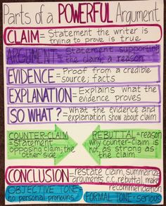
Evidence: What is your proof? Where is it from?
This is a fact or proof from a credible source (a quote).
This MUST include quotations from a credible text that prove your CLAIM.
Quotations include ANY piece of writing that is not YOUR OWN. If it’s not in your words OR if it’s not your own personal thought, place “quotations” around it.
Quotations MAY NOT always include characters speaking in dialogue.
This MUST include in-text citations.
Citations should come after your quotations and should include:
Prose: Author Last Name, Page Number
(Griffin 3)
Poetry: Line Number(s)
(3) OR if more than one (3-4)

Slide 12
Interpretation: So what?
This is your commentary or explanation.
You should explain what your evidence proves.
Must be at least TWO sentences.
This should be in your OWN words.
Do NOT use “I” or “You” in your interpretation.

Slide 13
Introduction
Your introduction introduces the reader to your topic.
It MUST contain three things:
Hook
Bridge
Thesis Statement

Slide 14
Introduction: HOOK
You must get your reader to WANT to read your essay first.
The hook contains between 1-3 sentences and MUST relate to the topic of your essay.

Slide 15
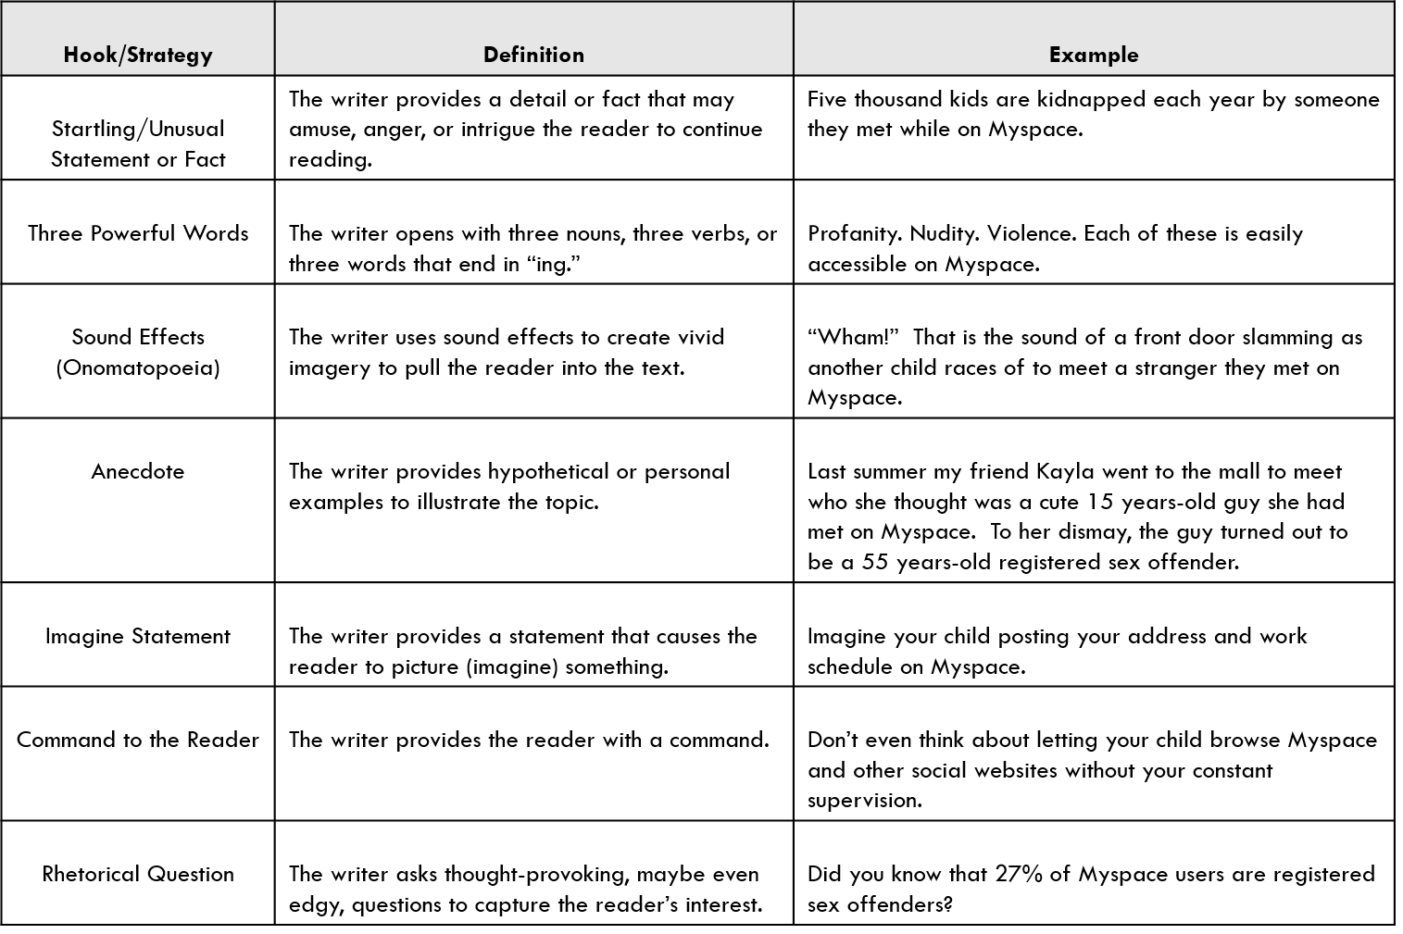
Introduction: HOOK

Slide 16
Introduction: BRIDGE
Present the necessary background to connect your hook and your thesis statement.
The Bridge ties the hook to the prompt and thesis statement while providing the reader with background information.

Slide 17
Introduction: Thesis Statement
It takes a stand rather than announces a subject.
It will NOT say: “In this paper I will…”
It will be specific with only ONE main point.
It comes at the END of the introduction.
Need help? Try using this method:
In title of text, author’s name uses concrete element to power verb abstract concept.
In The Tragedy of Julius Caesar, William Shakespeare uses strategically planted rhetorical devices to manipulate the audience’s reactions regarding the death of Julius Caesar.

Slide 18
ABSTRACT CONCEPT VS CONCRETE ELEMENT
ABSTRACT CONCEPT
CONCRETE ELEMENT
Love
Success
Moral
Good
Bad
Must be inferred by concrete elements.
Rhetorical Devices:
Something that is actually used within the piece of literature in order to create deeper meaning.
Directly in the text.

Slide 19
Introduction: Thesis Statement
Test your Thesis Statement:
Does it inspire a reader to ask: How? Why? Or want to learn more?
Would a reasonable reader not respond with “Duh!” or “So what?” or “No Kidding!”?
Does the thesis statement avoid general phrasing and/or sweeping words such as “all,” “none,” or “every”?
Does the thesis guide the reader toward the claims, or topic sentences?
Can the thesis be explained in the amount of length necessary?

Slide 20
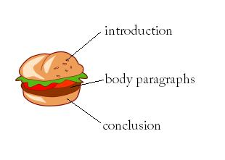
Body Paragraphs
Each of your body paragraphs MUST include
(1) Claim
(2) Evidence
(2) Interpretation
Your body paragraph will look like this:
Claim (1-2 sentences)
Evidence (1-2 sentences)
Interpretation (2-3 sentences)
Evidence (1-2 sentences)
Interpretation (2-3 sentences)

Slide 21
Conclusions
This is the easiest part of your essay and should be only 3-4 sentences.
Your conclusion should have:
(1) Topic Sentence: it is okay to start with “In conclusion,…”
(1) Restate your Thesis Statement: remind the reader of the most important ideas in the essay.
(1) Concluding Sentence: this should be STRONG. This sentence is the last sentence your reader will read. Leave an impression!
Examples of Concluding Sentences: rhetorical questions, make a prediction, or provide recommendations.

Slide 22
Rubrics
All rubrics come from the Georgia Department Board of Education End-of-Course Milestones Assessment for 11th Grade Literature and Composition.
Argumentative Rubric
Pg. 46 & 47
Expository Rubric
Pg. 44 & 45
Narrative Rubric
Pg. 43

Slide 23
Cardinal Sins
Using the following words or phrases will result in an automatic 50% on your essay, until they are corrected.
Using the pronoun “I”
“I” phrases:
I think
I feel
I know
I believe
Using the pronoun “You”
Using the wrong Subject/Verb Agreement
Committing the following “crimes” will result in an automatic 0% on your essay, until they are corrected.
Not using Paragraphs or Indentations
Additionally, using the following words or phrases will result in an automatic 50% on your essay, until they are corrected.
Using a naked quote
Using passive voice
NOT using correct MLA formatting= -11 points

