Slide 1
Slide 1
Writer’s Workshop
Notes:
These can be changed to reflect your school’s specific rules.

Slide 2
Slide 3
Table
of
Contents:
Station #1: MLA Formatting
Station #2: In-Text Citations
Station #3: Transitions
Station #4: Proofreading
Station #5: C.E.I.
Station #6: Theme Statement

Slide 3
Slide 4
Station #1: MLA Formatting
GOAL: Ensure that your paper meets ALL MLA formatting requirements. Failure to meet these requirements will result in a 50% on your essay. Please take time to review EACH person’s essay to ensure that all requirements are met.

Slide 4
Review the following resources:
1.Overview: https://owl.purdue.edu/owl/research_and_citation/mla_style/mla_overview_and_workshop.html
In-Text Citations: https://owl.purdue.edu/owl/research_and_citation/mla_style/mla_formatting_and_style_guide/mla_in_text_citations_the_basics.html
https://writing.wisc.edu/wp-content/uploads/sites/535/2018/07/MLA_2017.pdf

Slide 5
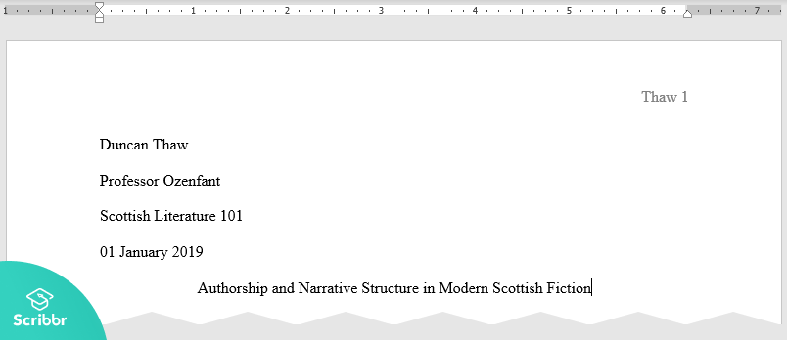
The basics:
Times New Roman
12 pt. font
Double-spaced
Header in the top left corner
Your name
Ms. Thorne
10th Honors World Literature
Day Month Year
Title (creative) in the center

Slide 6
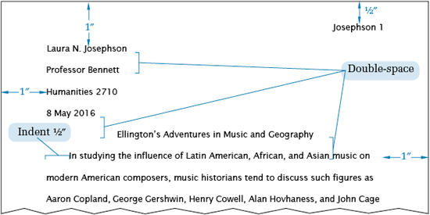
HOW TO CREATE A HEADER:
To create a header with your last name and page number that will automatically carry from page to page, following the steps below:
1. Click “INSERT” at the top of the menu.
2. Click “HEADER”
3. Click the first option that reads “BLANK”
4. Click “HOME” at the top of page.
5. Click “ALIGN RIGHT”
6. Click “TYPE HERE” and type JUST YOUR LAST NAME
7. Click “INSERT” again
8. Click “PAGE NUMBER”
9. HOVER over “TOP OF PAGE”
10. Click “PLAIN NUMBER 3”
**HINT: If your last name disappears, just type it in again before the number.
***HINT #2: You should only have to do this once. Your last name and the appropriate page number will carry over from page to page.

Slide 7
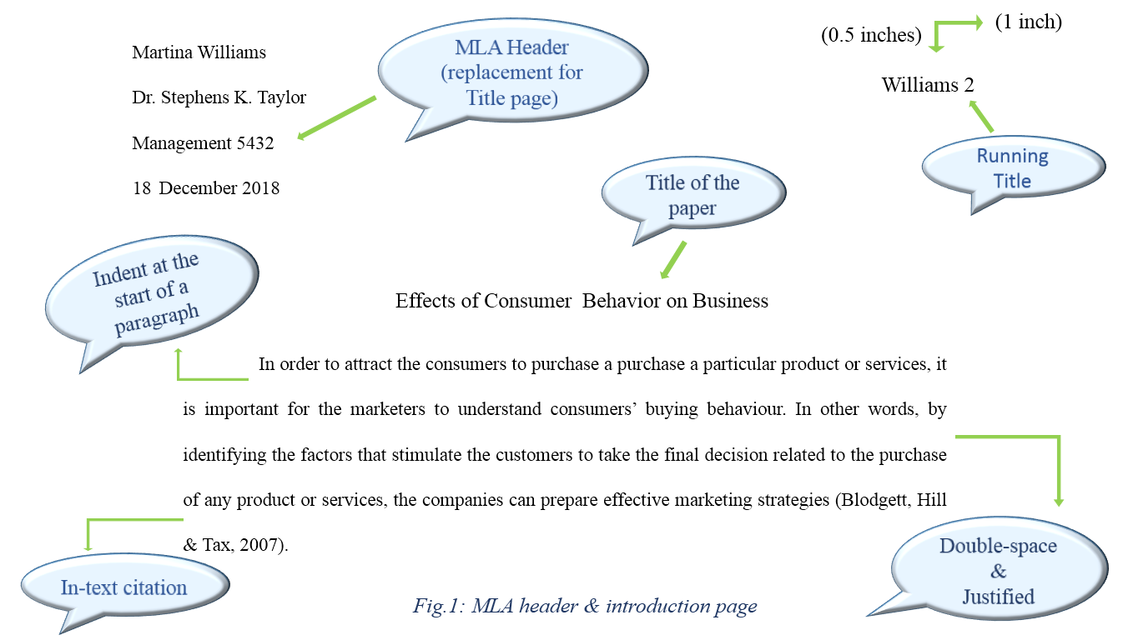

Slide 8
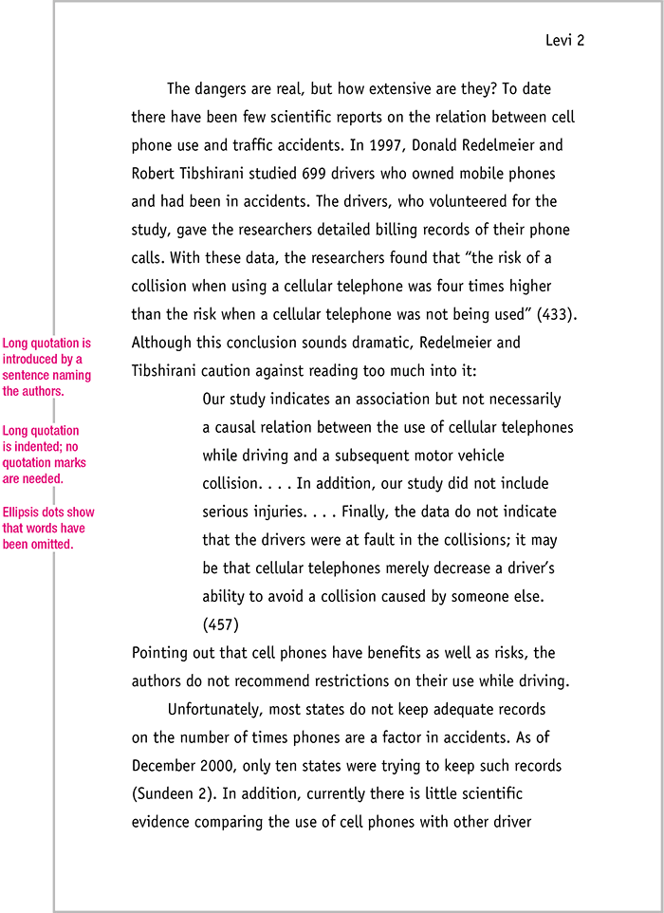
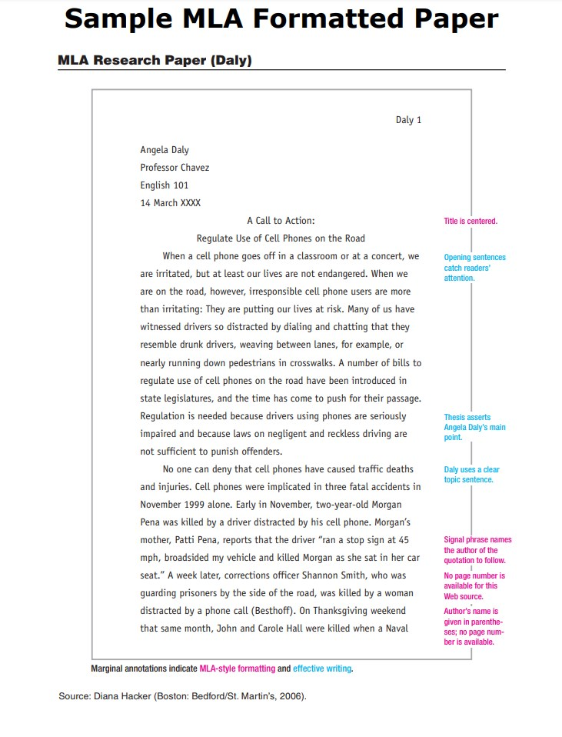
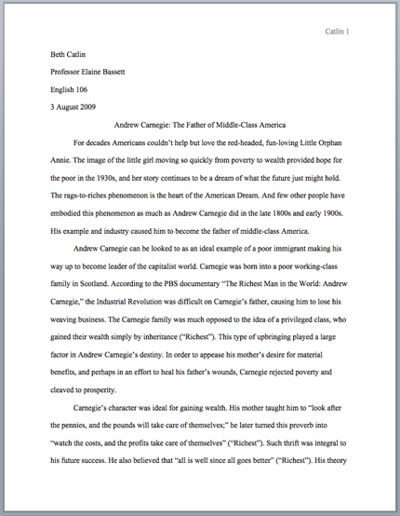
Examples:

Slide 9
Slide 5
Station #2:
In-Text Citations
GOAL: Ensure that your paper has AT LEAST two quotes per paragraph. Ensure that each quote is properly quoted within the paragraph. Ensure that each quote is properly cited.
Notes:
*Change this verbiage to the language your school uses.

Slide 10
Resources:
Owl Purdue “The Basics”: https://owl.purdue.edu/owl/research_and_citation/mla_style/mla_formatting_and_style_guide/mla_in_text_citations_the_basics.html
Quotations: https://owl.purdue.edu/owl/research_and_citation/mla_style/mla_formatting_and_style_guide/mla_formatting_quotations.html
Works Cited Page: https://owl.purdue.edu/owl/research_and_citation/mla_style/mla_formatting_and_style_guide/mla_works_cited_page_basic_format.html

Slide 11
The Basics:
Each paragraph needs to have at least two quotations directly from the book.
Be sure to use \ to indicate new lines in your quote.
Macbeth’s paranoia shows the impact of guilt on the human conscious, “Avaunt, and quit my sight! Let the earth\ hide thee” (3.4.92-94).
Each quote needs to be inside quotation marks.
Macbeth’s paranoia shows the impact of guilt on the human conscious, “Avaunt, and quit my sight! Let the earth\ hide thee” (3.4.92-94).
Each quote needs to be properly cited.
Macbeth’s paranoia shows the impact of guilt on the human conscious, “Avaunt, and quit my sight! Let the earth\ hide thee” (3.4.92-94).

Slide 12
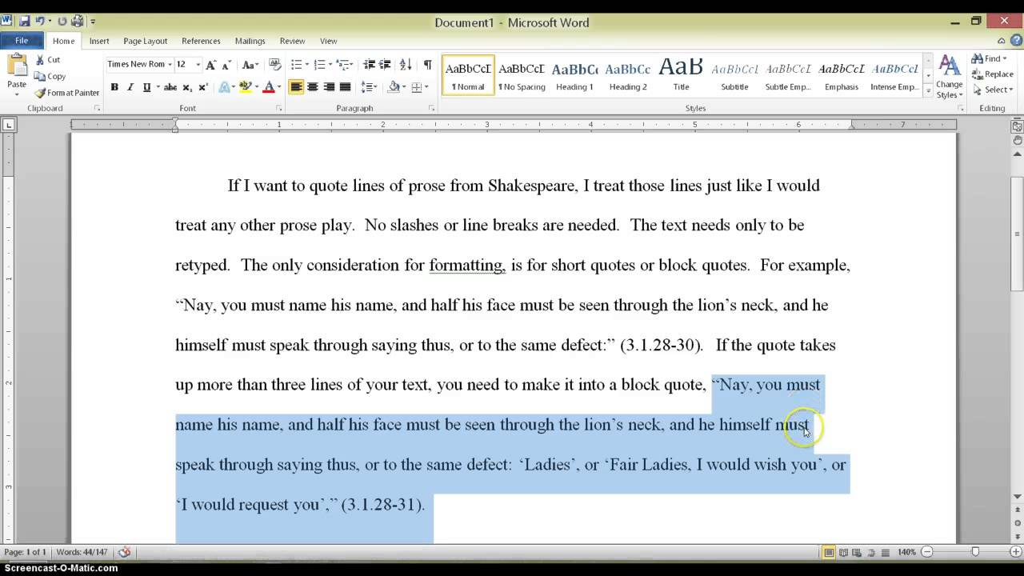

Slide 13
Slide 6
Station #3:
Transitions
GOAL: To read the paper and make suggestions on possible transitions that can be used to make your partner’s paper flow more smoothly.

Slide 14
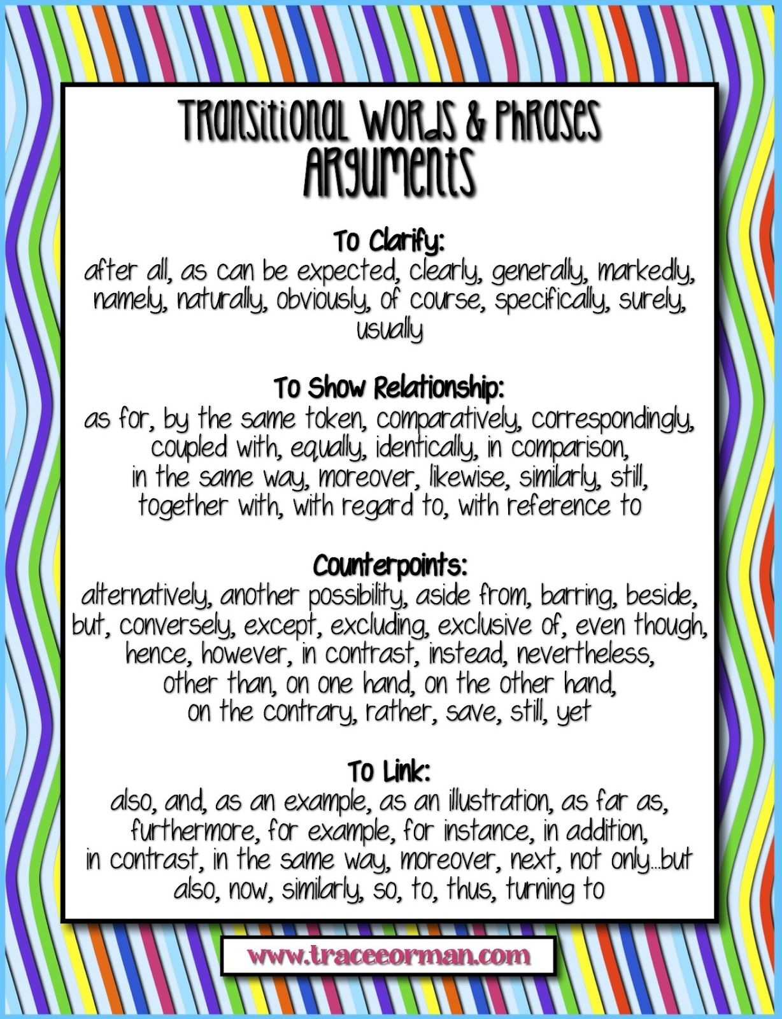

Slide 15
Slide 7
Station #4:
Proofreading
GOAL: To read AT LEAST two group member’s paper and to make any corrections using the rules on the following slide to guide your review of their paper. If you see any of the following rules being broken, make a physical note on your peer’s paper.

Slide 16
Ms. Thorne’s Rules of Writing: Failing to follow ALL of these rules will result in a 50% on your essay.
You may not use first and second person pronouns
I feel
I think
I believe
I know
You
You may not have any “naked quotes”
You must have subject/verb agreement
You may not use passive voice
You must have your thoughts organized into paragraphs
You must use MLA formatting

Slide 18
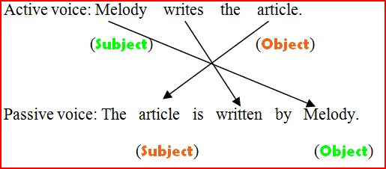

Slide 19
Station #5:
C.E.I-
Paragraph Structure
GOAL: Ensure that EACH paragraph in your paper flows smoothly and follows C.E.I guidelines. You need to have a claim. You need to have at least two quotes in each paragraph. Each quote needs to be followed by a detailed and thorough analysis explaining HOW the evidence supports your argument.

Slide 20
Paragraph Structure: C.E.I
Claim: What’s your point? What are you trying to prove?
This is an assertion.
You must answer the prompt.
Use adjectives to show comprehension.
Sample Prompt: Discuss the conditions of indentured servitude and the degree to which servants were treated fairly.
Sample Claim: Indentured servitude in the 17th century colonial America established clear and fair conditions for both servant and master.
This should be one sentence long.
This includes the answer in the form of a topic sentence.

Slide 21
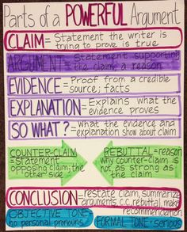
Evidence: What is your proof? Where is it from?
This is a fact or proof from a credible source (a quote).
This MUST include quotations from a credible text that prove your CLAIM.
Quotations include ANY piece of writing that is not YOUR OWN. If it’s not in your words OR if it’s not your own personal thought, place “quotations” around it.
Quotations MAY NOT always include characters speaking in dialogue.
This MUST include in-text citations.
Citations should come after your quotations and should include:
Prose: Author Last Name, Page Number
(Griffin 3)
Poetry: Line Number(s)
(3) OR if more than one (3-4)

Slide 22
Interpretation: So what?
This is your commentary or explanation.
You should explain what your evidence proves.
Must be at least TWO sentences.
This should be in your OWN words.
Do NOT use “I” or “You” in your interpretation.

Slide 23
Introduction
Your introduction introduces the reader to your topic.
It MUST contain three things:
Hook
Bridge
Thesis Statement

Slide 24
Introduction: HOOK
You must get your reader to WANT to read your essay first.
The hook contains between 1-3 sentences and MUST relate to the topic of your essay.

Slide 25
Introduction: HOOK

Slide 26
Introduction: BRIDGE
Present the necessary background to connect your hook and your thesis statement.
The Bridge ties the hook to the prompt and thesis statement while providing the reader with background information.

Slide 27
Introduction: Thesis Statement
It takes a stand rather than announces a subject.
It will NOT say: “In this paper I will…”
It will be specific with only ONE main point.
It comes at the END of the introduction.
Need help? Try using this method:
In title of text, author’s name uses concrete element to power verb abstract concept.
In The Tragedy of Julius Caesar, William Shakespeare uses strategically planted rhetorical devices to manipulate the audience’s reactions regarding the death of Julius Caesar.

Slide 28
ABSTRACT CONCEPT VS CONCRETE ELEMENT
ABSTRACT CONCEPT
CONCRETE ELEMENT
Love
Success
Moral
Good
Bad
Must be inferred by concrete elements.
Rhetorical Devices:
Something that is actually used within the piece of literature in order to create deeper meaning.
Directly in the text.

Slide 29
Introduction: Thesis Statement
Test your Thesis Statement:
Does it inspire a reader to ask: How? Why? Or want to learn more?
Would a reasonable reader not respond with “Duh!” or “So what?” or “No Kidding!”?
Does the thesis statement avoid general phrasing and/or sweeping words such as “all,” “none,” or “every”?
Does the thesis guide the reader toward the claims, or topic sentences?
Can the thesis be explained in the amount of length necessary?

Slide 30
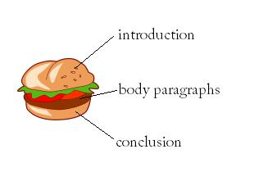
Body Paragraphs
Each of your body paragraphs MUST include
(1) Claim
(2) Evidence
(2) Interpretation
Your body paragraph will look like this:
Claim (1-2 sentences)
Evidence (1-2 sentences)
Interpretation (2-3 sentences)
Evidence (1-2 sentences)
Interpretation (2-3 sentences)

Slide 31
Conclusions
This is the easiest part of your essay and should be only 3-4 sentences.
Your conclusion should have:
(1) Topic Sentence: it is okay to start with “In conclusion,…”
(1) Restate your Thesis Statement: remind the reader of the most important ideas in the essay.
(1) Concluding Sentence: this should be STRONG. This sentence is the last sentence your reader will read. Leave an impression!
Examples of Concluding Sentences: rhetorical questions, make a prediction, or provide recommendations.

Slide 32
Station #6:
Theme Statement
GOAL: Ensure that your last body paragraph is an analysis of the universal message of _____________(different depending on what prompt you chose) and how it supports the universal message (theme) of Macbeth.

Slide 33
How to write a theme statement:
https://www.fsd157c.org/Documents/TeacherFiles/WritingThemeStatements_9_29_2017_6_57_28_AM.pdf

