Slide 2
Guiding Conceptual Questions: Intertextuality
1. How do texts adhere to and deviate from conventions associated with literary forms or text types? 2. How do conventions and systems of reference evolve over time? 3. In what ways can diverse texts share points of similarity? 4. How valid is the notion of a classic text? 5. How can texts offer multiple perspectives of a single issue, topic or theme? 6. In what ways can comparison and interpretation be transformative?

Slide 3
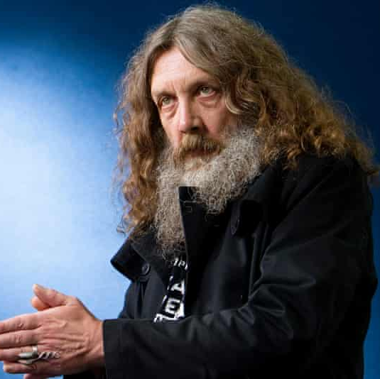
Alan Moore: Context

Slide 4
The Guardian: Goodbye, Alan Moore: the king of comics bows out Important Highlights
A brainy pop writer whose style veers between Stephen King and John le Carré, Moore’s influence can be felt everywhere – in our literature, on our screens, in our politics.
HBO’s great post-Game of Thrones hope is yet another adaptation of Moore’s most popular book, Watchmen, which (co-authored with illustrator Dave Gibbons) has sold millions of copies since it was first published in 1987. He’s played himself on The Simpsons, seen his work adapted into a number of films – none very good – and even inspired an activist collective: the Anonymous group wear Guy Fawkes masks as a tribute to V, the anarchist hero of Moore’s and illustrator David Lloyd’s V for Vendetta.
Moore draws very rarely: instead he writes comics scripts, and at punishing length. Those can run to hundreds of pages, describing every layer of background and every tertiary character.
Many fans have been left in the awkward position of liking Moore’s superhero comics a good deal more than he does himself.
Moore would be the first to tell you that seriousness isn’t always a virtue, but his was thoroughly transformative.
And for many readers, myself among them, it was a great relief to be taken seriously as a reader of something supposedly sub-literate and stupid, to be treated with intelligence and care, and to be introduced to Moore’s rebellious brand of morality: his passionate feminism, his suspicion of authority and wealth, his love of normal people and veneration of togetherness, especially in the face of the hopelessness of the real world. His gifts for cruelty and horror inspired undistinguished competitors to enter the field, but his unexpected gentleness was what kept readers coming back to him.

Slide 5
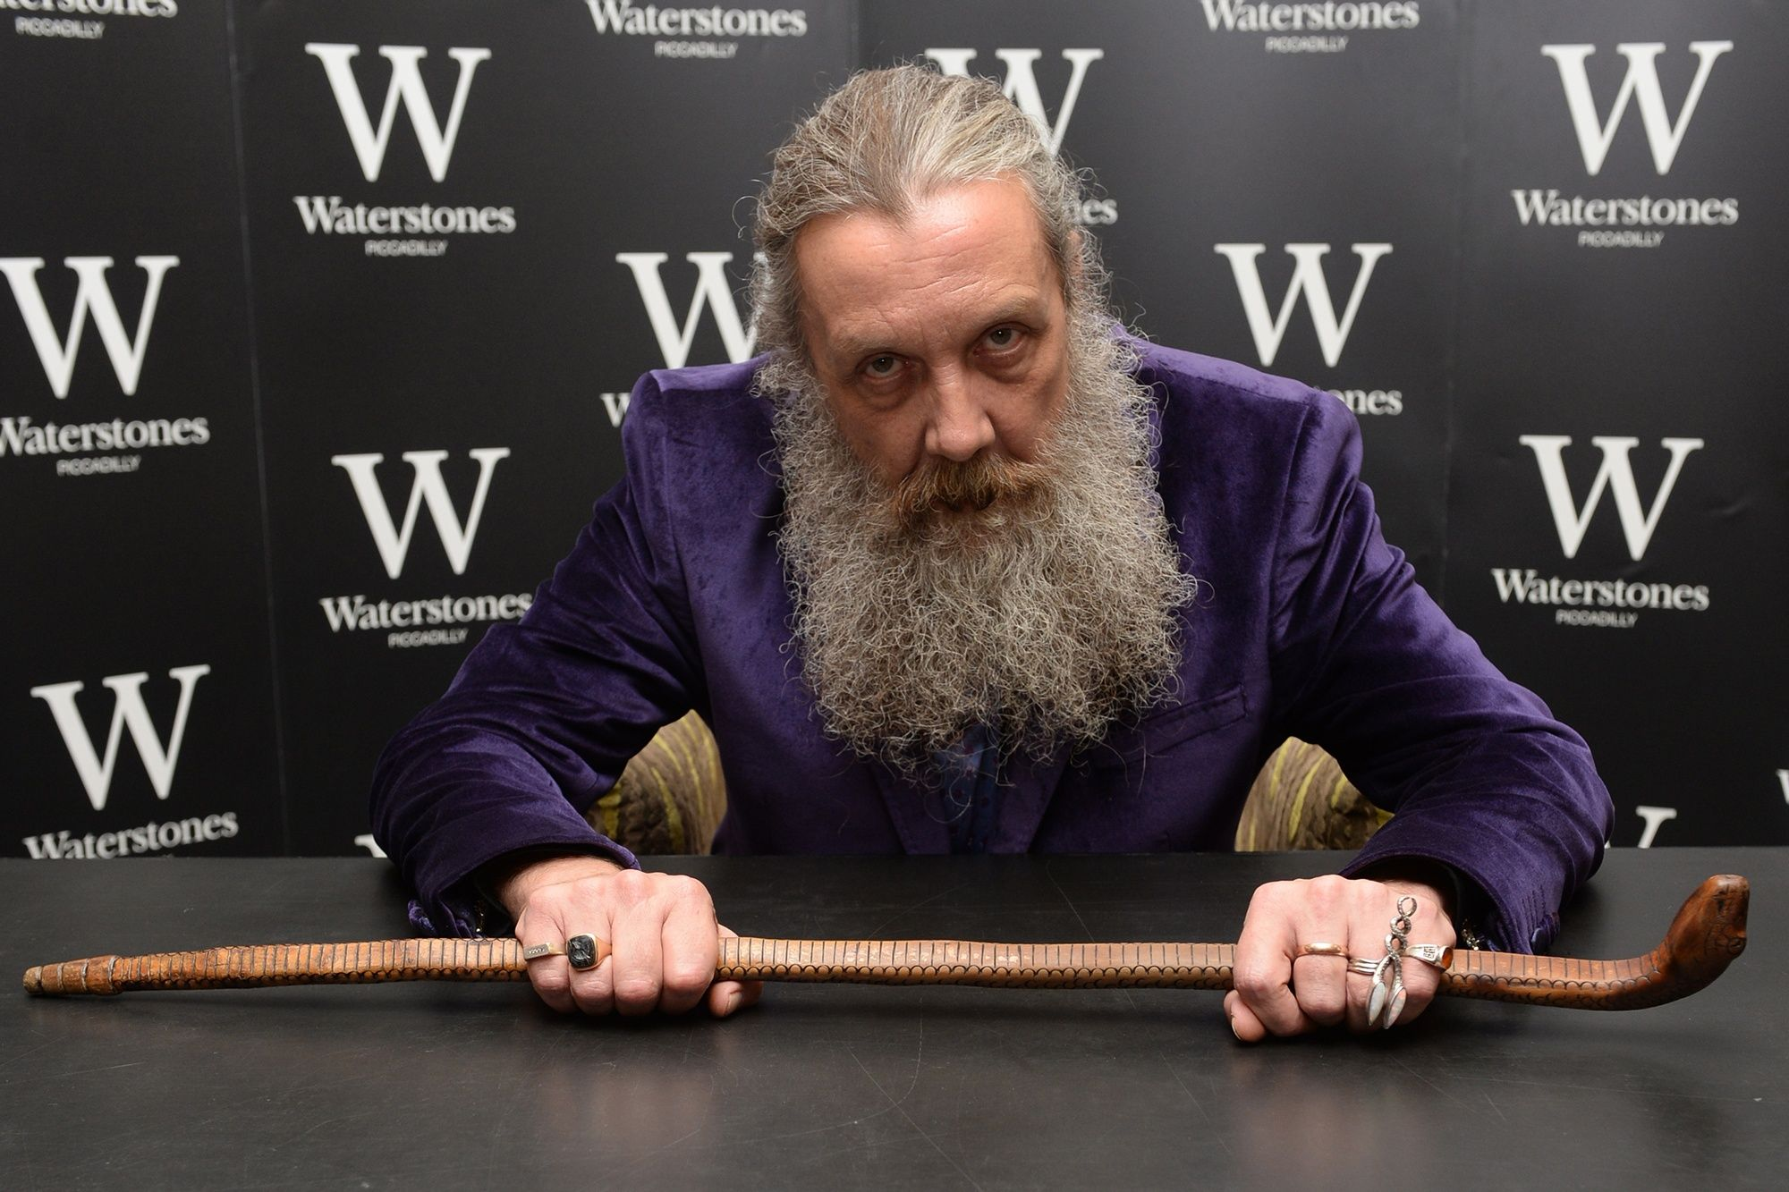
“The Mindscape of Alan Moore”: a film https://vimeo.com/212863120

Slide 6
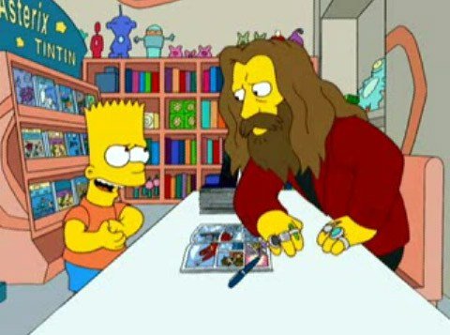
Intertextuality-Alan Moore & The Simpsons
This area of exploration focuses on the concerns of intertextuality, or the connections between and among media, text and audience involving diverse traditions and ideas. It focuses on the comparative study of texts so that students may gain deeper appreciation of both unique characteristics of individual texts and complex systems of connection.
This area allows for a further exploration of literary and linguistic concerns, examples, interpretations and readings by studying a grouping of texts set by the teacher or set in close conversation with a class or groups of students. Students will gain an awareness of how texts can provide critical lenses to reading other texts and of how they can support a text's interpretation by expanding on it or question it by providing a different point of view.

Slide 7
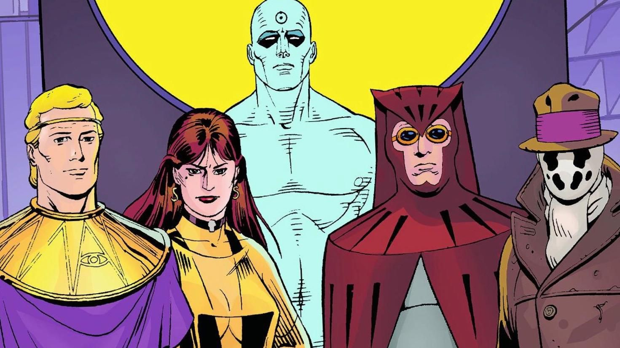
About Watchmen:
Written by: Alan Moore
Artist: Dave Gibbons
Colorist: John Higgins
Originally published monthly by DC Comics in 1986 & 1987
Collected in a single-volume edition in 1987
“incredibly complex and nuances and can be explored from many different perspectives and angles”

Slide 8
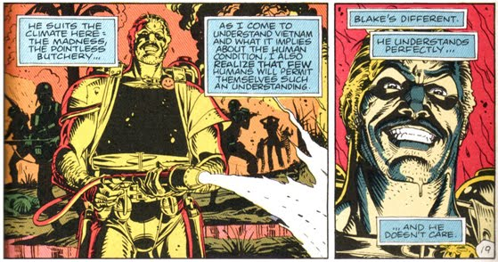
Historical Context: The Cold War

Slide 9
Historical Context Activity: The cold war and the threat of nuclear destruction is the ticking time bomb that is prevalent throughout Watchmen and provides significant plot tension.
Group A: Avery, Elizabeth, Noah, Tre, Aiden
Group B: Alex, Joseth, Molly, Nevaeh

Slide 10
Important Terms:
Juxtaposition:
Allusion:
Symbolism:
Time & Motion:
Moment to moment – which needs very little closure.
Action to action – feature a single subject transitioning.
Subject to subject – while staying within a scene or idea.
Scene to scene – transports the reader across a significant distance of time and space.
Aspect to aspect – bypasses time and sets a wandering eye on different aspects of a place, idea or mood.
Non-sequitur – no logical relationship between panels.

Slide 11
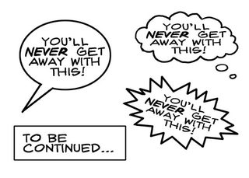
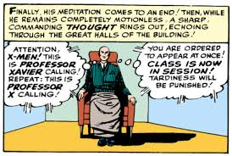
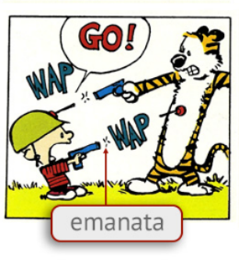
Important Terms: TEXT
Caption – text that speaks directly to the reader. Frequently, the text appears below the comic panel, but it can be placed beside or above it as well.
Emanata – Text or icons that represent what’s going on in the character’s head. Emanata are different from motion or speed lines, which indicate that a character is moving.
Balloon – Object used to contain the dialogue characters in comics speak. Also called speech balloons or bubbles. Balloons are frequently rounded but can take many shapes included rectangular. They typically have smooth edges but can also have jagged or irregular edges.

Slide 12
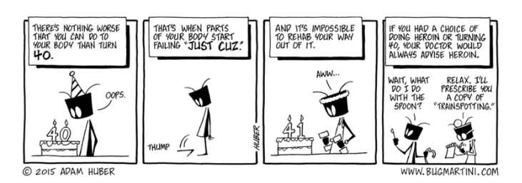
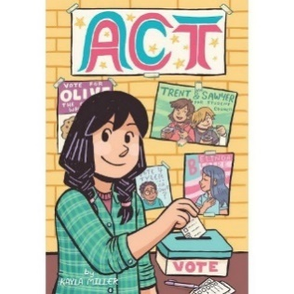
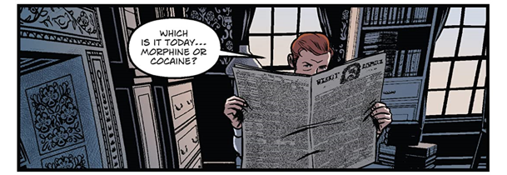
Important Terms: TEXT
Narratory Block – Rectangles or squares in which a narrator or a character from the story shares special information with readers. Also known as narrates before the scene in the panel.
Sign – Text labels written on objects in comics. Signs may be used to identify an object or to provide more information that is important to the scene. The sign can be a familiar object to the reader, like a stop sign; but they can also identify objects that may not be clear to the reader.
Label – Text labels written on characters in comics. The label can be the character’s name or a more general label that identifies the character as part of a general group. Labels are frequently used in political cartoons to identify the specific public figures who are included in the scene.

Slide 13
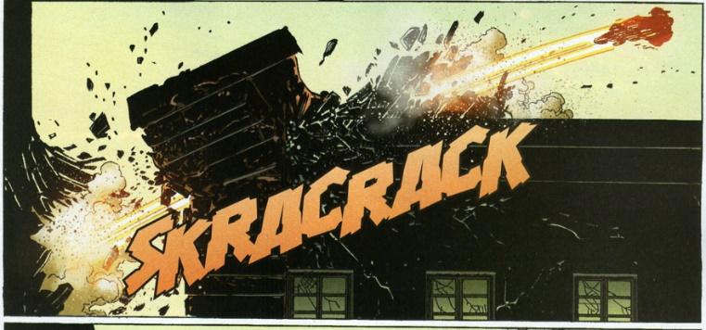
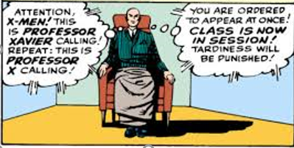
Important Terms: TEXT
Sound Effect – Words that indicate a sound that accompanies the comic panel.
Thought Bubble – Objects used to contain a character’s thoughts. These text containers are sometimes called thought bubbles because of the trail of little bubbles that connect the though balloon to the character in the comic.

Slide 14
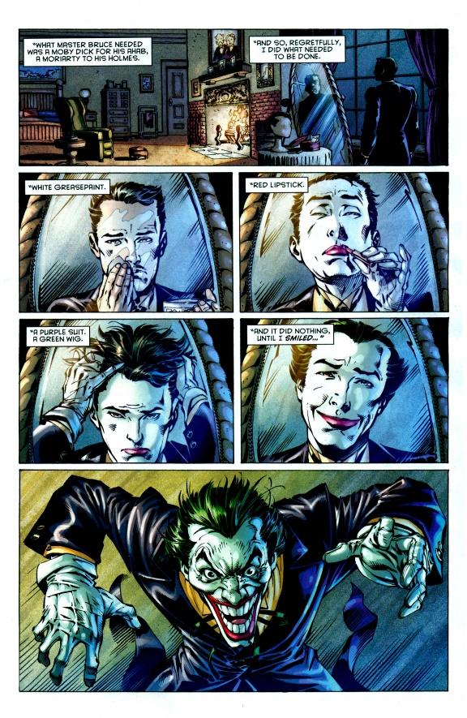
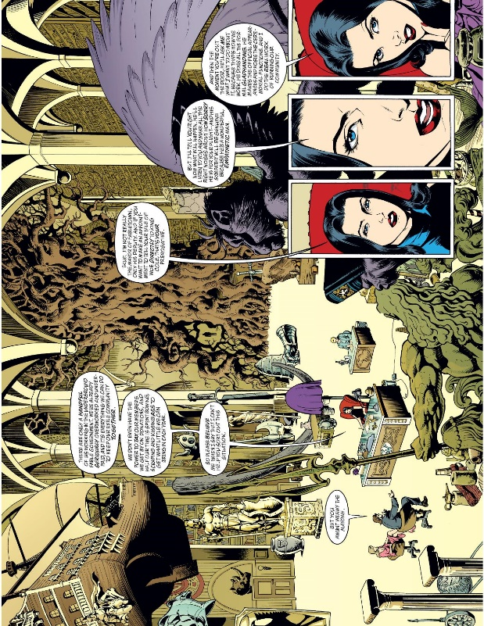
Important Terms: LAYOUT
Close-up – images that are shown in a large view. Frequently, close-ups focus on a character’s face, but they can be used to highlight anything.
Extreme Close-up – images that are shown in very large view, often focusing on a small portion of a larger object or character.
Bleed – Images that run outside the boarder of the panel. When an image runs outside the panel on all four sides, it is called a full bleed. Comic book covers frequently use a full bleed

Slide 15
Important Terms: LAYOUT
Extreme longshot – Images that show objects or characters in very small scale. Frequently, extreme longshots are used to show a full landscape or a crowd of characters. Extreme longshots may show objects or characters that are a mile or more away. An extreme longshot drawn from the perspective of someone above the characters or objects is called a bird’s eye view. Worm’s eye view describes an extreme longshot taken from below the objects or characters.
Longshot – Images that show objects fully, from top to bottom. When a longshot focuses on characters, the panel shows the characters from head to toe. Readers can see the character’s full body.

Slide 16
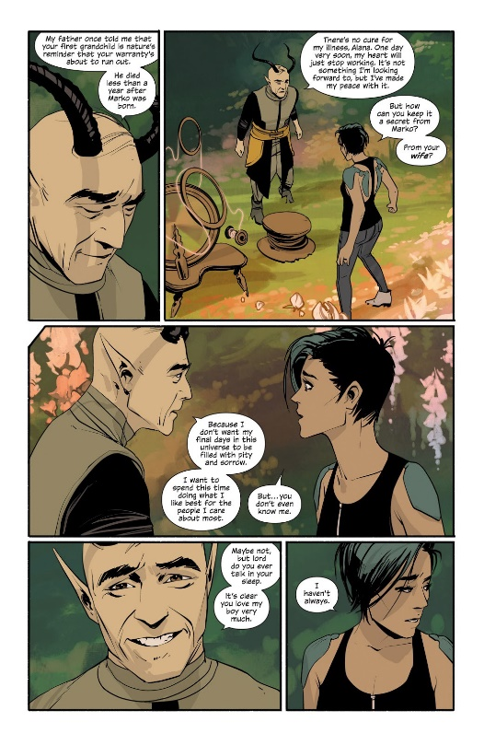
Important Terms: LAYOUT
Reverse – Images that are in reverse position from the previous panels. This technique in often used to show changes speaker or point of view.

Slide 17
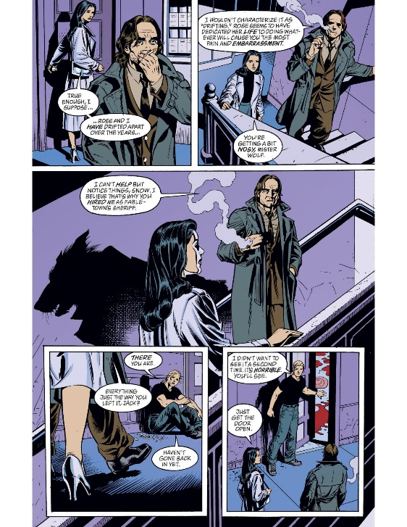
Important Terms: ANGLES
Boarder – the edge or outline of the comic page. Boarders are also known as panel frames.
Gutter – the space between the panels of the comic.
Open panel – panels where one or more, or even all, of the sides of the comic panel are open to show dramatic effect. Open panels are also known as borderless panels.
Panel – rectangles or squares where the action of the comic is drawn. Panels are also known as frames.
Splash Panel – a panel that takes up the space of several panels in the comic in order to introduce or highlight an action or character. Splash panels are like splash pages, which takes up the whole page of a comic to help introduce or give spatial attention to battles or particular events.

Slide 18
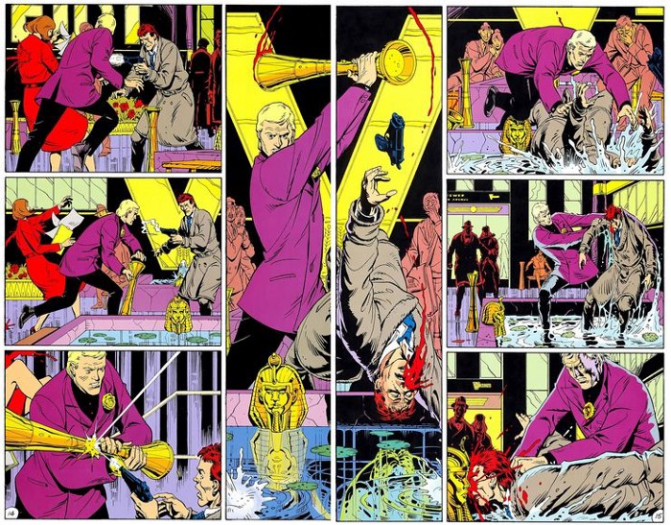
Artistic Concepts: Annotations
Throughout the course of this work, we will explore various features that are crucial in understanding comics.
It is important that we take note of the following: panel size, wordless panels, full-page spreads, use of color, ways to depict movement & time, and bleeds.

Slide 19
Bob Dylan: Exploring Allusions
In the opening of the book, illustrator Dave Gibbons writes, “It began with Bob Dylan. For me, a couplet from his 1966 masterpiece Desolation Row was the spark that would one day ignite WATCHMEN.”
After listening to the song, complete the chart.
Be prepared to discuss with the class ☺

Slide 20
Critical Lenses: important stuff to take note of as you read (annotations… ☺)
Consider how specific groups are portrayed/represented in the work:
Genders
Race
Superhero (traditional? Sign of the times?)
Police

Slide 21
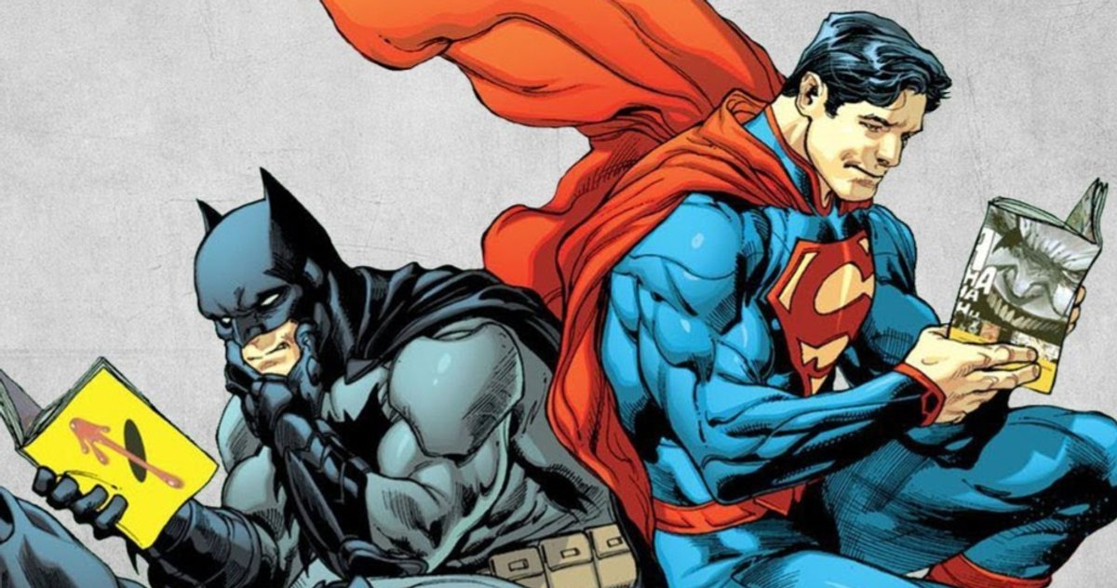
Reading Expectations:
Monday: What is a “hero” Socratic Seminar
Monday HW: Read Ch. 1 & answer questions
Tuesday: Discuss Ch. 1 Socratic Seminar
Tuesday HW: Read Ch. 2 & answer questions
Wednesday: Discuss Ch. 2 Socratic Seminar
Wednesday HW: Read Ch. 3 & answer questions
Thursday: Discuss Ch. 3 Socratic Seminar
Thursday HW: Read Ch. 4 and answer questions
Friday: Discuss Ch. 4 Socratic Seminar
You MUST:
Annotate each chapter (I would recommend using post-its so that your annotations can still be IN your book, but not directly on the page.)
Answer the questions for each chapter with very specific details (must include page numbers in order to receive credit).
Each response should have a specific example from the book. You must also explain how the example supports your answer to the question.
Keep all responses and work for this work in your LEARNING PORTFOLIO. ☺

