Slide 1
First 25:
How and why is a social group represented in a particular way?
Write an introduction with a theme statement, then a ten to twelve sentence explanation of which social groups are marginalized, excluded or silenced within the text.

Slide 2
Language of War
Part II

Slide 3
Goals:
Know: key persuasive techniques, including: euphemism, dysphemism and more...
Understand: that grammatical choices limit or enhance the impact of violence on the public
Be able to: analyze a media text to find examples of the key terms listed above
How is language used to exert or challenge power?

Slide 4
Agenda:
WRITTEN TASK #2 PRACTICE PEER EDIT: Students will discuss w/peer. (15 min.)
REVIEW: In your groups, review the key terms from last week.
TEXT ANLAYSIS: In your assigned groups, analyze the texts by using the terms, the power questions, and the EQ for this unit.

Slide 5
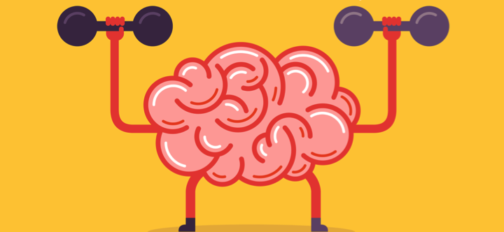
Key Terms
Look up the following key terms and add them to your Quizlet key terms card set. Try and include an example with each one (if applicable).
bias
dysphemism
euphemism
epithet
hyperbole
glittering generality
idiom (idiomatic expression)
proverb
emotive language

Slide 6
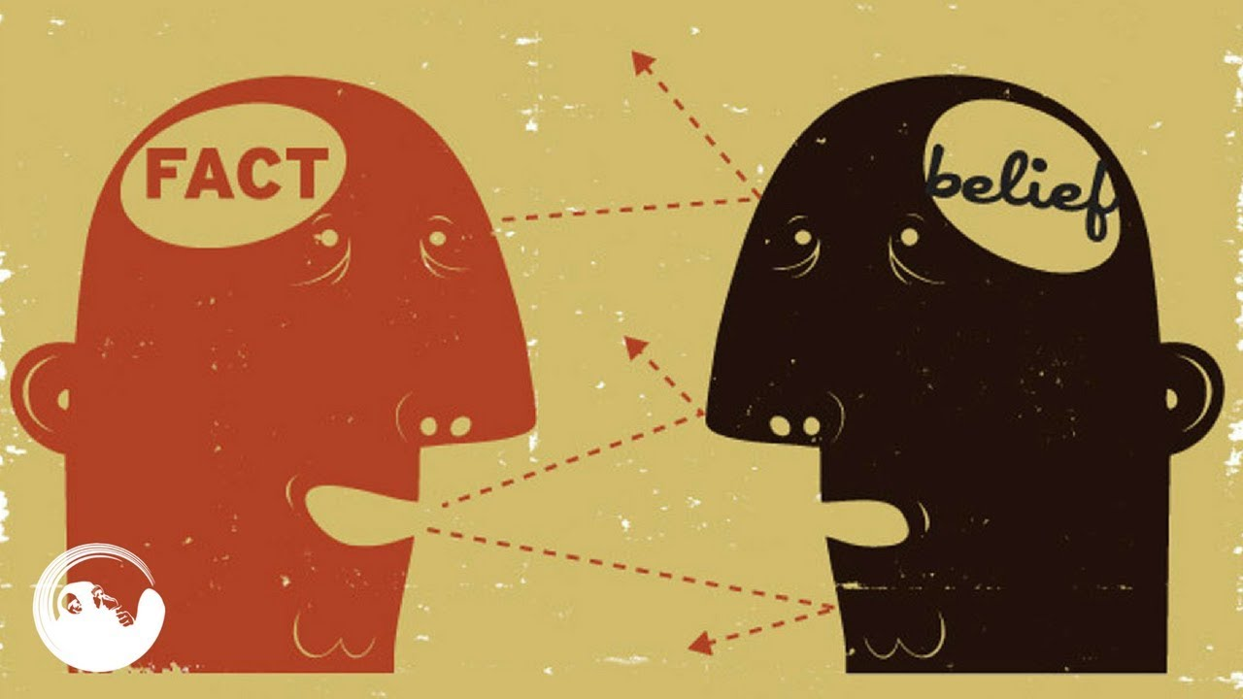
Bias
Prejudice in favor of or against one thing, person, or group compared with another, usually in a way considered to be unfair.
EX: "there was evidence of bias against foreign applicants"
synonyms: prejudice, partiality, partisanship, favoritism, unfairness, one-sidedness; bigotry, intolerance, discrimination, leaning, tendency, inclination, predilection
EX: "he accused the media of bias"

Slide 7
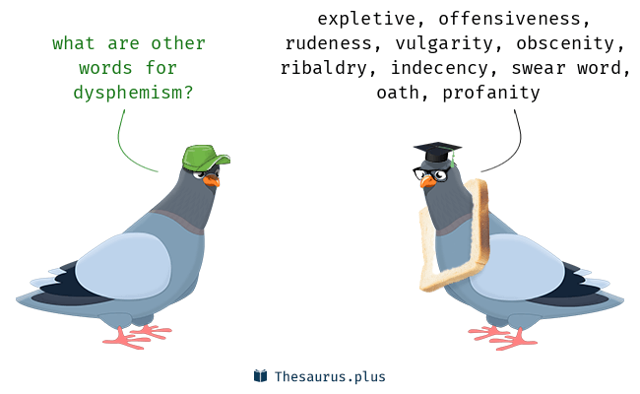
Dysphemism
A derogatory or unpleasant term used instead of a pleasant or neutral one, such as “loony bin” for “mental hospital.”

Slide 8
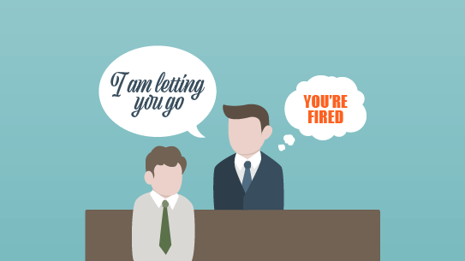
Euphemism
A mild or indirect word or expression substituted for one considered to be too harsh or blunt when referring to something unpleasant or embarrassing.
“downsizing” as a euphemism for cuts"

Slide 9
Epithet
An adjective or descriptive phrase expressing a quality characteristic of the person or thing mentioned.
"old men are often unfairly awarded the epithet “dirty.”

Slide 10
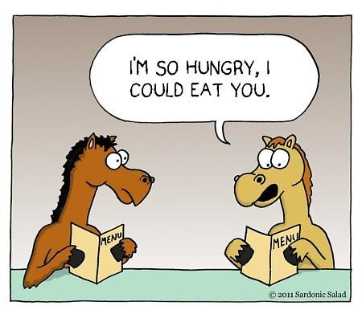
Hyperbole
Exaggerated statements or claims not meant to be taken literally.

Slide 11
Glittering Generality
A vague word or phrase used to evoke positive feelings rather than to convey information

Slide 12
Idiom (idiomatic expression)
Idiomatic expressions are a type of informal language that have a meaning different from the meaning of the words in the expression.
For example:
“Hold your tongue.”
This idiom doesn’t actually mean that you should stick your fingers in your mouth and grab you’re a hold of your tongue. It means that you shouldn’t talk.

Slide 13
Proverb
A proverb is a brief, simple, and popular saying, or a phrase that gives advice and effectively embodies a commonplace truth based on practical experience or common sense. A proverb may have an allegorical message behind its odd appearance.

Slide 14
Emotive Language
Emotive Language is the deliberate choice of words to elicit emotion (usually to influence).
Ideas can be expressed non-emotively. For example:
The men were killed.
However, they can also be expressed in a way that is positive or negative or welcoming or threatening. It all depends on the words selected. For example:
The victims were executed in cold blood.

Slide 15
Emotive Language
Non-emotive version: Another person in the restaurant was injured by the man's glass.
Emotive version: An innocent bystander suffered facial injuries when the evil man launched his glass across the restaurant.
Non-emotive version: The government will reduce interest rates.
Emotive version: The government will slash interest rates.

Slide 16
With this lesson you will understand that…
Writers use grammar and word choices to enhance or lessen the impact of violence on the public, usually to serve a particular agenda.

Slide 17
Agency is responsibility for an action, and it can be emphasized or hidden with grammar.

Slide 18
Analysis: How agency(responsibility) is hidden?
THE BASICS:
Sentences in English typically follow the pattern of SUBJECT (who the sentence is about) → VERB (the action) → OBJECT (the thing being acted upon).
This is called an ACTIVE sentence. For example, ‘Ms. Thorne stole a penguin’.
I could take myself out of this sentence and so hide my guilt with a PASSIVE sentence. For example, ‘A penguin was stolen’. The object has become the subject, and the person who performed the action (me) has been removed.
This effectively takes the emphasis away from me. This is an effective technique when you want to hide responsibility (agency) for a negatively perceived action.
Passive sentence structures also have the effect of creating less emotional involvement and greater objectivity. Thus, it is a particularly important part of scientific writing. (Check your latest lab reports - have you used passive sentences?)

Slide 19
INSTRUCTIONS:
All of the below information needs to be on your group’s post-it.
Step #1
Step #2
Step #3
WATCH each clip.
Identify literary devices in the text. Be sure to EXPLAIN HOW literary devices are used to enhance and/or lessen impact on the public.
Discuss AGENCY (or lack thereof) in the text.
DISCUSS & TYPE:
Power Questions:
(next slide)
Unit Question:
How is language used to exert or challenge power?
Put detailed analysis into our shared knowledge PPT (link on next pg).
VIRTUAL GALLERY WALK:
As a group, discuss other group’s PPT slides about their videos.
Leave comments on their slides.

Slide 20
SHARED KNOWLEDGE PORTAL: Please upload all work from today into the PPT below.
https://docs.google.com/presentation/d/1nyFayLWDzBRr3YYRBv4logJYLAPRjenDp8vqgXx76Pk/edit?usp=sharing

Slide 21
POWER QUESTIONS:
HOW is language used instrumentally and influentially to both exercise and undermine power in the text?
Is this an instance of public or personal power? How do you know?
Is this instrumental (coercive) or influential (motivational) or both? How do you know?
Is this an example of an attempt to maintain the status quo or make a change? How do you know?
Is this a harmful / beneficial use of language as power? Why?

Slide 22
GROUPING
A2:
A3:
GROUP #1: Jasmin, Max, Chrishya
GROUP #2: Kelsey, Ty
GROUP #3: Fran, Pili
GROUP #4: Noah, Keyvon
GROUP #5: Julia, Jayla
GROUP #6:
GROUP #7:
GROUP #8:
GROUP #9:
GROUP #1: Jada A., Llona, Cameron
GROUP #2: Jalyn, Aaron, Jada R.
GROUP #3: Jermya, Deja, Caliya
GROUP #4: Tyler, Charlese, Alysha
GROUP #5: Dom, Jessica, KeAuri
GROUP #6: Malana, Taylor O., Aleisha
GROUP #7: Shania, April, Camille
GROUP #8: T’Mia, Jordynn, Taylor G.
GROUP #9: Jamiah, Keith, Dereck, Michelle

Slide 23
GROUP #1
Jimmy Kimmel
+
Jimmy Fallon
+
President Trump
Text #1: https://www.youtube.com/watch?v=yqulWPljawo
Text #2: https://www.youtube.com/watch?v=c2DgwPG7mAA
Text #3: https://www.youtube.com/watch?v=QW6Q2W50GDQ
Text #4: https://www.nytimes.com/2017/11/28/business/media/jimmy-fallon-tonight-show-ratings-colbert-kimmel-decline.html

Slide 24
GROUP #2
Kim Kardashian West & Kayne West
+
President Trump
Text #1: https://www.youtube.com/watch?v=rzXpJcwqYIg
Text #2: https://www.youtube.com/watch?v=BiUTCLL4_ng
Text #3: https://people.com/tv/kim-kardashian-doesnt-support-donald-trump-but-smart-enough-to-use-connection/

Slide 25
GROUP #3
The View
Text #1: https://www.youtube.com/watch?v=cLHVJ7yGUNY
Text #2: https://www.youtube.com/watch?v=_WLyERvQ-yY

Slide 26
GROUP #4
Stephen Colbert +
President Trump
+
Hillary Clinton
Text #1: https://www.youtube.com/watch?v=NzxNSF_yS0A
Text #2:
https://www.youtube.com/watch?v=IvWZvxIuONA

Slide 27
GROUP #5
Fox 5 News
Text #1: https://www.youtube.com/watch?v=6DN4brsK2ws
Text #2:
https://www.youtube.com/watch?v=1690vwLAQuA

Slide 28
GROUP #6
The Daily Show
Text #1: https://www.youtube.com/watch?v=4LZ3P1sv9jE
Text #2: https://www.youtube.com/watch?v=mW-C7WE1xOs

Slide 29
GROUP #7
Ellen
Text #1: https://www.youtube.com/watch?v=JZXc5mlpSDk
Text #2:
https://www.youtube.com/watch?v=RecREW7iZz8
Text #3:
https://www.usatoday.com/story/life/entertainthis/2018/07/04/celebrities-got-political-social-media-july-4th/758051002/

Slide 30
GROUP #8
Tomi Lahren
+
Fox 5 News
Text #1: https://www.youtube.com/watch?v=vJBieWLnla0
Text #2:
https://www.youtube.com/watch?v=74KJk7RJf9o

Slide 31
GROUP #9
CNN
Text #1: https://www.youtube.com/watch?v=gz07eRaLUOE
Text #2:
https://www.youtube.com/watch?v=8aSIBbpS6NI

Slide 32
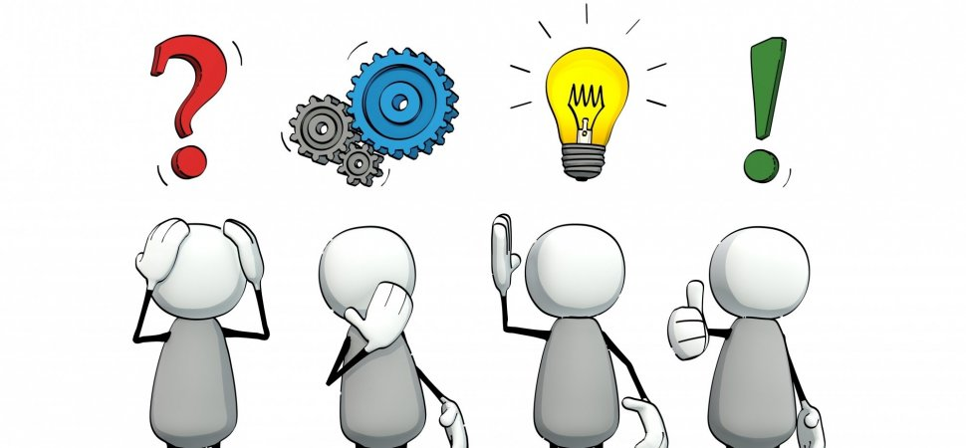
Once you have finished analyzing the text…
Be sure all necessary information is on your slides.
Read other group’s slides.
Each member of each group make 3 THOUGHTFUL and THOUGHT PROVOKING comments on EACH group’s slides.

Slide 33
How is this helping me towards assessment(s)?
FOA: For the further oral activity, you are expected to show a strong understand of the effect of language in a text. How about a meeting of editors, discussing the language in one of the articles about war? Changing grammar and language to lessen the impact of reported violence on the public?
Paper 1: The close stylistic analysis we conducted in this lesson is perfect preparation for a paper 1 exam. You could select two of the texts and complete a practice comparative analysis essay.

Slide 34
REMINDER:
Literary Device Storybook
DUE: 11/05 (MONDAY)
Instructions on website:
Thornezone.weebly.com

