Slide 1
DP Language & literature
Session 07- How is Pixar changing the world?

Slide 2
Agenda
First 15: 10 min.
How is Pixar changing the world?: 55 min.
MRJ: 20 min.
Closing: FOA #1 Reflection

Slide 3
Group discussion:20 min
RULES:
Only one person from each group is allowed to speak.
At the end of each 5 minute session, take 5 minutes to debrief with the speaker (this is when everyone can talk).
At the end of the 5 minute debrief, each person will take on a new job.
You may have a job more than once, but you must do every job at least once.
Everyone must speak for 6 minutes.
You will submit all work from today’s discussion.
Each person will speak for 5 minutes without stopping.
You may not read directly from your essay.
Use the questions to guide your verbal analysis.
While each person is speaking:
One person will be keeping time.
One person will be TAKING NOTES on what the person is saying.
One person will be RESPONDING to what the person is saying.

Slide 4
Small group discussion:20 min
How is Pixar changing the world?
How does language construct/deconstruct gender identities?

Slide 5
Large group discussion:15 min.
Choose one person from your group to report your group’s findings to the class.
This is the only person from your group that will be allowed to share out today. ☺

Slide 6
A2 groups:
Jasmin, Kelsey, Jayla
Ty, Julia, Noah
Keyvon, Francesca, Ayele
Pili, Chrishya, Max

Slide 7
A3 groups:
Charlese, Malana, Deja, Caliya
J. Alexander, Jermya, Keith, Llona, Cameron
T’Mia, Alysha, Dom., Aaron
Camille, Shadarria, Michelle, Aleisha
Jalyn, Taylor G., Tyler, Jamiah
Dereck, Jessica, April, Taylor O.
7. Ke’Auri, J. Ross, Jordynn, Shania

Slide 8
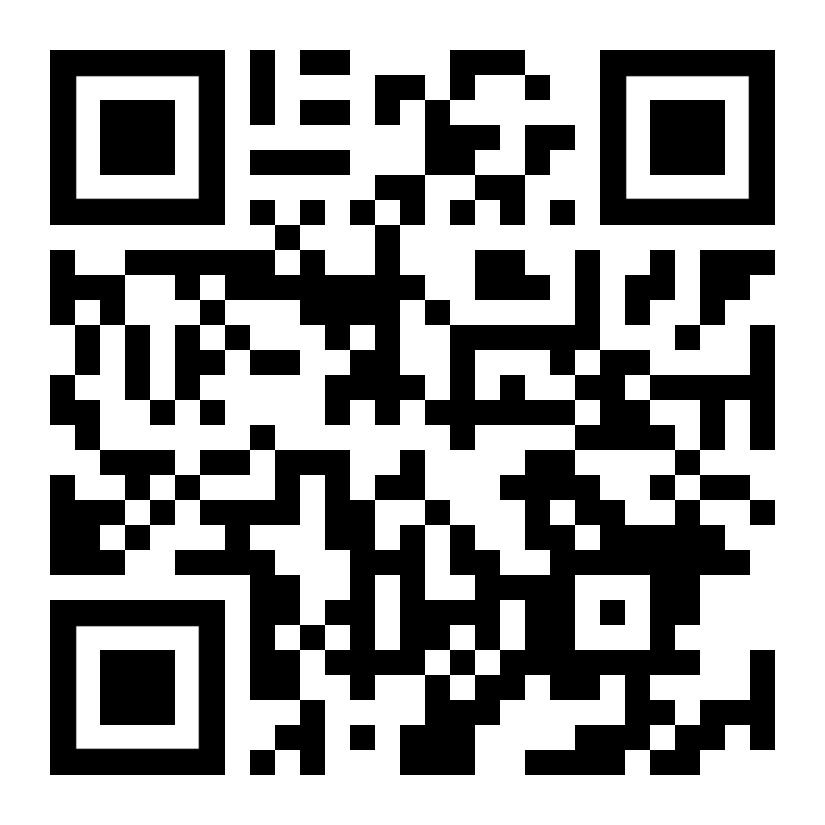
DISCUSSION DEBRIEF:
https://www.surveymonkey.com/r/MHHYM8W

Slide 9
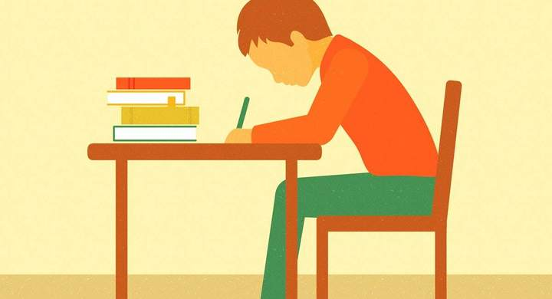
Homework:
Practice FOA #1 reflection due 09/09 (EMAIL TO THORNEE@FULTONSCHOOLS.ORG).
MRJ for Oryx and Crake #1 due 09/17

