Slide 1
SESSION 03: practice FOA #1
IB DP Language & Literature

Slide 2
EXTENSION: Three Ways to Speak English

Slide 3
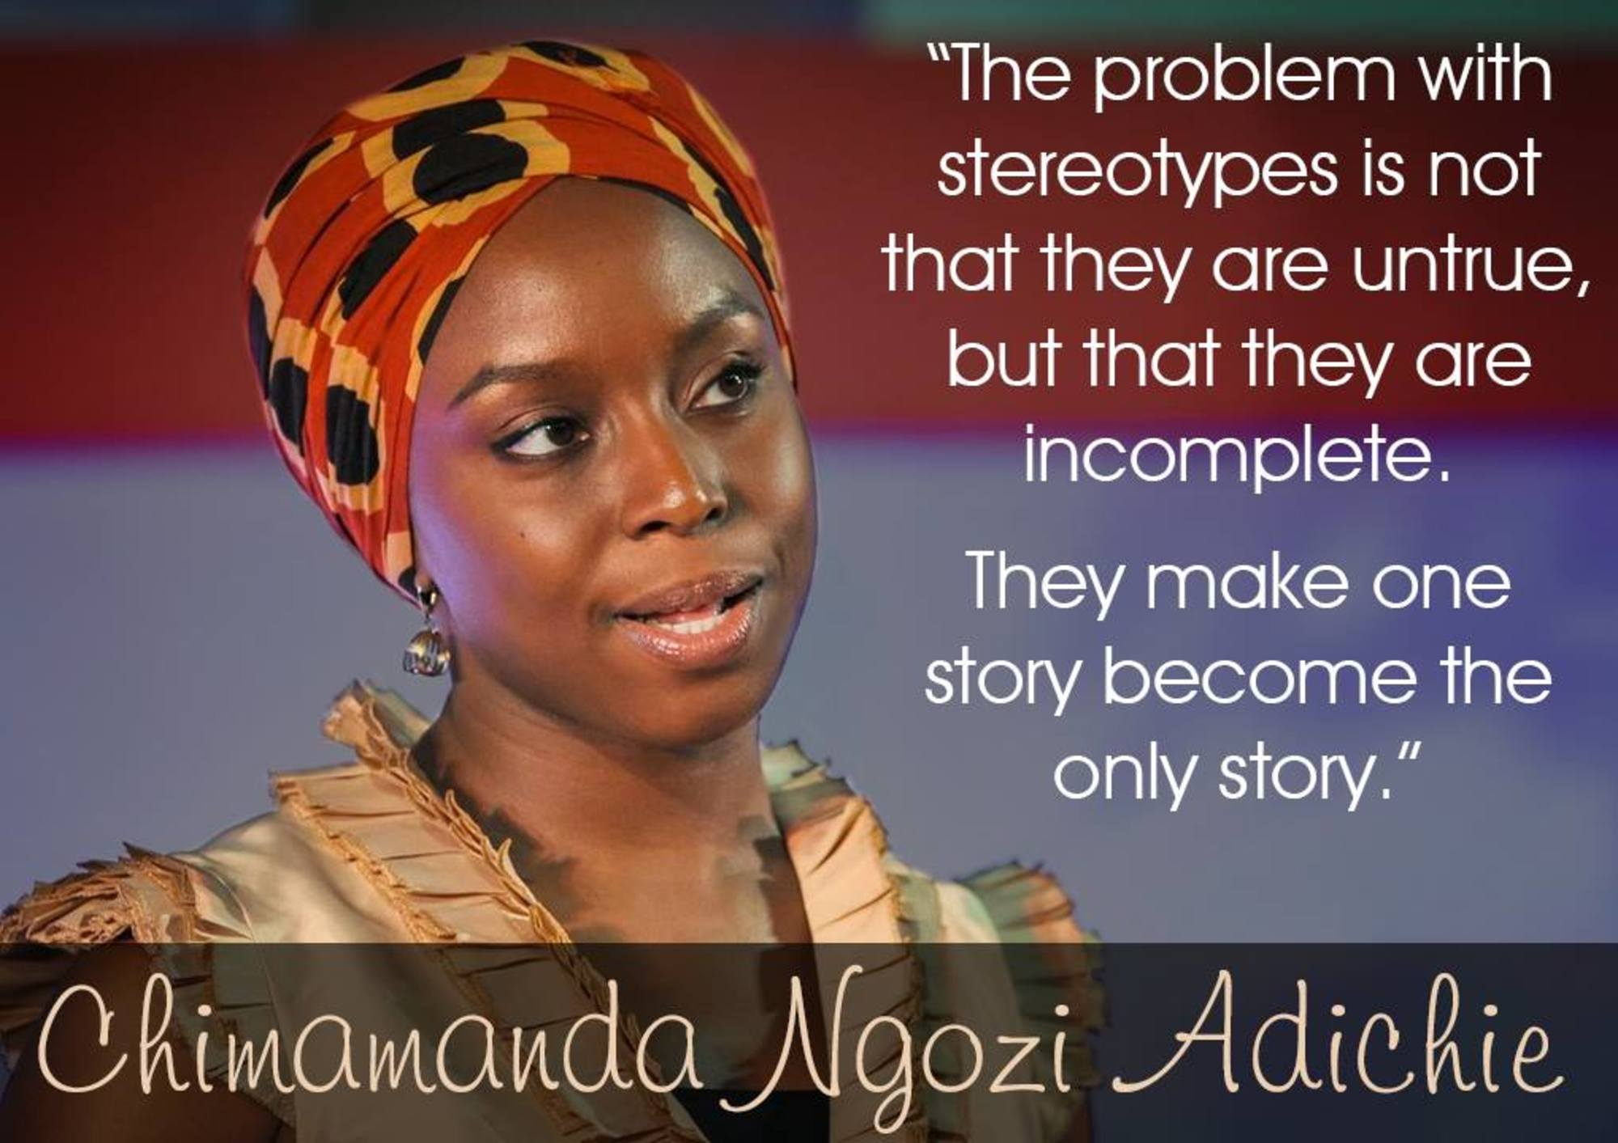
EXTENSION: THE DANGER OF A SINGLE STORY

Slide 4
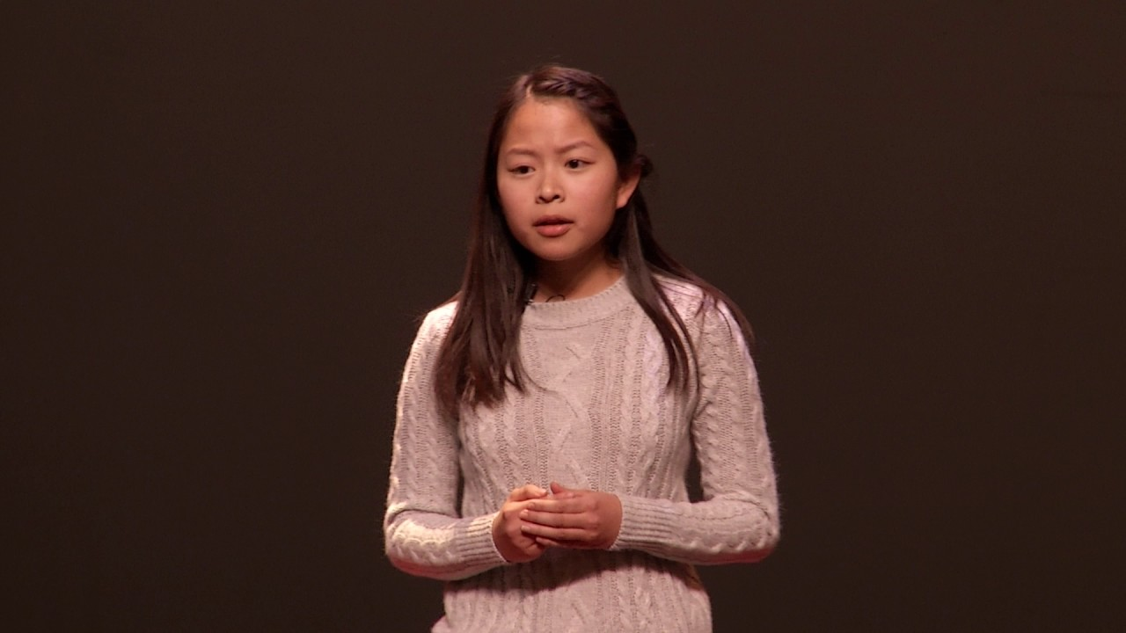
EXTENSION: Asian Doesn’t Start With A+

Slide 5
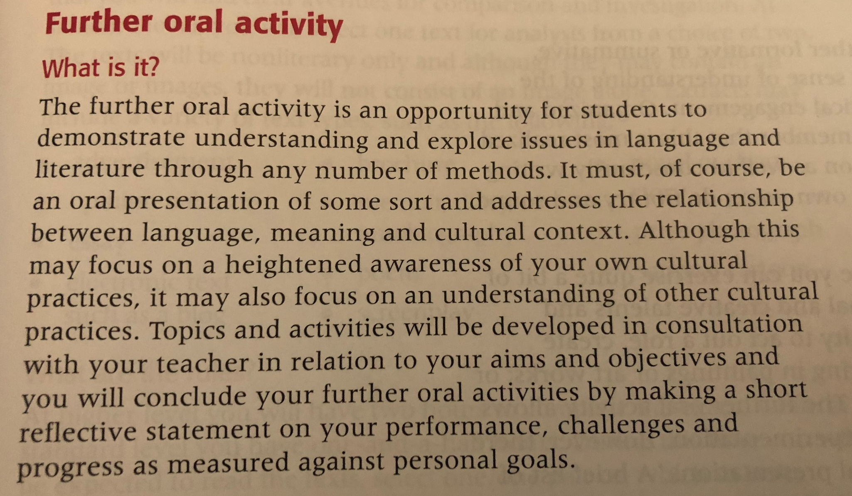
ABOUT THE FOA; What is it?

Slide 6
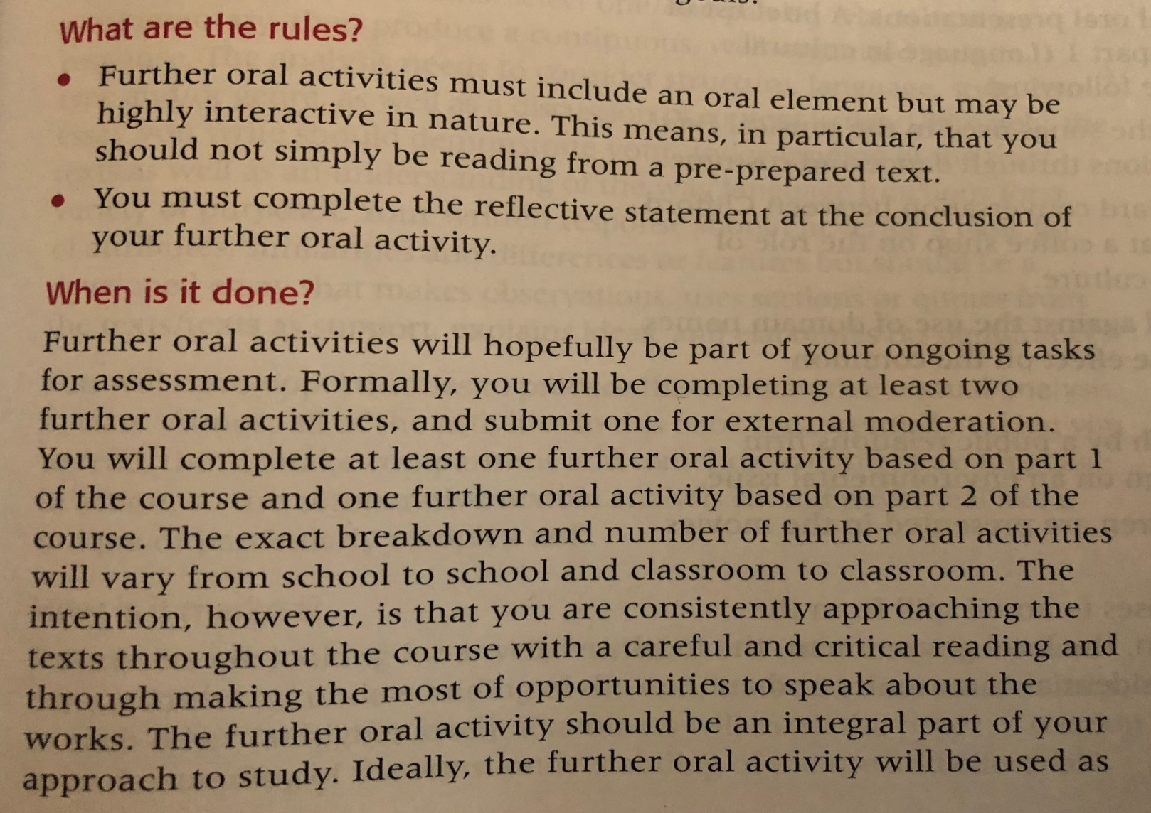
ABOUT THE FOA; What are the rules & when is it done?

Slide 7
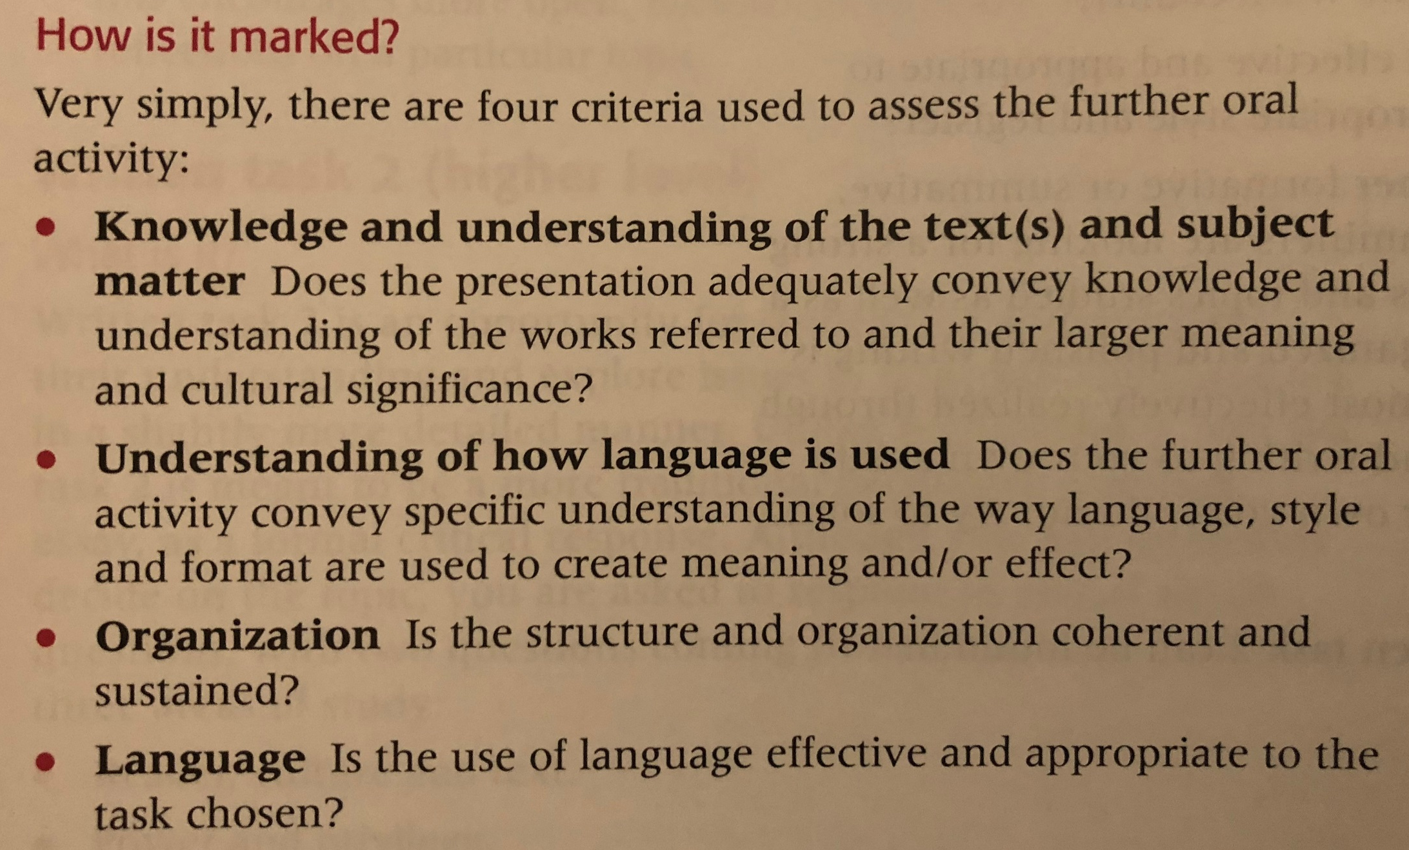
ABOUT THE FOA; How is it marked?

Slide 8
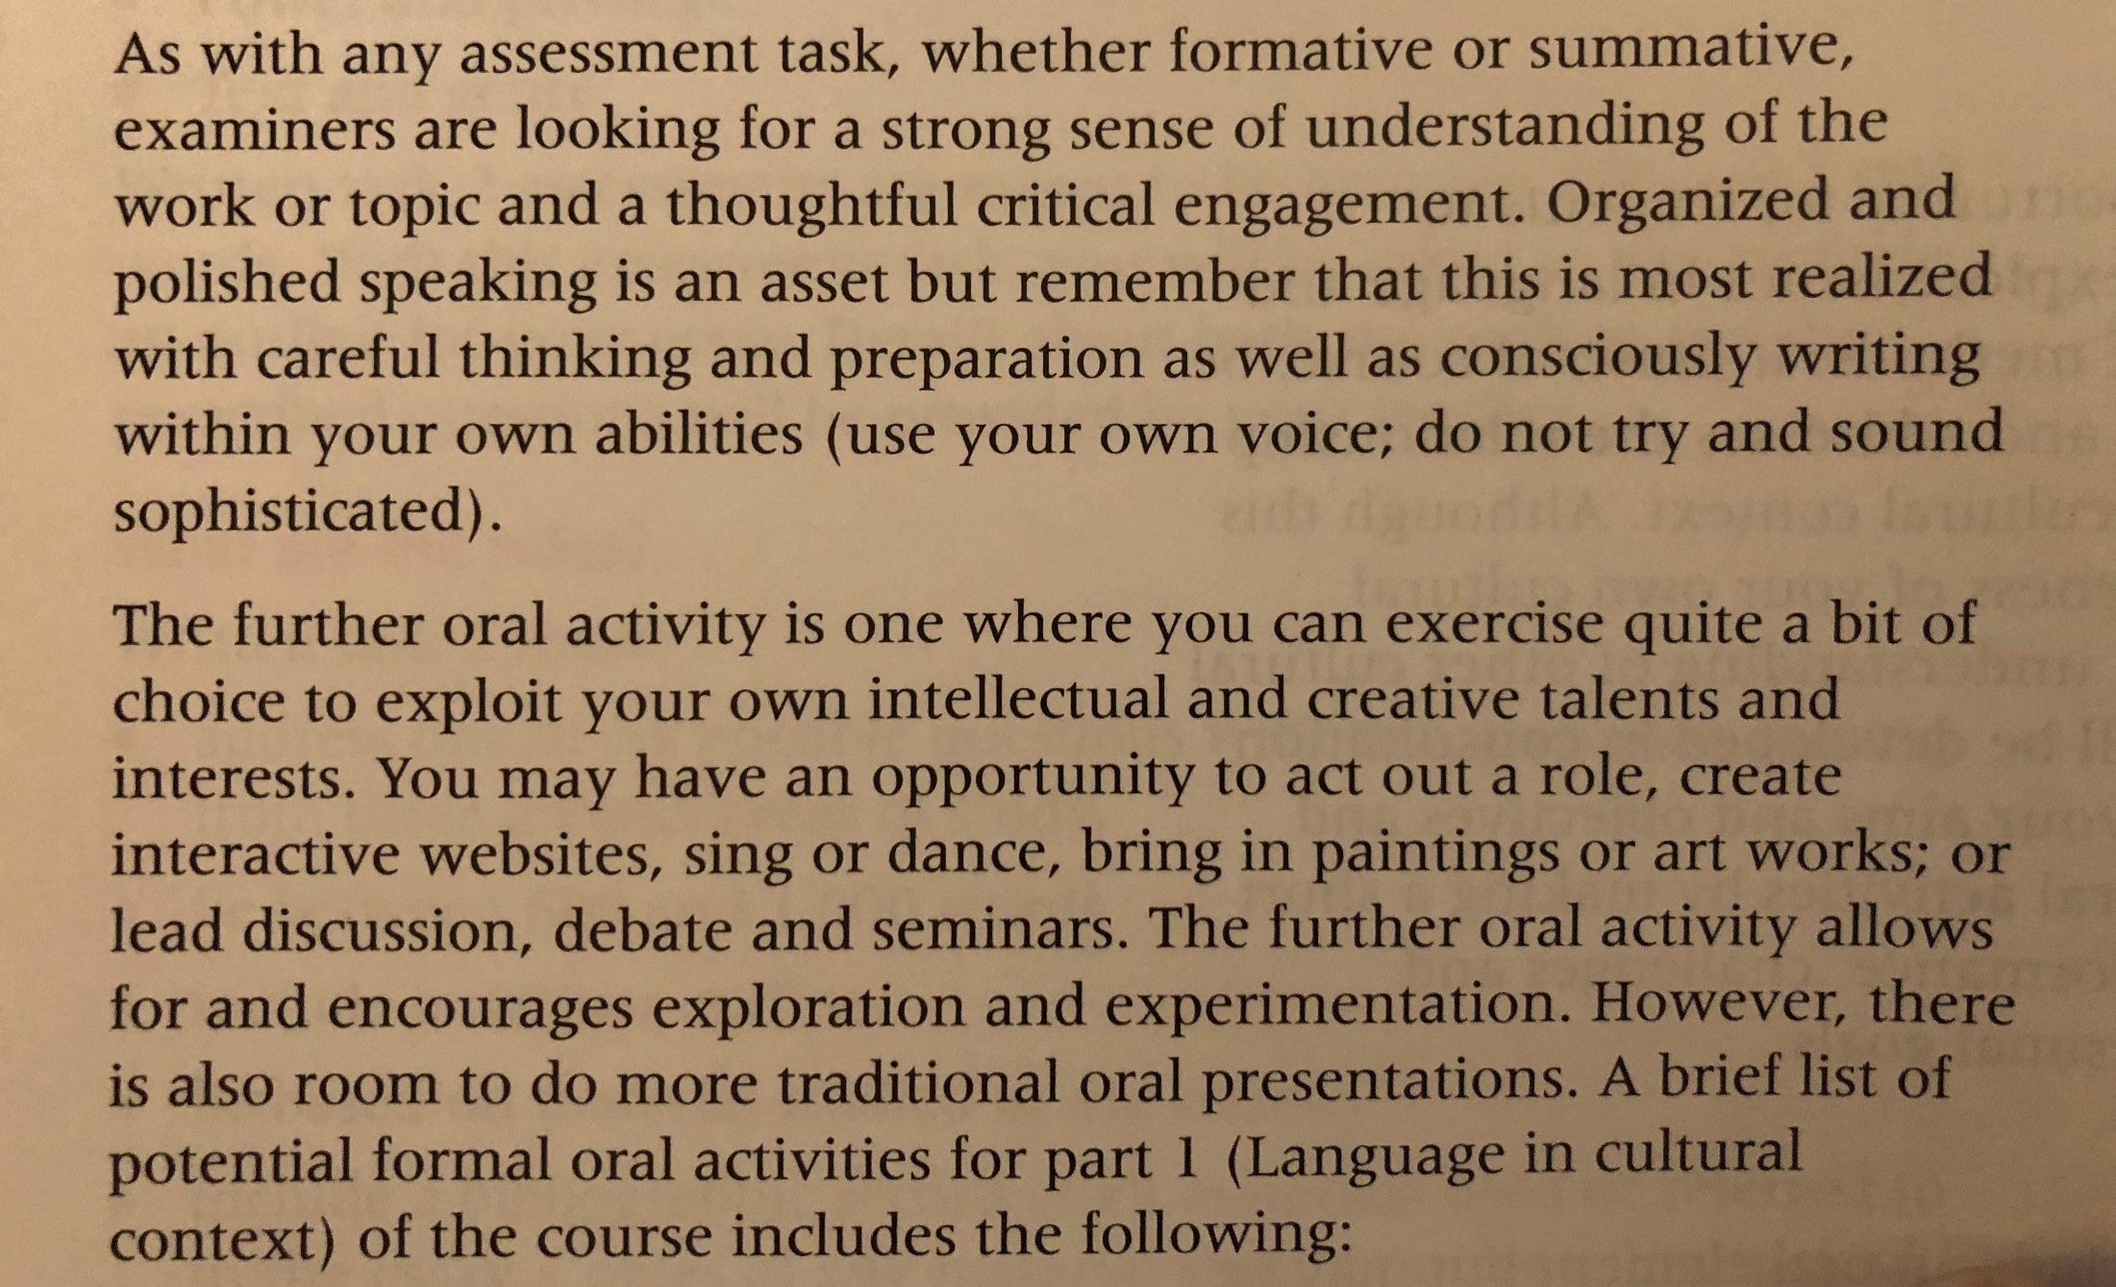
ABOUT THE FOA; How is it marked? (cont.)

Slide 9
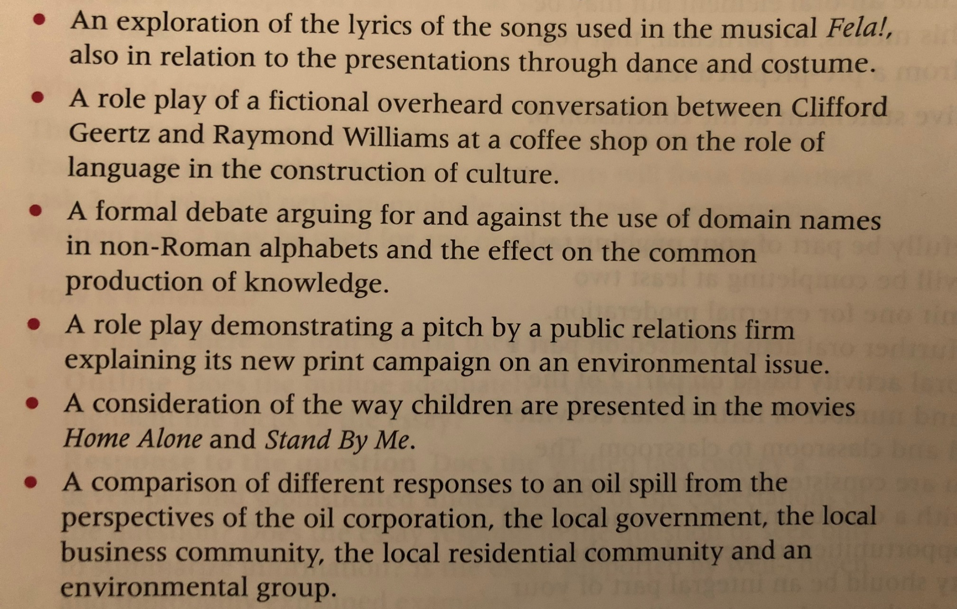
ABOUT THE FOA; How is it marked? (cont.)

Slide 10
PRIMARY SOURCE OPTIONS
1. The Language of African Literature
2. Preoccupations
3. English and the African Writer
4. Things Fall Apart
5. Three Ways to Speak English
6. The Danger of a Single Story
7. Asian Doesn’t Start With A+

Slide 11
AFTER EACH PRESENTATION
On a sheet of paper, write down a grade using the rubric provided.
Provide ONE aspect of presentation that went WELL.
Provide ONE aspect of the presentation that NEEDS IMPROVEMENT.
Give your grade & feedback to the group after you finish writing.

Slide 12
REFLECTION: due 08/29 BY 11:59 P.M.
REQUIREMENTS
GUIDING QUESTIONS
750 word minimum
Must use your feedback to guide your reflection
Must watch the recording of your practice FOA & reflect on what you see
Must be submitted to turnitin.com no later than 08/29 by 11:59 p.m.
Using the verbal and written feedback given to you, what do you want to improve upon for the next practice FOA?
What do you feel went well today?
What grade did your group receive? Do you feel this grade is fair? Why or why not?
What grade do you believe your group earned? Explain.

