Slide 1
DP Language & Literature
Day 4; Session 03
The Evils of English: The Politics of Learning Languages

Slide 2
AGENDA
I. Goals: 2 min.
II. Discuss Questions from Poetry: 15 min.
III. Warm Up- Boring Grammar: 5 min.
IV. Overview of Today: 1 min.
V. Context of Composition (team work): 13 min.
VI. Author Discussion (teach the class): 15 min.
VII. Read Extracts & Discussion ?s: 20 min.
VIII. Practice FOA #1 Assigned: 5 min.
VIIII. FOA Practice #1 Teams: 5 min.
IX. Practice FOA Team Time: 13 min.

Slide 3
GOALS:
Know: key terms - audience and purpose; context (composition; interpretation); add: socio-cultural-historical context to key definitions.
Understand: that language is used to construct identity and this changes depending on context
Overarching Idea for Today: Many individuals have a complicated and tense relationships with the English language – particularly those with multiple languages (and thus cultural identities). Through fiction and non-fiction prose we will examine some famous authors’ relationships with the English language and learn more about socio-cultural-historical context.

Slide 4
DISCUSS:
In 'Bilingual' Espaillat uses parenthesis to translate several words.
What is the effect of this on the audience?
How does this compare to how Alvarez mixes language and Bhatt switches from one language (English) to the next (Gujarati) and back again (English)?
In 'Bilingual' the author refers to her father's wish to keep Spanish and English separate, in different places and times.
How do all three authors view this idea of separating their languages? How does this make them feel as individuals?
3. In 'Bilingual Sestina', how does the author describe the importance of childhood memory and playing with 'things' to the experience of learning a language?
4. Explain the irony of the final words of 'Bilingual Sestina', 'en Inglais'.
5. In 'Search for my tongue', how does Bhatt play with the both the literal and figurative meaning of the word 'tongue'? How does she use imagery to illustrate her point?
6. There are many ways to discuss the nature of bilingualism and identity. Why do you think these authors chose to write poems rather than articles, memoirs or journals?

Slide 5
What is the point of reading these poems & how could they be used for an FOA?
1. These poems relate to our current unit- Language and Identity.
2. These poems allow us to further investigate how language impacts identity (i.e. how does being bilingual influence the speaker’s identity?)
3. These poems reinforces the idea that language is used to construct identity and this changes depending on context.

Slide 6
WARM UP:
I. discuss:
What was your experience learning English?
Where and when did you learn? In what manner?
Was it a mostly positive, negative, or mixed experience? Free-write in your notebook for 5 minutes.

Slide 7
OVERVIEW OF TODAY:
Today we will be exploring the English learning experiences of three writers – Seamus Heaney, Chinua Achebe, and Ngũgĩ wa Thiong'o. We will learn that while knowing English is incredibly useful, it produces a degree of anxiety in the individual due to social, cultural and historical reasons.
Basically, when we talk about context, we are referring to things like society, politics and culture of the time and place a text was written in. [Add social context, cultural context and historical context to your key terms card set on Quizlet!!]

Slide 8
CONTEXT OF COMPOSITION
In your teams, spend about 10 minutes reading about the author’s background on the internet.
Write down as many facts as you can find about the author.
Each team will then teach the class who in turn will take notes.

Slide 9
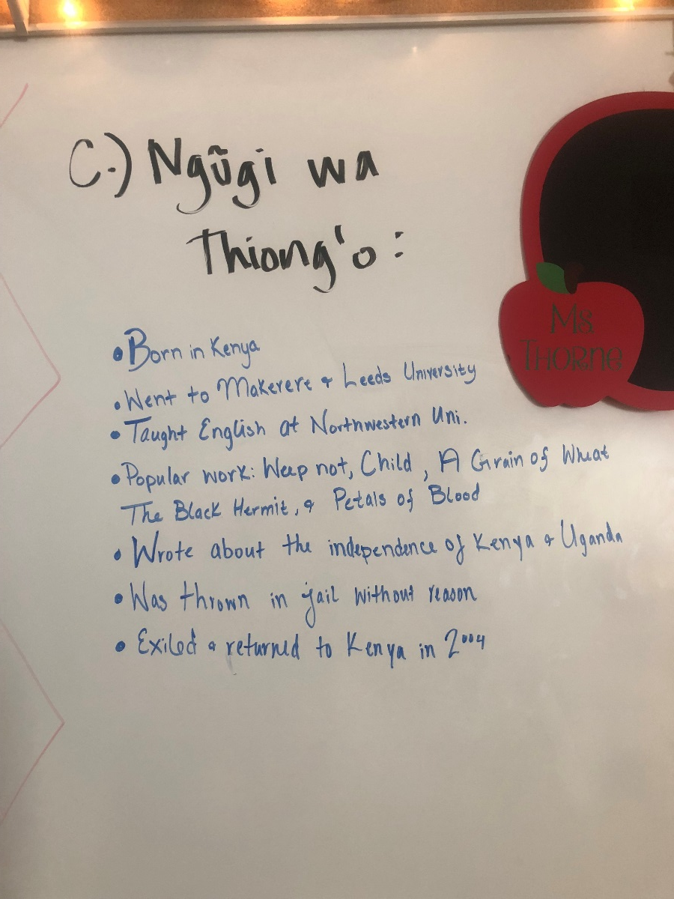
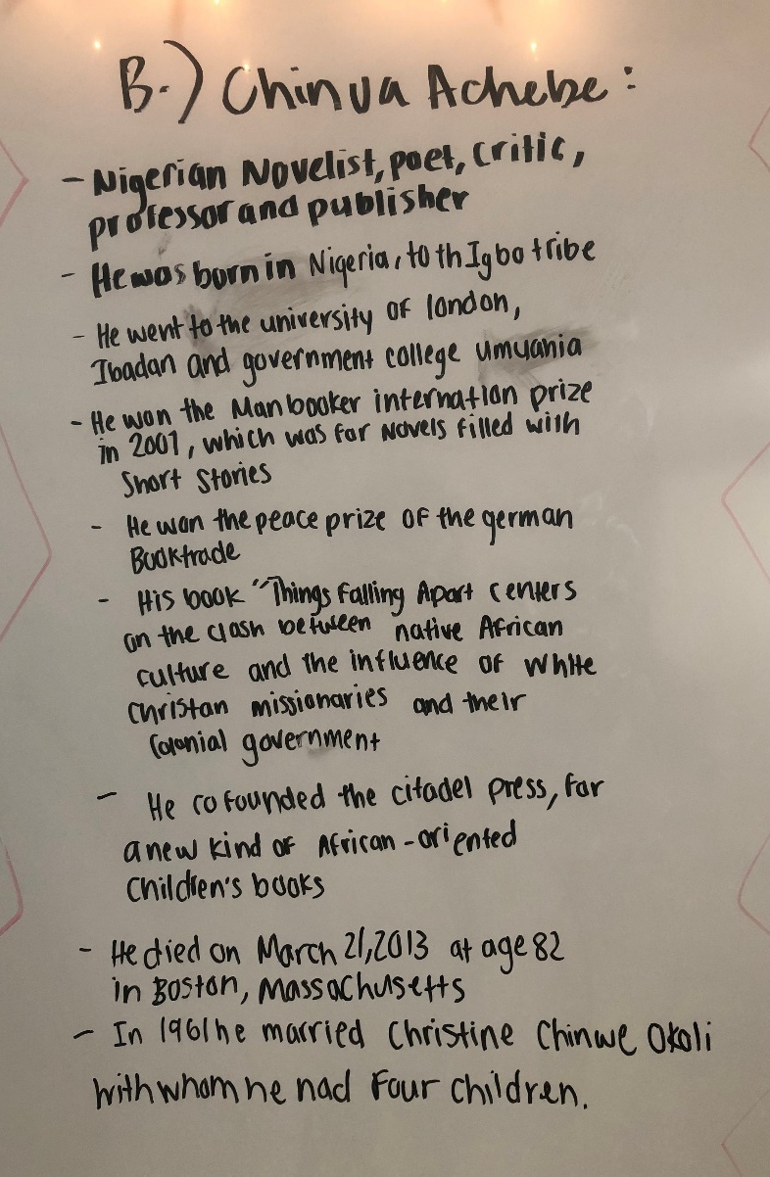
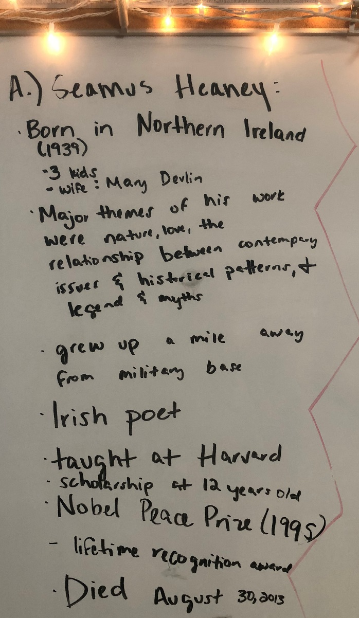
A2: About the Author (pictures from class)

Slide 10
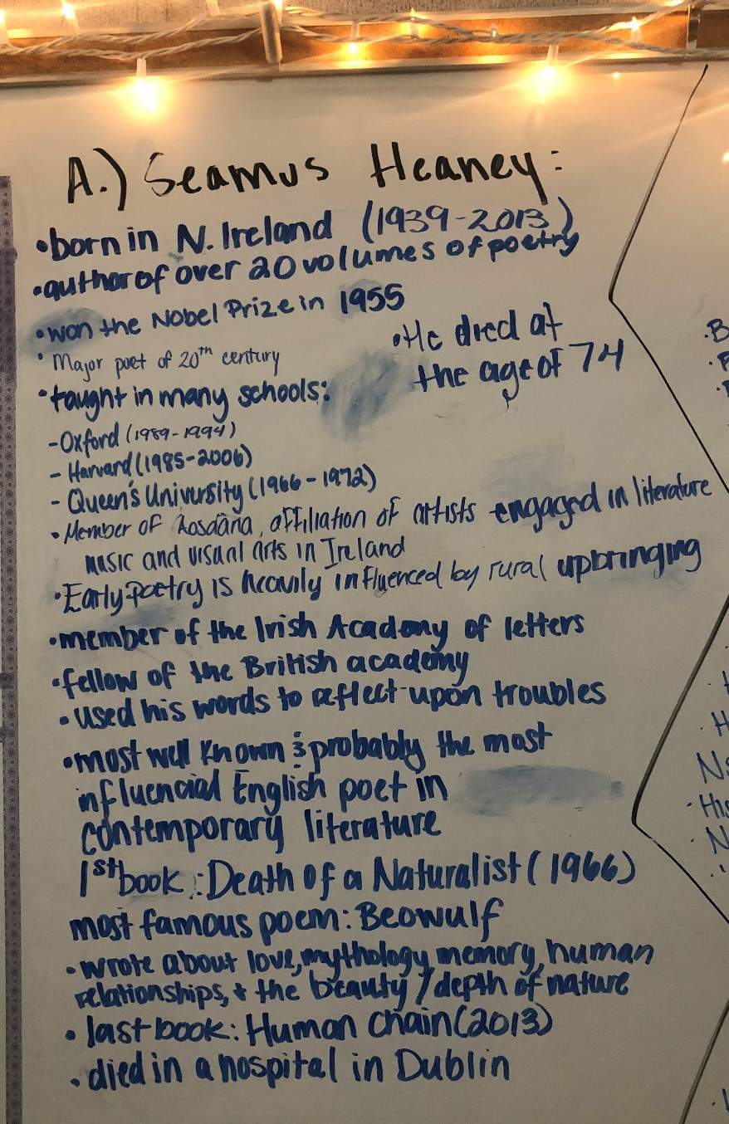
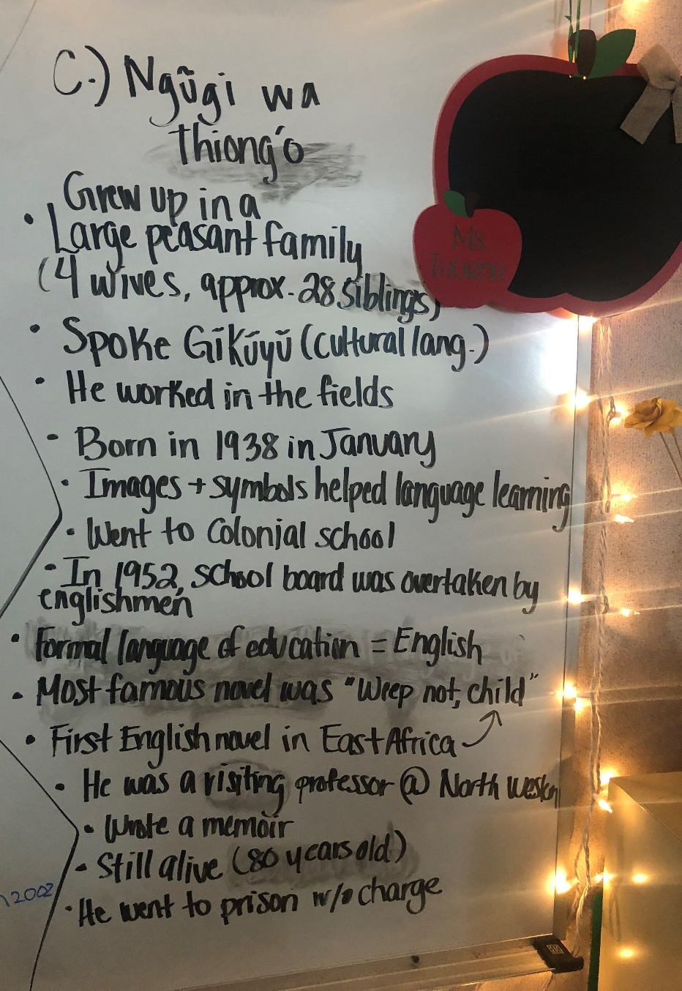
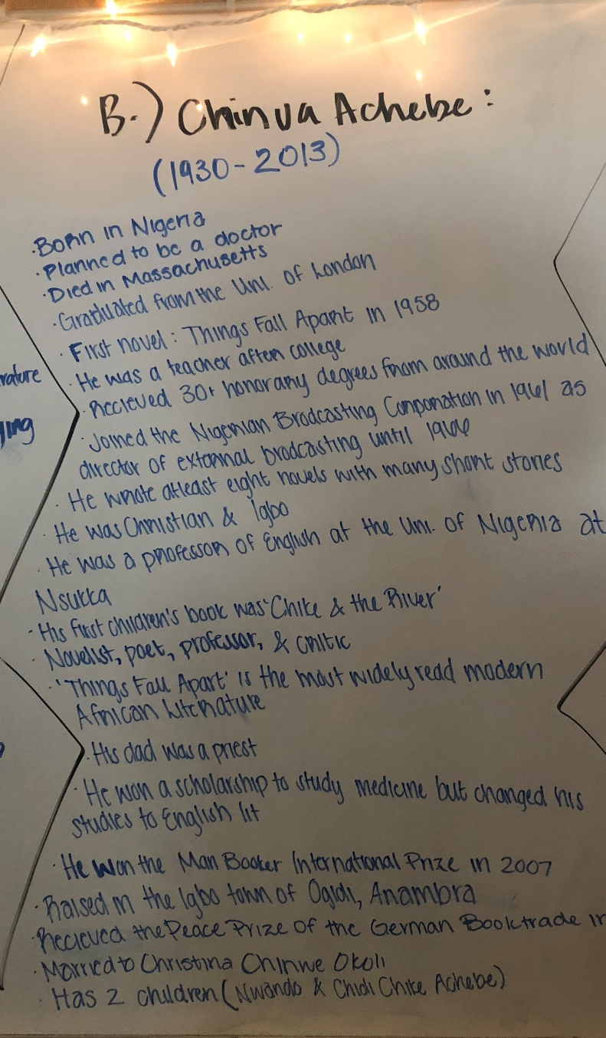
A3: About the Author (pictures from class)

Slide 11
NOW THAT WE HAVE LEARNED ABOUT ALL 3 AUTHORS…
Read the selected extracts from each author.
In small groups, complete the discussion questions.
Be prepared to share your ideas with the class!

Slide 12
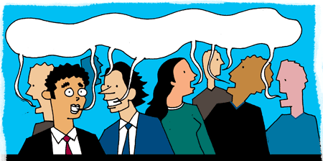
Discussion:
Heaney, Thiong’o, & Achebe

Slide 13
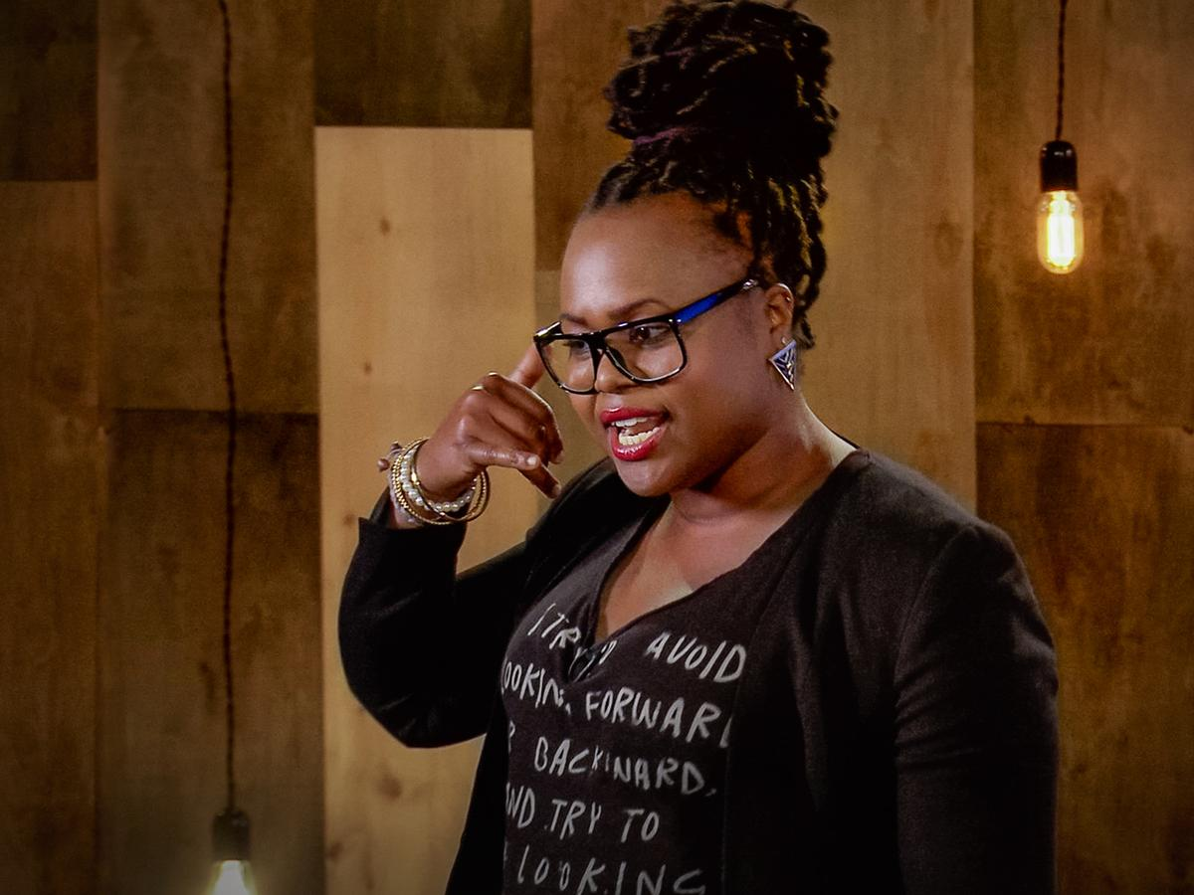
EXTENSION: Three Ways to Speak English

Slide 14
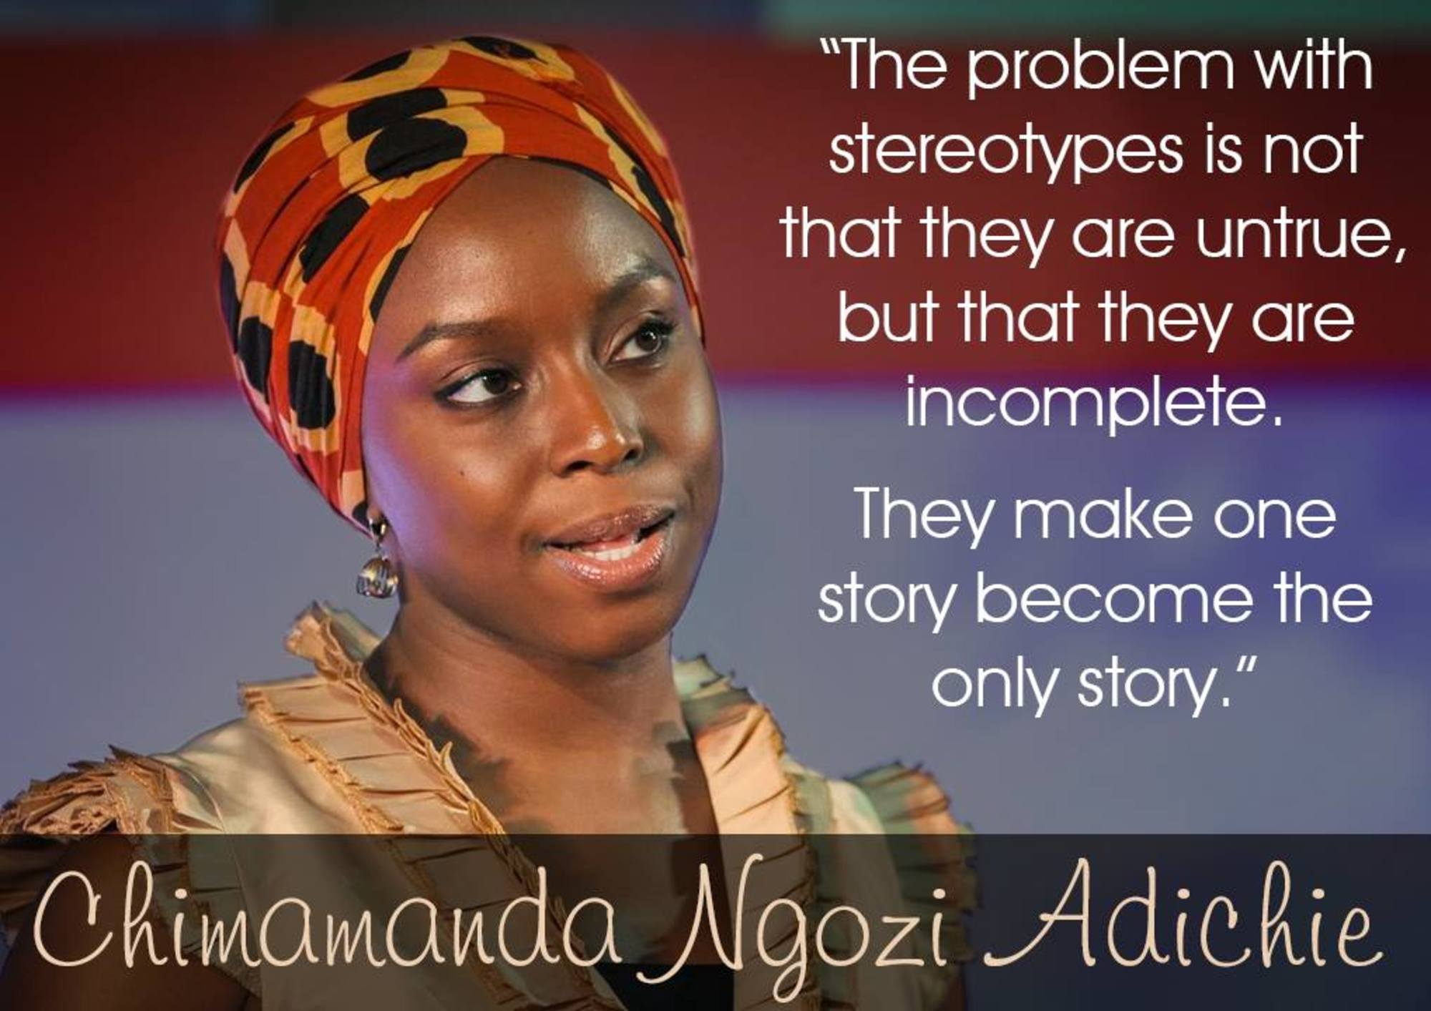
EXTENSION: THE DANGER OF A SINGLE STORY

Slide 15
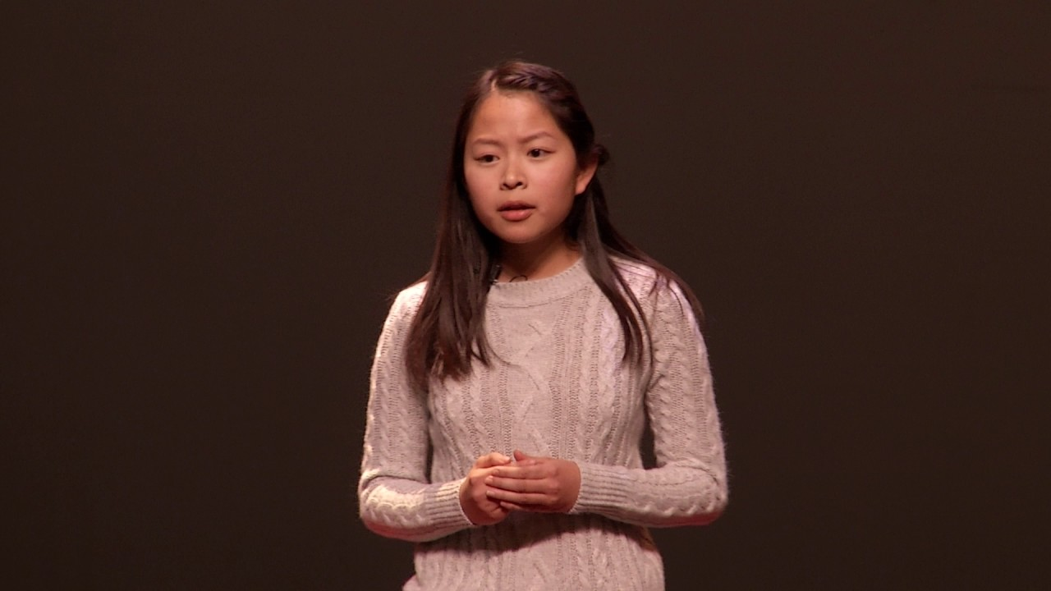
EXTENSION: Asian Doesn’t Start With A+

Slide 16
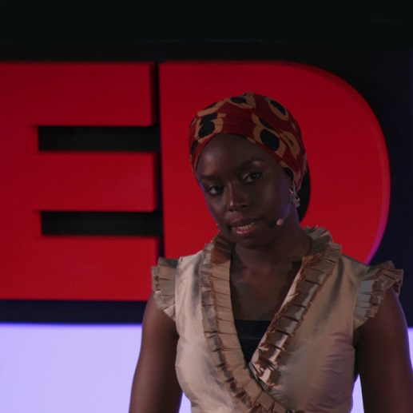
DISCUSS: The Danger of a Single Story
What happens when complex human beings and situations are reduced to a single narrative?
How do misunderstandings and limited perspective influence the way we perceive (and treat) others?
What is the call to action that Adichie challengers her viewers with?
How does this text relate to the bilingual poetry and the extracts from today?
How does my race, culture or ethnicity shape who I am?
What assumptions do we make about people from different races, ethnicities and cultures?
What does it mean to have a voice and how does this relate to us today?

Slide 17
Further Oral Activity
Pictures taken from pg. 134-136 of your textbook!

Slide 18
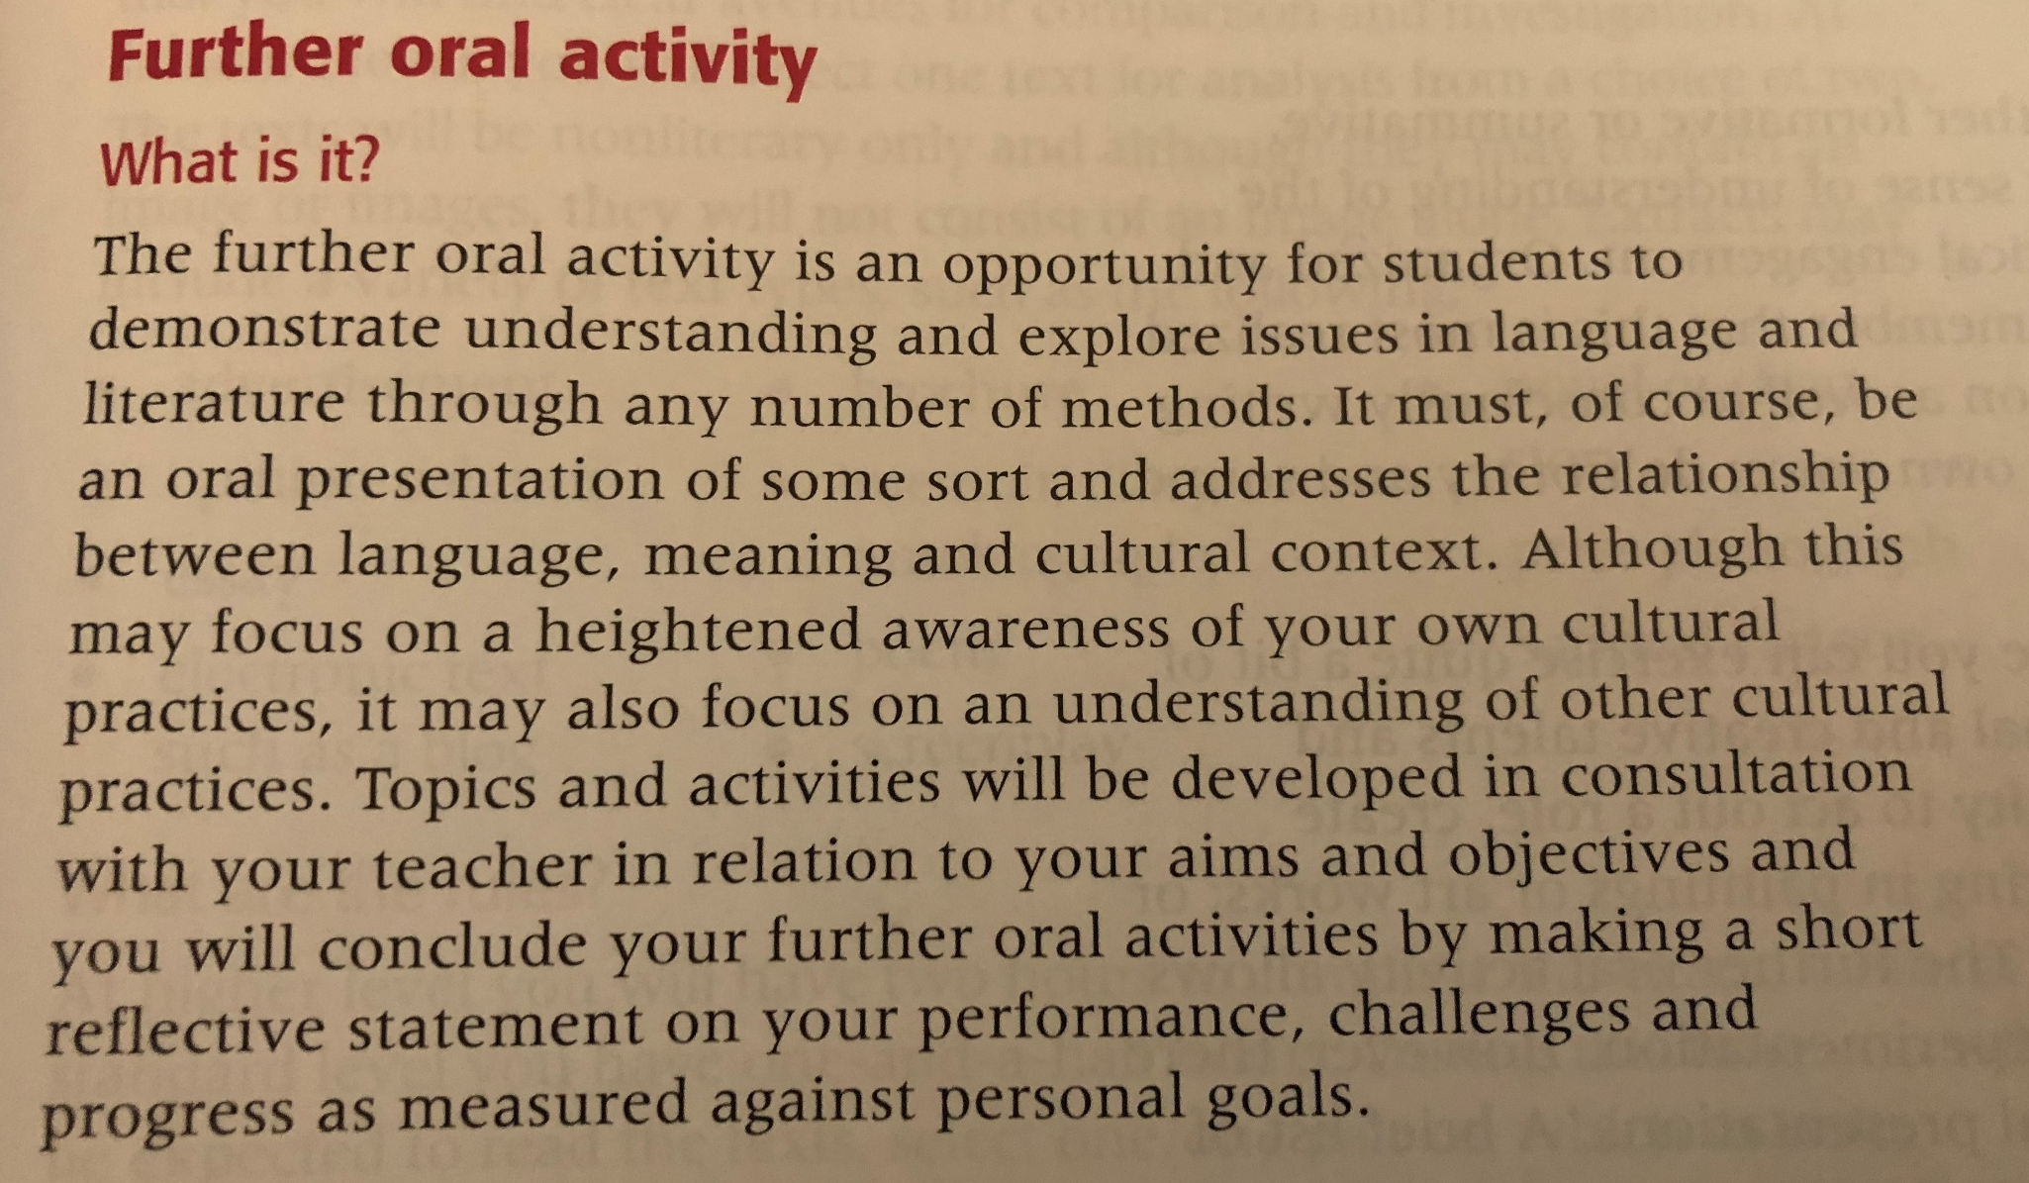
ABOUT THE FOA; What is it?

Slide 19
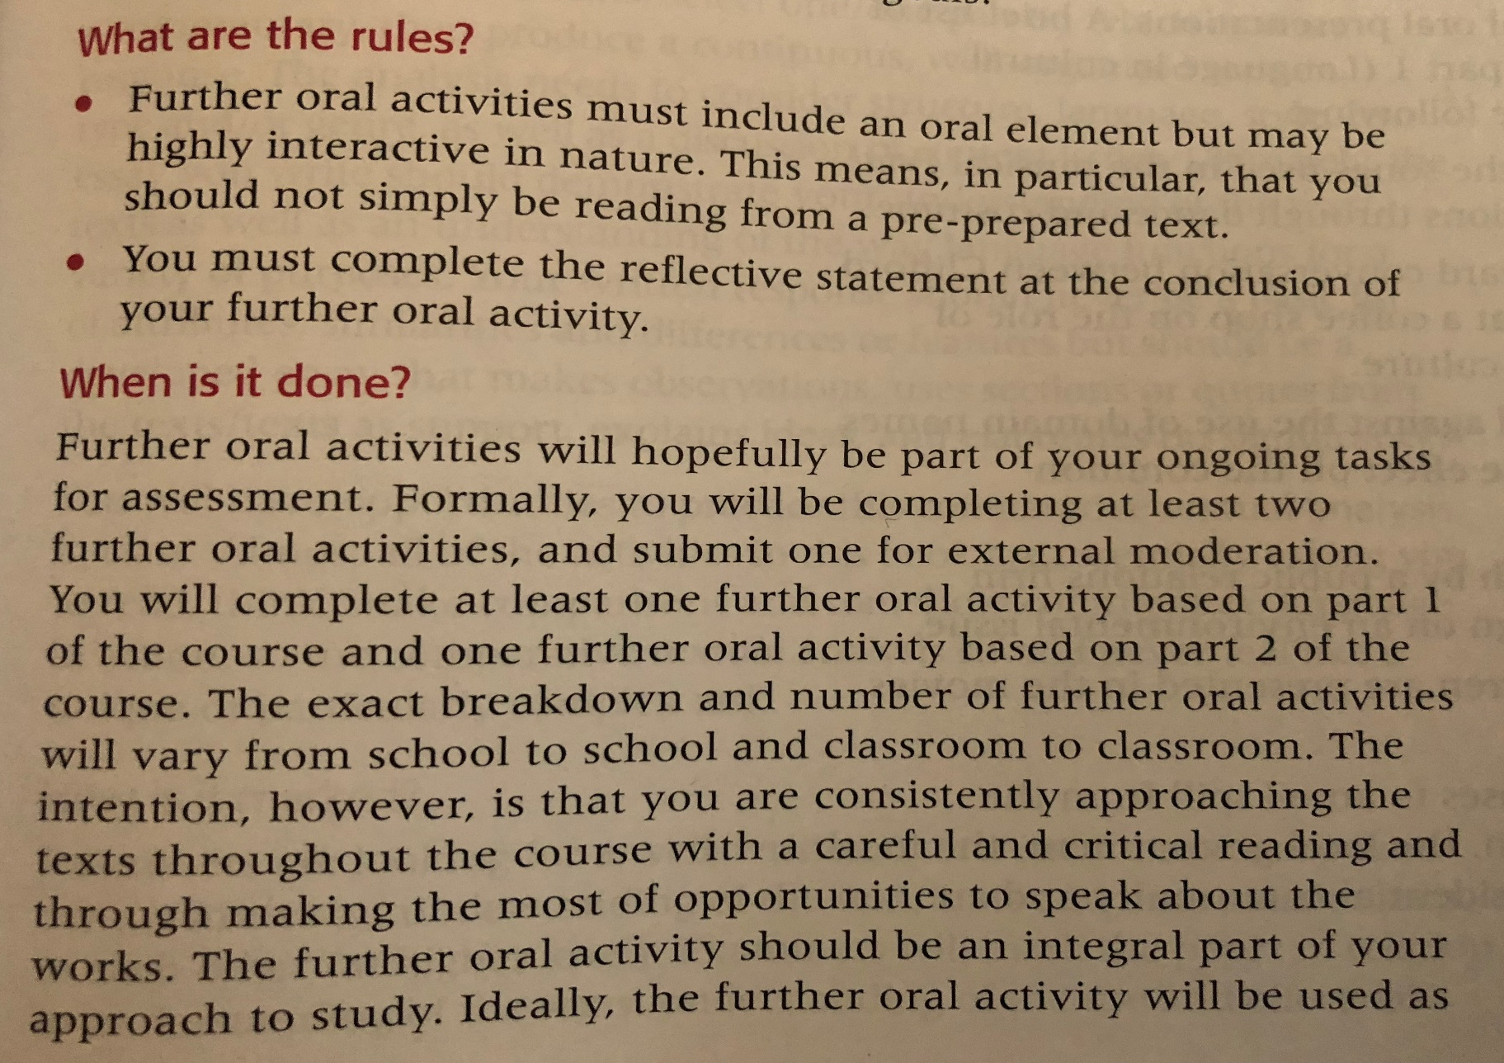
ABOUT THE FOA; What are the rules & when is it done?

Slide 20
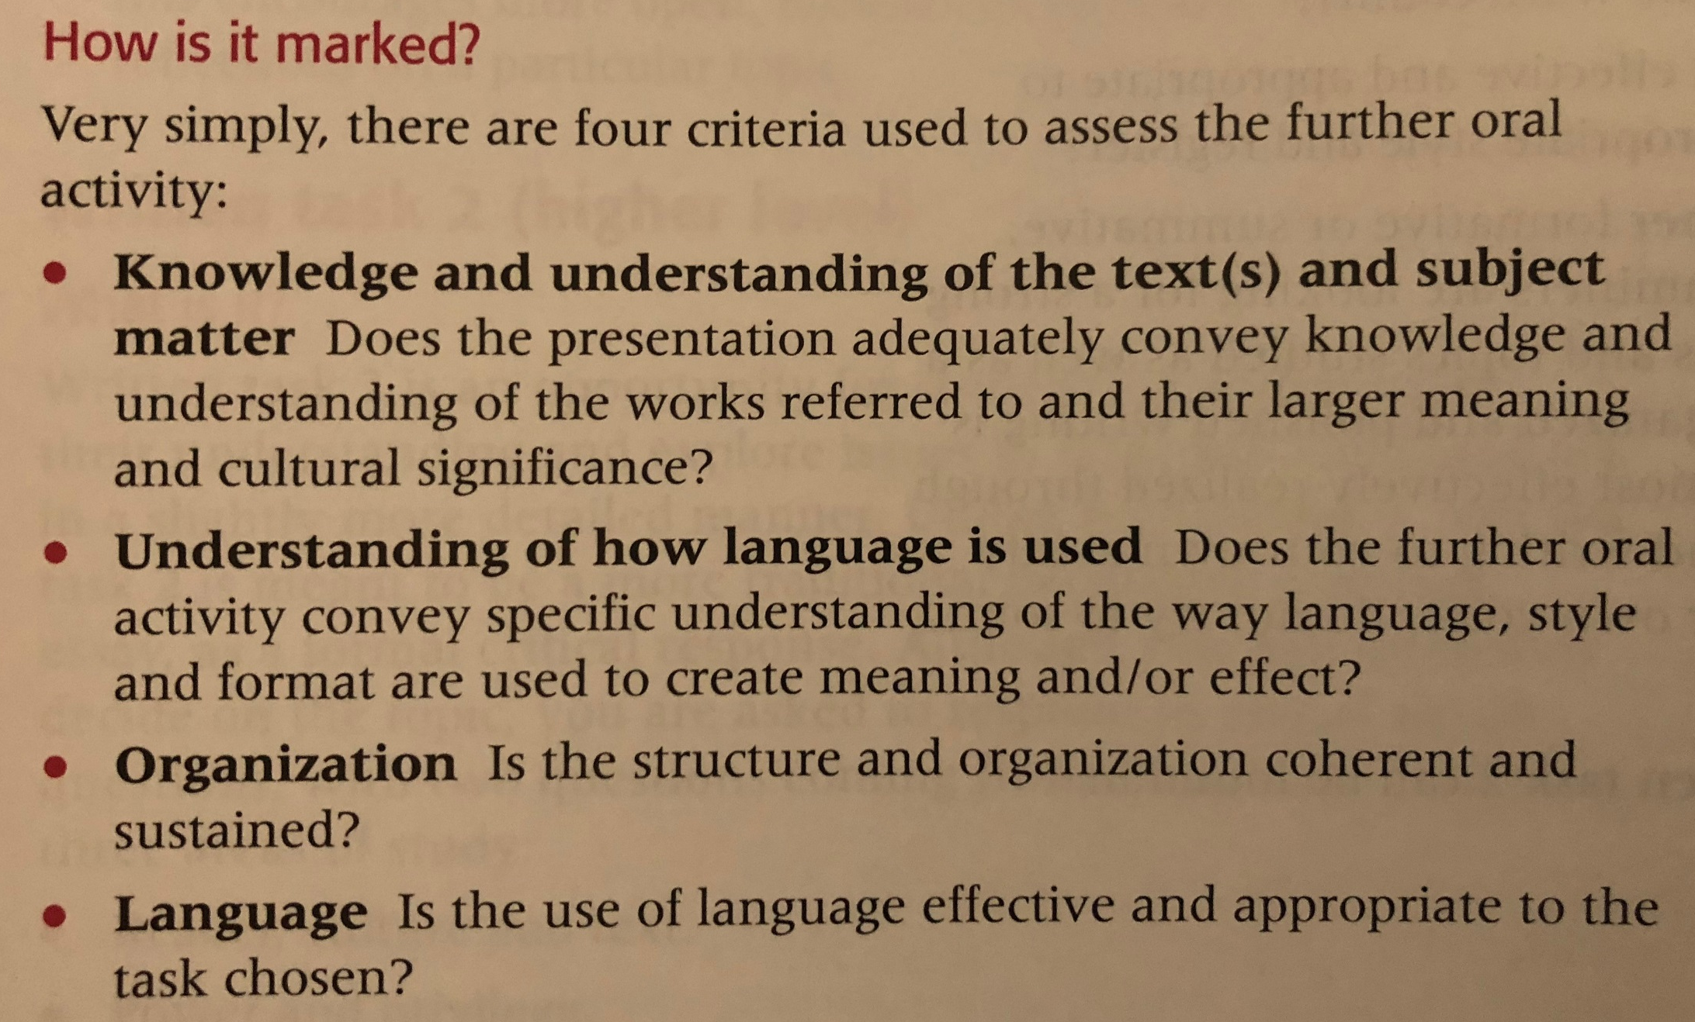
ABOUT THE FOA; How is it marked?

Slide 21
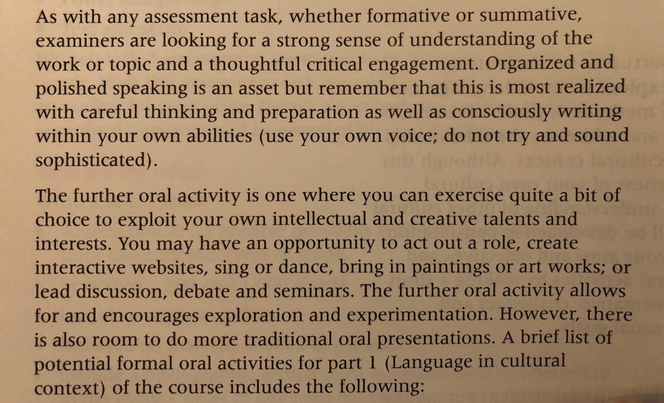
ABOUT THE FOA; How is it marked? (cont.)

Slide 22
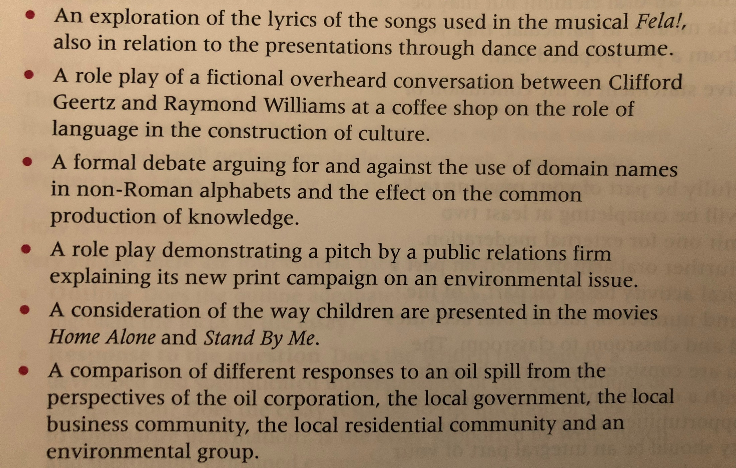
ABOUT THE FOA; How is it marked? (cont.)

Slide 23
PRIMARY SOURCE OPTIONS
1. The Language of African Literature
2. Preoccupations
3. English and the African Writer
4. Things Fall Apart
5. Three Ways to Speak English
6. The Danger of a Single Story
7. Asian Doesn’t Start With A+

Slide 24
PRACTICE FOA #1
A2
A3
Team 1: Jayla, Julia, Chrishya, Keyvon
Team 2: Ayele, Kelsey, Chrishya, Jazmin
Team 3: Ty, Francesca, Noah
Team 1: J. Alexander, Llona, Taylor O.
Team 2: Jalyn, Jermya, Deja
Team 3: Dereck, Jordynn, Dom.
Team 4: Aaron, T’Mia, Jada R.
Team 5: Camille,Taylor G., KeAuri
Team 6: Michelle, Cameron, Aleisha
Team 7: Camille, Shania, Jessica B.
Team 8: Malana, Jamiah, Shania
Team 9: Keith, April, Shadarria

Slide 25
Practice FOA #1 Requirements
1. You must work with your assigned team to create an FOA to present to the class.
2. Must be obviously related to the primary source of your choice.
3. Must include all group members.
4. Must complete reflection of FOA Practice #1 after presentation & submit to turnitin.com.

