Slide 1
DP Language & Literature
Day 3; Session 02; “Being Bilingual”
Multilingualism and Identity

Slide 2
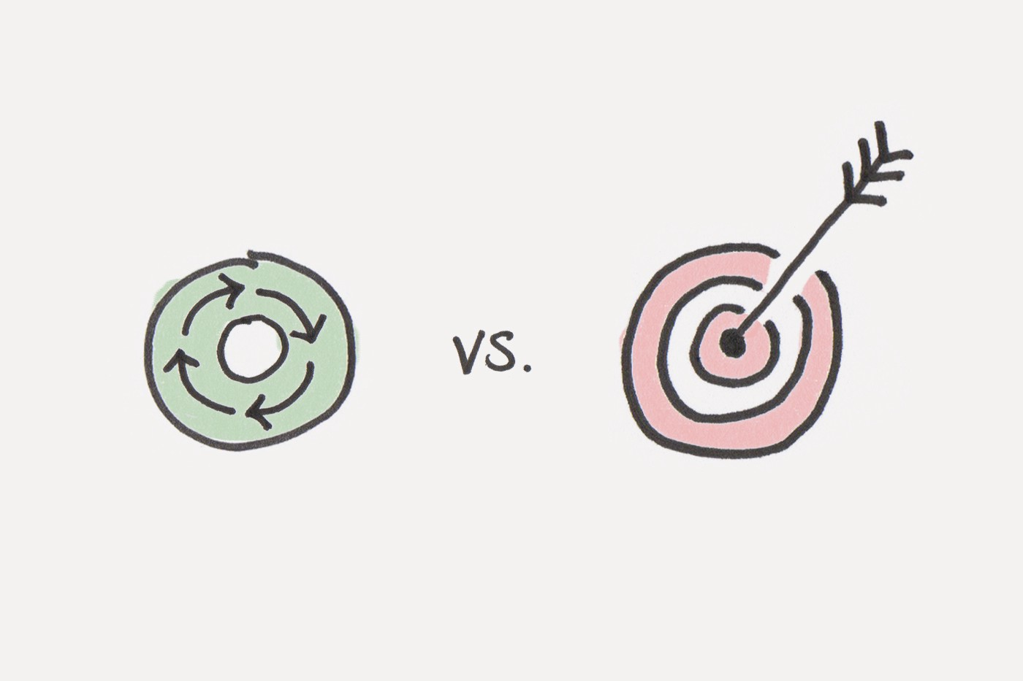
Agenda
Goals: 2 min.
The Big Five: 5 min.
Key Terms: 5 min.
Read pg. 36-39 & take notes: 15 min.
Bilingualism Poetry Reading: 10 min.
Bilingualism Poetry Questions: 15 min.
Bilingualism Poetry Analysis: 10 min.
Bilingualism Poetry w/The Big 5: 20 min.

Slide 3
Goals
Know: key terms - audience and purpose; context (composition; interpretation)
Understand: that language is used to construct identity and this changes depending on context

Slide 4
Review the Following
The Big Five: see printout
Please review and annotate this chart.
This will help you tremendously with Paper 1 (fall midterm) and the IOC (spring external assessment & final exam).

Slide 5
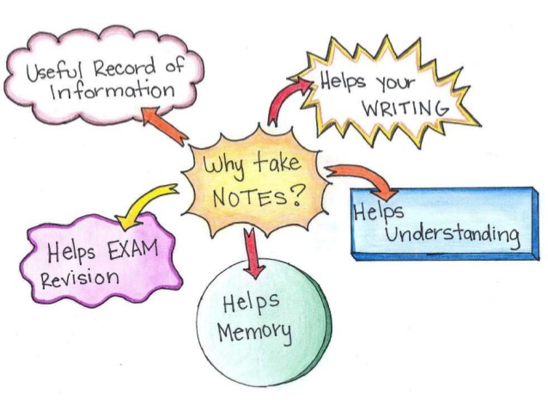
Key Terms
What is audience and purpose?
Read page 36-39 of the textbook and take notes.
Be sure to copy the diagram on the last slide.
Key terms: audience, purpose, context of composition, context of interpretation.

Slide 7
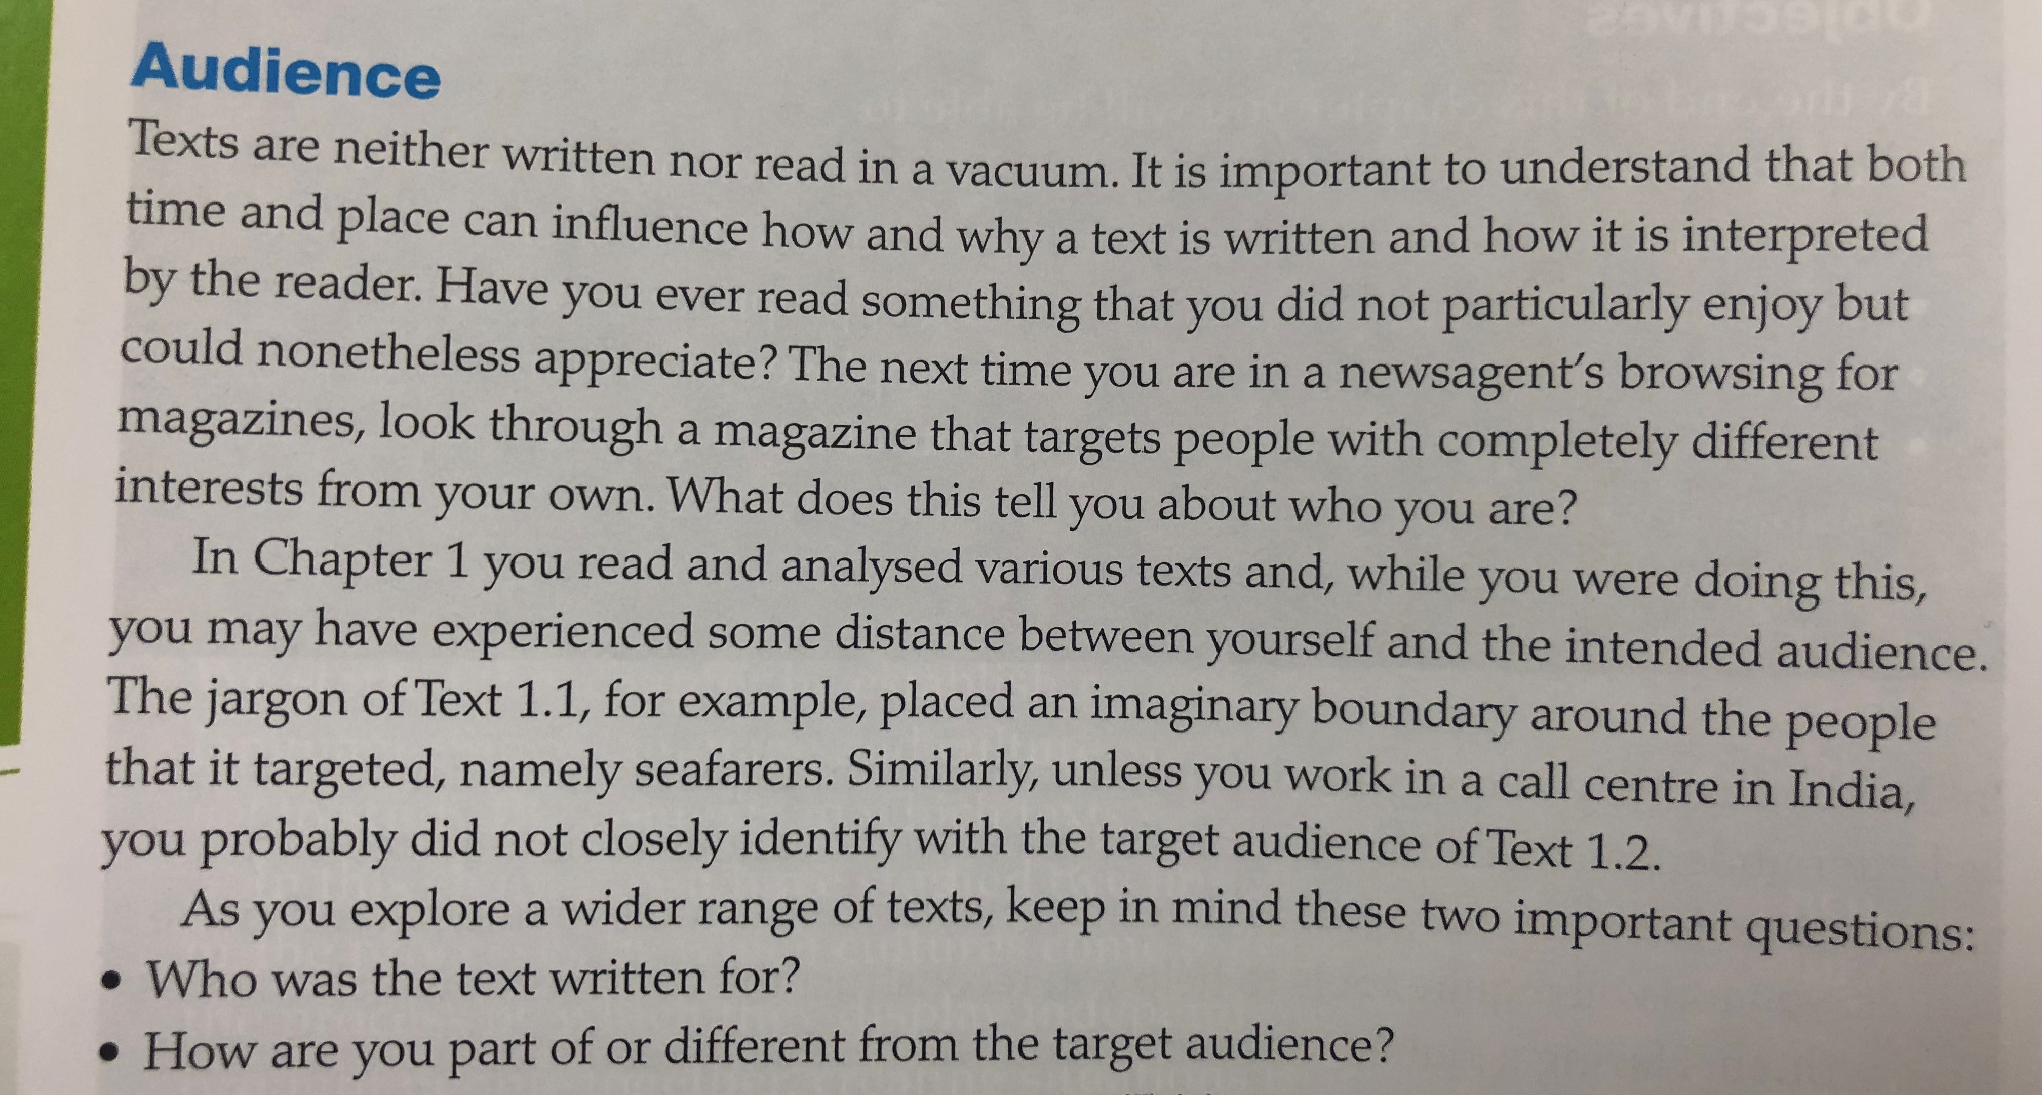

Slide 8
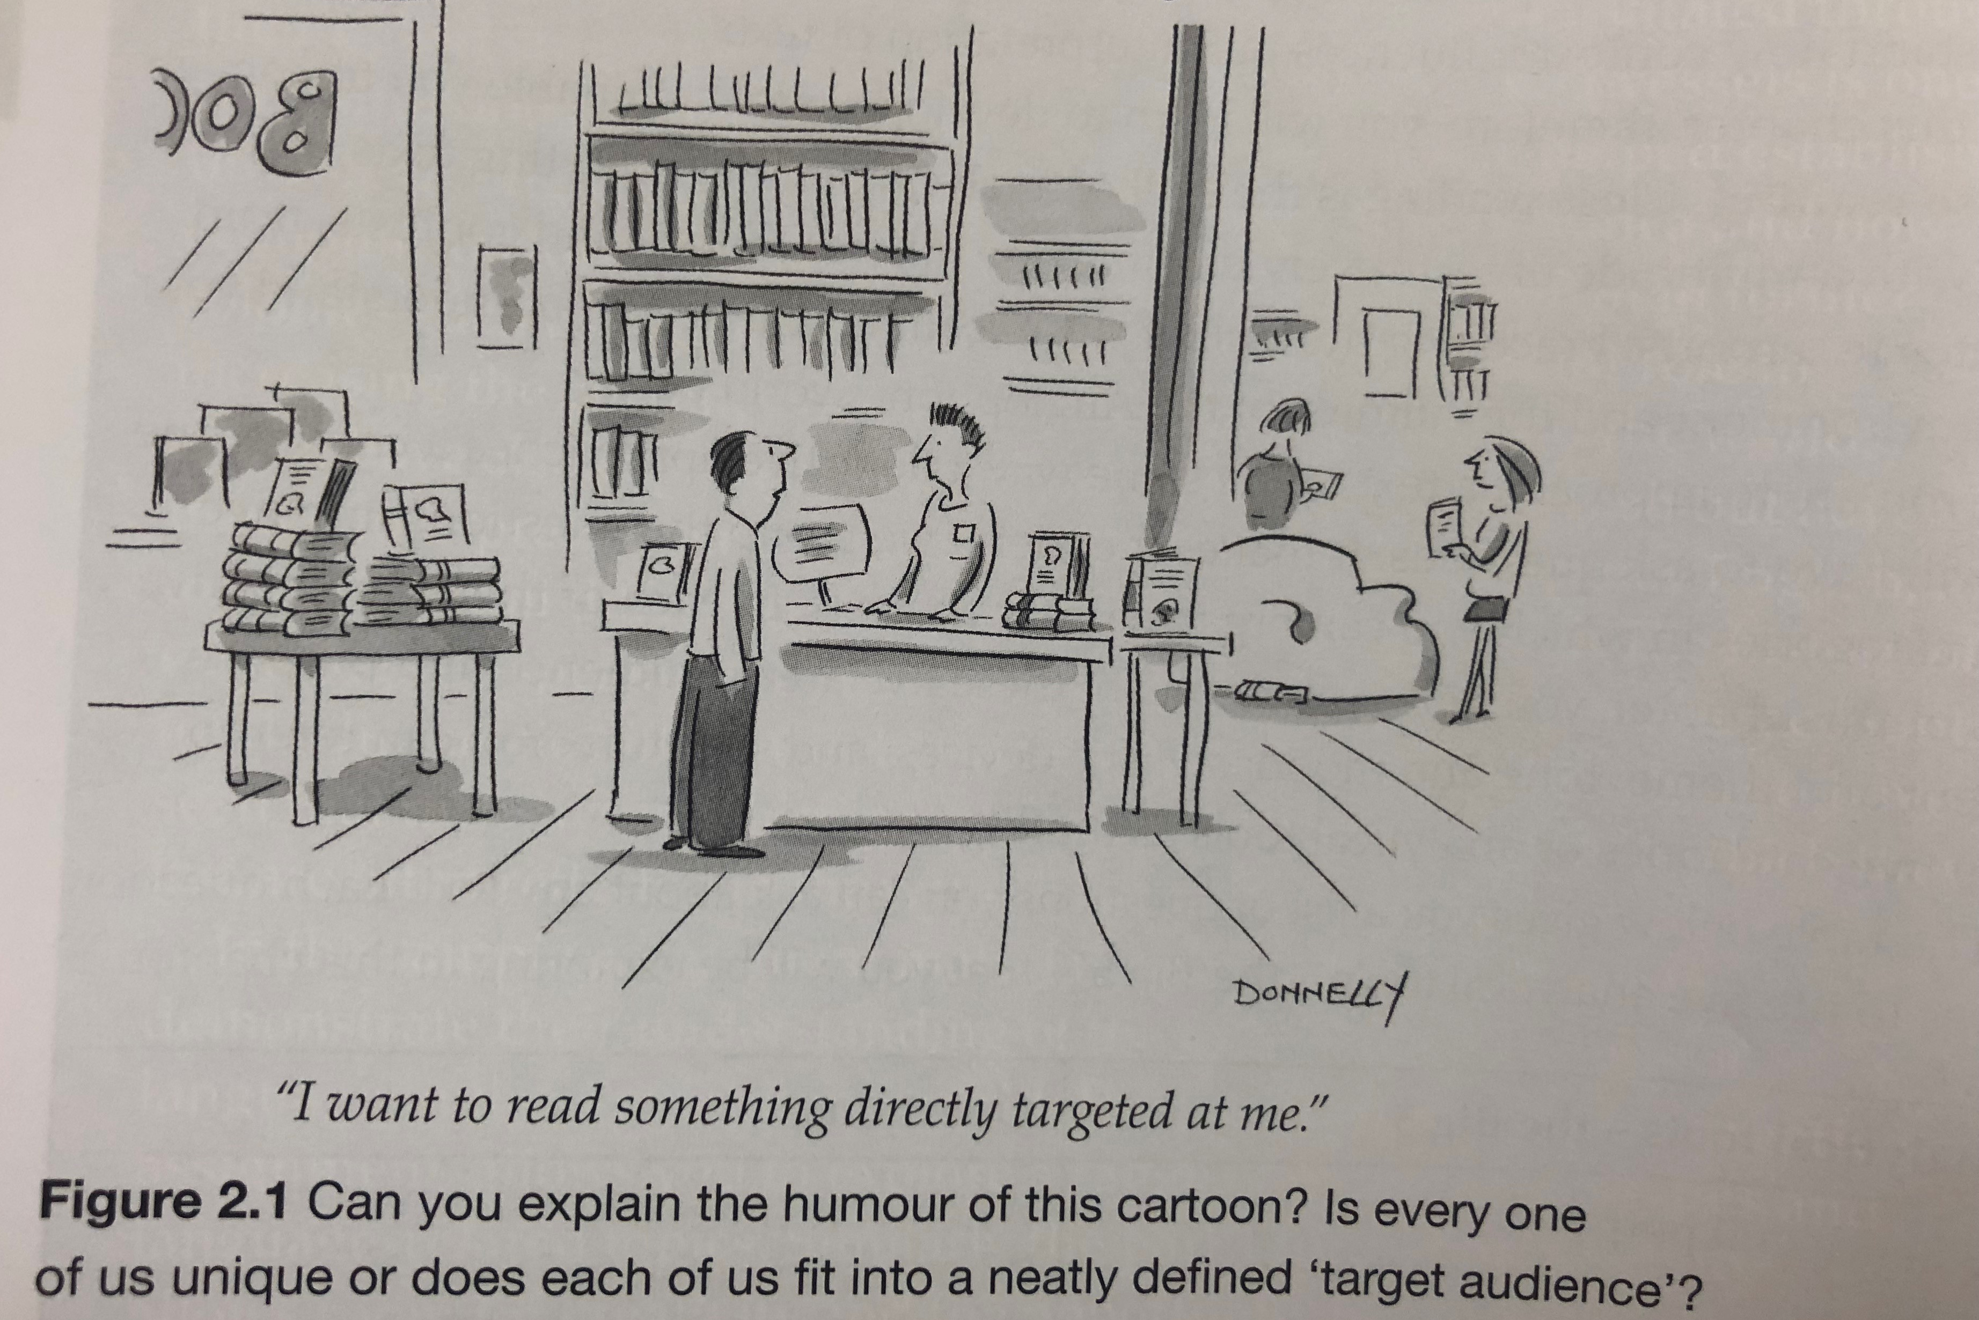

Slide 10
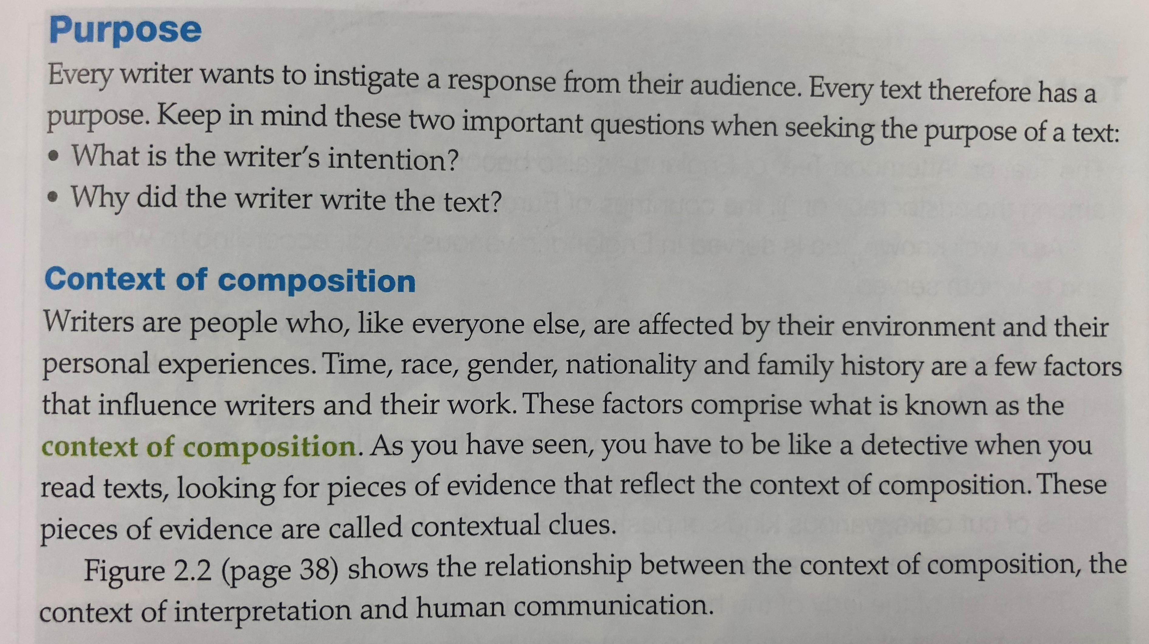

Slide 11
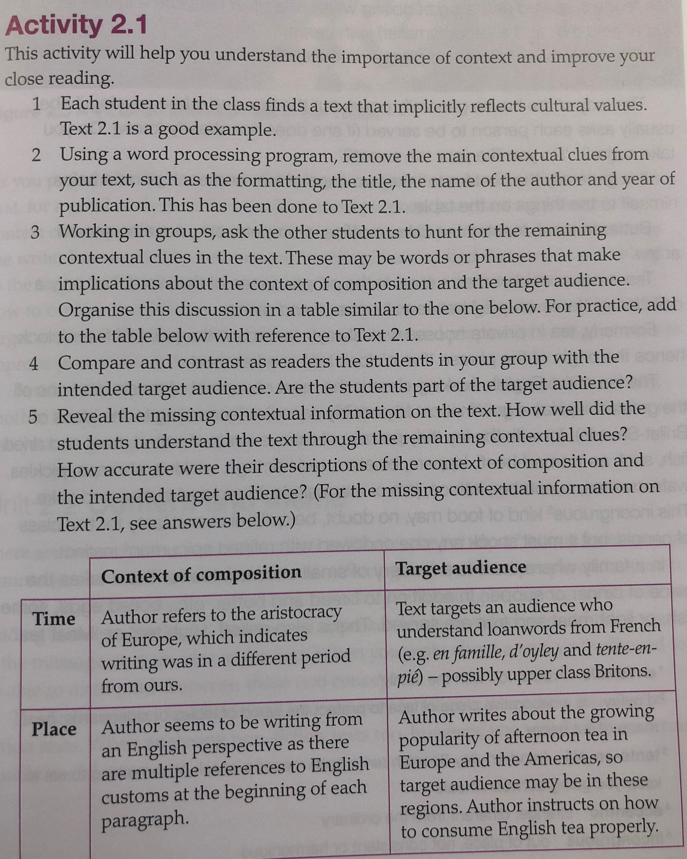

Slide 12
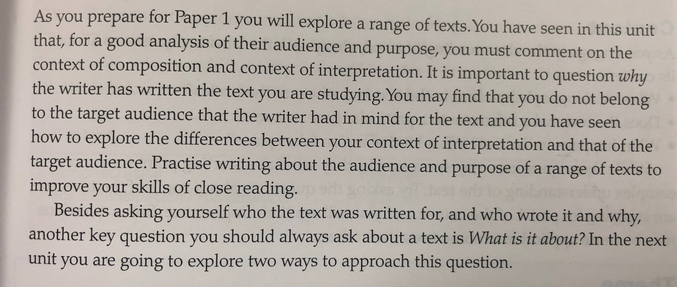
Paper 1 will be your Fall midterm!

Slide 14
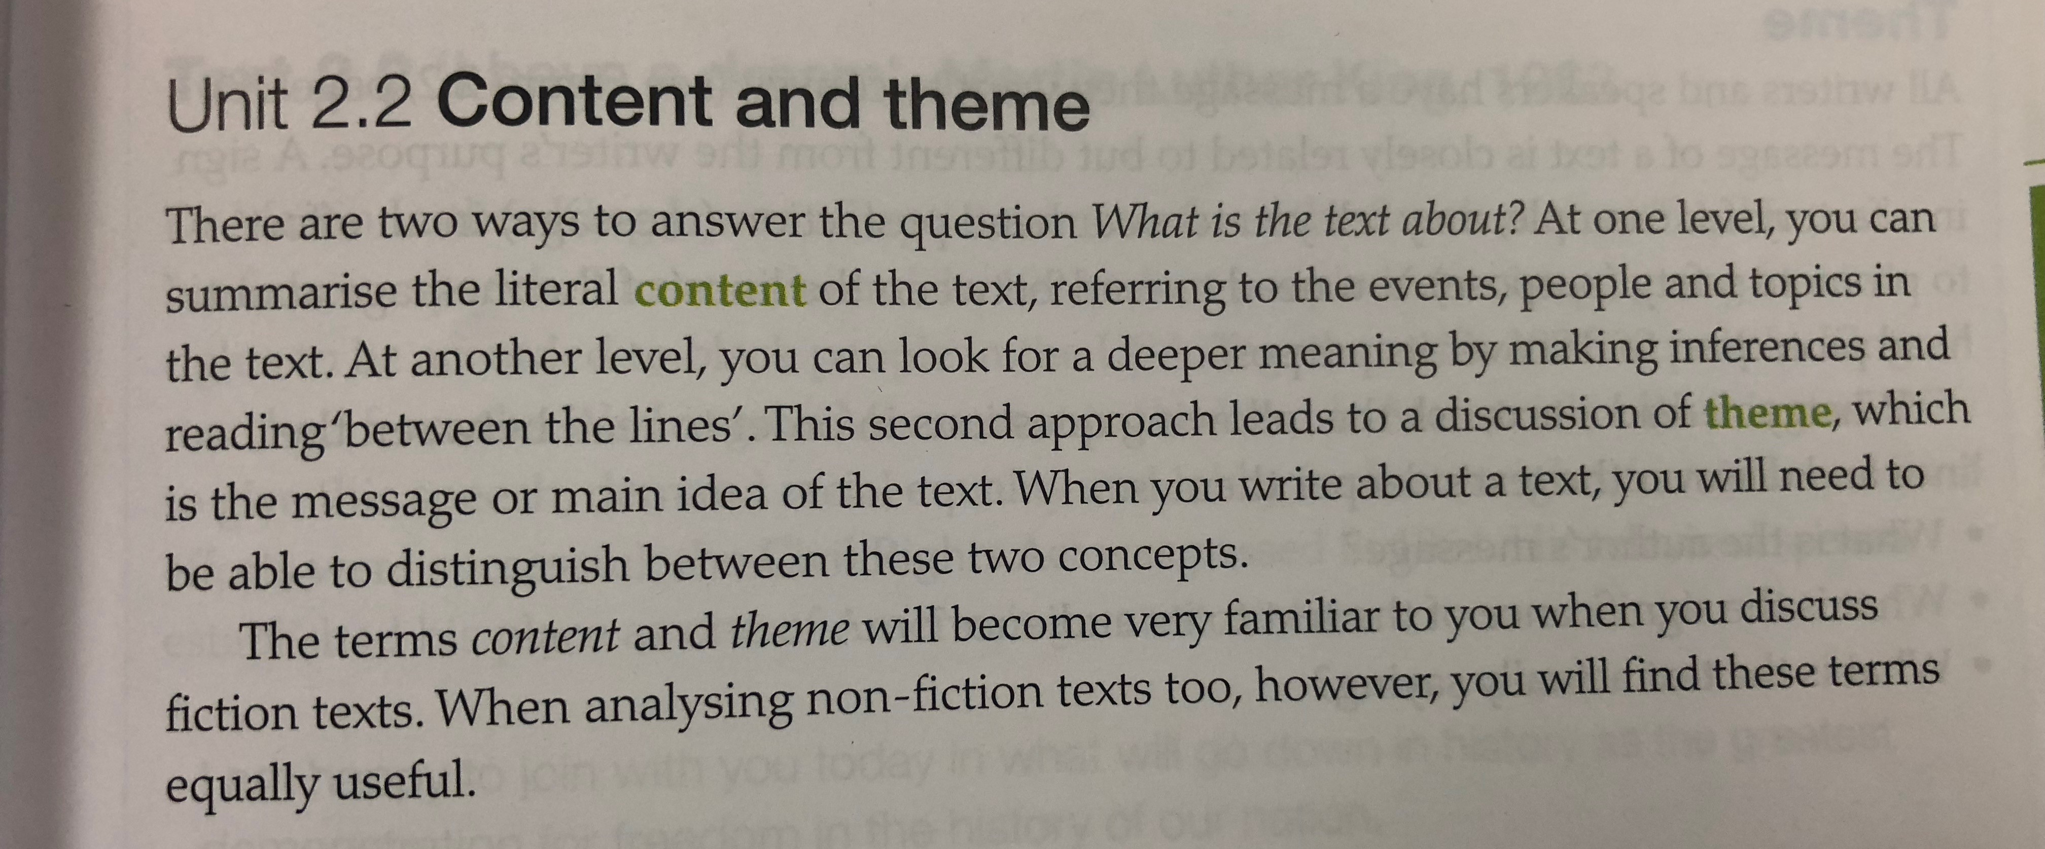

Slide 15
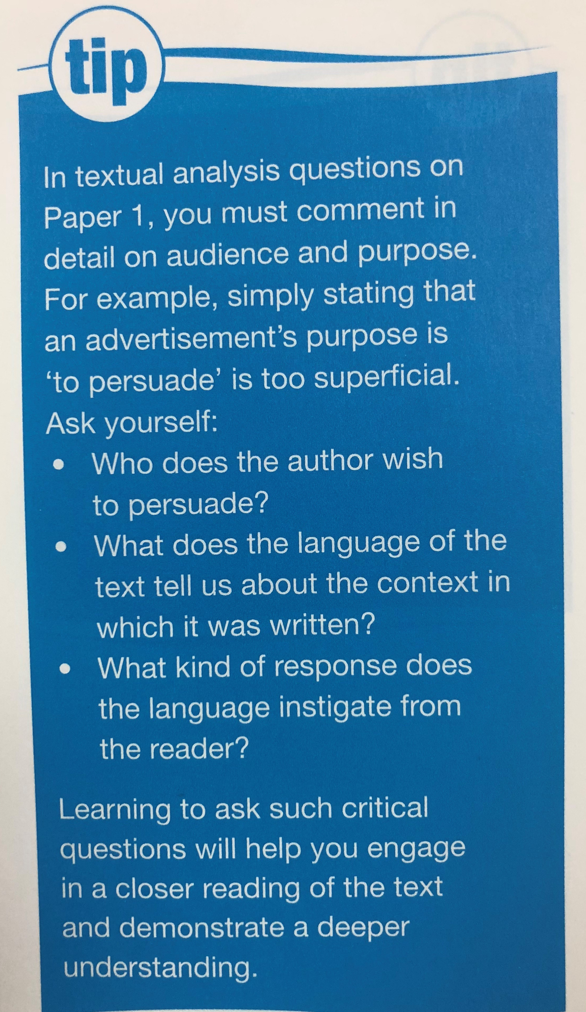

Slide 17
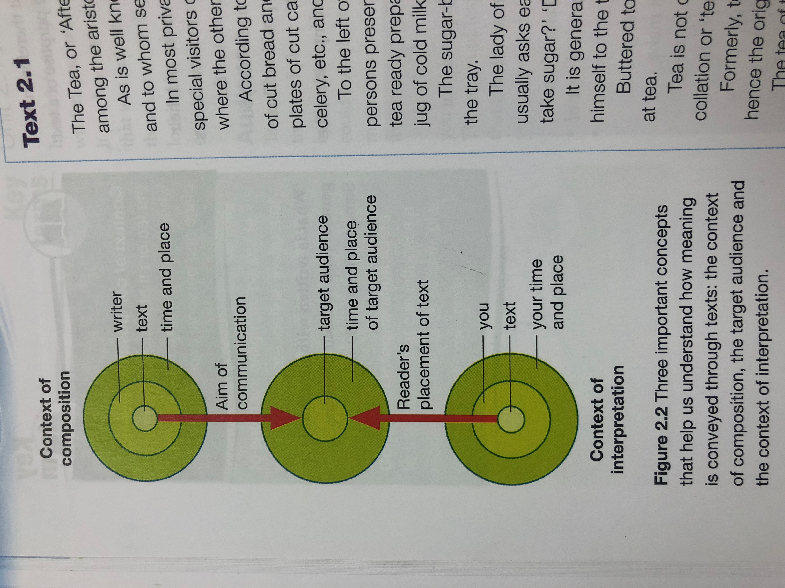
Copy this chart down in your notes! ☺
CONTEXT OF COMPOSITION
TARGET AUDIENCE
CONTEXT OF INTERPRETATION

Slide 18
Read: Bilingualism Poetry
Read (and listen to / watch) all three of the following poems about bilingualism.

Slide 19
Read: Bilingualism Poetry (Analysis)
Directions: Read and re-read the poems in order to answer the following questions with a partner.
In 'Bilingual' Espaillat uses parenthesis to translate several words. What is the effect of this on the audience? How does this compare to how Alvarez mixes language and Bhatt switches from one language (English) to the next (Gujarati) and back again (English)?
In 'Bilingual' the author refers to her father's wish to keep Spanish and English separate, in different places and times. How do all three authors view this idea of separating their languages? How does this make them feel as individuals?
In 'Bilingual Sestina', how does the author describe the importance of childhood memory and playing with 'things' to the experience of learning a language?
Explain the irony of the final words of 'Bilingual Sestina', 'en Inglais'.
In 'Search for my tongue', how does Bhatt play with the both the literal and figurative meaning of the word 'tongue'? How does she use imagery to illustrate her point?
There are many ways to discuss the nature of bilingualism and identity. Why do you think these authors chose to write poems rather than articles, memoirs or journals?

Slide 20
Analyze
Finally, choose one of the poems and complete a ‘Big 5’ analysis in your notebook (this is an individual activity). Analyze for the following:
Content and theme
Audience and purpose
Tone and mood
Style
Structure

Slide 21
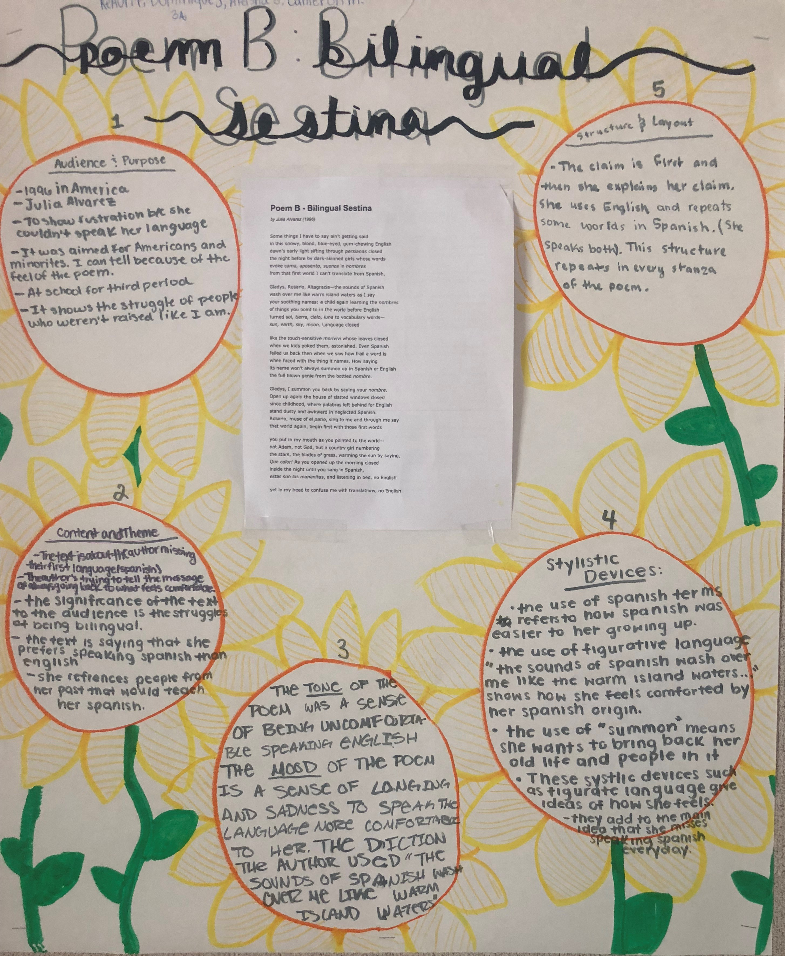
STUDENT SAMPLES

Slide 22
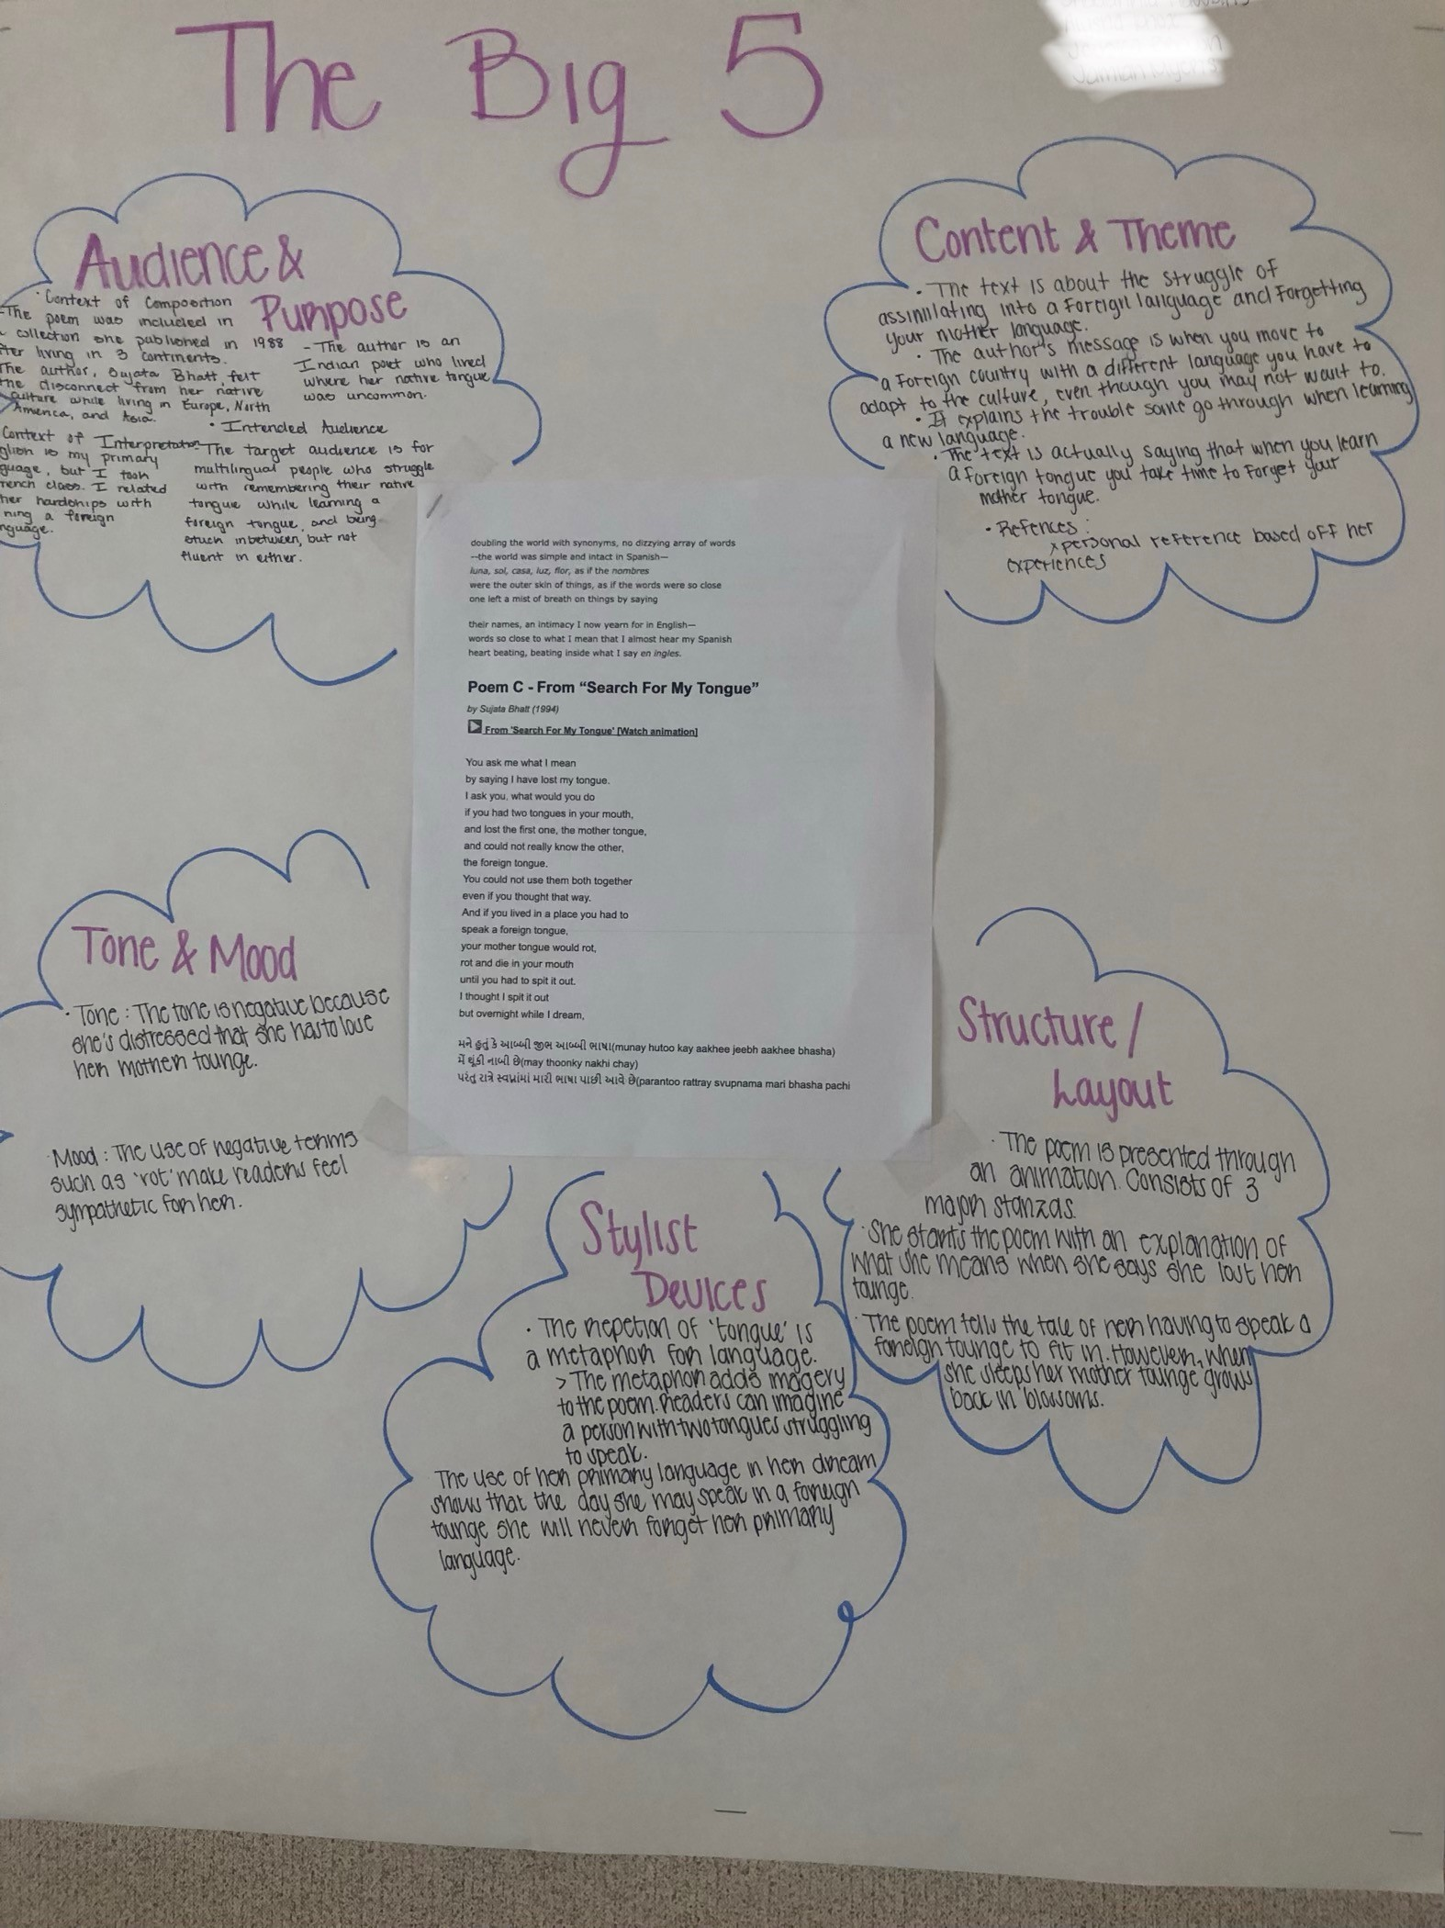
STUDENT SAMPLES

Slide 23
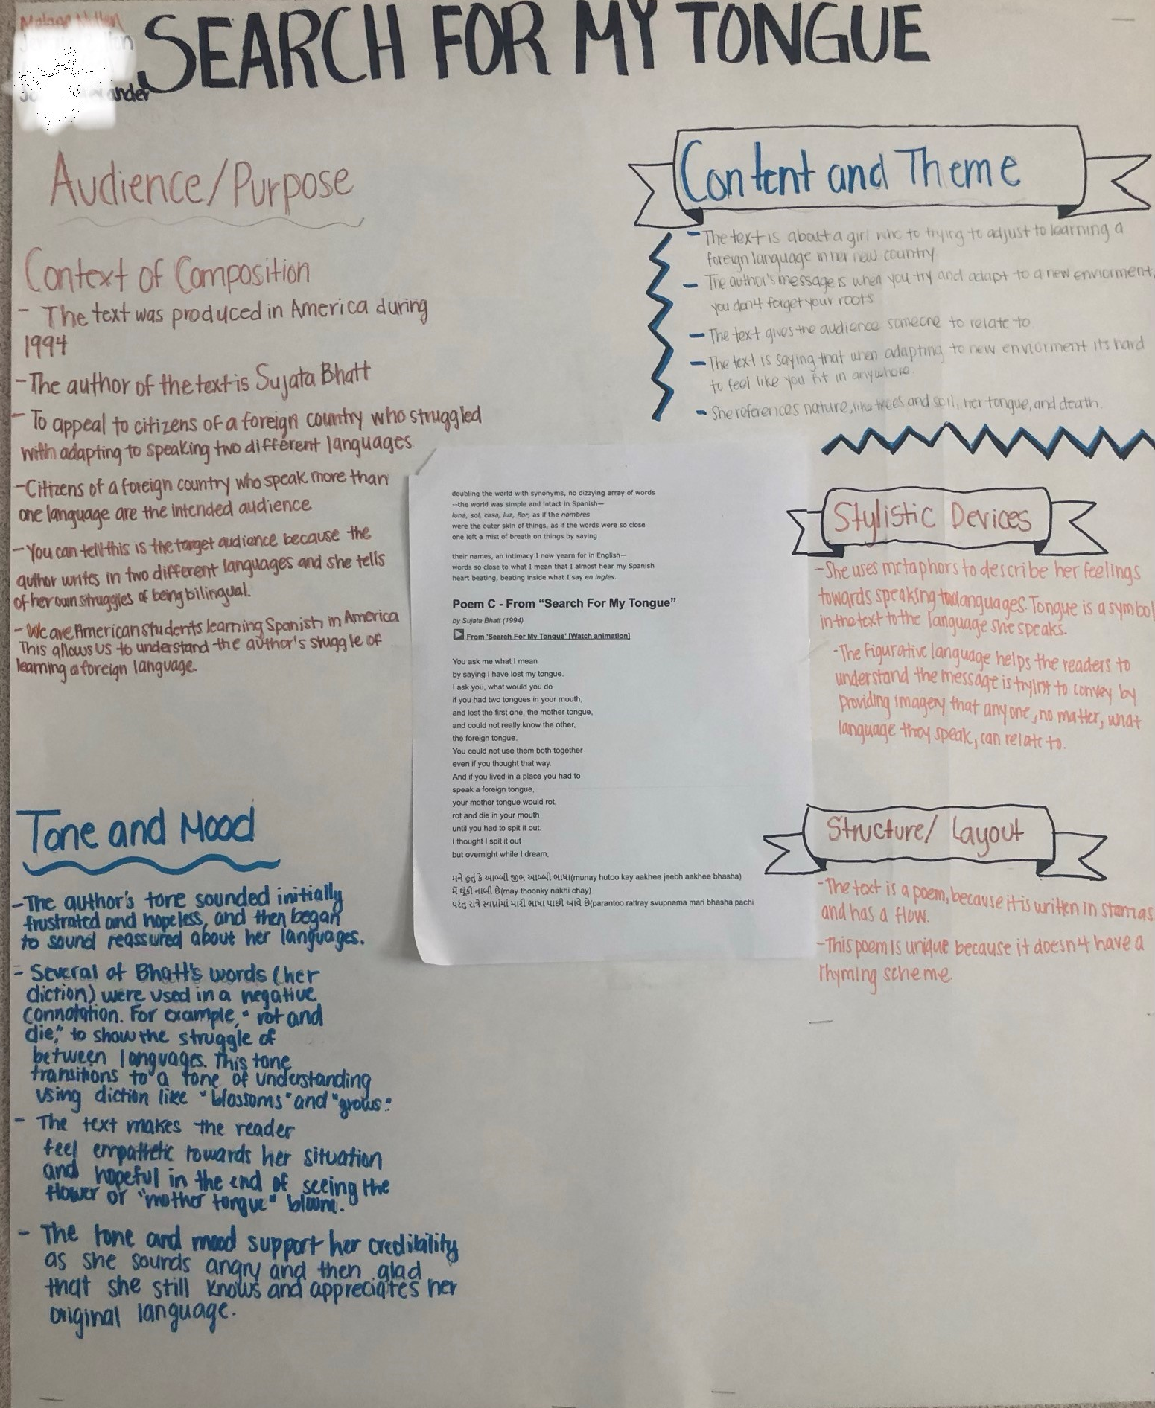
STUDENT SAMPLES

Slide 24
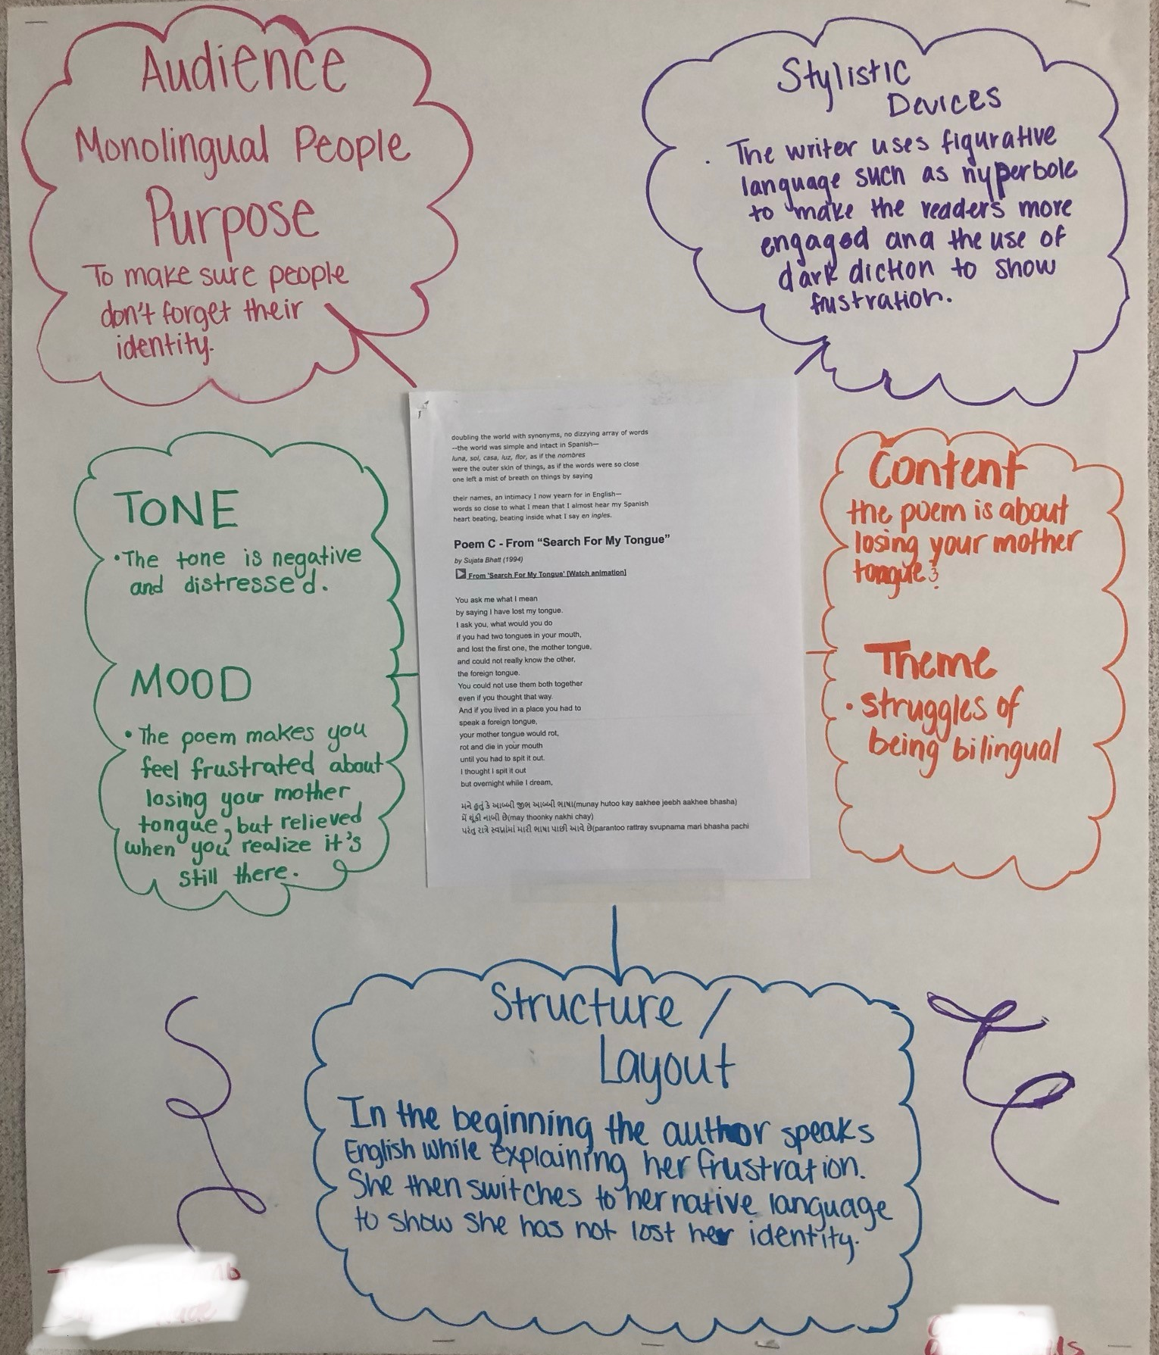
STUDENT SAMPLES

Slide 25
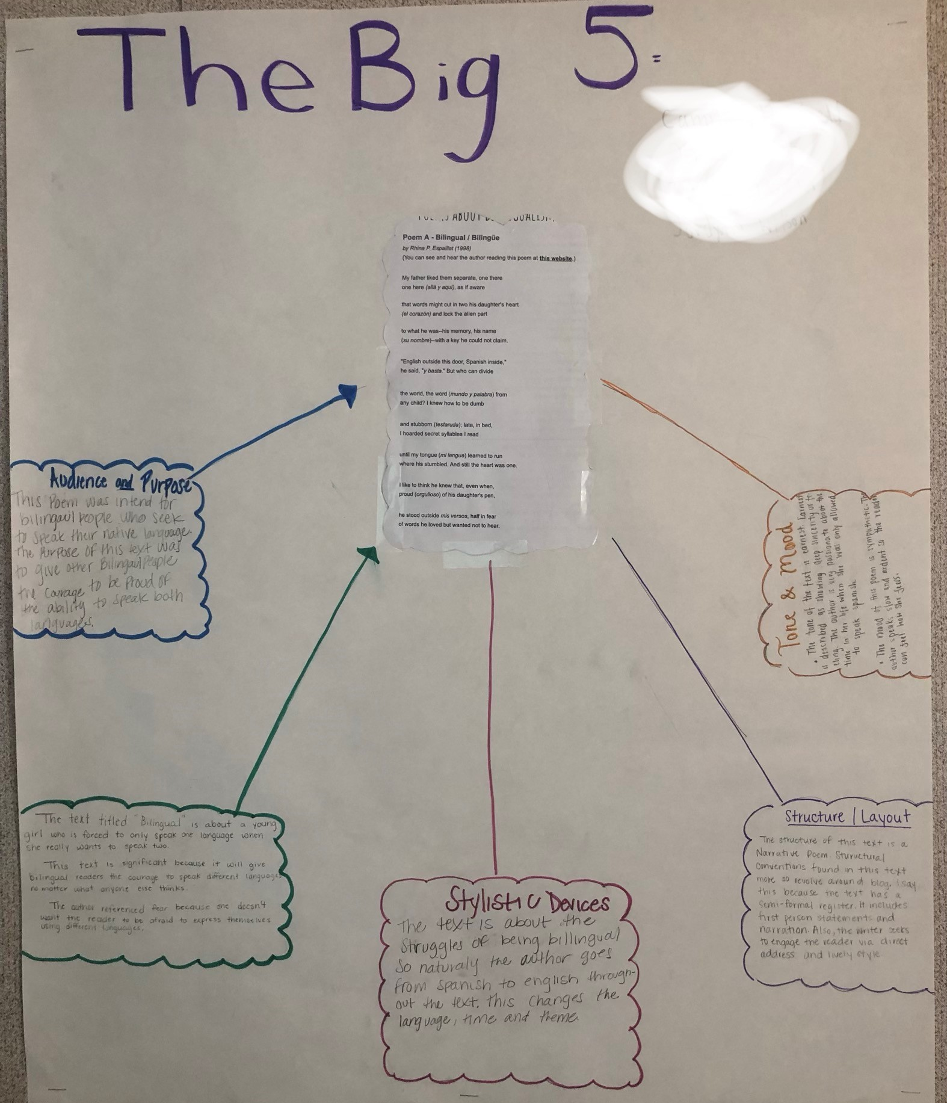
STUDENT SAMPLES

Slide 26
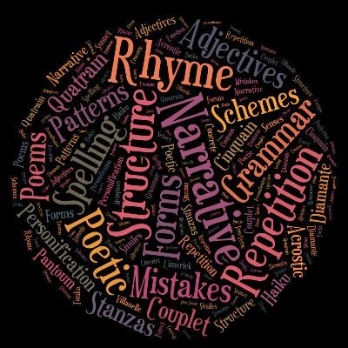
Extension Assignment
HW if not finished in class! Due: 08/13 (A) OR 08/14 (B)
Write a poem about your own multilingualism and identity!
Use some of the techniques employed by the poets of the poems you analyzed today.
Put your poem on white printer paper and decorate it. We will hang these up around the room!

