Slide 1
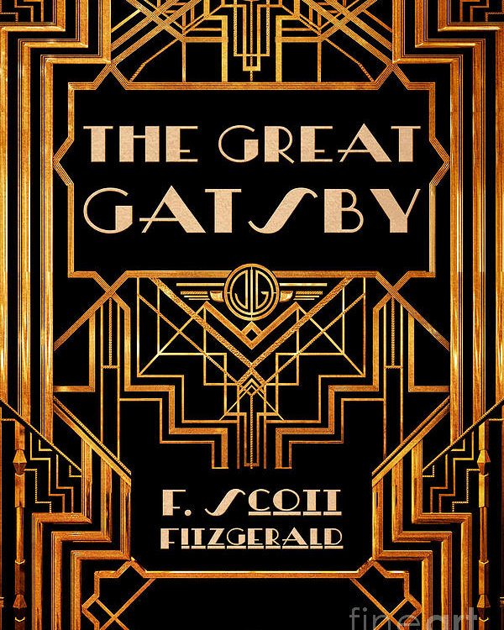
Chapter Nine Presentation

Slide 2
Learning Outcomes
Explore literary works in detail.
Understand the explicit and implicit meaning in a text
Identify and situate a text or an extract in the context of a larger work
Respond to the key features of texts such as language, characterization, and structure
Analyze elements such as theme and the ethical stance or moral values of literary texts
Identify the evidence in the text for a particular stance
Consider point of view in different literary genres
Understand and make appropriate use of literary terms

Slide 3
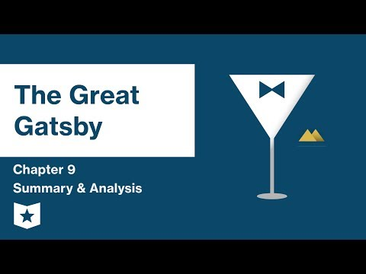
Summary of Chapter Nine
Nick feels that Gatsby would not want to go through his funeral alone, arranges a funeral for Gatsby in hope of Gatsby’s closest friends attending
Unfortunately, nobody shows up, including Tom and Daisy who have moved away, and Meyer Wolfsheim is busy with his business.
Gatsby’s father, Henry C. Gatz, hears about his son’s death and travel to Gatsby’s home to attend the funeral.
Nick, some servants, henry gatz, and owl eyes attend gatsby’s funeral
Nick meets with Jordan to talk about their relationship but ends up breaking it off as Jordan tells Nick she is engaged to another man.
Nick runs into Tom in New York City, refusing to shake Tom’s hands initially. Tom tells Nick that he told George Wilson that Gatsby owned the yellow car that killed Myrtle.
Nick draws to the conclusion that Tom and Daisy are careless people.
On the last night before heading back home, Nick heads to the beach, thinking of Gatsby and reaching out to the green light of Daisy’s dock, how he failed to grasp the American Dream and that it was already behind him.

Slide 4
Freytag’s Pyramid
Chapter Nine of The Great Gatsby falls under the denouement category of Freytag’s Pyramid. In comparison to the previous chapter, the events of chapter nine are not as eventful or exciting. The tone of this chapter takes on a somber feel as the audience realizes that the novel has come full circle.
Climax
Rising Action
Falling Action
Exposition
Denouement

Slide 5
Narrator & Point of View
The narrator of The Great Gatsby is Nick Carraway, who was chosen as the narrator of novel to provide the audience with an unbiased recollection of the summer of 1922. Nick begins the novel by saying that he tries not to judge men based off their actions, and he holds true to this quote for most of the novel. However, in chapter nine, Nick abandons this way of thinking, developing disgust for the people he spent that summer around. Nick’s narration is very important in this chapter since it blatantly holds judgement, and isn’t as reliable as it once was.
Aspect | Type | Evidence | Reason?
First Person | Major | After that I felt a certain shame for Gatsby—one gentleman to whom I telephoned implied that he had got what he deserved. 181 | Nick speaks using mainly first person pronouns.
Narration | Direct | ‘Hello!’ I interrupted breathlessly. ‘Look here—this isn’t Mr. Gatsby. Mr. Gatsby’s dead.’ 178 | The audience gets to read the conversations of the event instead of Nick’s summary of the conversation.
Speech | Direct | ‘It was a mad man,’ he said. ‘He must have been mad.’ ‘Wouldn’t you like some coffee?’ I urged him. ‘I don’t want anything. I’m all right now, Mr.——‘ ‘Carraway.’ ‘Well, I’m all right now. Where have they got Jimmy?’ 178 | Nick is narrating the chapter by using direct quotations of the characters speaking.

Slide 6
Narrator & Point of View
Tense | Past | “After two years I remember the rest of that day, and that night and the next day, only as an endless drill of police and photographers and newspaper men in and out of Gatsby’s front door. “ 174 | Nick begins the chapter by recalling the events that happened two years ago, therefore he’s speaking about the past.
Other | Level of omniscience reliability | About five o’clock our procession of three cars reached the cemetery and stopped in a thick drizzle beside the gate…” 186 “It was all very careless and confused. They were careless people, Tom and Daisy—they smashed up things and creatures and then retreated back into their money or their vast carelessness or whatever it was that kept them together, and let other people clean up the mess they had made….” 191 | Nick seems to know everything about the events following Gatsby’s death, just not the personal thoughts of the other characters. The reliability of Nick’s perspective comes into question as he lets his own opinions be known for once.

Slide 7
POV Contd.
Chapter 9 is narrated by an internal character Nick Carraway.
This is one of the first times where Nick’s perspective isn’t unbiased. In this chapter he allows his personal emotions and perspective of events to shine through. He expresses his disgust for the lack of morality and fakeness of the West.
Here Nick is chosen to reveal information. He tells the events of Gatsby’s death and funeral from two years ago.
Fitzgerald choosing Nick as the narrator, specifically his change in perspective in this chapter, adds new depth to his character. It also allows the circumstances of the East to be exaggerated in the sense of it really being morally compromising for Nick to judge, who is someone known to be not judgemental.

Slide 8
Conflicts
Nick Vs Society
Gatsby Vs Society
In this chapter, Nick is desperately trying to give Gatsby the funeral he believes Gatsby deserves, or the funeral he’s earned. Nick calls upon people he thought were close to Gatsby, like Daisy & Wolfsheim, yet no one grants him an audience. As the chapter goes on, Nick becomes frustrated and disappointed by those around him - his lover is engaged to another man and his own cousin recklessly ruined people’s lives without care. It seems like Nick cannot catch a break from a single person in this chapter.
Gatsby suffers a bit of defamation in this chapter as people speculate over the circumstances of his own death and Myrtle’s. Even though Gatsby is now deceased, we also learn that he was truly alone through life and death. His “friends” suddenly disappear, his business partners are too “busy” to attend his funeral, and the love of his life abandons the city without a trace. The society he surrounded himself with and was apart of deserted him in his loneliest hour.

Slide 9
Nick Carraway
Speech -
Nick becomes more expressive of his thoughts and feelings. In comparison to the Nick of the previous chapters, he’s no longer mute to what’s happening around him. He’s speaking out against the atrocities happening and what he thinks is wrong.
Thoughts -
Nick’s values have taken a large shift along with his speech. He begins to judge the people around him instead of keeping an unbiased view. He is obviously shifting away from his former peers.
Effects -
Even though Nick is trying desperately to get people to understand the importance of Gatsby’s death and their own actions, it seems like his words have very little effect. This shows how he remained true to his role (of the minor, unimpactful character) through the entire novel, even if it did not benefit him in the end.
Actions -
Nick’s refusal to shake Tom’s hand also shows his development as a character. At the beginning of the novel he lets Tom lead his actions and is hesitant to refuse the bigger man, yet in this chapter, he denies Tom’s act of hospitality - representing his newfound strength.
Looks -
He cries at Gatsby’s funeral, indicating that he truly cared for Gatsby.

Slide 10
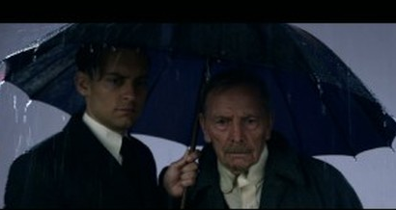
Imagery
“Its was Gatsby father, a solemn old man, very helpless and dismayed, bundled up in a long heap ulster against the warm september day his eyes leaked continuously with excitement, and when I took the bag and umbrella from his hands he began to pull so incessantly his sparse grey beard that i had difficulty in getting of his coat. He was on the point of collapse so I took him into the music room and made him sit down while i sent for something to eat. But he wouldn’t eat and the glass of milk spilled from his trembling hand.” Pg. 178
Analysis
The author appeals to the reader’s sense of sight of Gatsby’s Father’s physical appearance, something that we know very little of other than the fact that he was poor.
A glimpse of the mental state of Mr. Gatz at his son’s (Gatsby) funeral. He was very heartbroken at the fact of son’s death.

Slide 11
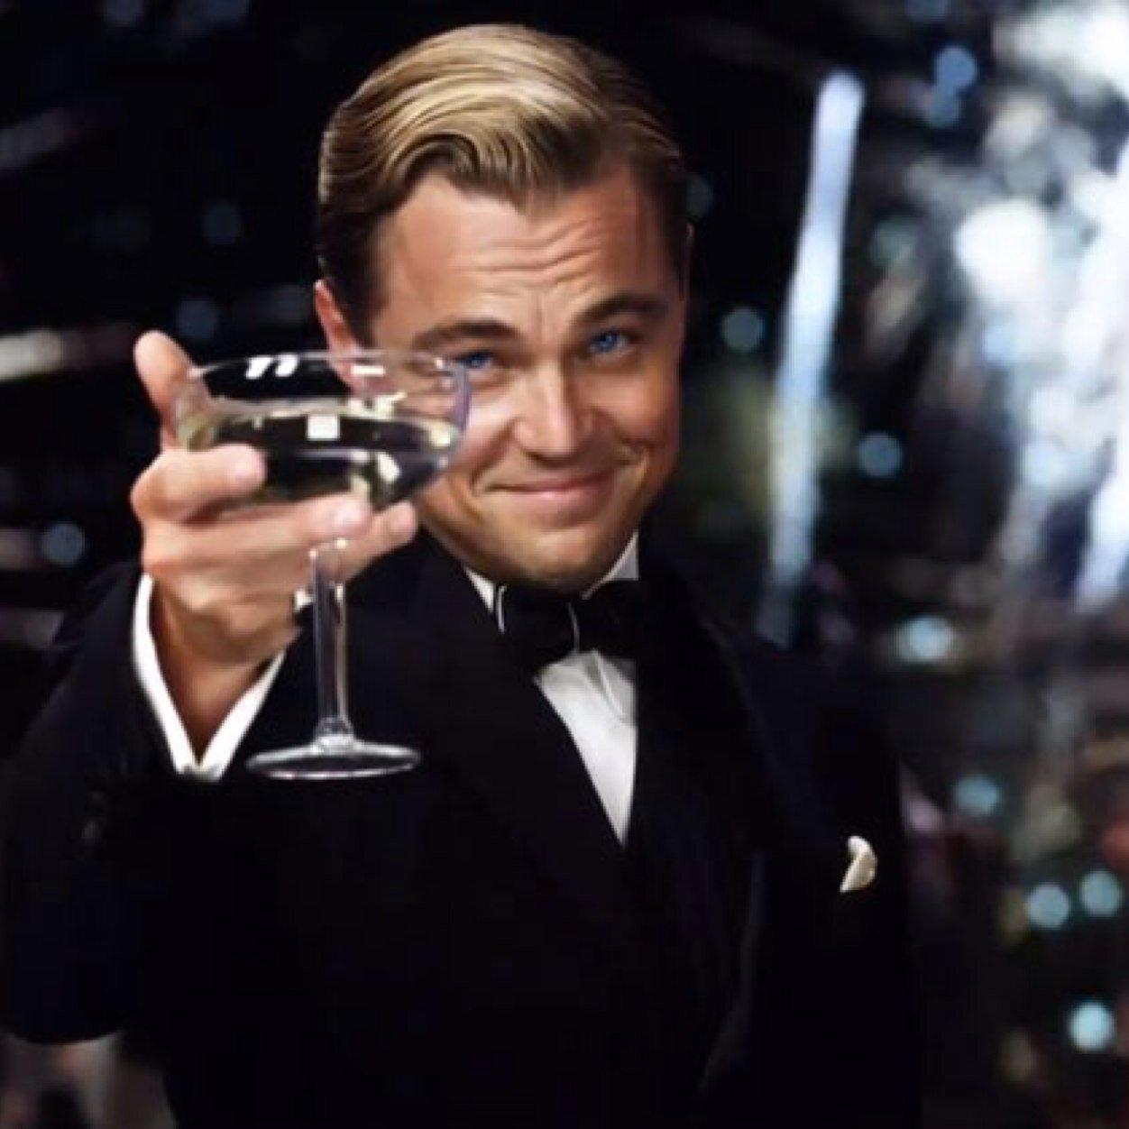
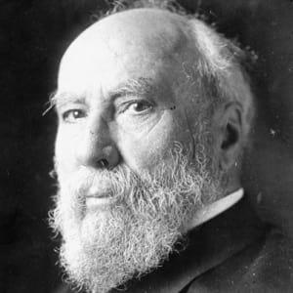
Allusion
“If he’d of lived he’d of been a great man. A man like James J. Hill. He’d of helped build up the country.”
Analysis
Mr. Gatz is comparing Gatsby to Jame J. Hill because he believes he gain his wealth by working hard and being ambitious just like James J. Hill.
Shows that gatsby’s character/personality gave the illusion to others that he was a hardworking and ambitious man and all his money was earned through honest work, but nobody really knows the real story behind Gatsby or his money.

Slide 12
Dramatic Irony
“ He ran over Myrtle like you’d run over a dog and never even stopped his car.”
Analysis
It is ironic because the reader knew that Daisy was the one that ran over Myrtle, not Gatsby. While Tom believes Gatsby did and has moved away with Daisy” Tom Describes how brutally Gatsby ran over Myrtle, not knowing that it was his wife was the culprit.

Slide 13
Flashback
“I spent my saturday nights in New York, because those gleaming, dazzling parties of his were with me so vividly that i could still hear the music and the laughter, faint and incessant, from his garden, and the cars going up and down his drive.”
Analysis
Nick has a vivid and sensory-rich memory of the parties that Gatsby threw at his house every saturday. The West egg seems almost dead without these parties, but Nick didn’t care for the parties, he cares about the man who threw them. These memories are attached to Nick because reminds him of Gatsby and how they met. They pain Nick to the point that he can’t spend his saturday nights at his home.

Slide 14
Symbolism
“I thought of Gatsby’s wonder when he first picked out the green light at the end of Daisy’s Dock. He had come a long way to this blue lawn and his dream must have seemed so close that he could hardly fail to grasp it.”
Analysis
The symbol is the green light and it symbolizes The American Dream that Gatsby is trying to achieve: the, money, the fame, and the love. He had already captured two parts of this dream, with the third part being so close that failure seemed out of the question, but just like the light, it could never be captured.
His ambition was him reaching, but he could never reach far enough to get to the green light (American dream).

Slide 15
Simile
“And if you think i didn’t have my share of suffering-look here, when I went to give up that flat and saw that damn box of dog biscuits sitting there on the sideboard I sat down and cried like a baby. By God it was awful--”
Analysis
Tom tries to sympathize with Nick because he lost somebody he loved too, but Nick sees through it because he caused the death of Gatsby and Myrtle’s death was accidental and Gatsby’s wasn’t responsible
Shows that Tom did care for Myrtle beyond having an affair. The dogs treats were for the dog he bought her, and the thought of dogs biscuits brings those happy memories back and he cries because he that bond is severed forever.

Slide 16
Metaphor
“So we beat on, boats against the current, borne back ceaselessly into the past.”
Analysis
The author compares the human drive, ambition, to “boats against the current.” a constant upstream battle.
“We” implies that all humans row hard against the current of life to try to get ahead, but we are always brought back to where we began.
Gatsby ambition was rowing upstream, overcoming many obstacles, and he continued indefinitely, no matter how difficult things got for him, but he’ll never reach his destination, the past, because it doesn’t exist after he already passed it.

Slide 17
Love
Love is thoroughly explored throughout the novel, however, it has never been pure. Daisy’s love has been fueled by money lust while Tom’s has been fueled by domination of his partner. Even Gatsby’s love was fueled by his wild ambitions.
And for Fitzgerald to introduce pure love at the end of the novel provides the audience with a sort of resolution for the tragedies that commenced.
However, this chapter explores pure love, a significant shift from previous chapters of the book. We learn that Nick genuinely loves Gatsby, not for his wealth or his lavish parties. We also learn that Henry, Gatsby’s father, loves his son even after not seeing him for several, several years.

Slide 18
Important Quotes
“They were careless people, Tom and Daisy--they smashed up things and creatures and then retreated back into their money or their vast carelessness, or whatever it was that kept them together, and let other people clean up the mess they had made…” (179)
This quote was said by Nick after running into Tom.It is significant because it further emphasizes the theme of moral decay of the upper class. Daisy and Tom don’t have to worry about the consequences of their actions because they have money to fall back to. This carelessness and lack of concern for other people clearly illustrates the dehumanization and apathy of the upper class.
"Why, my God!" They used to go there by the hundreds!" (175) - Owl Eyes on the topic of Gatsby's funeral.
People are content with attending Gatsby’s parties, but when he passes away, none can be bothered to show up to his funeral. Reinforces the idea of dehumanization and apathy. They were content with ‘using’ Gatsby and were so self-absorbed with their own reckless lives they couldn’t be bothered to come to the funeral of the man who threw the parties they so often attended. Also displays irony.

Slide 19
Important Quotes Contd.
“Gatsby believed in the green light, the orgastic future that year by year recedes before us. It eluded us then, but that's no matter--tomorrow we will run faster, stretch out our arms farther. . .And one fine morning. . .”
Nick says this quote on the last page of the novel, thinking about Gatsby and the pursuit for a new future or American Dream. This quote describes both Gatsby and the American Dream as a whole. American Dream is “receding” and “eluding”. The American Dream is a bluff, made impossible by the emptiness and corruption of the upper class, even though people want to believe otherwise.
“So we beat on, boats against the current, borne back ceaselessly into the past” (180),
Even though we try to make a future for ourselves, we are ultimately “boats against the current”, battling the waves of the past. This is comparable to Gatsby who wanted to focus on a new future with Daisy, but was still rooted in the past and as a result did not see her for who she was.

Slide 20
One More Quote
"Jimmy always liked it better back east. He rose up to his position in the east."(176)
Henry C. Gatz is referring to more than simply geographically but rather referring to the lifestyle led in the east. Gatsby did not only "like it better in the east" but preferred the lifestyle of the east, and spent his life trying to attain it. From Gatsby's residence in the West Egg Fitzgerald shows he could never fully attain his desire to be "from the east"; although he is wealthy he lacks the mannerism and social skills of the upper class.

Slide 21
Kahoot time!
https://create.kahoot.it/share/great-gatsby-chapter-9-analysis/3b0b6109-eba0-475d-8e89-dc226bcc3199

