Slide 1
The road Pages 132-143
By: Cameron mayfield

Slide 2
Important subjects
Violence:
“They came upon themselves in a mirror and he raised the pistol. It’s us, Papa, the boy whispered. It’s us.” pg. 132
The father was so paranoid that upon seeing his own reflection he mistook him and his own son for a threat. His first instinct was to use a weapon (violence) against the so called “threat”.
Isolation:
“They weren’t going to be here that long and he wasn’t going to be opening and closing the hatch any more than they had to.” pg. 139-140
The father basically locked them in the bunker in order to keep them safe and separated from any outside possible threats.

Slide 3
Mortality:
Good Vs. Evil:
“ Crossing the grass he felt half faint and he had to stop. He wondered if it was from smelling the gasoline. The boy was watching him. How many days to death? Ten? Not so many more than that.”
pg. 133
The dad knew he was getting closer and closer to death and was starting to experience the symptoms for his declining health.
“He’d been ready to die and now he wasn’t going to and he had to think about that.” pg.144
Once him and his son had found the bunker full of food and supplies, the father was no longer at fear of death because he was finally surrounded by all the supplies he needed to survive.
“Its here because someone thought it might be needed. But they didn’t get to use it. No. They didn’t. They died. Yes. Is it okay for us to take it? Yes. It is. They would want us to. Just like we would want them to. They were the good guys? Yes. They were. Like us. Like us. Yes. So its okay. Yes. Its okay.” pg. 139-140
The father is twisting the situation for his own good and using this as a biased example to prove that since they are “good guys” whoever stocked the bunker was a “good guy” as well.
“Okay this is what the good guys do. They keep trying. They don’t give up.” pg. 137
Anytime the father wanted to convince the son to be on his side or to do something for him he would mention how a good guy would do the same.

Slide 4
Love:
“He reached and took the lamp from the boy. He started to descend the stairs but then he turned and leaned and kissed the child on the forehead.” pg. 137
The father wanted to comfort the boy because he knew the boy was afraid and the kiss further proved he loved him and would never let anything happen to him.

Slide 5
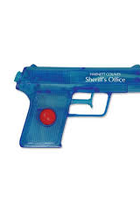
Symbols:
The Pistol
“He held the pistol at his waist and held the boy by the hand.” pg.131
“They came upon themselves in a mirror and he almost raised the pistol.” pg. 132
“On the top shelf were two cans of motor oil and he put the pistol in his belt and reached and got them and set them on the bench.” pg.133
“Hold your hand in front of the flame. Don’t let it go out. He rose and took the pistol from his belt.” pg.137
I think the pistol always having the pistol in his belt represents his anxious nature and having it always at his side shows his distrust towards people as he’s always ready to use it if he has to.

Slide 6
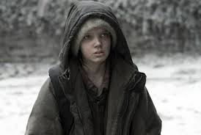
The boy always watching:
“He stepped back and looked out the door. The boy was sitting on the back steps of the house wrapped in the blankets watching him.” pg. 133
“Crossing the grass he felt faint and he had to stop. He wondered if it was from smelling the gasoline. The boy was watching him.” pg. 133
I think the boy watching represents the father’s constant eyes on him and the father constantly has someone looking up to him and watching his every move so he has an important job to do to show that everything is okay.
The man is constantly looking at his son only to find his son staring blankly back at him.
The son could also represent the watchful eyes of a child and the boy having to constantly watch his father struggle for him.

Slide 7
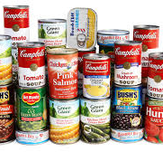
The Food and Supplies
“What did you find? I found everything. Everything.” pg. 139
The discovery of the bunker with everything in it represents their new found hope. They finally have a means of survival when throughout the whole book they had to scavenge for their food.
“Chile, corn, stew, soup, spaghetti sauce. The richness of the vanished world.” pg. 139
The cans of corn, stew, soup, spaghetti, etc. represent them finally finding a glimpse of the old world.

Slide 8
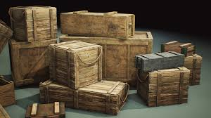
Literary devices
Imagery:
“On the patio was a barbeque pit made from a fifty-five gallon drum slit endways with a torch and set in a welded iron frame.” pg. 132
“The bunker was walled with concrete block. A poured concrete floor laid over with kitchen tile. There were a couple of iron cots with bare springs, one against either wall, the mattress pads rolled up at the foot of them in army fashion.” pg.138
“Crate upon crate of canned goods. Tomatoes, peaches, beans, apricots. Canned hams. Corned beef. Hundreds of gallons of water in ten gallon plastic jerry jugs. Paper towels, toilet paper, paper plates. Plastic trashbags stuffed with blankets.” pg. 138

Slide 9
Thematic concepts
Motivation
Beauty of the old world
Declining Health
Life

Slide 10
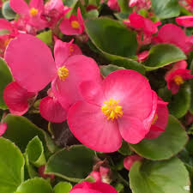
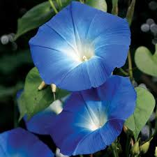
Thematic Concepts:
The boy is the father’s motivation
“Slow going. God he was tired. He leaned on the spade. He raised his head and looked at the boy. The boy sat as before. He bent to his work again.” pg. 134
This shows how the boy was the man’s motivation. We can see from this quote that the dad is tired but the moment he looks at his son, he realizes he needs to keep going no matter how tired he gets.
The flower seeds are a reminder of the beauty of the old world
“He opened the cabinet. Old catalogs. Packets of seed. Begonia. Morning glory. He stuck them in his pocket. For what?” pgs. 132-133
In this book there aren't very many green healthy plants or trees. Everything is covered in ash. The father picking up the flower seeds represents the color of the world before, back when lawns had flowers that were planted and bloomed. Flowers as we know are also generally pretty things to look at. These flower seeds show the contrast between the grey atmosphere they currently live in.
These flower seeds are literally useless to their current situation but for some reason the father still wants to keep them.

Slide 11
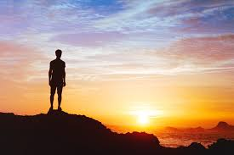
The man is slowly losing his ability to think clearly and remember things
The father finally has a chance to survive.
“He couldn’t think. Why had he stopped? He turned and looked down at the grass. He walked back. Testing the ground with his feet. He stopped and turned again.” pg. 134
“He didn’t know where he was. He was lying with his coat over him. He sat up and looked at the boy asleep on the other bunk. He’d taken his shoes off but he didn’t remember that either.” pg.143
“He’d been ready to die and now he wasn’t going to and he has to think about that.” pg. 144

Slide 12
Motifs
Need for Protection
“What he didn’t find was a gun. He took the battery latern and walked over the floor and he checked the walls for any hidden compartment. After a while he just sat on the bunk eating a bar of chocolate. There was no gun and there wasn’t going to be one.” pg.143
This shows the father’s desperation for an need for protection. In this scene despite the father having all the food and bedding needed to survive he is still searching for weapons by looking for hidden compartments. He already has a pistol at his waist, which he relies on heavily, but wants another gun for added protection.

Slide 13
Discussion questions
How does the father’s new chance on life change the direction of the story?
Why does the father rely so heavily on the use of weapons throughout the book?
How does the selfishness of the dad and the selflessness of the son reflect our actual society?
Why is it that even with a place to stay and food to eat the dad chooses to continue moving?
Does it look like the son actually have a future in this book?
How can love still exist in a world with no hope?

