Slide 1
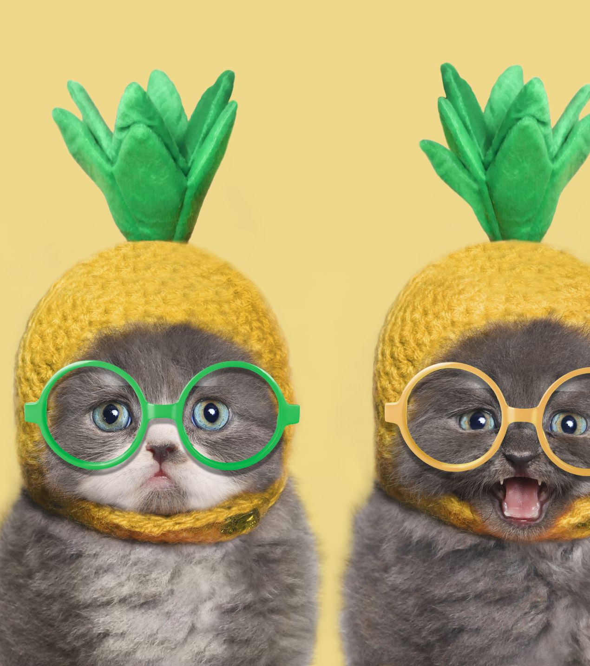
The Taming of the Shrew
By William shakespeare

Slide 2
GUIDED CONCEPTUAL QUESTIONS
1. How important is cultural or historical context to the production and reception of a text? 2. How do we approach texts from different times and cultures to our own? 3. To what extent do texts offer insight into another culture? 4. How does the meaning and impact of a text change over time? 5. How do texts reflect, represent or form a part of cultural practices? 6. How does language represent social distinctions and identities?

Slide 4
CONTEXT:
- Elizabethan era
- Set in Padua, Italy (IMPT B/C: location would have been chosen because the Elizabethan audiences associated cities in Italy with certain attributes or characteristics: Florence was thought to be a center of old-fashioned courts and manners; Rome was a false paradise; Venice (where Petruchio goes to buy his wedding clothes) was the center of fashion. Padua, in the north of Italy near Venice, was known as a great center of learning. Its university was among the oldest in Europe)
- The idea of “taming” one’s wife was a popular idea during this time period in Elizabethan England
- Marriage was seen between two people of the same social class (didn’t want to mess up the social order of things- hierarchy)

Slide 5
CONTEXT:
- $$$=HAPPINESS
- “Shrew” is a derogatory term for a woman with a sharp tongue and a bad temper. A shrew was a common character in commedia and in literature of Shakespeare’s day. Elizabethans distinguished between a “shrew” and a “scold”—a scold was much worse than a shrew. A scold was a woman who offended public order through her speech. Unlike the shrew, who utters angry, nagging, mean-spirited words, a scold committed more slanderous acts, punishable under the law, such as gossiping, insulting, and deliberately attempting to stir up trouble between neighbors.
- In this period, willful women were beaten until bloody and broken, then wrapped in the salted skin of their husbands’ old plow horse until they agreed to be submissive and obedient.
- There were also interesting but cruel punishments for non-obedient wives in the Elizabethan Era. One such punishment was to force a shrew to wear something called a scold’s bridle. Attached to the bridle was a metal pronged that, and when inserted into the mouth of the shrew it depressed her tongue and made it impossible for her talk.

Slide 6
CONTEXT- WOMEN SUBMISSIVS DURING THE TIME OF A POWERFUL QUEEN
Female submissiveness may seem like an odd theme for a play written during the reign of a powerful queen. Elizabeth I, however, was regarded as an exception to the normal or "natural" gender restrictions of her time. Few dared to openly question the queen's right to rule, but the notion of a woman in charge was seldom accepted in other areas of life.
Elizabeth herself was well aware of her subjects' prejudices and sometimes sought to cultivate a martial, masculine public image. In one famous 1588 speech, Elizabeth urged her subjects to overlook her feminine frailty: "I know I have the body but of a weak and feeble woman," she said to a group of soldiers assembled at Tilbury to defend against a Spanish invasion, "but I have the heart and stomach of a king." Her speech, which came on the eve of a great victory for the English Armada, was widely celebrated. Those in attendance copied it down for posterity.
Still, other writers admonished their readers not to misinterpret Elizabeth's example: although a queen might rule England, they suggested, a wife should not be allowed to rule her household. Dozens of misogynistic books and pamphlets were published during Elizabeth's reign, warning of the disasters that would befall if women overstepped their bounds. One such treatise, entitled A Godly Form of Household Government, was published in 1598, five years before Elizabeth's death. Its author, Robert Cleaver, issued a grim prediction for households in which the wife "will make her head" against her husband "and seek to have her own ways." "Things will go backward," Cleaver warned, and "the house will come to ruin."

Slide 7
CONTEXT: THE HIERARCHY
Elizabethan England had four main classes: the Nobility, the Gentry, the Yeomanry, and the Poor. A person's class determined how they could dress, where they could live, and the kinds of jobs people and their children could get.
A nobleman was rich and powerful and therefore during the reign of Elizabeth as well as the reigns of her father and grandfather Henry VIII and Henry VII, the monarch rarely appointed new nobles. They viewed the noble class as a threat to their power and liked to keep their numbers small. A person could become a noble either by birthright or by grant from the king or queen. Nobility could lose their fortune, but it took a high crime like treason to lose their title.
The gentry were knights, squires, gentlemen and gentlewomen whose fortunes were great enough that they did not have to work with their hands for a living. Their numbers grew rapidly, and became the most important class during Elizabethan time. They could start as a knight and through generations and marriages they could gradually build a wealth and title. Most of the important people of this time came from this class.
The Yeomanry were the ‘middleclass'. They could live comfortably with the little savings they built up, but at any moment, be it illness or famine, could lose everything. While the gentry spent their wealth building large homes, the yeomen used their wealth more simply and instead worked to expand their land and improve it.
At the bottom were the Poor who for some reason or another found themselves without money, food, or shelter. Because their numbers were increasing, the Poor Laws were passed to assist them. Any Poor person found guilty of being able to do an honest day's work but who chose not to, could be sentenced to death.

Slide 8
The

Slide 9
THE CHARACTERS:

Slide 10
MARRIAGE
- Play focuses heavily on how characters go from interested in one another to actually married.
- Explores how marriage effects everyone who is involved.
Lucentio is allowed to marry Bianca after her father finds out how wealthy he is.
- Explores the idea that marriage changes love.
Katherine and Petruchio aren’t happy on their wedding day but end up being happier than Bianca and Lucentio.

Slide 11
THEMES TO TRACK:
Important to note that the early mentions of power and wealth shows that Shakespeare is hinting at the revelation that power determines the way one acts, dresses, and is treated.
- Transformation - Family
- Art & culture - Power
- Gender - Madness
- Education - Marriage
- Society & class

Slide 12
THE INDUCTION:
- Provides context
Elizabethan Era [1558-1603]
Hierarchy [4 classes; determined how one could dress, act, marry, etc.]
Gender norms [men superior; women inferior]
- Foreshadowing what is to come in the play
- A play within a play
The induction is about to watch the play The Taming of the Shrew
- Establishes themes: we will be tracking these themes throughout the play
Transformation
Art & culture
Gender
Marriage
Education
Society & class
Family
Language & communication
Power

Slide 13
THE INDUCTION:
- Sly’s identity is eventually altered because of the clothes he is given.
Clothes=power. We will see this again with Lucentio and Tranio in the play.
- Sly is super gullible.
Lord can easily trick him.
Similar to what we will see with Baptista.
- Sly is in a position of essentially no control over what is happening to him.
Parallel to Kate’s role of wife [traditional female role]

