Slide 1
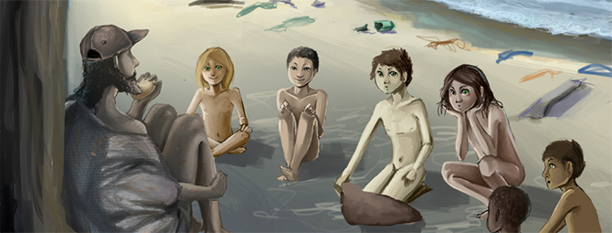
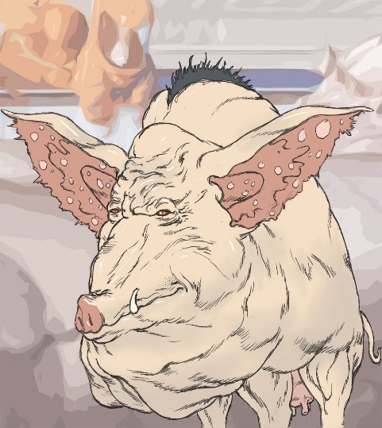
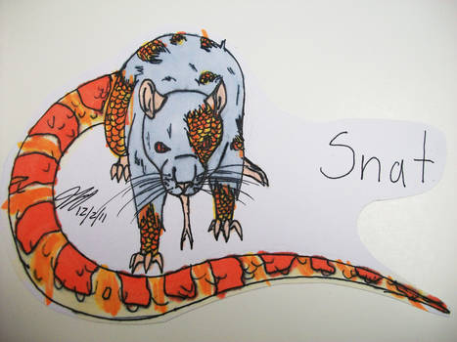
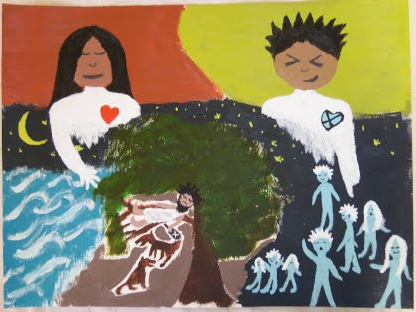
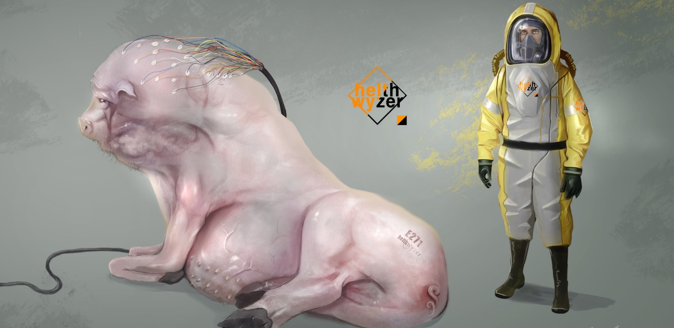
Oryx and crake

Slide 2
Learning outcomes
Explore literary works in detail
Analyze elements such as theme and ethical stance or moral values of literary texts
Understand and make appropriate use of literary terms

Slide 3
Rules for socratic seminar
#1. You must record your discussion [part of your grade will be based on how well you listen and respond to others]. [30 pts.]
- This means that you may NOT talk over anyone.
- This means that you must allow others to speak.
- This means that you must LISTEN.
- This means that in order to get a grade for today, I must hear you on the recording.
#2. You must SPECIFICALLY reference the novel FIVE TIMES (that means providing a specific page #(s) AND quote). [35 pts.]
**Remember: The ONLY reason we are discussing these hot topic issues is because it directly relates to the overall message of the novel. This should be discussed in your Socratic Seminar.
#3. You must SPEFICALLY reference the article(s) THREE TIMES. [35 pts.]
**Remember: The ONLY reason we are discussing these hot topic issues is because it directly relates to the overall message of the novel. This should be discussed in your Socratic Seminar.

Slide 4
Procedure:
STEP #1: Read AND ANNOTATE the articles assigned to your group.
STEP #2: Decide who will be in the inside circle & who will be in the outside circle. [I did this for you ☺.]
STEP #3: INSIDE CIRCLE INSTRUCTIONS:
You will talk for 15 minutes.
You must specifically reference the text 5 times.
You must specifically reference the article(s) 3 times.
STEP #4: OUTSIDE CIRCLE INSTRUCTIONS:
You must each “grade” one member of the inside circle.
On a separate sheet of paper, you will write the name of the person you are grading and will take specific notes on what he/she is saying in the inside circle.
In addition, you will comment on what he/she is saying by using the following prompts:
1. I agree but, ….
2. I disagree but. …
3. This reminded me of ….
4. This is important because …

Slide 5
Grouping:
Group #1: Power
Group #2: Human Relationships
LEADER: Aaron
Jada A. Jalyn
Llona Malana
Jessica Jermya
Alysha Cameron
Charlese KeAuri
Camille Fran
Jordynn Jamiah
LEADER: Garner
Caliya Michelle
Jada R. Oliver
T’Mia Shadarria
Dereck Shania
Keith Dom
Tyler April
Aleisha Deja

Slide 6
Socratic seminar group #1

Slide 7
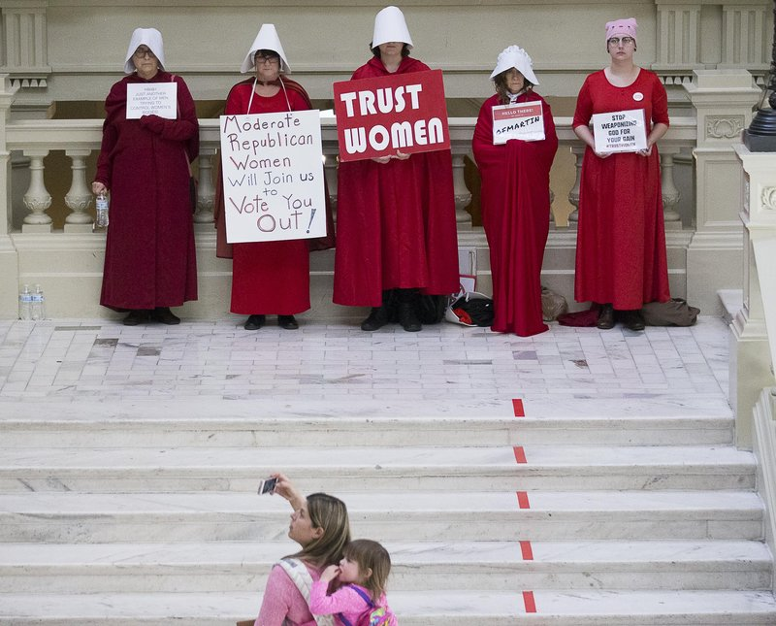
Margaret atwood & women

Slide 8
Read this:
Georgia Senate Passes ‘Heartbeat’ Abortion Ban Pill
http://time.com/5557435/georgia-senate-passes-heartbeat-abortion-ban-bill/
Women Are Not Ideas:
Oryx is the character with the most psychological strength. A passage details her experiences, beginning with when she was sold from her village into sex trafficking as a young girl, where she then survived by cooperating, stealing when possible and developing an impenetrable shell. Oryx is difficult to read, partly because she is so accustomed to acting, and partly because Jimmy and Crake each see her in their own, distorted fashion.
She made it to North America when she was purchased, with a group of other women, by a man who kept them all in his garage. Crake later tracks Oryx down through a computer algorithm designed to help people find prostitutes. He recruits her, both for her services and as a crucial partner in his genetic engineering project. Jimmy is also brought aboard for marketing purposes, and immediately falls for Oryx. The two begin an affair behind Crake’s back.
Neither Crake nor Jimmy are ever truly seeing Oryx as a person. Crake is inspired, viewing her as a spectacular model of what humanity could be, and a means to an end to achieve his goals. Jimmy sees Oryx as a beautiful thing, miraculously survived in the exotic world outside the compound walls.
Considering “The Handmaid’s Tale,” the choice to make the sole female main character in Oryx and Crake a distant enigma must be intentional on the part of Atwood, a way to wordlessly show how men often can’t get out of their own heads and see women as people on their own. Jimmy and Crake consider themselves her liberators, but Oryx is still performing the version of herself they each want to see.

Slide 9
Socratic seminar group #2

Slide 10
Margaret atwood & human trafficking

Slide 11
Read this:
Sex Trafficking & The Super Bowl NPR
https://www.npr.org/2018/02/02/582613447/sex-trafficking-and-the-super-bowl
Human Relationships:
One issue addressed in Margaret Atwood’s novel, Oryx and Crake, is the child sex slave trade. The sex trade, as represented in the novel, mirrors real life. Children often enter the business in much the same way. Parents sell their children, are promised their children will have a better life, away from the poverty they were born to. Child prostitution exists in countries such as Thailand, Bangkok, the Philippines, and other places worldwide. According to the ECPAT (End Child Prostitution in Asian Tourism) there are nearly one million children world wide involved in the child sex trade. Marketing tactics, such as postcards and brochures, aid in advertising the sex tours of children, making it more accessible to pedophiles world wide. Although many have spoken out against the trade, little is being done to stop it. One U.S. law that does seek to stop it enables the prosecution of a pedophile once they have returned to the country. Many argue that it is not enough. With increased access internationally to the child sex trade, it does not appear that the business will be dying down anytime soon. As boys, Jimmy and Crake watch child porn sites, once spotting a girl who is alluring to both of them. Many years later the girl Oryx, from that site, comes into their lives. She relates her story to Jimmy— sold to her “employer,” leaving her village, being taken into the city to immerse her into the sex trade. Her life revolves around this for many years.

Slide 12
Homework #1:
Print and complete the Socratic Seminar Reflection. This document is on the website. Due Thursday!

Slide 13
Homework #2:
Be prepared to teach the class about your question on Thursday.

Slide 14
a2

Slide 15
Homework instructions
Analyze the text using the question provided to you [your name is at the top of one of the slides].
Discuss the question with your partner.
Find AT LEAST THREE examples in the text to support your analysis [be sure to jot down the page #].
Discuss how this analysis contributes to the overall theme of the text.
Discuss how this analysis shows character development.
Discuss why this question is important as we study for our IOC.
Access the “Shared Knowledge” Google PPT. Add a slide and input your analysis. You can add as many slides as you need.
You must provide specific quotes in the text [must include page #]
You must go into explicit detail when answering your question.
Please put enough information onto your slide so that if anyone is absent, they will be able to get all of the same information.
Be prepared to discuss your slide with the class on Thursday 03/28.
Presentations should be 5 minutes [no more, no less].

Slide 16
Jasmin
In Oryx and Crake, Margaret Atwood shows what can happen when big corporations and scientists are no longer governed by ethics and morals.
Argue that this is a cautionary tale designed to inform and warn readers.

Slide 17
Max
By examining the websites Jimmy and Crake explore in the novel and the video games they play argue that Atwood uses speculative fiction to voice her concerns about contemporary culture: specifically the mainstreaming of violence and pornography into mass culture.

Slide 18
Keyvon
The game “Extinctathon” emerges as a key component in the novel. Jimmy and Crake also play “Barbarian Stomp” and “Blood and Roses.” Comparable video games exist today. What are those games. What is your opinion of such games and those who play them. Are they a sign of a desensitized society or merely harmless fun?

Slide 19
chrishya
Crake’s destruction of humanity can be traced back to his formative years.
What do you find in his childhood and in his time at university that hints at his plans for humanity?

Slide 20
kelsey
The pre-catastrophic society in Oryx and Crake is fixated on physical perfection and longevity, much as our own society is. Discuss the irony of these quests, both within the novel and in our own society.

Slide 21
Noah
One aspect of the novel's society is the virtual elimination of the middle class. Economic and intellectual disparities, as well as the disappearance of safe public space, allow for few alternatives: People live either in the tightly controlled Compounds of the elites, or in the more open but seedier and more dangerous Pleeblands.
Where would your community find itself in the world of Oryx and Crake?

Slide 22
pili
Snowman soon discovers that despite himself he's invented a new creation myth, simply by trying to think up comforting answers to the "why" questions of the Children of Crake.
In Part Seven-the chapter entitled "Purring"-Crake claims that "God is a cluster of neurons," though he's had trouble eradicating religious experiences without producing zombies. Do you agree with Crake? Do Snowman's origin stories negate or enhance your views on spirituality and how it evolves among various cultures?

Slide 23
julia
How might the novel change if narrated by Oryx?
Do any similarities exist between her early life and Snowman's?
Do you always believe what she says?

Slide 24
jayla
In the world of Oryx and Crake, almost everything is for sale, and a great deal of power is now in the hands of large corporations and their private security forces. There are already more private police in North America than there are public ones. What are the advantages of such a system? What are the dangers?

Slide 25
ayele
a phrase, quotation, or poem that is set at the beginning of a document or component.
The book has two epigraphs, one from Jonathan Swift's Gulliver's Travels and one from Virginia Woolf's To the Lighthouse.
Why do you think these were chosen?
What purpose do they serve?

Slide 26
ty
The ending of the novel is open, allowing for tantalizing speculation. How do you envision Snowman's future?
What about the future of humanity—both within the novel, and outside its pages?

Slide 27
a3

Slide 28
Homework instructions
Analyze the text using the question provided to you [your name is at the top of one of the slides].
Discuss the question with your partner.
Find AT LEAST THREE examples in the text to support your analysis [be sure to jot down the page #].
Discuss how this analysis contributes to the overall theme of the text.
Discuss how this analysis shows character development.
Discuss why this question is important as we study for our IOC.
Access the “Shared Knowledge” Google PPT. Add a slide and input your analysis. You can add as many slides as you need.
You must provide specific quotes in the text [must include page #]
You must go into explicit detail when answering your question.
Please put enough information onto your slide so that if anyone is absent, they will be able to get all of the same information.
Be prepared to discuss your slide with the class on Thursday 03/28.
Presentations should be 5 minutes [no more, no less].

Slide 29
Jordynn, camille
In Oryx and Crake, Margaret Atwood shows what can happen when big corporations and scientists are no longer governed by ethics and morals.
Argue that this is a cautionary tale designed to inform and warn readers.

Slide 30
Jada a., malana
By examining the websites Jimmy and Crake explore in the novel and the video games they play argue that Atwood uses speculative fiction to voice her concerns about contemporary culture: specifically the mainstreaming of violence and pornography into mass culture.

Slide 31
Llona, jermya
The game “Extinctathon” emerges as a key component in the novel. Jimmy and Crake also play “Barbarian Stomp” and “Blood and Roses.” Comparable video games exist today. What are those games. What is your opinion of such games and those who play them. Are they a sign of a desensitized society or merely harmless fun?

Slide 32
Jalyn, aaron
In the novel Atwood describes a world where science is important and the arts are not valued except as a way to sell things. Nevertheless, the names of things seem very important. Examine the names of various things you found intriguing in the novel and explain why they are so effective and if you like, compare to product names today.

Slide 33
Jada r., caliya
Crake’s destruction of humanity can be traced back to his formative years. What do you find in his childhood and in his time at university that hints at his plans for humanity?

Slide 34
Fran, taylor
The game "Extinctathon" emerges as a key component in the novel. Jimmy and Crake also play "Barbarian Stomp" and "Blood and Roses."
What comparable video games do you know of? What is your opinion of arcades that feature virtual violence? Discuss the advantages and dangers of virtual reality. Is the novel form itself a sort of virtual reality?

Slide 35
Keith, dereck
The pre-catastrophic society in Oryx and Crake is fixated on physical perfection and longevity, much as our own society is. Discuss the irony of these quests, both within the novel and in our own society.

Slide 36
Alysha, Jessica
One aspect of the novel's society is the virtual elimination of the middle class. Economic and intellectual disparities, as well as the disappearance of safe public space, allow for few alternatives:
People live either in the tightly controlled Compounds of the elites, or in the more open but seedier and more dangerous Pleeblands. Where would your community find itself in the world of Oryx and Crake?

Slide 37
Charlese, tyler
Snowman soon discovers that despite himself he's invented a new creation myth, simply by trying to think up comforting answers to the "why" questions of the Children of Crake.
In Part Seven-the chapter entitled "Purring"-Crake claims that "God is a cluster of neurons," though he's had trouble eradicating religious experiences without producing zombies. Do you agree with Crake? Do Snowman's origin stories negate or enhance your views on spirituality and how it evolves among various cultures?

Slide 38
Deja, taylor o., Michelle
How might the novel change if narrated by Oryx?
Do any similarities exist between her early life and Snowman's?
Do you always believe what she says?

Slide 39
Shadarria, jamiah
In the world of Oryx and Crake, almost everything is for sale, and a great deal of power is now in the hands of large corporations and their private security forces.
There are already more private police in North America than there are public ones. What are the advantages of such a system? What are the dangers?

Slide 40
Aleisha, keAuri, cameron
In what ways does the dystopia of Oryx and Crake compare to those depicted in novels such as Brave New World, 1984, Fahrenheit 451, and in Atwood's The Handmaid's Tale?
What is the difference between speculative fiction—which Atwood claims to write—and science fiction proper?

Slide 41
April, t’mia
a phrase, quotation, or poem that is set at the beginning of a document or component.
The book has two epigraphs, one from Jonathan Swift's Gulliver's Travels and one from Virginia Woolf's To the Lighthouse.
Why do you think these were chosen?
What purpose do they serve?

Slide 42
Dom, shania
The ending of the novel is open, allowing for tantalizing speculation. How do you envision Snowman's future?
What about the future of humanity—both within the novel, and outside its pages?

