Slide 1
How does fear manipulate people?
Comparing “The masque of the red death” & “The legend of sleepy hollow”

Slide 2
The masque of the red death
How does fear manipulate people in the text and affect the plot?
How does wealth motivate people in the text?
How is this story an allegory?

Slide 3
ABOUT THE STORY:

Slide 4
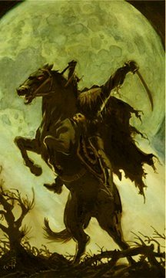
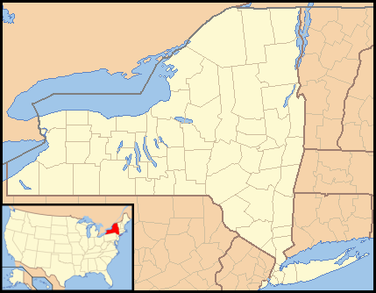
The story is set in a Dutch settlement called Tarrytown, New York, in the lonely, secluded valley (glen) of Sleepy Hollow.

Slide 5
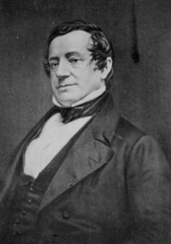
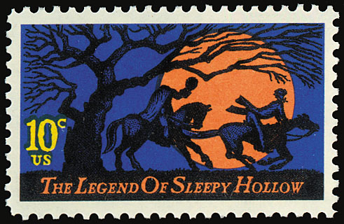
The story was written by Washington Irving and published in 1820. At the time that he wrote the story, Irving was living in Birmingham, England, but he had visited Tarrytown and Sleepy Hollow which are villages that sit beside the Hudson River in New York.
Irving also wrote “Rip Van Winkle” which is a famous story that takes place in the Catskill Mountains of New York.
There is even a stamp
commemorating the story.

Slide 6
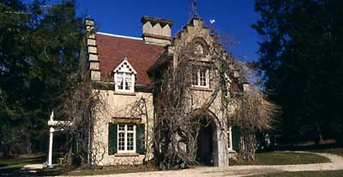
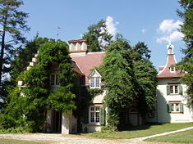
Irving eventually bought a home about 3 ½ miles away from the Old Dutch Church. It had belonged to a Dutch farmer. In June 1835 Irving acquired Sunnyside, a 10-acre estate that lies along the Hudson River, for $1800.

Slide 7
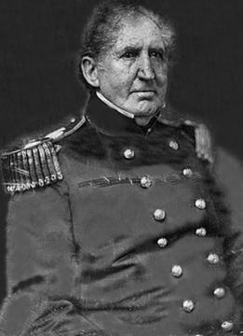
“The Legend of Sleepy Hollow” is a short story that tells the story of an extremely superstitious schoolmaster from Connecticut. The name of the character was taken from an army colonel that Irving had met, but that is where the similarity ends. Colonel Crane was a stout, strong man. The character of Ichabod doesn’t possess any of these qualities.

Slide 8
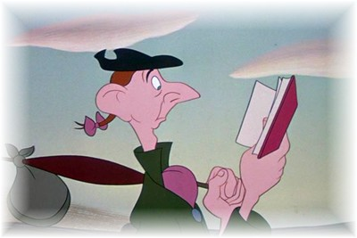
It is rumored that Colonel Crane was extremely upset with the depiction of his namesake. After publication he reprimanded Irving for the character that carried his name. The physical description of Ichabod Crane in the story, however, is taken from a Revolutionary War veteran, Samuel Youngs. Youngs, a resident of Tarrytown, became a teacher after the war. It is said that Youngs was lean, lanky, and superstitious, just as the protagonist in Irving’s famous tale.
Disney’s depiction of Ichabod Crane
Even though he is no great hero, Ichabod is seen by some as feeling somewhat superior to the residents of Tarrytown. Many believe that he felt that his education made his more worthy than the people of Tarrytown.

Slide 9
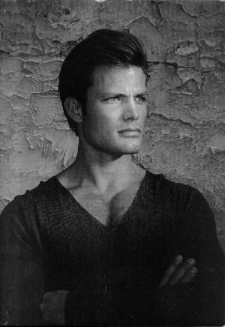
Abraham “Brom Bones” Van Brunt is the antagonist in the story. He is the “town rowdy” who is in love with the same girl that Ichabod loves. The 18-year-old Katrina Van Tassel is the object of both men’s affection. Brom Bones is a very dominating character; when he enters the room, people notice. He is also portrayed as a playful practical joker who doesn’t really wish to harm anyone.
He was ready for either a fight or a frolic; but had more mischief than ill-will in his composition; and, with all his overbearing roughness, there was a strong dash of waggish good humor at bottom.
- from The Legend of Sleepy Hollow
Casper Van Dien played Brom Bones in the 1999 version of the movie.

Slide 10
Katrina Van Tassel is the beautiful 18-year-old girl that both Brom Bones and Ichabod love. Katrina is the daughter and sole heir of a wealthy farmer. The name was drawn from a deceased resident of Sleepy Hollow, Catriena Ecker Van Tessel. The description of Katrina was taken from Catriena’s niece, Eleanor Van Tassel Brush. Prior to Ichabod’s arrival in town, Katrina had been Brom’s girlfriend.
Katrina was played by Christina Ricci in the 1999 version of the story.

Slide 11
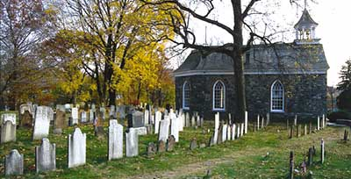
The denouement (conclusion) of the story occurs at a bridge that crosses the Pocantico River. It is near the Old Dutch Church and Burying Ground in Sleepy Hollow.
Old Dutch Church and Burying Grounds
Headless Horseman Bridge

Slide 12
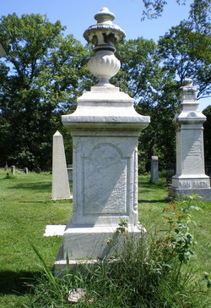
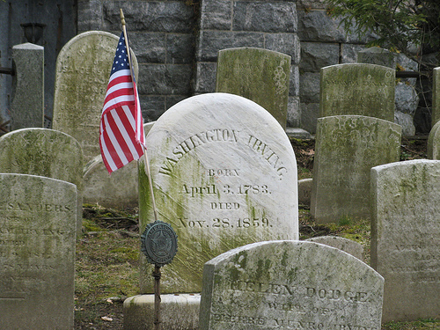
Sleepy Hollow Cemetery is the resting place of people made famous because of the story. The inspiration for Katrina, Eleanor Van Tassel Brush (1763-1861), lies next to the inspiration for Brom Bones, Abraham Martling(1741-1779). Washington Irving(1783-1859) rests in the south corner of the cemetery overlooking the setting of his best known story.
Gravesite of Eleanor
Gravesite of Washington Irving

Slide 13
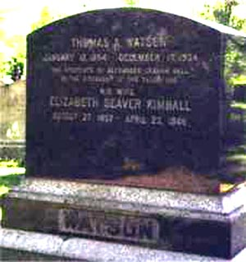
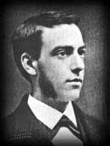
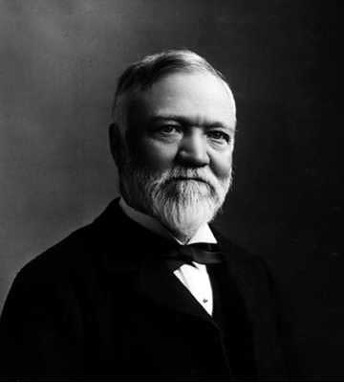
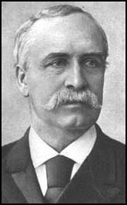
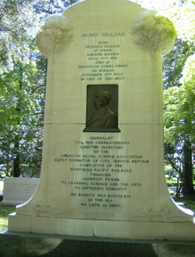
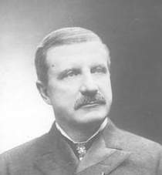
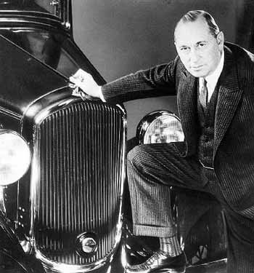
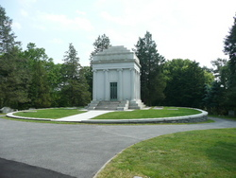
Several other famous people also rest in Sleepy Hollow cemetery which also contains the graves of 70 Revolutionary War soldiers.
Thomas Watson – Created IBM
Andrew Carnegie (1835-1919) A well-known business and philanthropist
Walter Chrysler (1875-1940) Industrialist, commissioned the Chrysler Building
William Rockefeller )1841-1922) Noted businessman, head of Standard Oil Company
Henry Villard – Organized General Electric Company

Slide 14
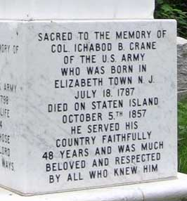
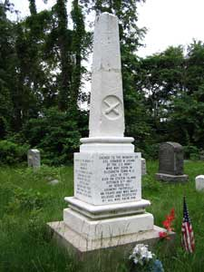
Colonel Ichabod Crane’s grave is located in Staten Island.

Slide 15
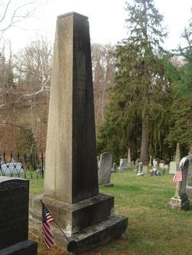
Samuel Youngs, inspiration for Ichabod’s physical appearance and mannerisms, was originally buried in the churchyard of the Old Dutch Church of Sleepy Hollow, the setting for “The Legend of Sleepy Hollow.” He was moved, however, to Ossining in 1851 when the administrators of the Dale Cemetery wished to have a “notable citizen” to grace their new cemetery.

Slide 16
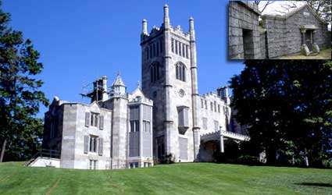
“The Legend of Sleepy Hollow” is not the only tale that was used Sleepy Hollow as its setting. In the 1960’s there was a television series called Dark Shadows set at Lyndhurst in Tarrytown. In the series, this castle served as the Collinwood estate in the full-length film, House of Dark Shadows.

Slide 17
In the story, Ichabod is said to be rather popular among the ladies because he is a “man of letters.” (This meant he had an advanced education.) He was a school teacher. Remember that education in this time was a luxury; therefore, anyone having an advanced education was seen as enviable. He would often stroll with “country damsels” along the banks of the mill pond.
“Country bumpkins” would hang back and watch Ichabod on these strolls. They envied Ichabod’s popularity with the ladies. (Conflict)

Slide 18
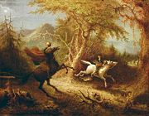
The climax of the story begins as Ichabod leaves a party at the Van Tassel house on a windy autumn night. He is upset for he has just discovered that Katrina danced with him in an effort to make Brom Bones jealous. As he rides home, he is suddenly pursued by what is supposedly the ghost of a Hessian trooper or soldier. (Hessian soldiers were from German states and fought in the American Revolution.)

Slide 19
According to legend the soldier had lost his head, literally, when a stray cannon ball had struck him. “The ghost rides forth to the scene of the battle in nightly quest of his head…the rushing speed with which he sometimes passes along the Hollow, like a midnight blast, is owing to his being belated, and in a hurry to get back to the church-yard before daybreak.”

Slide 20
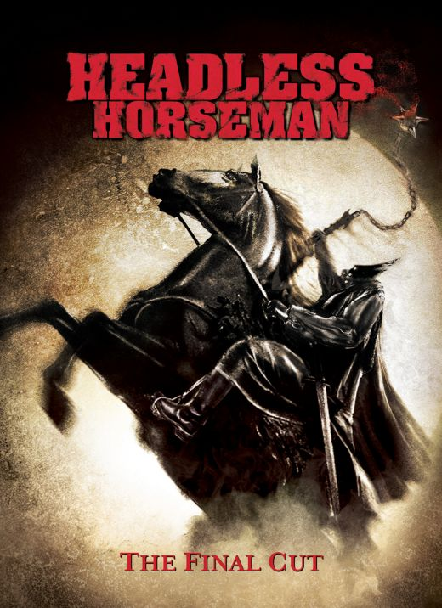
The next day Ichabod’s horse was found wandering in a pasture, but Ichabod was never seen again. There are rumors that he is dead; others say he is too terrified to return to Sleepy Hollow. Brom Bones reportedly smiles when the story of Ichabod’s disappearance is told. Does this mean he posed as the headless horseman to rid Tarrytown of his only competition for the fair Katrina? By the way, Katrina and Brom were married after Ichabod’s disappearance.

Slide 21
Impact of the Story
Sleepy Hollow, Illinois, was named for the famous story. There are also streets in this town named after some of the characters: Van Tassel Drive, Ichabod Lane, etc.

Slide 22
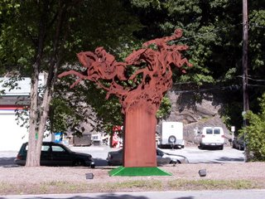
Further Impact
A large statue depicting the headless horseman was placed along Route 9 in Sleepy Hollow/Tarrytown, New York, in 2006.

Slide 23
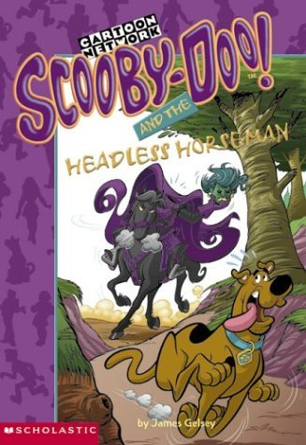
More Impact
The Scooby-Doo series had an episode and a book that made allusions to the famous story by Washington Irving.

Slide 24
Further Impact
The Real Ghostbusters was the second cartoon series to rely on the story. In the episode, Ichabod’s great-great-granddaughter tells the story of Ichabod’s escape from the horseman. After starting a family, however, Ichabod and his descendants are still haunted by the headless ghost…with a twist. The ghost now rides a motorcycle. Obviously, the Ghostbusters take care of the irritating motorcyclist.

Slide 25
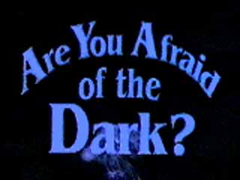
More Impact
In the Are You Afraid of the Dark series, the writers crossed the story of Paul Revere with that of Washington Irving.
Ian Matthews, a teenager, moves to Sleepy Hollow where he meets a new girlfriend, the town tough guy, and the notorious headless horseman. Ian soon learns that the folktale is not just a legend.

Slide 26
The story:
https://www.ibiblio.org/ebooks/Irving/Sleepy/Irving_Sleepy.pdf

Slide 27
Reading comprehension questions:
Look at the word document on the website!

Slide 28
Questions to consider:
Contrast Ichabod Crane and Brom Bones. How are they different in physical appearance? How are their actions different? What would have made Katrina attracted to each of them?
What evidence is there that Ichabod Crane had an active imagination?
What role do Katrina’s parents play in her life? What is her father’s attitude toward his wealth? What is his attitude toward his daughter? What is Katrina’s mother’s attitude toward her?
What does the illustration on page 27 show about Ichabod? What other characters are pictured? How can you tell?

Slide 29
Escape room-
On a separate sheet of paper, write down the answers to each lock.

Slide 30
What horror films teach us about ourselves and being human-
BE PREPARED TO DISCUSS W/THE CLASS!

