Slide 1
The Road pgs: 239-260
By Chrishya Simmons

Slide 2
Summary:
The man and the boy have found a boat on the beach filled with supplies. The boy gets sick and the man cares for him. While he is taking care of the boy a thief comes and steals all of their stuff off of the beach. The man threatens the thief and the boy shows compassion to him.

Slide 3
Thematic Concepts

Slide 4
Themes
Strength & Skills
Family
Love

Slide 5
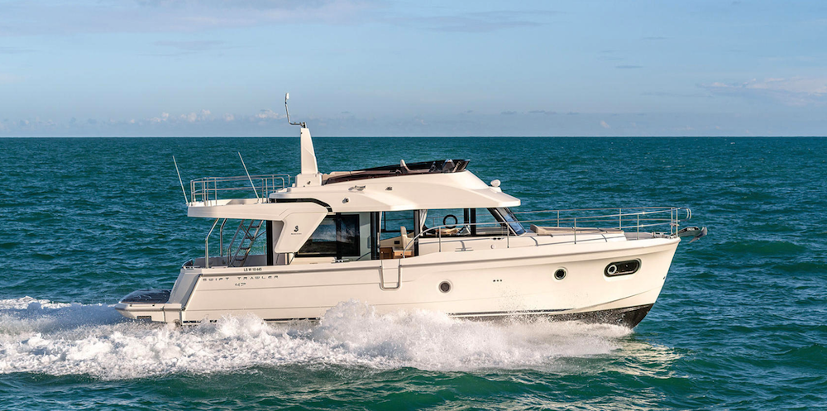
Quotes: Strength & Skills
“He was about to get up again when he realize that he’s been looking at the fasteners in the bulkhead on the far side of the cockpit they were four of them stainless steel at one time the Ventis had been covered with cushions and he could see the ties at the corner where they ripped away at the bottom center of the bulkhead just above the seat there was a nylon strap sticking out…..” pg. 239.
“He fixed dinner while the boy played in the sand. He had a spatula made from a flattened food tin and with it he build a small village” pg. 244
The man shows his knowledge of the boat and how to survive if he were out at sea.

Slide 6
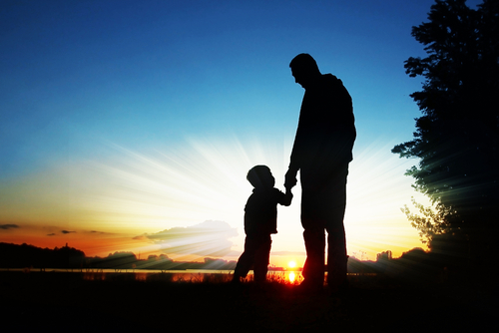
Quotes: Family
“He cupped the boy’s forehead in his hand. He was burning he picked him up and carried him to the fire. It’s OK he said. You’re going to be ok.” pg. 247
The man shows his love for the boy by taking care of him.

Slide 7
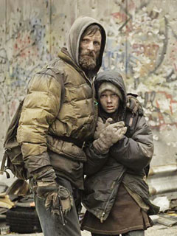
Quotes: Love
“He held him all night, dozing off and walking in tear, feeling for the boys heart. In the morning he was no better. He tried to get him to drink some juice but he would not. He pressed his hand to his four head, conjuring up a cool Ness that would not come. He wiped his white mouth while he slept. I will do what I promised, he whispered. No matter what. I will not send you into the darkness alone.” pg. 248
Here we can see the man’s love for the boy and his hesitancy to leave him.

Slide 8
Motifs & Symbols

Slide 9
Motifs & Symbols
Hope
Violence
Good v. Evil

Slide 10
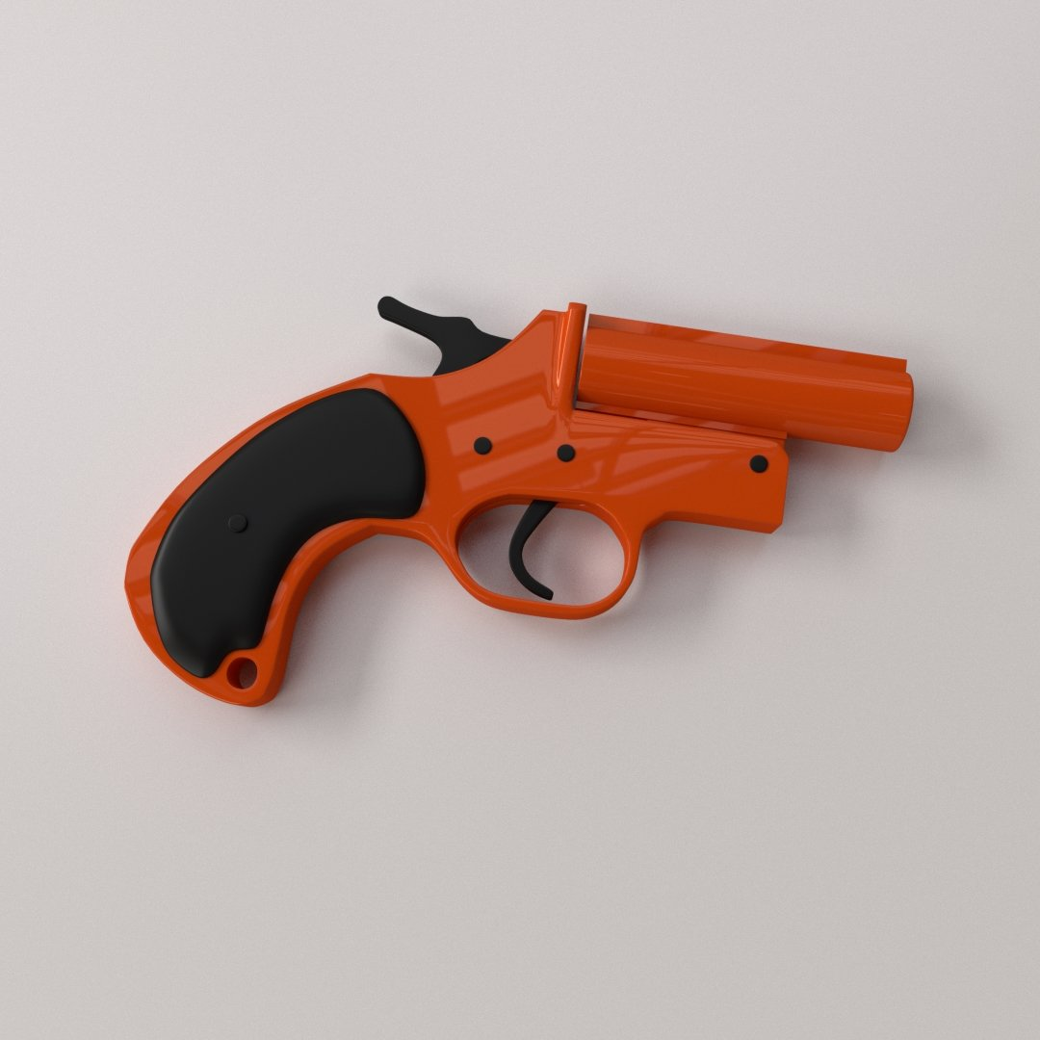
Quotes
Hope
The boy wants to light the flares like a celebration and he believes that they can signal to his others.
“A flaregun” pg. 241

Slide 11
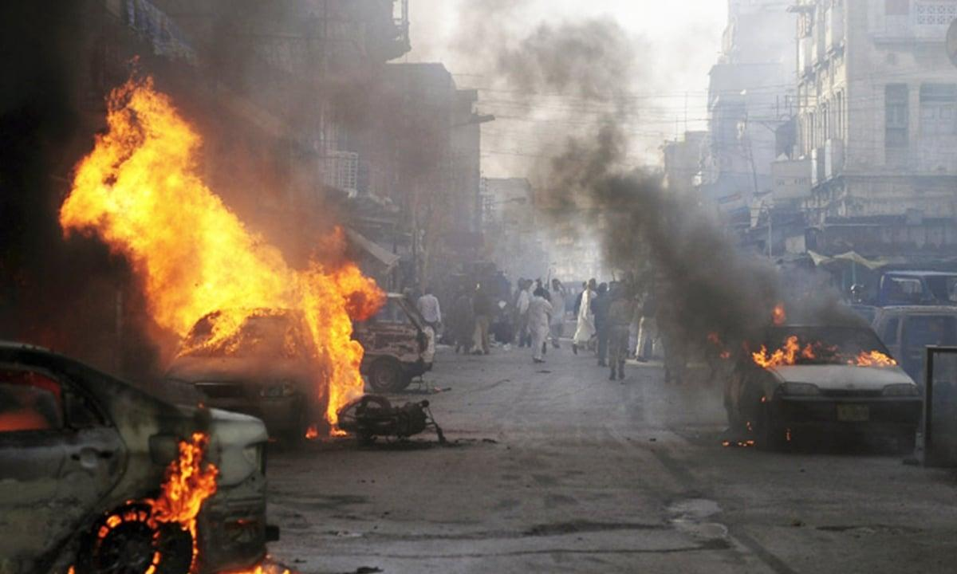
Quotes
“ The boy lifted the gun from the case and held it. Can you shoot somebody with it? he said.” pg. 241
“If you don’t put down the knife and get away from the cart, the man said, I’m going to blow your brains out.” pg. 257
Violence
The man is very aggressive when protecting himself and the boy. The man tells the boy how to use their new discovery as a weapon.

Slide 12
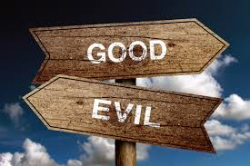
Quotes
“He thought about the boy and his concerns and after a while he said: you’re probably right. I think they’re probably dead. Because if they were alive we be taking their stuff. And we’re not taking their stuff. I know. Ok.” pg. 243
“Can you write something in the sand? Maybe we could write a letter to the good guys. So if they came along Dave know we were here. We could ride it up there where it wouldn’t get washed away. What if the bad guys saw it?” pg. 245
Good v. Evil
The idea of bad guys have continuously stopped the boy from doing normal childhood things.The man and the boy also struggle with knowing whether they are the good guys or the bad guys.

Slide 13
Literary Devices

Slide 14
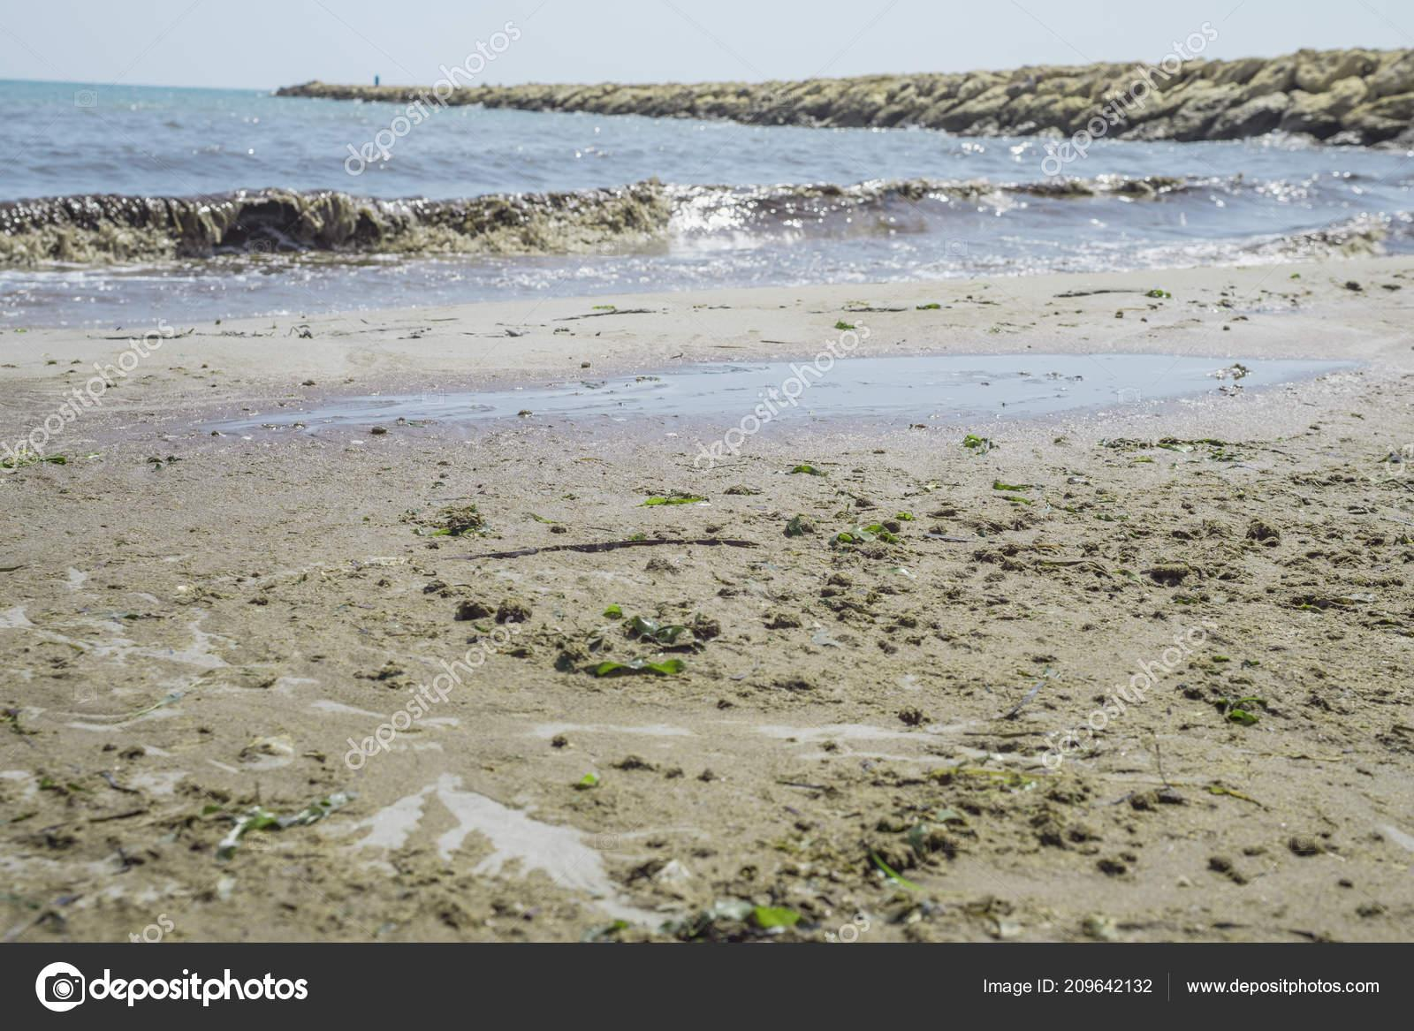
“The hot tendrils of magnesium drifted slowly down the dark in the pale foreshore tide started in the glare and slowly faded.”

Slide 15
Important Subjects

Slide 16
Subjects
Compassion
Spirituality/ Morality
Isolation

Slide 17
Quotes
“Where do you think the people went papa? That run the ship? Yes. I don’t know. Do you think they died? I don’t know.” pg. 242 (isolation)
“They couldn’t see very far,could they, Papa? Who? Anybody. No. Not five. If you wanted to show where you were. You mean like to the good guys? Yes. Or anybody that you wanted them to know where you were. Like who? I don’t know. Like God? Yeah. Maybe somebody like that.” pg. 246 (spirituality)
“Are we going to kill them? I don’t know.” pg. 255 (morality)
“Papa please don’t kill the man. The thief’s eyes swung wildly. The boy was crying. Come on, man. I done what you said. Listen to the boy.” pg. 256 (compassion)

Slide 18
Discussion Questions

Slide 19
Questions
What does The Road ultimately suggest about good and evil? Which force seems to have greater power in the novel?
What makes the relationship between the boy and his father so powerful? How do they maintain their affection for and faith in each other in such brutal conditions?
How is McCarthy able to make the postapocalyptic world of The Road seem so real and utterly terrifying? What do you find to be the most horrifying features of this world and the survivors who inhabit it?
“The characters of a novel can only be individualized if they are set in a background of particularized time and place.” How important is the setting of a particular time and/or place to the development of the characters? Refer in detail to at least two novels or short stories.

