Slide 1
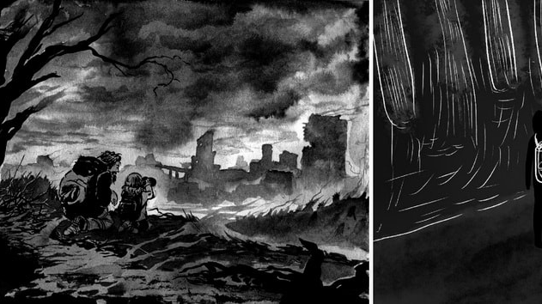
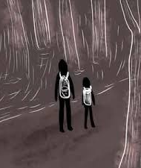
The Road Pgs. 261-287
Shania Wade

Slide 2
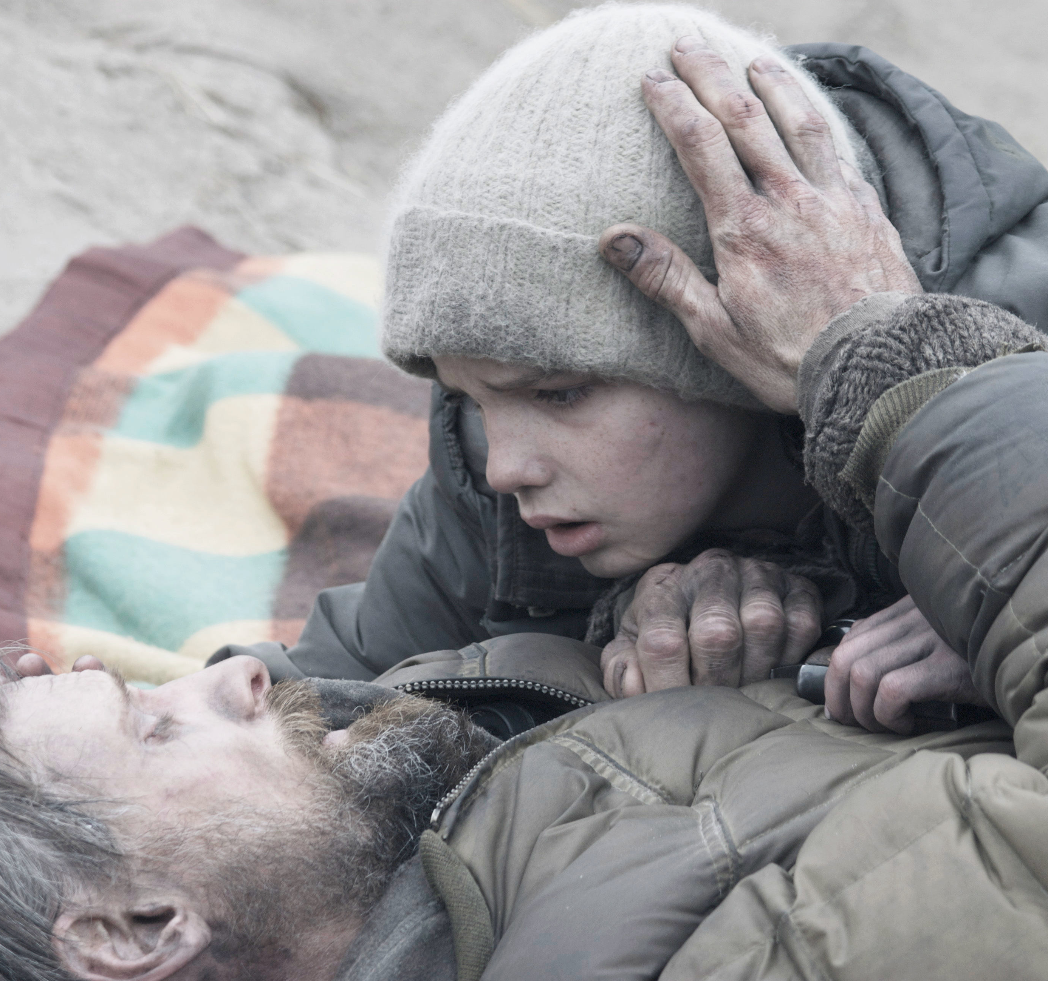
The End
We’ve made it towards the end of the book, same as how the man has made it to the end of his journey. In these last few pages of The Road, the man and boy’s roles shift. The man can no longer hide that he is dying and tells the boy he has to keep moving South without him.

Slide 3
Thematic Concepts

Slide 4
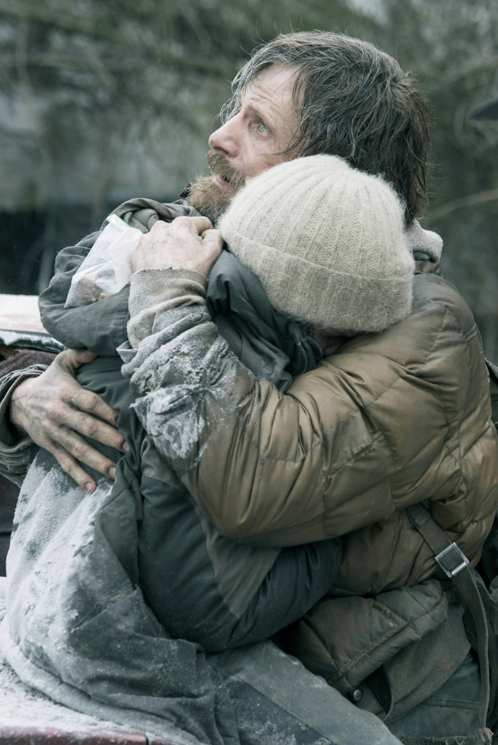
Family Bond
Throughout the book, the bond between father and son is the only love and bond shown. Especially since the father is on the brink of death, it causes the love to become very relevant. The boy doesn’t want his father to leave him all alone, even though the man believes he can handle himself.
“You’re going to be okay Papa. You have to…I want to be with you” (278)
“Just take me with you. Please… You said you wouldn’t ever leave me” (279)

Slide 5
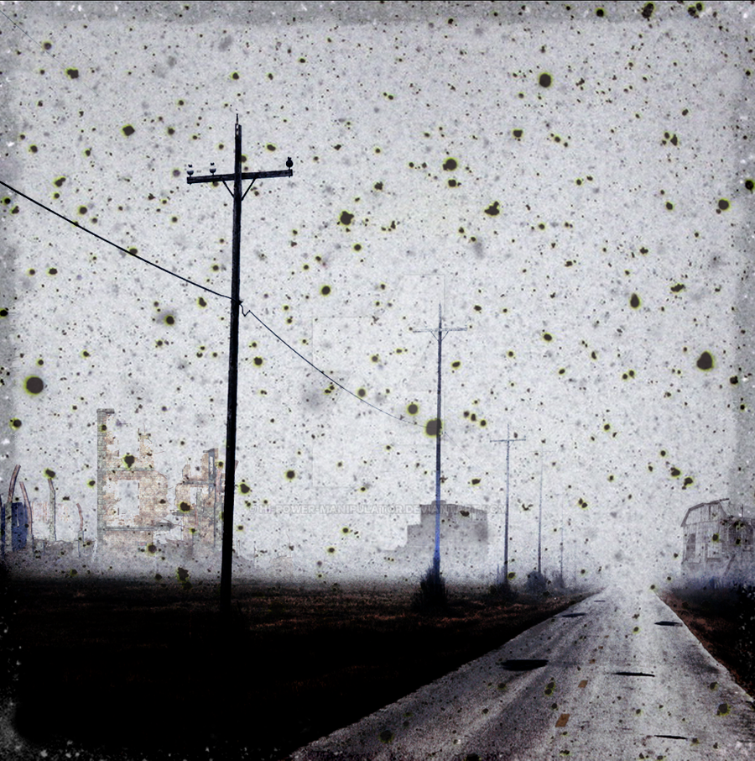
Coming of Age
From the beginning of the book to now, the boy has matured. Instead of the man, he is now going to search for food, carrying the pistol, and the man is telling him to continue their journey to the South by himself.
“You need to keep going…It’s all right.” (278)
“He went up the road and come dragging back a piece of plywood from the roadside…but he came back emptyhanded” (278)

Slide 6
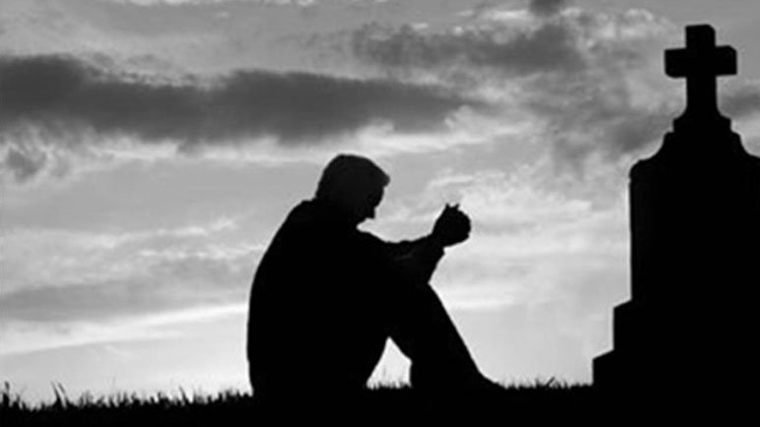
Death/Grief
The Road is set in a post-apocalyptic world, so of course death is an obvious concept. The book foreshadowed the man’s death within the first pages of the book. Now, the man has died and left the boy to continue the journey, despite the boy pleading for the man to take him with him.
“He slept close to his father that night and held him but when he woke in the morning his father was cold and stiff” (281)
“When he came back…back the way he had come” (281)

Slide 7
Symbols

Slide 8
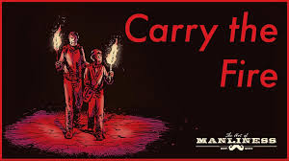
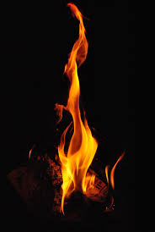
Fire
Carrying the fire, is repeated many times throughout The Road. The fire represents light and hope for the man and the boy. Even on his death bed, the man tells the boy to continue to carry the fire, and look for other people for carry fire.
“You have to carry the fire…Is it real? The fire” (278)
“Are you carrying the fire…Yes” (283)

Slide 9
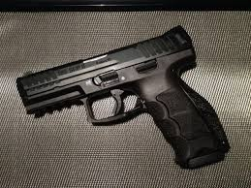
Pistol
The gun represents protection and safety for the man and the boy. It’s not used until the end when the man is attacked by the man with a bow and arrow. Later it’s passed down to the boy for his own protection.
“The boy tried to hand him the pistol but he wouldn’t take it. You hold onto that” (285)
“He had the pistol in the pocket of his coat and carried the flaregun in his hand” (262)
“Keep the gun with you at all times” (278)

Slide 10
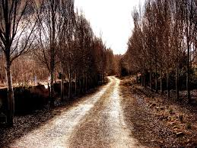
The Road
The road is a symbol for the journey the man and boy are on to make it to the South. Even after the man’s death, the boy continues his journey with a new family, just like his father wanted.
“You need to go on…You don’t know what might be down the road” (278)
“Keep going South. Do everything the way we did it” (278)

Slide 11
Motifs

Slide 12
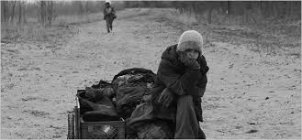
The South
The South represents hope. Before the father dies he tells the boy to keep moving South and make sure he gets there.
“Keep going South” (278)

Slide 13
Literary Devices

Slide 14
Repetition
Imagery
McCarthy repeats the word “dead” to emphasize the nature and setting of the post-apocalypse.
“A dead swamp. Dead trees standing out of the gray water…” (274)
“They’d begun to come upon dead windfalls of pine trees…” (274)
The Road is a very detailed book. McCarthy does not give characters names so readers can focus on the descriptions and details given for us to further connect with book.
“He got up and walked out to the road…The earth itself contracting with the cold” (261)
“They walked out on the pier… (261)

Slide 15
Foreshadowing
The man foreshadowed the boy meeting other “good” guys when he said to make sure to find other people who “carry the fire”.
“You need to find the good guys but you can’t take any chances” (278)

Slide 16
Important Subjects

Slide 17
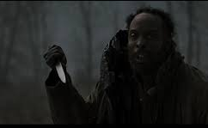
Violence
There was a lot of violence in The Road, but the man and boy were not directly affected until the end. The man was shot in the leg with an arrow, which caused him to shoot the bow and arrow man with his flare gun, killing him.
“He heard the dull thwang of the bowstring and felt a sharp hot pain in his leg” (263)
“The flare went rocketing up toward the window in a long white arc and then they could hear the man screaming” (263)

Slide 18
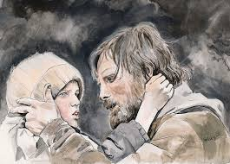
Love
The love between the man and boy is what kept both of them going post- apocalypse. While the father is dying the son wants to go with him, the man refuses and says he could never hold his dead son in his arms. This shows how the man was the boy’s rock and how the man loves his son so much that he could never harm him, even if it is to put him out of his misery.
“I’m sorry I yelled at you… Let’s start over” (267)
“Just take me with you…You always were” (279)
“What about my papa…Could we cover him with one the blankets?” (285)

Slide 19
Strength and Skills
The boy has matured to the point where he is now searching for food and carrying the pistol. He is more cautious about who he wants to help and is less naïve about being a “good” guy.
“He started to turn around and go back into the woods but he didn’t. He just stood in the road and waited, the pistol in his hand” (281)
“He went up the road and come dragging back a piece of plywood from the roadside trash…emptyhanded” (278)

Slide 20
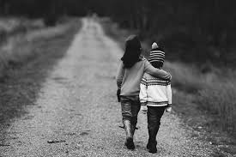
Compassion
The hopeful ending was surprising considering there was no compassion shown for anyone on the road throughout the book. The boy found a family willing to take him in and who also “carries the fire”, just like what the man told him to look for.
“Goodness will find the little boy. It always has. It always will” (281)
“Where’s the man you were with…I think you should come with me” (282)
“Could we cover him with one of the blankets…Okay” (283)
“Will you be alright…he was crying and couldn’t stop” (286)

Slide 21
Discussion Questions

Slide 22
Why has McCarthy chosen a plot twist with a hopeful ending, but avoided the sense of hope throughout the novel?
To what extent has McCarthy gone to create interesting characters whose thoughts remain hidden?
How has The Road portrayed psychological, physical, or some other kind of violence?
Why hasn’t McCarthy stated what cause the apocalypse?
How did McCarthy manage to control our sympathy while reading The Road?
Do the characters find any meaning to their lives?

