Slide 1
A2 Grouping:
Jasmin, Pili, Chrishya, Ayele
Kelsey, Max, Jayla, Julia
Fran, Ty, Keyvon, Noah

Slide 2
A3 Grouping:
Jada A., Llona, Jessica, Shadarria
Jalyn, Caliya, Jada R., Jermya, Cameron
Dereck, Deja, Dom, T’Mia
Taylor G., Alysha, Jordynn, KeAuri
Aaron, Charlese, Camille, Keith
Malana, Jamiah, April, Taylor O.
Aleisha, Michelle, Tyler, Shania

Slide 3
First 25:
Which social groups are marginalized, excluded or silenced within the text?
Write an introduction with a theme statement, then a ten to twelve sentence explanation of which social groups are marginalized, excluded or silenced within the text.

Slide 4
Homework:
Read a partner’s First 15 paragraph.
Using the Written Task #2 rubric, give specific feedback for improvement.
Be prepared to discuss with your partner on Friday.

Slide 5
DP Language & Literature
Unit 02; Session 03- The Language of War

Slide 6
The Language of War
War is a practical, tangible use of power, but what about the language of war? How is language used to exert or challenge power?

Slide 7
Agenda
Goals: 1 min.
Review: 5 min.
Intro Activity: 10 min.
Key Terms: 2 min
Case Study #1: 15 min
Case Study #2: 15 min
Analysis: 10 min.
Conclusion: 10 min.

Slide 8
Goals
Know: key persuasive techniques, including: euphemism, dysphemism and more...
Understand: that grammatical choices limit or enhance the impact of violence on the public
Be able to: analyze a media text to find examples of the key terms listed above

Slide 9
Review
power
public discourse
interpersonal discourse
Instrumental
influential
With your group, revise the different key terms relating to power from the last session and think of some examples of each ‘type’ of power.

Slide 10
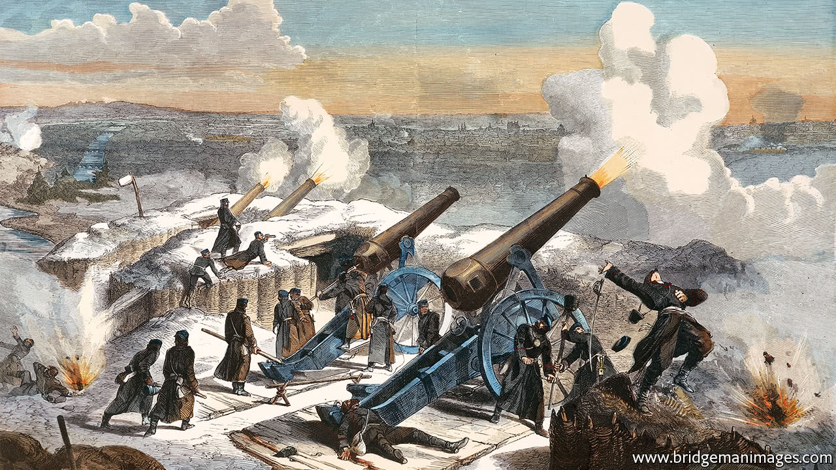
Introduction
Watch this news report.
The video is about a physical or practical use of power. But what about the language that is used to report on the event?

Slide 11
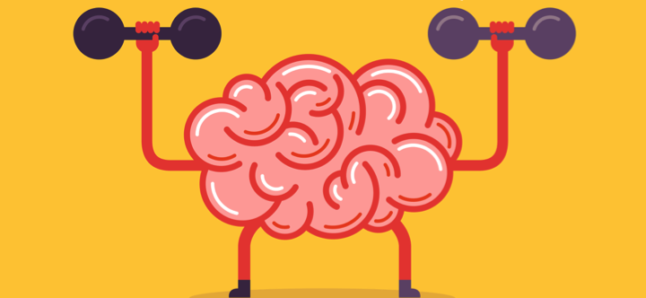
Key Terms
Look up the following key terms and add them to your Quizlet key terms card set. Try and include an example with each one (if applicable).
bias
dysphemism
euphemism
epithet
hyperbole
glittering generality
idiom (idiomatic expression)
proverb
emotive language

Slide 12
Bias
Prejudice in favor of or against one thing, person, or group compared with another, usually in a way considered to be unfair.
EX: "there was evidence of bias against foreign applicants"
synonyms: prejudice, partiality, partisanship, favoritism, unfairness, one-sidedness; bigotry, intolerance, discrimination, leaning, tendency, inclination, predilection
EX: "he accused the media of bias"

Slide 13
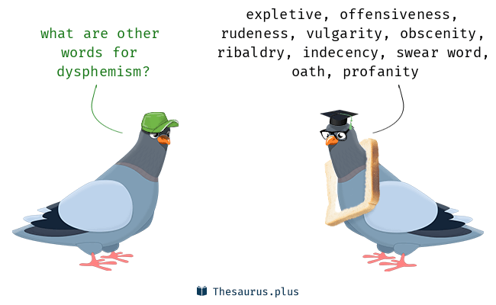
Dysphemism
A derogatory or unpleasant term used instead of a pleasant or neutral one, such as “loony bin” for “mental hospital.”.

Slide 14
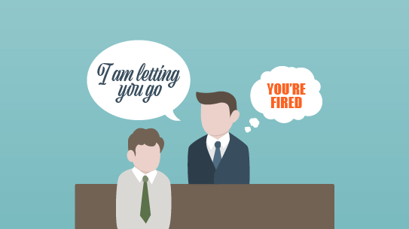
Euphemism
A mild or indirect word or expression substituted for one considered to be too harsh or blunt when referring to something unpleasant or embarrassing.
“downsizing” as a euphemism for cuts"

Slide 15
Epithet
An adjective or descriptive phrase expressing a quality characteristic of the person or thing mentioned.
"old men are often unfairly awarded the epithet “dirty.”

Slide 16
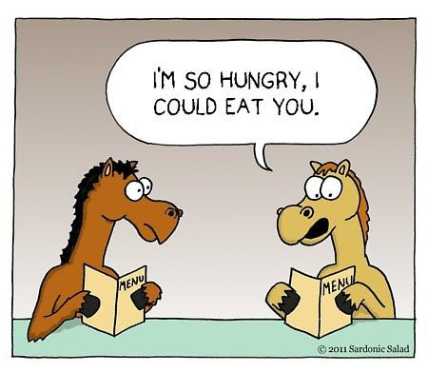
Hyperbole
Exaggerated statements or claims not meant to be taken literally.

Slide 17
Glittering Generality
A vague word or phrase used to evoke positive feelings rather than to convey information

Slide 18
Idiom (idiomatic expression)
Idiomatic expressions are a type of informal language that have a meaning different from the meaning of the words in the expression.
For example:
“Hold your tongue.”
This idiom doesn’t actually mean that you should stick your fingers in your mouth and grab you’re a hold of your tongue. It means that you shouldn’t talk.

Slide 19
Proverb
A proverb is a brief, simple, and popular saying, or a phrase that gives advice and effectively embodies a commonplace truth based on practical experience or common sense. A proverb may have an allegorical message behind its odd appearance.

Slide 20
Emotive Language
Emotive Language is the deliberate choice of words to elicit emotion (usually to influence).
Ideas can be expressed non-emotively. For example:
The men were killed.
However, they can also be expressed in a way that is positive or negative or welcoming or threatening. It all depends on the words selected. For example:
The victims were executed in cold blood.

Slide 21
Emotive Language
Non-emotive version: Another person in the restaurant was injured by the man's glass.
Emotive version: An innocent bystander suffered facial injuries when the evil man launched his glass across the restaurant.
Non-emotive version: The government will reduce interest rates.
Emotive version: The government will slash interest rates.

Slide 22
With this lesson you will understand that…
Writers use grammar and word choices to enhance or lessen the impact of violence on the public, usually to serve a particular agenda.

Slide 23
Agency is responsibility for an action, and it can be emphasized or hidden with grammar.

Slide 24
Analysis: How agency(responsibility) is hidden?
THE BASICS:
Sentences in English typically follow the pattern of SUBJECT (who the sentence is about) → VERB (the action) → OBJECT (the thing being acted upon).
This is called an ACTIVE sentence. For example, ‘Ms. Thorne stole a penguin’.
I could take myself out of this sentence and so hide my guilt with a PASSIVE sentence. For example, ‘A penguin was stolen’. The object has become the subject, and the person who performed the action (me) has been removed.
This effectively takes the emphasis away from me. This is an effective technique when you want to hide responsibility (agency) for a negatively perceived action.
Passive sentence structures also have the effect of creating less emotional involvement and greater objectivity. Thus, it is a particularly important part of scientific writing. (Check your latest lab reports - have you used passive sentences?)

Slide 25
#1
What do you already know about the Vietnam War? After sharing your knowledge, watch this short summary video. Remember: to be able to truly understand a text, we need to know about the socio-cultural-historical context in which it was written.
There are four texts expressing different perspectives on the Vietnam War here.
In a group of four, divide the texts between you - select one each. Read the text and complete the following two activities:
Guess the context of the text - author, time, place, purpose. What makes you say this?
Highlight and annotate to identify stylistic devices (see key terms list).
Be prepared to ‘teach’ your text to the other members of your group.
Summary: Write a paragraph in your notebook to answer the focus question for these lessons - How is language used to exert power during times of war? Use a concise thesis statement, support your idea with key terms, evidence and examples, and fully explain your ideas.

Slide 26
#2
What do you already know about the Iraq War? After sharing your knowledge, read this summary from History.com. Remember: to be able to truly understand a text, we need to know about the socio-cultural-historical context in which it was written.
Read a news article about the US bombing of a Baghdad marketplace during the Iraq War (case study 2).
According the article, who is responsible? Notice how vague the article is about who is responsible? The US forces (the ‘Coalition’) is not even mentioned until well into the text. The author is ‘hiding agency’. Read about how this is done in the case study document.
The editing process. Sometimes we can find evidence of the deliberate changing of language for this purpose. Look at the following example (on the next slide), think about this question: is this a beneficial or harmful use of power? Why?

Slide 27
Case Study #2
The web-version of the above article included a photo, with the caption: An Iraqi man comforts a friend at the Baghdad neighborhood bombed Wednesday However, if one looked at the html, the original caption had been stored as the text to display if the image was missing (my emphasis): An Iraqi man comforts a friend at the Baghdad neighborhood struck Wednesday by two U.S. missiles. Obviously some editor has chosen to delete the U.S. involvement. It would have been interesting to see the whole article before it was edited.

Slide 28
Summary:
Writers use grammar and word choices to enhance or lessen the impact of violence on the public, usually to serve a particular agenda.
Agency is responsibility for an action, and it can be emphasized or hidden with grammar.

Slide 29
In conclusion:
Once again, write a paragraph in your notebook to answer the focus question for these lessons - How is language used to exert power during times of war?
Use a concise thesis statement, support your idea with key terms, evidence and examples, and fully explain your idea. If you are having trouble, read this article (very clear and succinct).

Slide 30
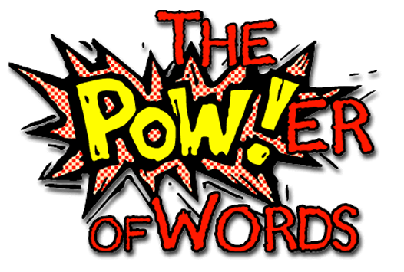
How is this helping me towards assessment(s)?
FOA: For the further oral activity, you are expected to show a strong understand of the effect of language in a text. How about a meeting of editors, discussing the language in one of the articles about war? Changing grammar and language to lessen the impact of reported violence on the public?
Paper 1: The close stylistic analysis we conducted in this lesson is perfect preparation for a paper 1 exam. You could select two of the texts and complete a practice comparative analysis essay.

