Slide 1
DP Language & Literature
Unit 2; Session 02- What is power? (cont.)

Slide 2
WHAT IS POWER?
Language is used instrumentally and influentially to both exercise and undermine power.
KEY CONCEPTS:
Language & knowledge communities (jargon)
Language status & dialects
Euphemisms and emotive language
Modality & persuasion

Slide 4
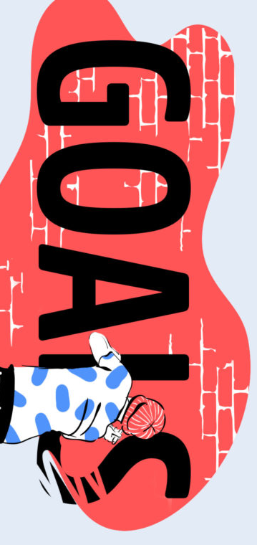
Know: what power means; definitions of instrumental and influential power
Understand: the relationship language has to power - both influential and instrumental
Be able to: analyze a text and start identifying ways language is used to exert power

Slide 6
POWER & BATHROOM SIGNS
What kind of power do bathroom signs have?
How do bathroom signs have the power to REDEFINE or REAFFIRM our understanding of gender?

Slide 7
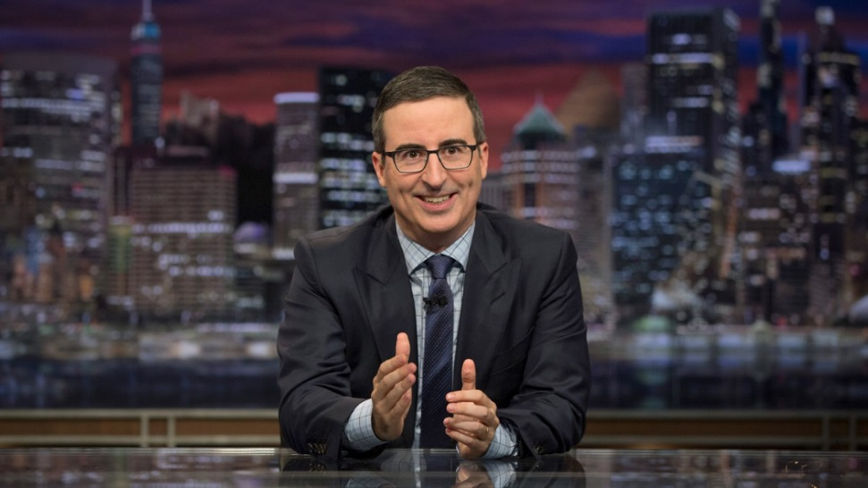
MISS AMERICA & JOHN OLIVER
HOW is language used instrumentally and influentially to both exercise and undermine power in the text?
Is this an instance of public or personal power? How do you know?
Is this instrumental (coercive) or influential (motivational) or both? How do you know?
Is this an example of an attempt to maintain the status quo or make a change? How do you know?
Is this a harmful / beneficial use of language as power? Why?

Slide 8
DOVE BEAUTY CAMPAINGE
HOW is language used instrumentally and influentially to both exercise and undermine power in the text?
Is this an instance of public or personal power? How do you know?
Is this instrumental (coercive) or influential (motivational) or both? How do you know?
Is this an example of an attempt to maintain the status quo or make a change? How do you know?
Is this a harmful / beneficial use of language as power? Why?

Slide 9
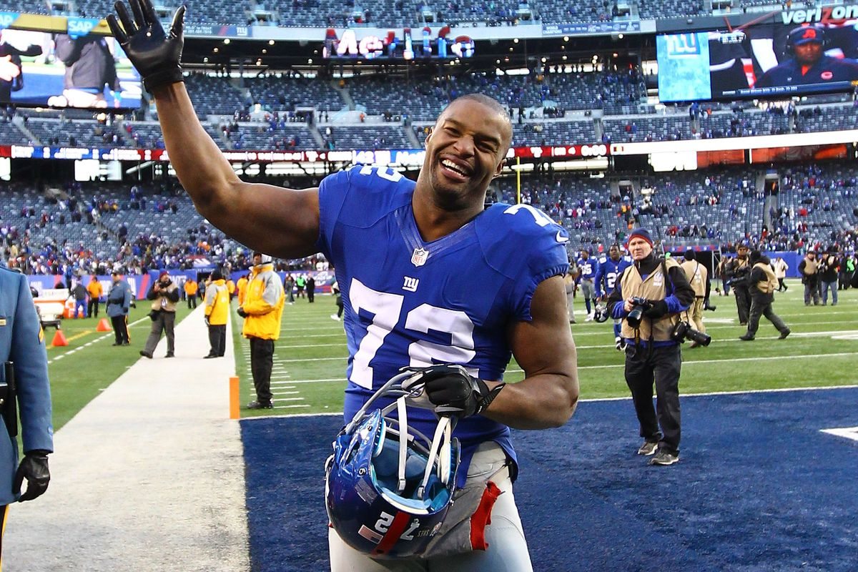
NO MR. TRUMP, YOU’RE DISRESPECTING THE FLAG.
HOW is language used instrumentally and influentially to both exercise and undermine power in the text?
Is this an instance of public or personal power? How do you know?
Is this instrumental (coercive) or influential (motivational) or both? How do you know?
Is this an example of an attempt to maintain the status quo or make a change? How do you know?
Is this a harmful / beneficial use of language as power? Why?

Slide 10
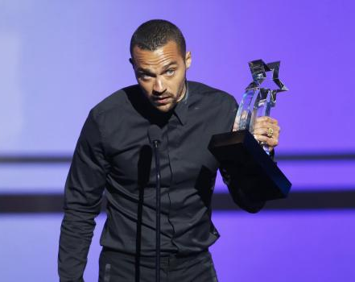
Jesse Williams
HOW is language used instrumentally and influentially to both exercise and undermine power in the text?
Is this an instance of public or personal power? How do you know?
Is this instrumental (coercive) or influential (motivational) or both? How do you know?
Is this an example of an attempt to maintain the status quo or make a change? How do you know?
Is this a harmful / beneficial use of language as power? Why?

Slide 11
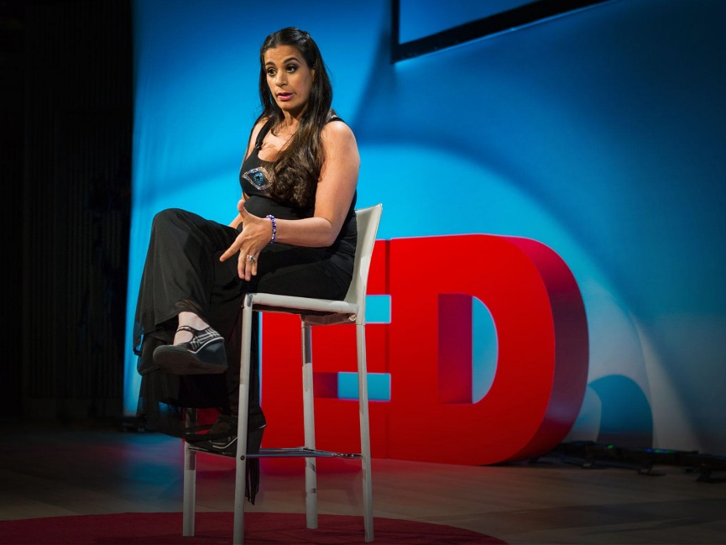
I GOT 99 PROBLEMS…PALSY IS JUST ONE.
HOW is language used instrumentally and influentially to both exercise and undermine power in the text?
Is this an instance of public or personal power? How do you know?
Is this instrumental (coercive) or influential (motivational) or both? How do you know?
Is this an example of an attempt to maintain the status quo or make a change? How do you know?
Is this a harmful / beneficial use of language as power? Why?

Slide 12
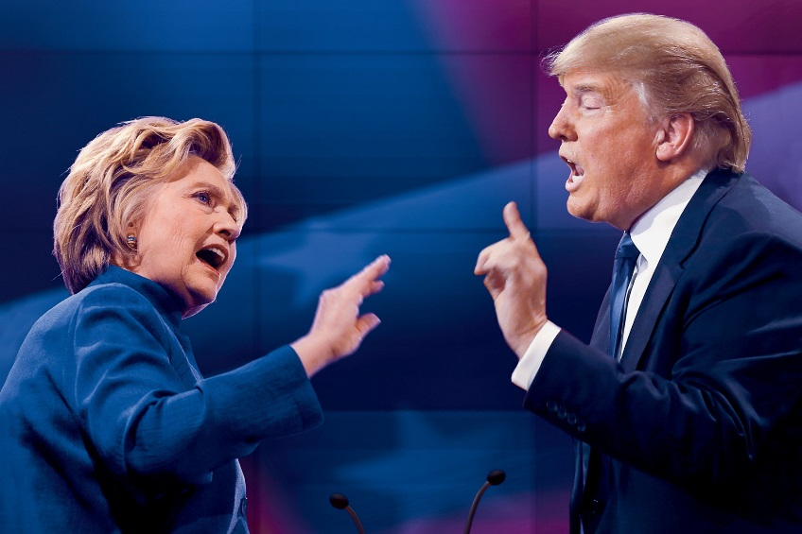
PRESIDENTIAL DEBATE
HOW is language used instrumentally and influentially to both exercise and undermine power in the text?
Is this an instance of public or personal power? How do you know?
Is this instrumental (coercive) or influential (motivational) or both? How do you know?
Is this an example of an attempt to maintain the status quo or make a change? How do you know?
Is this a harmful / beneficial use of language as power? Why?

Slide 13
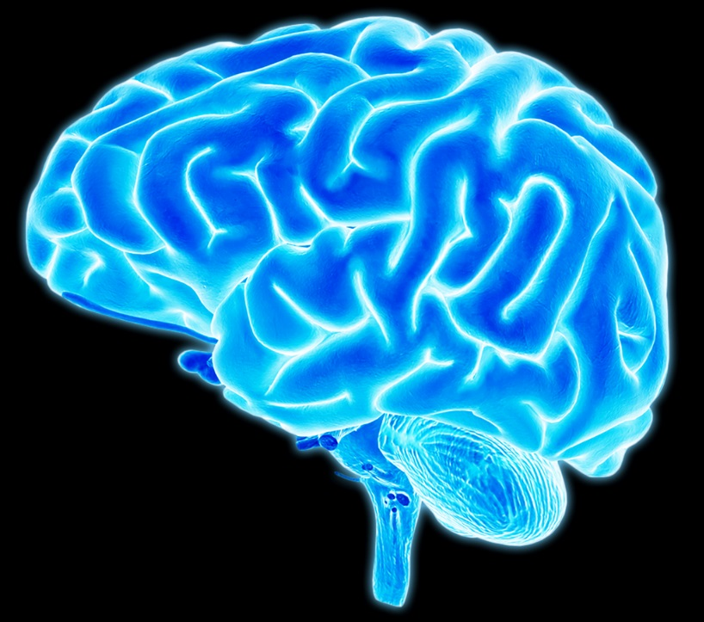
Consciousness & The Brain
Look for examples of each speaker trying to exert power over the other.

Slide 14
How is this helping me towards upcoming assessment(s)?
FOA: For the further oral activity, you will be expected to discuss the language of a text in depth and present this orally. You could do a ‘political debate roundup’ style of discussion, analyzing the use of candidates’ use of language and attempts to assert power.

Slide 15
ON YOUR OWN
STEP 1: Find an example of:
language being used instrumentally to exercise or undermine power.
language being used influentially to exercise or undermine power.
STEP #2: Analyze the text using the questions on the next two slides.
STEP #3: Add your examples & analysis into the class PPT
STEP #4: Be prepared to share with the class on Thursday.

Slide 16
EACH GROUP SHOULD HAVE…
FOUR SLIDES TOTAL
1 slide= EXAMPLE #1
1 slide= EXAMPLE #2
1 slide= WRITTEN TASK #2 QUESTION ANALYSIS FOR EXAMPLE #1
1 slide= WRITTEN TASK #2 QUESTION ANALYSIS FOR EXAMPLE #2

Slide 17
QUESTIONS TO CONSIDER:
HOW is language is used instrumentally and influentially to both exercise and undermine power in the text?
Is this an instance of public or personal power? How do you know?
Is this instrumental (coercive) or influential (motivational) or both? How do you know?
Is this an example of an attempt to maintain the status quo or make a change? How do you know?
Is this a harmful / beneficial use of language as power? Why?

Slide 18
QUESTIONS TO CONSIDER: choose one for EACH example
How could the text be read and interpreted differently by two different readers?
If the text had been written in a different time or place or language or for a different audience, how and why might it differ?
How & why is a social group represented in a particular way?
Which social groups are marginalized, excluded or silenced within the text?
How does the text conform to, or deviate from, the conventions of a particular genre, and for what purpose?
How has the text borrowed from other texts, and with what effects?

