Slide 1
First 15: Respond to the question below on a sheet of paper.
How and why is a social group represented a particular way?

Slide 2
DP Language & literature
Unit 2; Session 01- What is power?

Slide 3
What is power?
Language is used instrumentally and influentially to both exercise and undermine power.
KEY CONCEPTS:
Language & knowledge communities (jargon)
Language status & dialects
Euphemisms and emotive language
Modality & persuasion

Slide 4
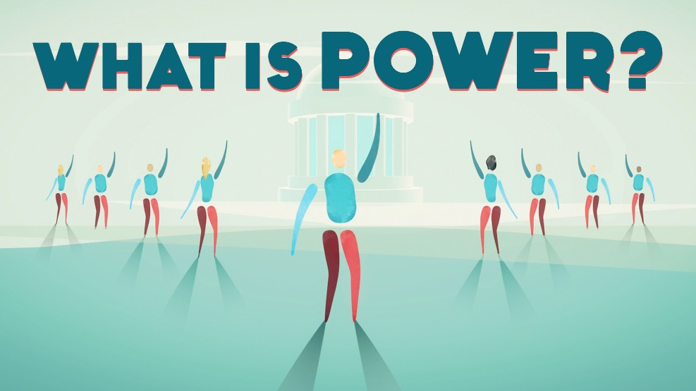
AGENDA
What is power?: 1 min
Goals: 1 min.
Warm up- the power of poetic language: 10 min.
Intro Activity- great game of power: 10 min.
Notes- language & power: 20 min.
The Story of an Hour ANALYSIS: 20 min.
Exit ticket- 3 min.

Slide 5
Know: what power means; definitions of instrumental and influential power
Understand: the relationship language has to power - both influential and instrumental
Be able to: analyze a text and start identifying ways language is used to exert power

Slide 6
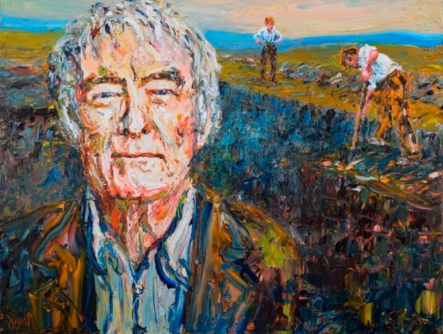
Warm up: small group →large group
Read (and listen to) Seamus Heaney’s poem The Harvest Bow. Read once for enjoyment and again ‘with your pen’ (annotate). Ask yourself the regular questions in your discussion with your peers: * What is the story? * Who is telling it? Who are they telling it to? (audience) * How is the author telling the story? * Why might the author be telling this story? * What is the other story? * Where is the power in this story?
Focusing on this last question: what does it mean in relation to poetry? How does Heaney create this effect using language? Pick out some words or phrases to discuss.
Now watch this video from the grammarians at TED and see what they have to say about powerful language use. According to the video, what makes language powerful?

Slide 7
Introduction activity: great game of power
Power is a lot more complicated than simple emotional effect. The following game may help us realize this. To play, follow these instructions:
At your table, collect a bunch of random objects of different shapes and sizes.
Now make one object more ‘powerful’ than the others.
Next, make the object the most powerful it can be.
Introduce a new object - try to take away some of that power for itself.
Finally, discuss what happened when you completed this activity - what observations did you make? What could this activity tell us about this concept of power?

Slide 8
notes:
PowerPoint.
Write down the most important information from each slide.
At the end of the Google Slides presentation there some example texts and an activity. Complete both activities to examine how language can be used in different ways to exert power.
Political or ideological debate / discussion
Language of the Classroom

Slide 9
THE STORY OF AN HOUR
CONTEXT OF INTERPRETATION: refers to the factors that can influence a reader of a text, such as time, place and personal experience.
CONTEXT OF COMPOSITION: refer to the factors that influence a writer when creating a text, such as time, place and personal experience.
How does language empower and disempower people? ​

Slide 10
Power in the story of an hour
is this an instance of public or personal power?
is this instrumental (coercive) or influential (motivational)?
is this an example of an attempt to maintain the status quo or make a change?
is this a harmful / beneficial use of language as power?

Slide 11
Exit ticket
On a sheet of paper, respond to the following question:
What is one new thing you learned today? What is one thing you want to know more about?

Slide 12
How is this helping me towards upcoming assessment(s)?
FOA: For the further oral activity, you will be expected to discuss the language of a text in depth and present this orally. You could do a ‘political debate roundup’ style of discussion, analyzing the use of candidates’ use of language and attempts to assert power.

