Slide 1
Socratic seminar
Session #2

Slide 2
Standards met with today’s activity
ELAGSE9-10RI1: Cite strong and thorough textual evidence to support analysis of what the text says explicitly as well as inferences drawn from the text.
ELAGSE9-10RI6: Determine an author’s point of view or purpose in a text and analyze how an author uses rhetoric to advance that point of view or purpose
ELAGSE9-10SL1: Initiate and participate effectively in a range of collaborative discussions(one-on-one, in groups, and teacher-led) with diverse partners on grades 9–10 topics, texts, and issues, building on others’ ideas and expressing their own clearly and persuasively. a. Come to discussions prepared having read and researched material under study; explicitly draw on that preparation by referring to evidence from texts and other research on the topic or issue to stimulate a thoughtful, well-reasoned exchange of ideas. b. Work with peers to set rules for collegial discussions and decision-making (e.g., informal consensus, taking votes on key issues, presentation of alternate views), clear goals and deadlines, and individual roles as needed. c. Propel conversations by posing and responding to questions that relate the current discussion to broader themes or larger ideas; actively incorporate others into the discussion; and clarify, verify, or challenge ideas and conclusions. d. Respond thoughtfully to diverse perspectives, summarize points of agreement and disagreement, and, when warranted, qualify or justify their own views and understanding and make new connections in light of the evidence and reasoning presented.

Slide 3
Agenda
First 15: Vocabulary- 15 min.
Socratic Seminar Rules & Procedures: 10 min.
Socratic Seminar Group #1: 20 min.
Socratic Seminar Group #2: 20 min.
Socratic Seminar Group #3: 20 min.
Closing & HW: 5 min.

Slide 4
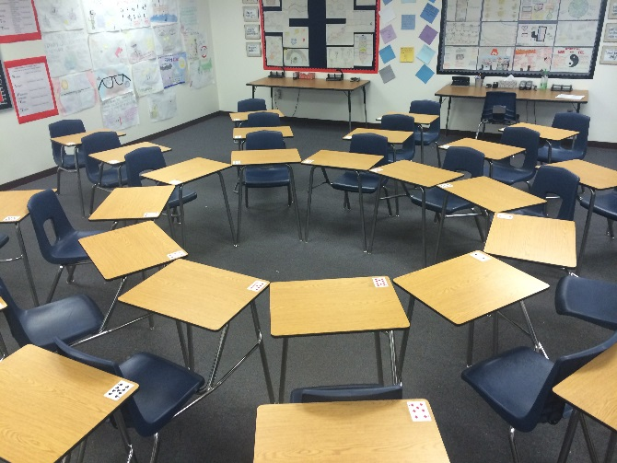
How it works:
GROUPS
INNER VS. OUTER CIRLCE
Each group will have a TEAM LEADER
At the beginning of each round, the team leader will decide what each member of the group is going to do. Your job will change EACH ROUND. Every member of the group must sit in the inner circle ONCE.
Inside Circle Talker
Conversation Mapper
Blogger
Reporter
Shadower
INNER CIRLCE:
Talk consistently for 20 minutes to only members of the inner circle.
Refer directly to the text (this means you will need to bring your documentary notes & your research into the inner circle with you)
Respect everyone’s thoughts and opinions
Stay away from simply saying “I agree” or “I disagree”
OUTER CIRLCE:
Everyone must have a job.
Team leader will assign you a job.
You must submit all required materials from each job, each round.

Slide 5
Socratic seminar: rules
Inside circle talks.
You must carry a conversation for 20 minutes with other members of the inside circle.
You must be in the inside circle once.
You must directly refer to the texts.
Outside circle listens.
You must listen to the inside circle discuss.
You must complete a job for each round you are in the outside circle.

Slide 6
Socratic seminar: procedures of The inside circle
You will bring all of your texts and sit in one of the desks in the center of the room.
You must actively participate in conversation the entire time (20 min.).
You must directly refer to the text when discussing.
You must respect the opinions and thoughts of other members of the group.
You may not say “I agree” or “I disagree” without providing detailed explanation/reasoning.

Slide 7
Socratic seminar: procedures of The outside circle
You will complete one of the following jobs for each round that you are sitting in the outside circle.
You will not talk at all to anyone in the classroom. Your job is to listen to the conversation going on inside the circle; you can’t listen if you are talking.
Please be prepared to submit you designated job task at the end of each round.

Slide 8
Job descriptions
Session #2

Slide 9
job #1: SOCRATIC SEMINAR LEADER
Responsible for ASSIGNING each color group a job new after EACH round of Socratic Seminar.
Responsible for CLARIFYING job descriptions & expectations to classmates.
Responsible for ensuring outside circle members, no matter the job, are quiet while the inner circle is talking.
Must be RESPECTFUL & HELPFUL to each member of your group.
Must GRADE the overall performance of the inner circle’s conversation using rubric.

Slide 10
JOB #2: Blogger
Responsible for RESPONDING to what is being discussed in the inside circle.
Responsible for explaining why you disagree/agree with what is being discussed in the inside circle.
Must articulate yourself in a thoughtful and meaningful manner.
Must be respectful of members in the inside circle.

Slide 11
JOB #3: Reporter
Responsible for taking diligent notes of what is being discussed in the inside circle.
Responsible for summarizing what the members of your group are discussing in the inside circle.
Reports should be extremely detailed and thoroughly analyze the strengths and weaknesses of the conversation in the inside circle.

Slide 12
JOB #4: Conversation Mapper
Responsible for drawing the conversation between people in the inside circle.
Each mapper must have the SAME color.
Each rotation will be represented by a DIFFERENT color on the Conversation Map.

Slide 13
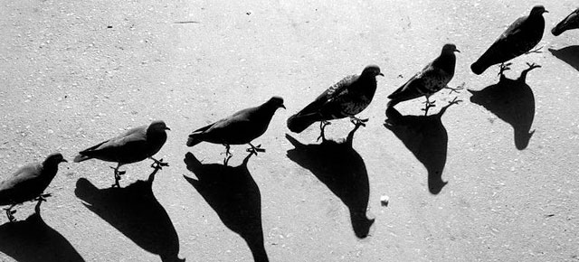
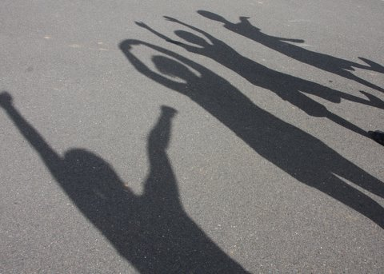
JOB #5: Shadower
Each member of your group will have someone to shadow them as they converse in the inside circle.
Responsible for completing the observation checklist.

Slide 14
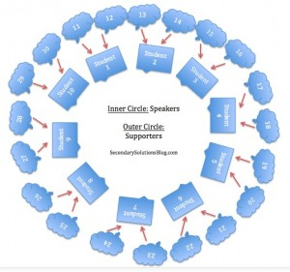
JOB #6: INSIDE CIRCLE
Bring all required materials to a desk in the inner circle.
Be prepared to articulate yourself to other members of the inner circle.
Directly reference the texts (It’s A Girl! documentary, research, I Am Nujood)

Slide 15
The prompt
Session #2

Slide 16
Consider this…
Female feticide is one of the primary means of eliminating females in both India and China, yet some of the human rights communities are hesitant to actively work against female feticide because it’s related to abortion rights.
Is there a contradiction between supporting abortion rights in general and trying to restrict or ban abortions based on sex?

Slide 17
After socratic reflection
Session #2

Slide 18
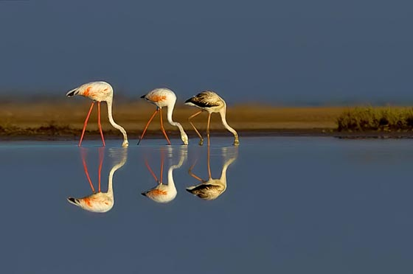
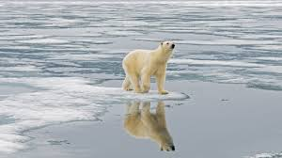
Reflection: - to be completed after S.S. - must be typed & submitted via turnitin.com by 11:59 p.m. on Sunday 08/26
What was your favorite job today? Why?
What do you think went well?
What do you think we could change to improve our Socratic Seminar?
What did you take away from today’s Socratic Seminar?

