Slide 1

I Am Nujood, Age 10 and Divorced

Slide 2
Agenda
First 15- Vocab: 15 min.
Rhetoric & Ethos/Logos/Pathos Review: 15 min.
So What? Discussion: 10 min.
Summative Project Assigned: 10 min.
  DAY #1 ACTIVITES: 40 min.
Closing- Debrief & Next Class Plan: 5 min.

Slide 3
The power of language is RHETORIC.
Rhetoric is the counterpart of Dialectic. Both alike are concerned with such things as come, more or less, within the general ken of all men and belong to no definite science. Accordingly all men make use, more or less, of both; for to a certain extent all men attempt to discuss statements and to maintain them, to defend themselves and to attack others.
Ordinary people do this either at random or through practice and from acquired habit. Both ways being possible, the subject can plainly be handled systematically, for it is possible to inquire the reason why some speakers succeed through practice and others spontaneously; and every one will at once agree that such an inquiry is the function of an art.
- Aristotle, in his introduction to Rhetoric, written circa 350 BCE

Slide 4
Rhetoric: The art of speaking or writing effectively.
Aristotle says rhetoric is "the ability, in each particular case, to see the available means of persuasion." He described three main rhetorical strategies:
Ethos – Speaker Perceived credibility or reputation of the speaker. Level of respect and honor given to the speaker by the audience.
Pathos – Audience. Appeals to the audience’s emotions.
Logos – Words. An appeal to logic. A demonstration of proof.

Slide 6
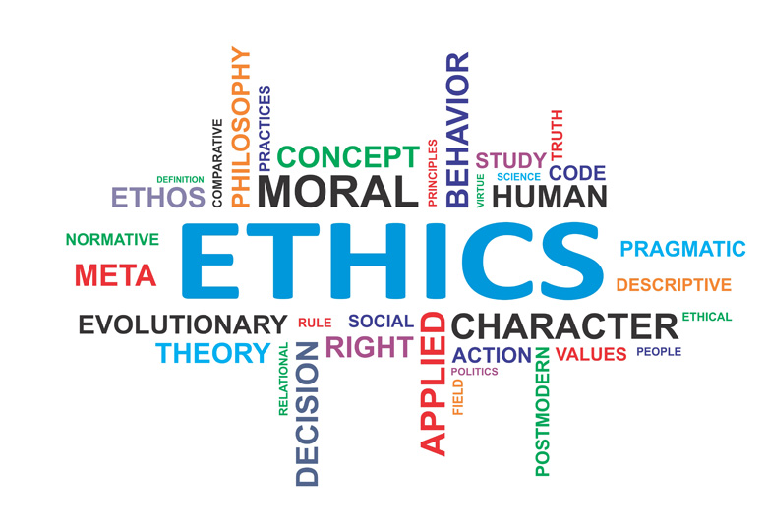
Rhetorical appeal #1: ETHOS
Ethos is an appeal to ethics, and it is a means of convincing someone of the character or credibility of the persuader.
How credible is the SPEAKER?
  Personal experience?
  Degree?

Slide 7
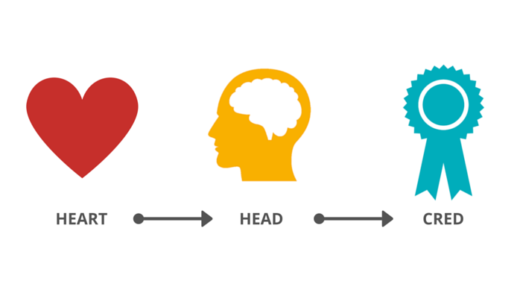
Rhetorical appeal #2: PATHOS
Pathos is an appeal to emotion, and is a way of convincing an audience of an argument by creating an emotional response.
What does the SPEAKER want the READER/LISTENER to feel?
HOW does the SPEAKER accomplish this?

Slide 8
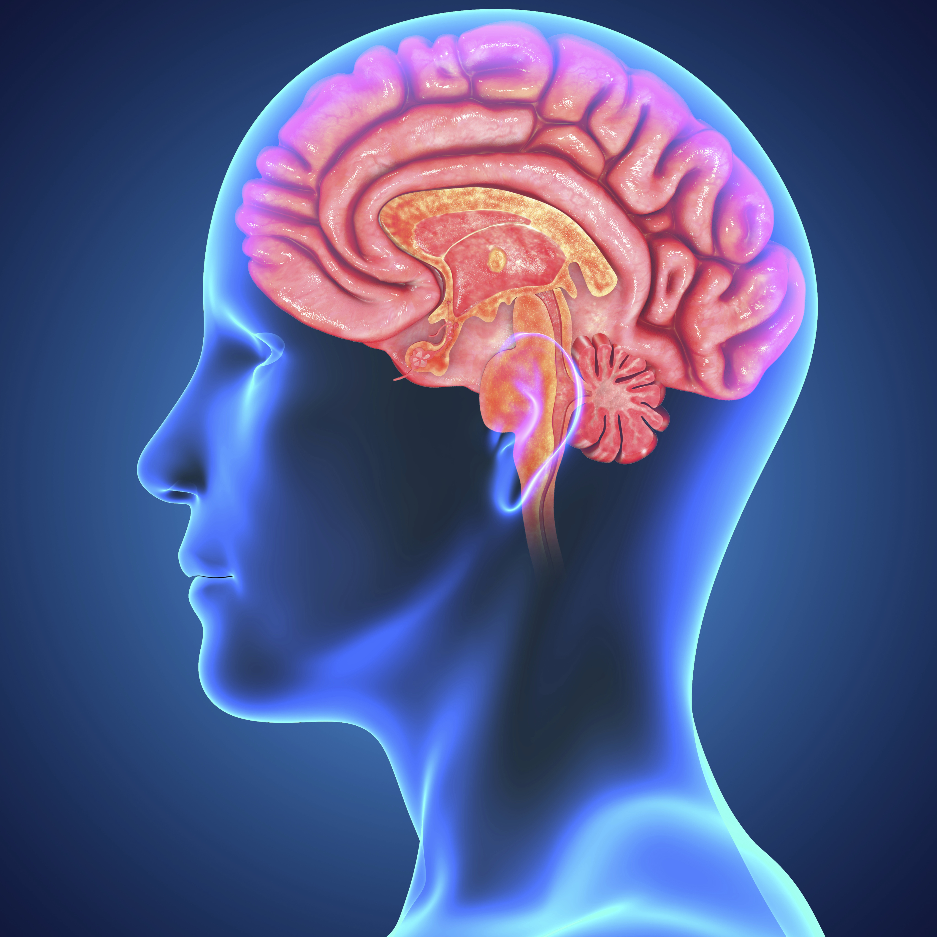
Rhetorical appeal #3: LOGOS
Logos is an appeal to logic, and is a way of persuading an audience by reason.

Slide 9

Example #1: Ethos, logos, or pathos?

Slide 10

Example #2: Ethos, logos, or pathos?

Slide 11
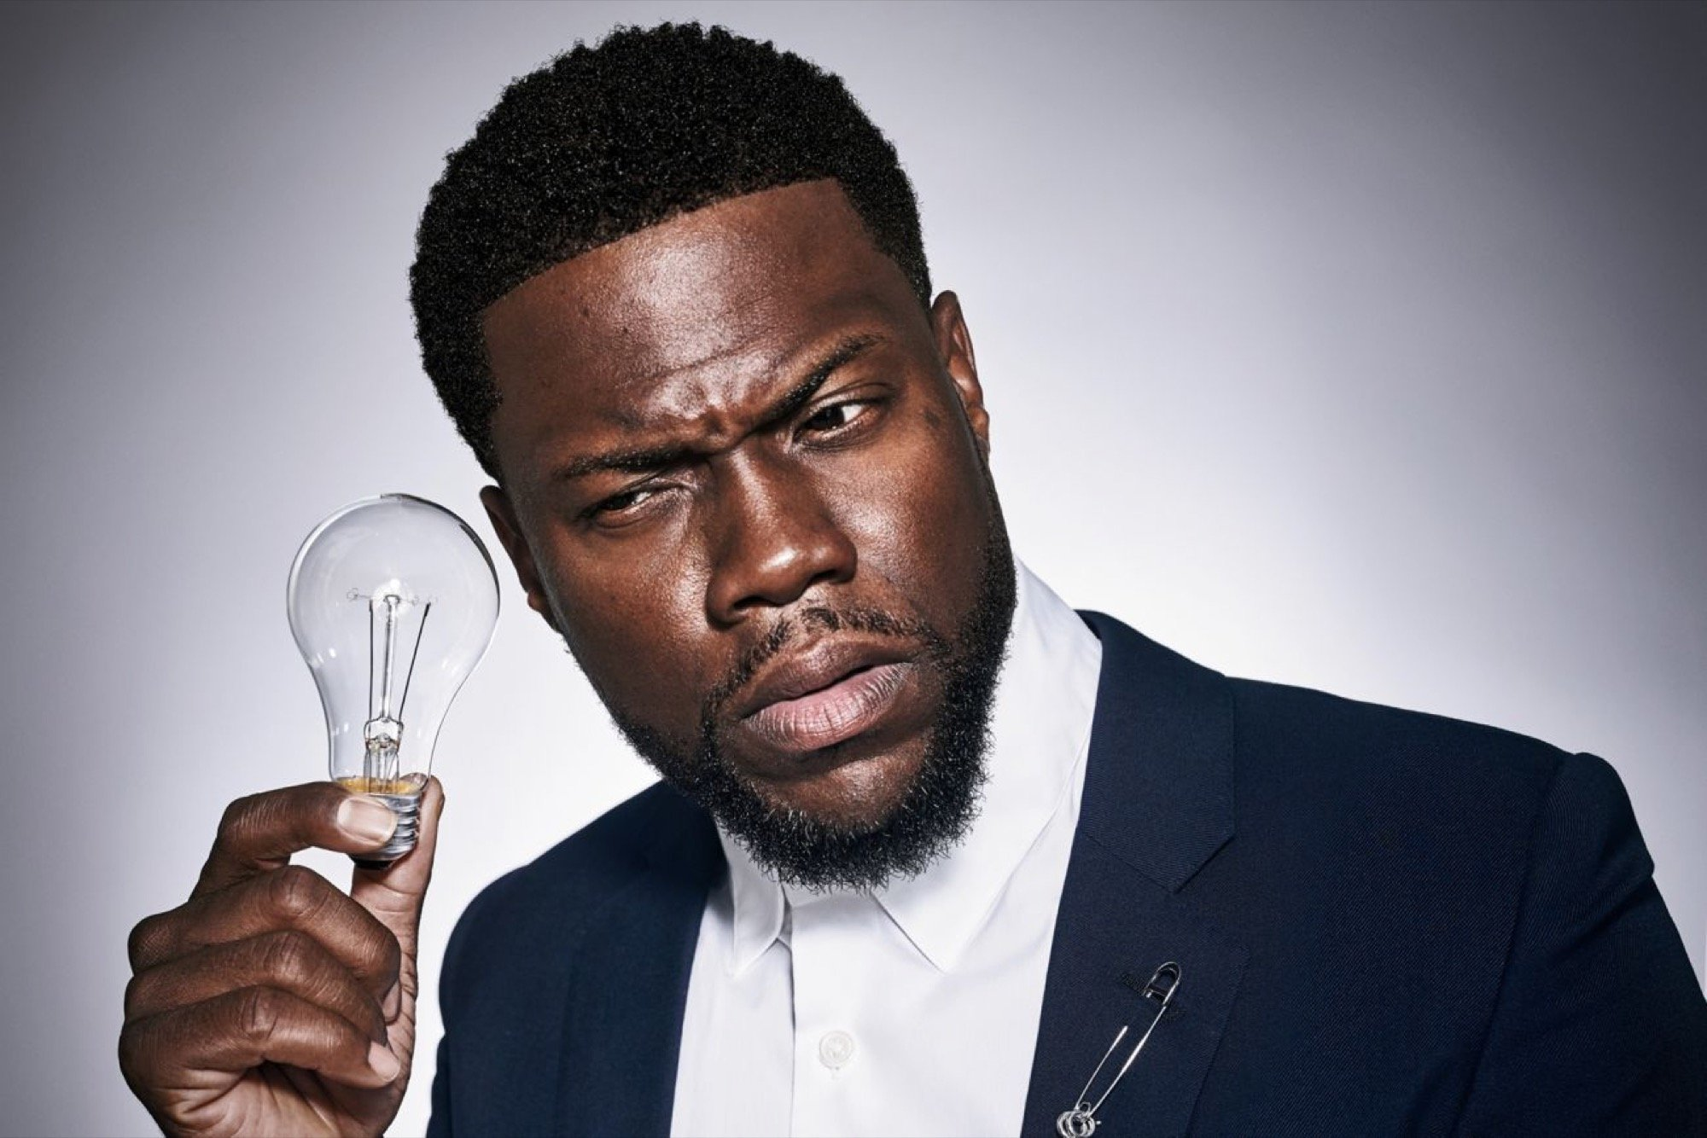
Example #3: Ethos, logos, or pathos?

Slide 12

“Since their unprecedented victory in April 2008, Nujood’s courageous defiance of both Yemeni customs and her own family has attracted a storm of international attention. Her story even incited change in Yemen and other Middle Eastern countries, where underage marriage laws are being increasingly enforced and other child brides have been granted divorces. As she guides us from the magical, fragrant streets of the Old City of Sana’a to the cement-block slums and rural villages of this ancient land, her unflinching look at an injustice suffered by all too many girls around the world is at once shocking, inspiring, and utterly unforgettable."

Slide 13

UNIT #1 SUMMATIVE PROJECT

Slide 14

Due @ the end of class TODAY:
Written proposal explaining the details of your project.
Must submit for approval!

