Slide 1
10th Grade Honors World Literature

Slide 2
Agenda
Goals
Warm Up- Dancing On My Own
The Man Box
How Movies Teach Manhood
The Little Match Girl
Homework: Fairytales Over The Years

Slide 3
part one: LEARNING OUTCOMES
Analyse how audience and purpose affect the structure and content of texts.
Analyse the impact of language changes.
Demonstrate an awareness of how language and meaning are shaped by culture and context.

Slide 4
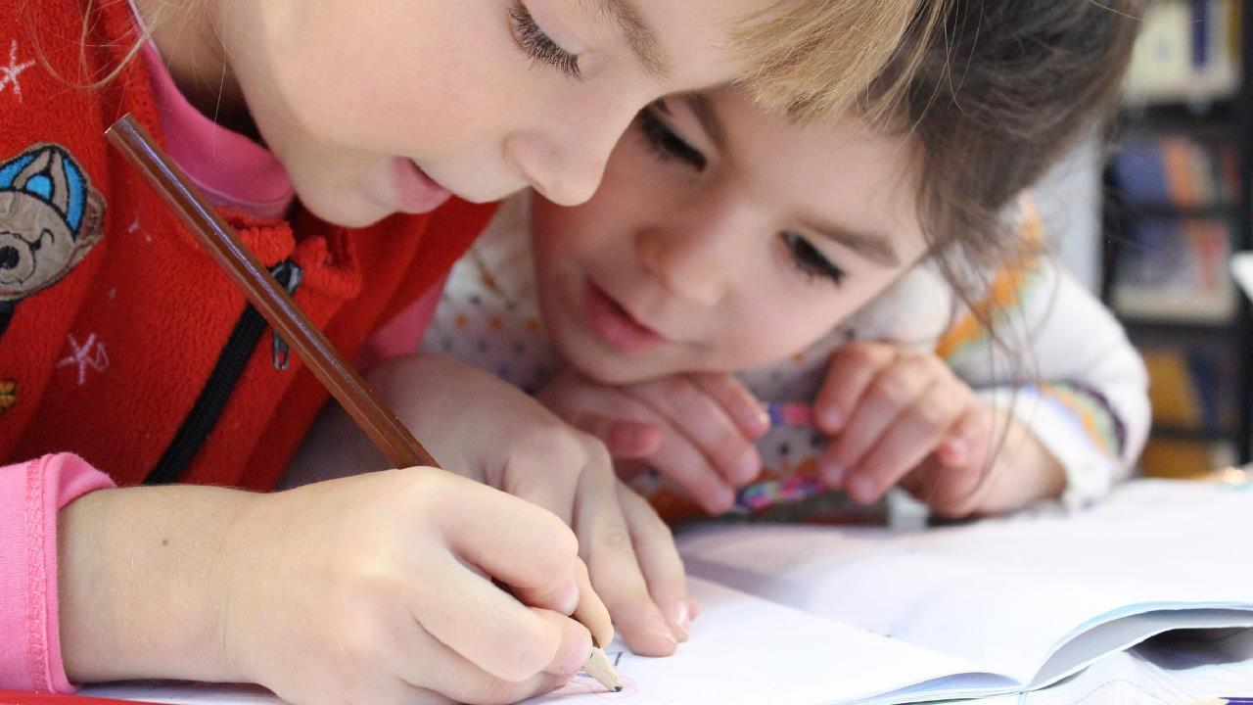
G O A L S
Know: how language affects gender
Understand: the connection between language, culture and identity
Be able to: identify the author’s main idea, purpose and tone

Slide 5
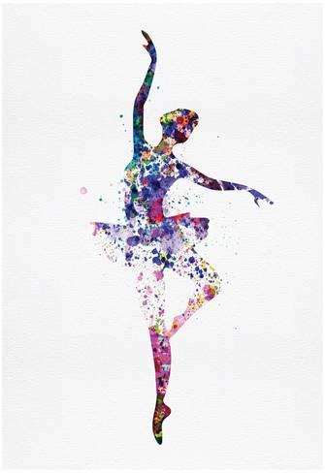
Dancing On My Own

Slide 6
Dancing On My Own
What is the impact of the language change?
How do audience and purpose affect the structure and content of the text?
How language and meaning are shaped by culture and context?

Slide 7
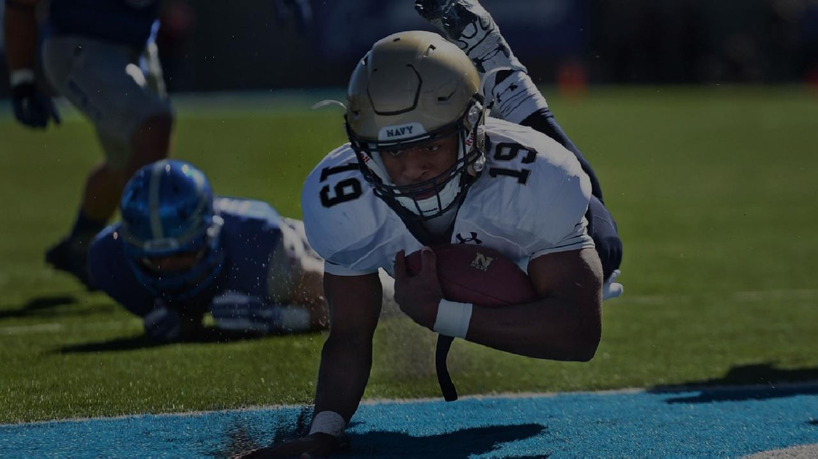
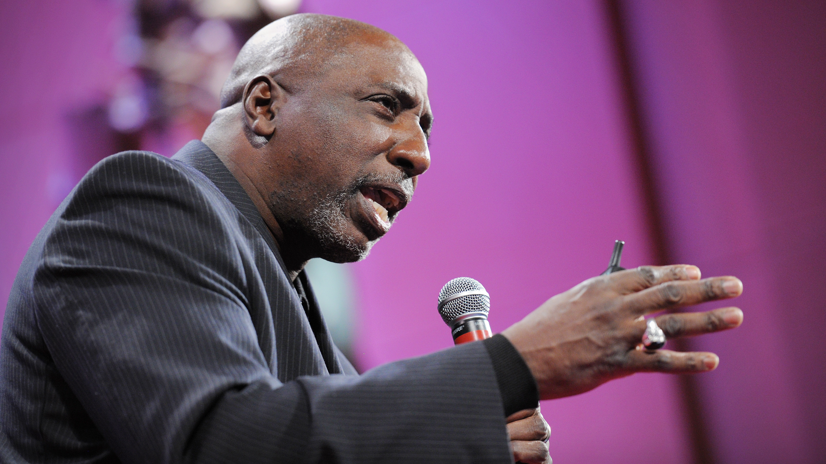
The Man Box
Enter his/her favorite sport here.
Enter his/her team here.

Slide 8
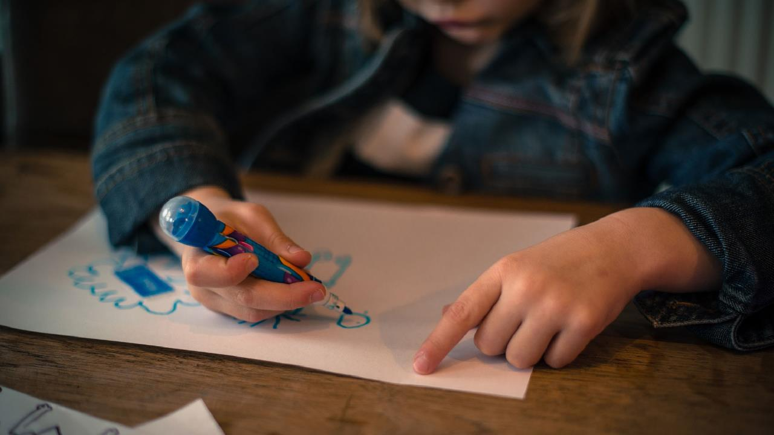
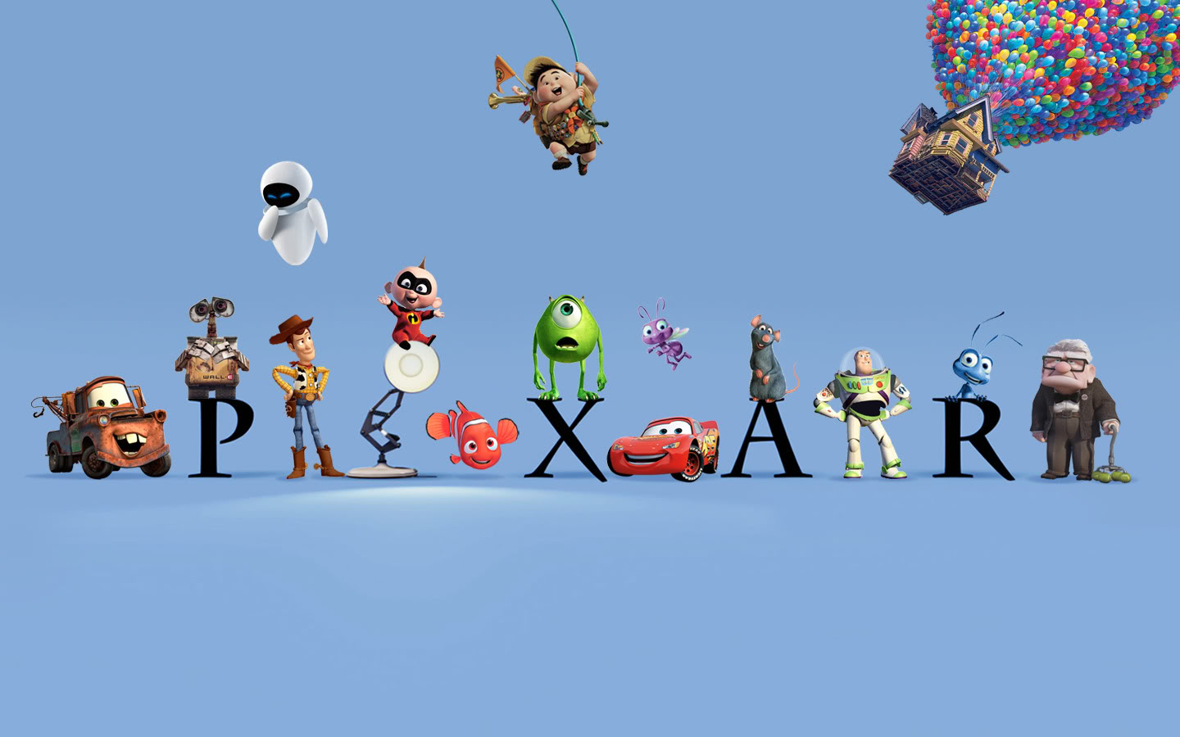
How Movies Teach Manhood

Slide 9
The Little Match Girl Release in 2006 by Walt Disney.

Slide 10
The Little Match Girl: Discussion of the Text
How are gender roles portrayed in this film?
Is the main character male or female?
Do women get to be lead characters or secondary (wife, girlfriend, sister)?
What is considered “normal” gender roles here?; what is considered “radical”?
Is this what you expect for this time period?
What racial or ethnic groups are portrayed, and where? (Hero, villain, background?)
What kinds of cultural change do you see in this film?
What is at stake, for who?
Are female roles stereotypical (shrewish wife, innocent girl, seductress, woman-with-power-gone-mad) or more complex?
Who dies, and who learns a lesson (i.e. race/ethnicity, gender)?
Does the film play on a stereotypes?

Slide 11
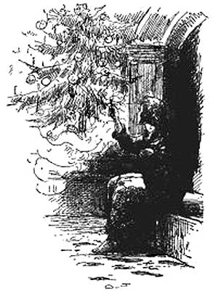
The Little Match Girl Written in 1845 by Hans Christian Andersen

Slide 12
The Little Match Girl: Discussion of the Text
How are gender roles portrayed in this text?
Is the main character male or female?
Do women get to be lead characters or secondary (wife, girlfriend, sister)?
What is considered “normal” gender roles here?; what is considered “radical”?
Is this what you expect for this time period?
What racial or ethnic groups are portrayed, and where? (Hero, villain, background?)
What kinds of cultural change do you see in this film?
What is at stake, for who?
Are female roles stereotypical (shrewish wife, innocent girl, seductress, woman-with-power-gone-mad) or more complex?
Who dies, and who learns a lesson (i.e. race/ethnicity, gender)?
Does the film play on a stereotypes?

Slide 13
The Little Match Girl
Consider…
What are some other examples?
How do fairytales shape our perceptions of gender roles?
What is the purpose of fairytales?
Who is the audience?
SYMBOLS
IMAGERY
Can you think of an example of a fairytale that was made into a movie/show?
What changed?
Why do you think these aspects of the story changed in the movie?

Slide 14
How is Pixar changing the world?
Watch your assigned movie, and write a 400-500 word analysis of societal issues (gender, class, ethnicity issues) in the film. Suggested format: give a one-paragraph (100 words) summary of the plot, and spend the rest of the page (200-500 words) identifying and discussing societal issues in the text. Use specific examples from the text (symbolism, imagery, language, tone, mood).
Questions to think about:
How are gender roles portrayed in this film? Is the main character male or female? Do women get to be lead characters or secondary (wife, girlfriend, sister)? What is considered “normal” gender roles here?; what is considered “radical”? Is this what you expect for this time period? What racial or ethnic groups are portrayed, and where? (Hero, villain, background?) What kinds of cultural change do you see in this film? What is at stake, for who? Are female roles stereotypical (shrewish wife, innocent girl, seductress, woman-with-power-gone-mad) or more complex? Who dies, and who learns a lesson (i.e. race/ethnicity, gender)? Does the film play on a stereotypes?

Slide 15
Movie Assignments: A3
TOY STORY: Sade, Solomon, Jayden, Xavier
MONSTERS INC: Aaliyah, Mia, Lauryn, Jha’Quez
FINDING NEMO: Sadiq, Christopher, Ashaki, Ashton
RATATOUILLE: Tevanie, Janine, Malayjah, Adrienne
BRAVE: Senait, Amayah, JaNiyah, Kaitlyn
INSIDE OUT: Taniya, Tyler, Dezmond, Champel
WALL-E: Izzy, Keyallah, Tianna
BUGS LIFE: Raegan, Ajana, Destiny, La’Ryah
UP: Samantha, Akira, Shawna

Slide 16
Movie Assignments: A4
WALL-E: B. Green, Curtis, B. Stewart, Austin
INSIDE OUT: Alaina, Dana, Karsen, Shaniya
INCREDIBLES 2: Kelsi, Asha, Jumoke, Alaya
FINDING DORY: Amaka, Maci, Liberty, Ellijah
UP: Zina, Victor, Zacara, Keith
MONSTERS UNIVERSITY: Danielle, Angelyn, Camille, Kamille
COCO: Jayla, Terrell, Tyler, Taniya
A BUGS LIFE: Grant, Thurgood, Jason, Josh

Slide 17
Movie Assignments: B1
INCREDIBLES 2: Daya, Youssoufa, Kamill, Mercedes
COCO: Kayla, Daiesha, KJ, Amiah, Jai
A BUGS LIFE: Tyrell, Dene, Faith, Aden
UP: Umme, Gnoumma, Nneka, Dasharia
RATATOUILLE: Natayah, Jalal
INSIDE OUT: Jacob, Bennett, John
INCREDIBLES 2: Amari, Kelsey Willing, Patience
WALL-E: Jalahni, Selah, Ian
MONSTERS UNIVERSITY: Justin, Christopher, Rasiyah
BRAVE: Myles, Mason, Nolan, Alex

Slide 18
Movie Assignments: B2
WALL-E: Christopher, Michelle, Esther, Andrew
INSIDE OUT: Khloe, Aisha, Fatou, Joshua
INCREDIBLES 2: Amira, Cameron, Eric, Jessica
FINDING DORY: Pier, Ayanna, Tremayne, Adele, KeMarion
UP: Ezra, Zyonn, Brandon, Delaney, Saniya
MONSTERS UNIVERSITY: Chelsy, Blessing, Gianna, Rob
COCO: Lauryn, JaMya, Devon
A BUGS LIFE: Brooke, Donovan, Lyric, Rodney

