Slide 1
Life of pi
Part #1 Project

Slide 2
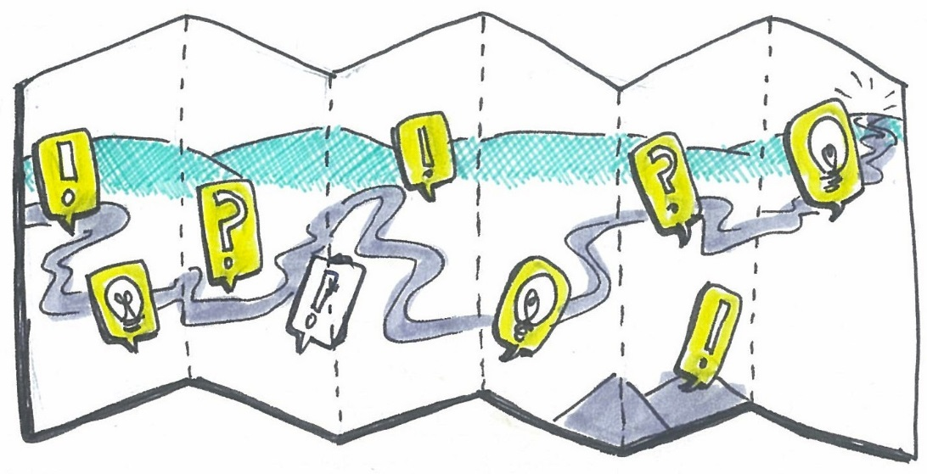
PLOT: the roadmap of a story
Plot is like a roadmap of a story. It details the major events of a story as well as the impacts of those events on the major character(s).
Know: key phases of plot (exposition, rising action, climax, falling action, resolution)
Understand: the centrality of conflict to plot; the link between plot and character
Be able to: use Freytag’s pyramid to summarize the plot of a novel
Use Freytag’s pyramid [on the next slide] to identify where your chapter[s] appear on the pyramid.
PLOT ARCHETYPES: Select the most appropriate plot archetype for The Life of Pi, apply the structure by seeing how closely the story follows. Then, create a timeline of events of the chapter that show how it conforms to (or deviates from) the plot archetype.

Slide 3
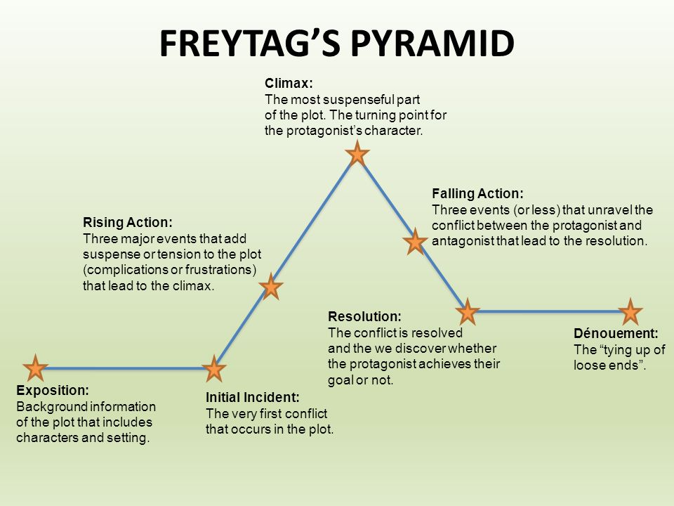

Slide 4
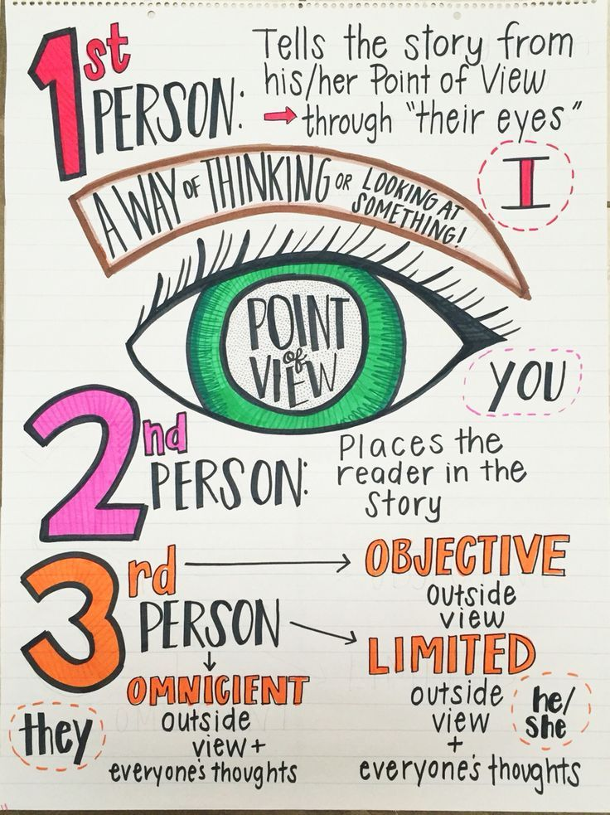
Narrator & Point of View
Even more important than what is being told in a story is who is telling it, how they are telling it, and who they are telling it to.
Understand: truth is relative - it depends on who is telling the story, how they are telling it, and who they are telling it to.
Be able to: describe and analyze the author’s narrative POV choices in a literary work
Need some help w/point of view? https://www.brainpop.com/english/writing/pointofview/
Complete the chart & answer the questions on the following slides.

Slide 5
Point of View:
first person | second person | third person (omniscient, limited, objective)
narration (direct, frame, indirect) | tense (past, present, historical present) | the unreliable narrator

Slide 6
Chart for Narration & Point of View
Aspect | Type | Example / Evidence | Why did the author choose this?
Point of view (first [major, peripheral], second, third person etc…)
Narration (direct, frame, indirect)
Speech (direct, reported, free indirect)
Tense (past, present, historical present tense)
Other (Objectivity? Reliability? Level of omniscience? Voice? )

Slide 7
Questions for Narration & Point of View
Is the story being interpreted by an external narrator or one of the characters, or both?
If the latter, how must this character’s mind affect the interpretation of the story? (ex. Is the character perceptive or imperceptive? Is the character truthful? (Whether by ignorance, stupidity or self deception.)
Has the character been chosen to conceal information? (Or to reveal it?)
How has the author’s choice of narrator yielded the greatest possible insight into the story?

Slide 8
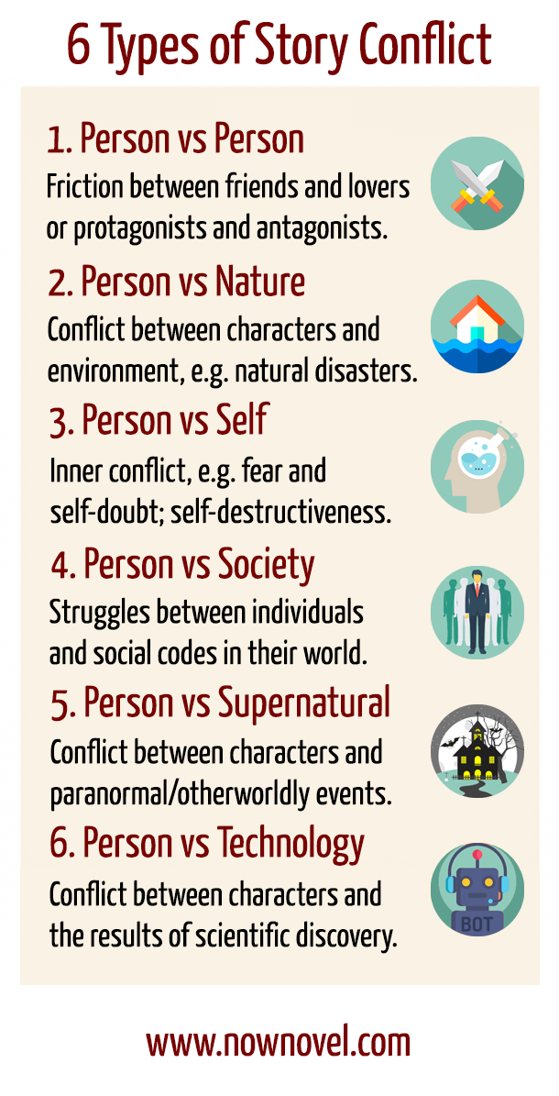
CONFLICT
What conflicts, internal or external, drive the plot?
What are the resolutions?

Slide 9
CHARACTER ANALYSIS
Interpretive fiction stories are usually character-driven rather than plot-driven.
Discuss the characters in your chapter by completing/discussing the following:
S.T.E.A.L the character
flat vs. round characters
static vs. dynamic characters

Slide 10
ALL LITERARY & RHETORICAL ELEMENTS
Find AT LEAST 15 different examples in your chapter.
Provide page #.
Discuss HOW the device contributes to the text.
Discuss WHY the author chose to use this device in the text.

Slide 11
THEMATIC CONNECTION
Good literary fiction will always reveal some ‘truth’ about life, and this is commonly referred to as the ‘theme’ or the work.
Theme is the most important consideration when analyzing any piece of interpretive fiction. It is the unifying element and it provides focus for your discussion.
Know: key definitions (motif vs. theme)
Understand: that the ability to state the theme of a story is the ability to truly understand it
Be able to: successfully provide a statement of theme for a novel and support with evidence
How does this part contribute to the overall theme of the play?
Look at the following slide for possible themes to discuss.

Slide 12
Themes to discuss:

Slide 13
CONNECTIONS:
TEXT-TO-TEXT: Please provide the actual text in your PPT and explain HOW the text relates to our novel.
TEXT-TO-SELF: How does this text relate to you/your life/your friends/ etc.?
TEXT-TO-WORLD: Find a REAL WORLD example on a CREDIBLE news website. Copy and paste the text into a slide.

Slide 14
IMPORTANT QUOTATIONS
Identify & explain at least 15 quotes that are important to the overall theme of the text.
Explain the significance of EACH quote using the text to justify your answer (CEI).

Slide 15
RUBRIC:
________ (70 pts.): Thoroughly teach the class using ALL of the information on the previous slide [less summary; majority analysis] ________ (10 pts.): Presentation is free of spelling & grammatical errors, is well organized and displays an obvious amount of effort.
________ (10 pts.): Presentation is entertaining and easy to follow.
________ (10 pts.): Reflection [to be completed the night after your presentation] explaining how you felt your presentation went, what you feel the students gained most from your lesson, what you wish you had explained better, and how teaching the class about this chapter allowed you a better understanding of the text. [INDIVIDUAL]

