Slide 1
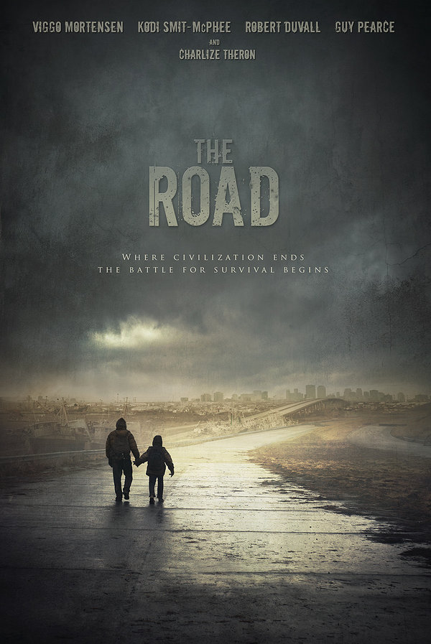
The Road
Pages 54-71

Slide 2

Thematic Concepts
Fire
“Beyond the window just the gathering cold, the fires on the horizon.” (pg. 59)
-This is a continuous theme throughout this section. From the burning of buildings, to how the man shapes the fire. The fire is referred physical and figuratively. It represent the end of the old world and the start of a new. The man the boy are known to carry the fire on the, meaning they are the only source of light.

Slide 3
Thematic Concepts
Family
“He held aloft the scrawny red body so raw and naked and cut the cord with kitchen shears and wrapped his son in a towel.”(pg.59)
-The author strongly shows the connection between a man and his son. The man still has his son and the son still has his father. The relationship between them is sacred. This is why the author included the birth of the boy.

Slide 4
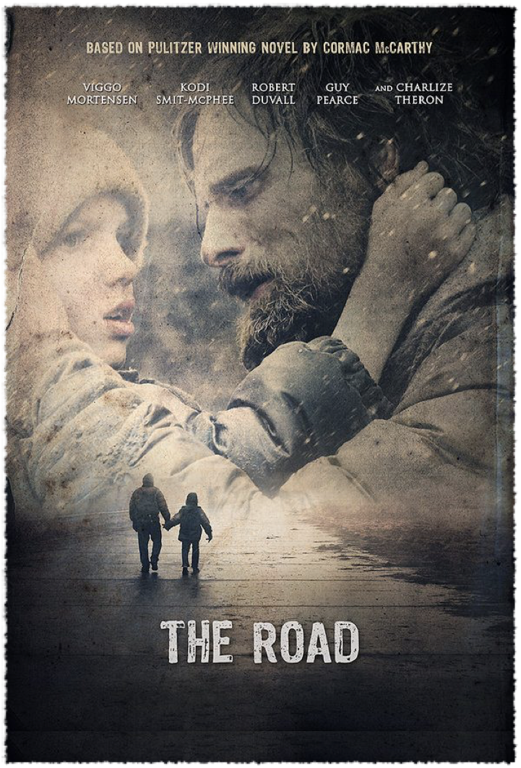
Symbols
The South
“The child had his own fantasies. How things would be in the south. Other children.” (pg.54)
-The south symbolize hope. The boy hopes for a world that does not involve just him and his father. A world where the sun shines bright and things are no longer gleam.

Slide 5
Symbols
The Boy
“Their birth in grief and ashes. So, he whispered to the boy. I have you.” (pg.54)
-The boy is symbolized by the man as the his light. The boy is the reason the man continues to live on. He carries all things still good about the world.
The Bad Man
“…the man stood with one hand put at his side, the dirty crumpled paintmask that he wore sucking in and out.”(pg.62)
-This man and the road gangs symbolizes the deterioration of the human race. They represent the ugliness that has emerged in this new world.

Slide 6
Motif
The Road
“Then he heard on the road behind them what sounded like a diesel truck.”
-The road is a reoccurring it is where most of the story takes place. The road is what’s leading the boy and the man to their paradise. The road poses an obstacle sometimes because it’s so open. Sometimes the man and the boy have to stray away from it.

Slide 7
Literary Devices
Simile
“Like an animal inside a skull looking out the eyeholes.”(pg.63)
-The man is no longer a man. He is now a product of the destroyed new world. He looks and is shaped like a man but the through his eyes the father sees that he is an animal.
“The boy so frail and thin through his coat, shivering like a dog.”(pg.67)
- The man and the boy had no place to stay with heat. So, they were stuck outside to find warmth within themselves. Since, the boy is so small and young he would get really could causing him to shake vigourously.

Slide 8
Imagery
“He held aloft the scrawny red body so raw and naked…”(pg.59)
-The description of the birth shows the purity of the child. The child is vulnerable and it is the fathers duty to protect him.
Flashback
“I don’t care. I don’t care if you cry. It doesn’t mean anything to me.”
“Please.”
(pg.55)
-The man has a flashback about the moments before his wife kills herself. They have an argument about what she’s about to do. The man tries to get her to stay but she doesn’t want to. Not even for her family, she has given up.

Slide 9
Important Subjects to look for
Violence
Love
Morality
Spirituality
Isolation
Good vs. Evil
Memory and the Past
Strength and Skills
Versions of Reality
Compassion and Forgiveness

Slide 10
Violence
“The man fell back instantly and lay with blood bubbling from the hole in his forehead.”(pg.66)
Love
“The boy was stumbling he was so tired and the man picked him up and sung him onto his shoulders and they went on.” (pg.71)
Morality
Man: “Don’t say it. It’s a bad thing to say.”
Boy:”I can’t help it.”
Man: “I know. But you have to.”
Boy: “How do I do it?”
(pg. 55)
Strength and Skills
“The man had already dropped to the ground and he swung with him and leveled the pistol…”(pg.66)

Slide 11
Memory and the Past
Man: “Death is not a lover.”
Woman: “Oh yes it is.”
Man: “Please don’t do this.”
Woman: “I’m sorry.”
Man: “I can’t do it alone.”
The Woman: “Then don’t. I can’t help you.”
(pg.57)

Slide 12
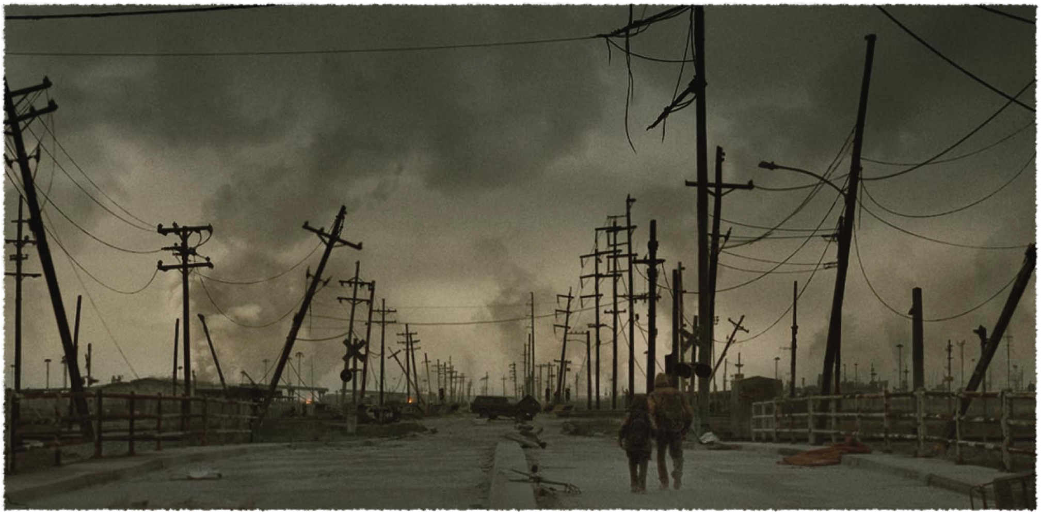
Discussion Questions

Slide 13
What do you think “All things of grace and beauty such that one holds them to one’s heart have a common provenance in pain” mean?
I think the author is saying that when you love something it opens you up to pain. The more you care about something or someone, the easier it is for you to get hurt.

Slide 14
Why do you think the man repeatedly looked at boy when he was talking to the father?
The man repeatedly looks at the boy because he sees him as the man’s weakness. Since the boy is the man doesn’t think the father will shoot. Also, he uses the boy as a way to persuade the father to come with him back to the truck. However, the man does not go with him because the group would probably harm him and his child.

Slide 15
Does the conversation between the woman and the man change your perspective of the mother?
The conversation changed my perspective of the mom because it shows she truly had no doubts about her actions. She no longer cared for her husband nor her child.

Slide 16
Why does the author say “They say women dream of danger to those in their care and men of danger to themselves?
I believe the author is referring to the mother here. She was willing to kill her child a long with killing herself but the man wouldn’t let her. Whereas the father would not have thought twice about it. He would only take his life and not his child’s

Slide 17
Why do you think the author includes details about the remains of the man the father killed?
He does this to show what the world has become. The people that the bad man thought were his people ate him. Leaving behind only his bones.

Slide 18
2014
Prose: The novel and short story
Discuss the means by which authors endeavor to control our sympathy in at least two works you have studied.

