Slide 1
Life of pi
Written by: Yann Martel

Slide 2
Reading objectives
▪ broaden understanding of the role of minor characters
▪ achieve better understanding of foil characters
▪ explore how literary allusions enhance characterization and theme
▪ identify direct and indirect characterization
▪ build an interpretation of a whole text, recognizing links between themes and characters
▪ read critically to develop original interpretations of a work
▪ read a literary work analytically, seeing the relationship between form and content
▪ respond to literature by describing and analyzing its stylistic features such as parallel structure
▪ analyze, compare and contrast ideas, viewpoints, and themes, within a work
▪ use supporting points with precise evidence and commentary
▪ identify and explain the significance of the essential literary elements of novels: character, setting, plot, theme, tone, point of view
▪ identify figurative language devices used by the author in a work
▪ examine how writers use figurative language, symbolism, and diction to shape meaning
▪ analyze how writers shape meaning through a range of organization and syntax
▪ explore language variation and development according to time, place, culture, and society
▪ evaluate the ways in which ideas, viewpoints, and themes in a work may be interpreted differently according to the perspective of the reader

Slide 3
Writing objectives
▪ engage in formal writing assignments that require utilization of all stages of the writing process
▪ revise writing for clarity and depth of content
▪ respond in discussions and in writing, using personal, literal, and interpretative stances, to works of fiction and/or non-fiction
▪ communicate through writing using precise language
▪ write as a method of discovering and clarifying ideas
▪ use a wide-ranging vocabulary used appropriately and effectively
▪ establish a convincing viewpoint by drawing on a repertoire of techniques to shape the reader's response
▪ participate in discussions and writing which demonstrates an understanding of diverse cultural perspectives
▪ create a range of paragraph structures to convey ideas and achieve particular literary effects
▪ write complex analytical essays, maintaining accuracy and deploying a range of grammatical conventions appropriately
▪ make conscious and purposeful adaptations to grammar for specific effect
▪ engage in informal writing assignments: reader response, focused freewriting, response journals
▪ use technology to access information, organize ideas, and develop writing

Slide 4
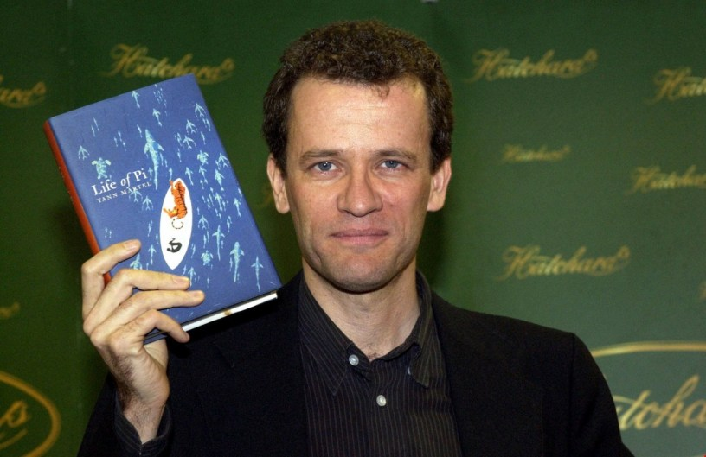
About the author
Yann Martel was born in Salamanca, Spain. Because his father was a professor and a diplomat, Martel’s family moved frequently. During his childhood he lived in Portugal, Alaska, Costa Rica, France, Mexico, and the Canadian provinces of Ontario and British Columbia. Martel continues to travel extensively and stayed in India, Iran, and Turkey over a long period of time. He received a degree in philosophy from Trent University in Ontario
Martel performed much of the research that would lead to the writing of Life of Pi in India, where he spent thirteen months visiting mosques, temples, churches, and zoos. Following that, he spent one year reading various background texts for his novel before taking two years to write his award winning novel. Life of Pi is an international bestseller and has received numerous awards: Canada’s Hugh MacLennan Prize for Fiction in 2001 and the 2002 Man Booker Prize.
A fictitious author in Life of Pi writes a tale about a 16 year-old-boy named Piscine Patel who survives on a lifeboat for 227 days with a zebra, a hyena, an orangutan, and a 450-pound tiger. When Pi’s father decides to relocate the family and the family zoo to Canada, the cargo ship Tsimtsum sinks. The character gives himself the name “Pi.” He is a curious young man who studies science and three religions simultaneously-Christianity, Hinduism, and Islam-extensively. Pi is rescued, landing on a beach in Mexico, and later recounts his story for survival to investigators of the cause of the ship’s sinking.

Slide 5
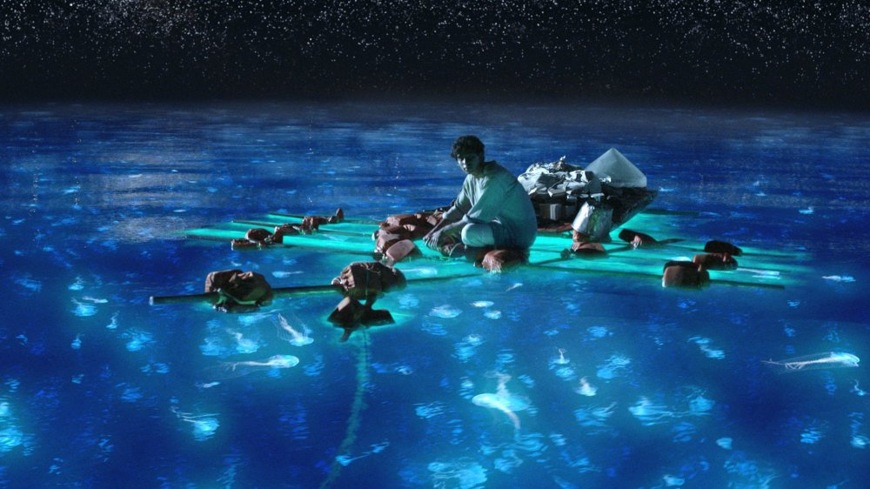
Interview with the author

Slide 6
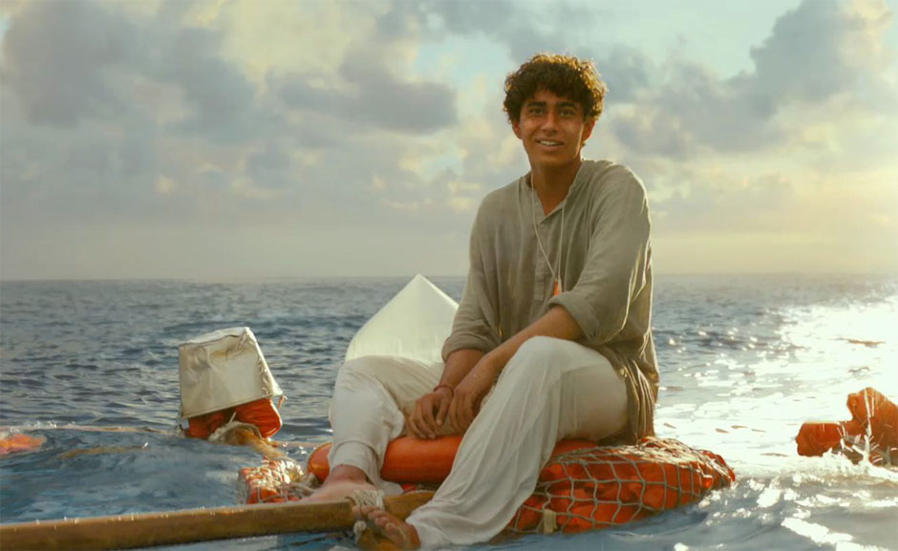
Life of pi
Why did Pi and his family leave India for Canada?
Yann Martel does not go into depth on this subject – This introductory lesson to Life of Pi will cover the Indian Emergency - the circumstances that forced Pi's family to leave India which occurred from June 1975 to March 1977.

Slide 7
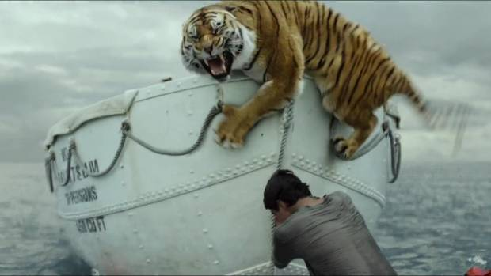
Background information- Context of composition
Pi remembers his childhood in Pondicherry (a French colonial settlement in India until 1954) with fondness and a sense of peace and fascination at living in a zoo. However, the reality for Indians at this time was a far different one from the imagined world of Pi.
Indira Gandhi was the Prime Minister of India at this time and she enacted several controversial decisions. This period of time came to be called the Indian Emergency because it was a period of time in which the Constitution of the country was suspended and police were given extraordinary powers such as the arrest and detention of political activists and curfews upon the population.

Slide 8
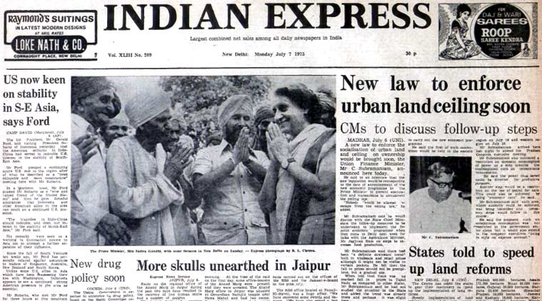

Slide 9
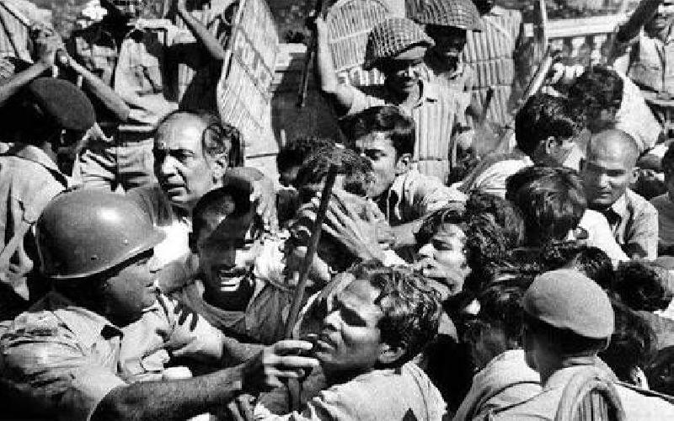
The Indian emergency
The Indian Emergency of 25th June 1975-21st March 1977 was a 21 month period, when President Fakhruddin Ali Ahmed, upon advice by Prime Minister Indira Gandhi, declared a state of emergency under Article 352 of the Constitution of India, effectively bestowing on her the power to rule by decree, suspending elections and civil liberties.
This was a dramatic turn in the Indian political affairs. The democracy was brought to a grinding halt and all the fundamental rights and legal remedies protected by the Constitution of The Republic of India were suspended.
Indira Gandhi tried to defend the emergency on the grounds that she was trying to protect the State and the Indian people. Nevertheless, her emergency rule faced immense criticism and is undoubtedly one of the most controversial periods of the political history of Independent India.

Slide 10
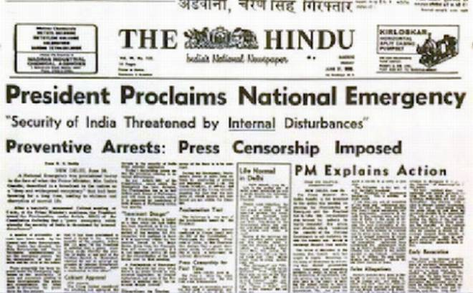
The Indian emergency video

Slide 11
Define the following terms:
▪ hero journey
▪ irony
▪ juxtaposition
▪ memento mori
▪ motif
▪ narrator
▪ paradox
▪ personification
▪ simile
▪ surrealism
▪ theme
▪ the Indian Emergency of 1975
▪ allusion
▪ bildungsroman
▪ characterization
▪ chiaroscuro
▪ chiasmus
▪ cliché
▪ comic relief
▪ diction
▪ foil
▪ symbolism
▪ syntax

Slide 12
Reading comprehension questions & quiz breakdown
Ch. 1-5
Ch. 6-10
Ch. 11-16
Ch. 17-23
Ch. 24-29
Ch. 30-36
Ch. 37-42
Ch. 43-47
Ch. 48-53
Ch. 54-58
Ch. 59-65
Ch. 66-72
Ch. 72-81
Ch. 82-91
Ch. 92-94
Ch. 95-100

Slide 13
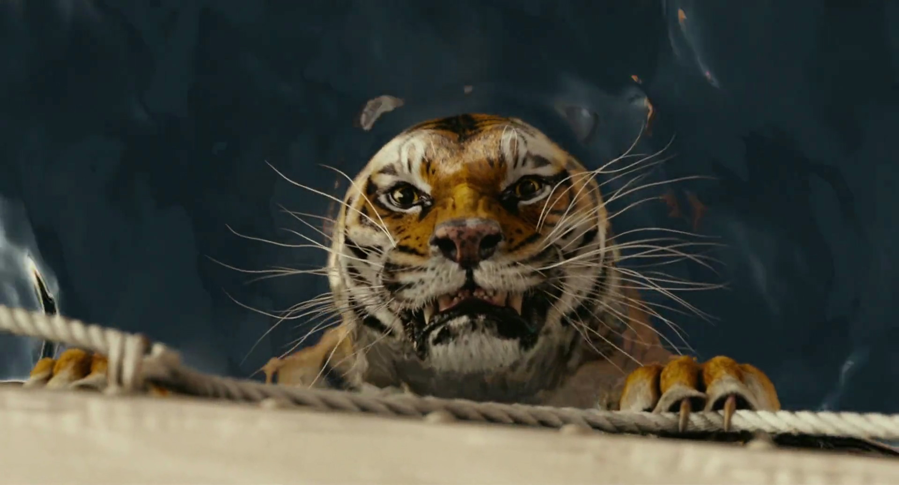
Life of pi trailer

