Slide 1
Today we will be traveling to…
China (E. Asia) India (S. Asia) & Yemen (W. Asia)

Slide 2
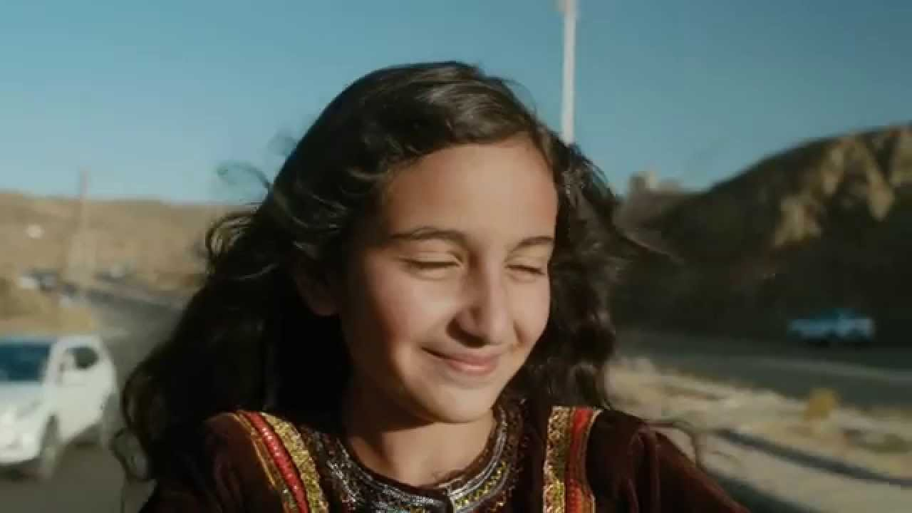
Agenda
Gendercide
Documentary: It’s A Girl
Silent Discussion/Anticipation
Yemen
(background info of book)
Start Reading the novel

Slide 3
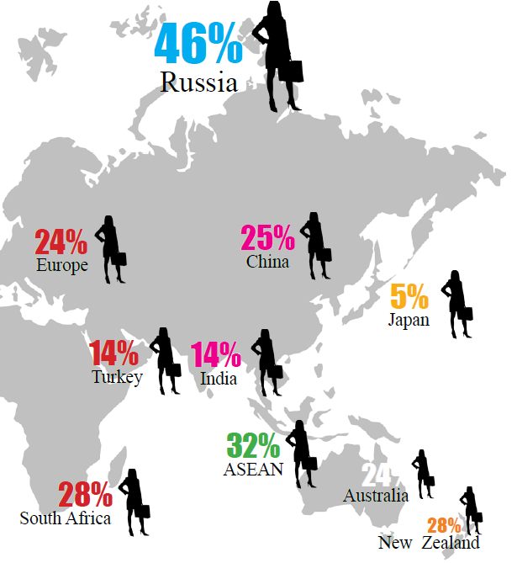
A Patriarchal World

Slide 4
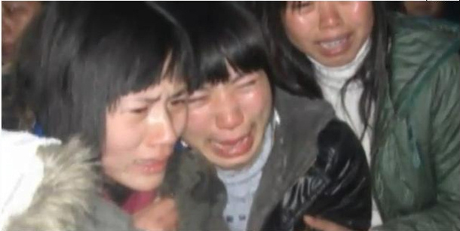
Gendercide: “It’s a girl…the 3 deadliest words in the world.”
What is it?
Systematic killing of members of a specific sex
June 2015, United Nations
“200 million women, demographically missing”
“In China, there are whole villages of ‘bare branches’.”
“What worries [them] is that there are 37 million marriage age, military age men in China” & the same in India.”

Slide 5
What’s the result?
Issues with human trafficking and sex slavery
In China (as a result of the 1-child policy), 336 women have been aborted and 195 million have been sterilized (in 30 years).
Within 40 yrs, there will be 500 million elderly citizens.
In India (unborn girls are discriminated against/dowry system), women who have girls know that in time they will have to pay a huge lump sum to marry them off.
A woman in May of 2015 admitted to having aborted 18 girls after having 2 daughters.
Gendercide is an issue in: Vietnam, Singapore, Taiwan, Bangladesh, Nepal, Pakistan, Afghanistan, Turkey, Syria, Iran, Azerbaijan, Armenia, Georgia, Albania, Romania, Montenegro, Kosovo, Macedonia, Egypt, Tunisia, Algeria, and most sub-Saharan countries in Africa.

Slide 6
What’s the result? Cont’d…
UN reported, “When we look at percentages, it is evidence that China, with 10.3 percent of its women missing, eliminates a higher percentage of its females than any other country in the world. India follows next, with about 7 percent missing, and then Afghanistan with 7 percent.”
It continued: “One might think that when men compete for a limited number of women, women’s power and prestige increases. However, the opposite is true. Because women are scarce, bachelors turn to ever younger girls as brides. Young girls are married off to much older men, sometimes even before the girls reach puberty. Once married, these girls have no time for education or paid work. Their older husbands and in-laws, eager for heirs, press them into childbearing as soon as possible. These girls give birth before their bodies are ready, resulting in high rates of maternal death and injury.”
And for men? “A population surplus of young men, mainly lower class, develops. These men never marry, have families, or become part of society. The Chinese call them ‘bare branches’ or ‘floaters.’ In China, these men have shorter life expectancies than married men.”

Slide 7
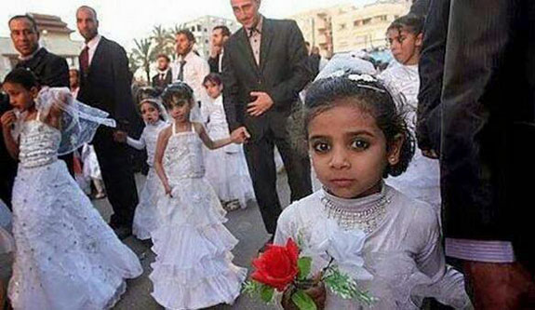
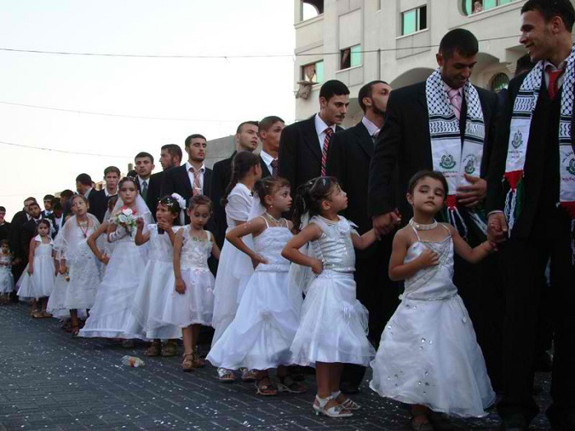

Slide 8
It’s A Girl Documentary

Slide 9
Silent Discussion
You have 10 minutes to think about this prompt.
You may ONLY respond to the prompt with a question.
Please write all questions you come up with on the board.
Remember, you must be silent. That means NO talking…
We will discuss as a class after the time is up.

Slide 10
Question with a Question Activity
Female feticide is one of the primary means of eliminating females in both India and China, yet some of the human rights community are hesitant to actively work against female feticide because it’s related to abortion rights.
Is there a contradiction between supporting abortion rights in general and trying to restrict or ban abortions based on sex?

Slide 11
Yemen
Intro to Age 10 and Divorced

Slide 12
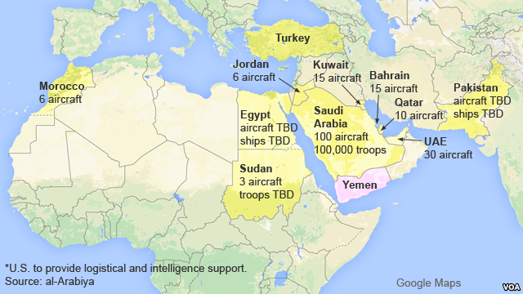

Slide 13
Facts
Second largest county in the Arabian Peninsula
Includes more than 200 islands
Bordered by Saudi Arabia, the Red Sea, the Gulf and Aden and the Arabian Sea.
Capital is the city of Sana’a however, the city has been under rebel control since Feb 2015.
Capital has been temporarily relocated to the port city of Aden on the southern coast.
Yemen has been in chaos since 2011.
Started with street protests against poverty, unemployment, corruption and president Saleh’s plan to amend the constitution. To eliminate presidential term limit (he wanted to be president for life).
Speak Arabic.

Slide 14
Facts continued…
“The name of the country is derived from the legendary ancestor Yaman, the son of Qahtan, or from the Arabic root ymn ("the right") since Yemen is located to the right of the Meccan sanctuary of Kaaba. Some scholars compare the Arabic word yumna ("happy") with the Roman name for the southwest Arabia, Arabia Felix ("Happy Arabia"). Inhabitants feel that they have a common culture, although local and class identities are still important.”
“The colors of the national flag (horizontal bands of red, white, and black) reflect pan-Arab symbolism, being similar to the flags of Syria, Iraq, and Egypt. The national anthem and national days of celebration emphasize the unification of the country.”
“About one-fourth of the gross domestic product is derived from agriculture. However, the nation imports more than sixty percent of its food needs. About twenty percent of the population suffers from malnutrition. Agriculture employs more than half the labor force. The principal crops are sorghum, potatoes, dates, wheat, grapes, barley, maize, cotton, millet, and garden vegetables, but only part of the harvest is produced for sale. This is also the case for sheep, goats, and camels. Coffee, biscuits, grapes, sesame seeds, sugar, honey, and dried and salted fish are exported.”
“The 1994 constitution states that women are men's sisters and have rights and duties guaranteed by Islamic Shari'a and secular law. However, gender disparity in all aspects of life outside the family is striking, since religious authorities strongly recommend gender segregation. For example the testimony of two women in court equals that of one man.”

Slide 15
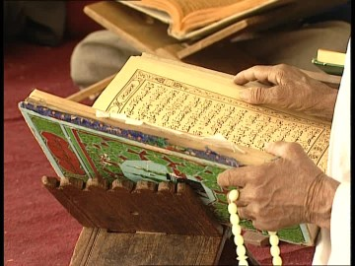
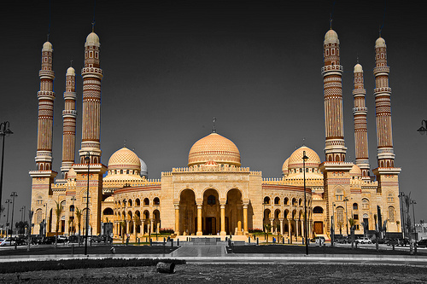
Religion
Majority of the population is Muslim, which is split between two groups.
Long-running conflict between the two groups about the Prophet Mohammed’s successor.
60-65% Sunni
Support the picking of Muhammed’s close friend and advisor.
35-40% Shia
Believe the prophet’s cousin should have filled the role

Slide 16
Women
Gender-based violence and gender inequality are a grave problem throughout Yemen.
92% of women have said that violence commonly occurs in the home (according to the country’s 2013 demographic and health survey).
Problem is worsening.
Women viewed as “subordinate and indulgent mothers, sisters, and wives who perform household duties.”

Slide 17
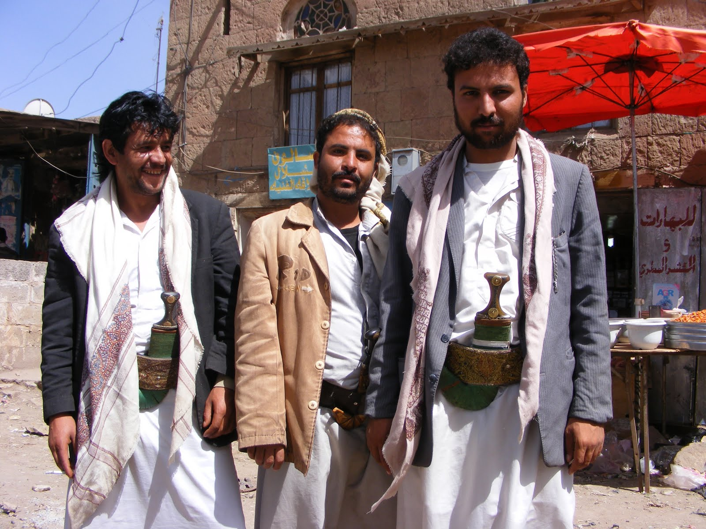
Men
In Yemen’s ultra-conservative society, girls are not even allowed to talk with strangers who are potential suitors except when buying from a male shopkeeper or asking for directions or other information.
Segregated schools and restaurants
“…are seen as financial providers in the outside world, responsible for the wellbeing and prestige of the family.”
Believe real and honorable love comes after marriage.
Relationships between single men and women are disgraceful.
Unlike many neighboring countries where restrictions on relationships between young men and women have been relatively eased, Yemen and Saudi Arabia are still highly conservative. Relationships outside the framework of marriage are seen as “prohibited.”

Slide 18
Consider This…
“Love [outside marriage] in Yemen is socially associated with shame.
Generally speaking, Yemeni people disapprove of love even though it’s pure and true, and consider it to be out of the norm,” journalist Adnan Rajeh, 27, told The Media Line. “The culture of shame attached to love has built a solid wall between the youths of both sexes.”
Compare this quote with what you know to be true about love and dating.

Slide 19
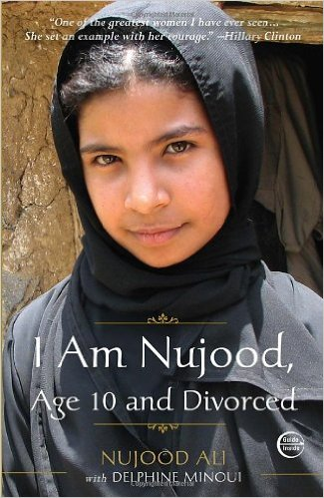
Book Trailer “I’m a simple village girl who has always obeyed the orders of my father and brothers. Since forever, I have learned to say yes to everything. Today I have decided to say no.”

Slide 20
HW:
Find, read, & print ONE relevant news article related to the documentary/novel.
You must annotate the text & bring it with you to class.
Be prepared to share/analyze the text with the class!

