Slide 2
Learning Outcomes
Notes:
These can be changed to reflect your school’s specific rules.

Slide 3
Analyze elements such as theme and ethical stance or moral values of literary texts
Explore literary works in detail
Understand and make appropriate use of literary terms

Slide 4
Essential Question
Notes:
These can be changed to reflect your school’s specific rules.

Slide 5
What makes a work of fiction have literary merit?
Literary fiction provides authentic insights about life through entertaining depictions of imaged experiences.

Slide 6
Unit Plan:
Notes:
These can be changed to reflect your school’s specific rules.

Slide 7
The Great Gatsby unit:
DAY 1 [01/30]: Test + Unit Discussion/Plan
DAY 2 [02/01]: Theme Poster
DAY 3 [02/05]: Theme Poster
DAY 4 [02/07]: Presentations (Ch. 1 & 2)
DAY 5 [02/11]: Presentations (Ch. 3 & 4)
DAY 6 [02/13]: Presentations (Ch. 5 &6)
DAY 7 [02/21]: Presentations (Ch. 7 & 8)
DAY 8 [02/25]: Presentations (Ch. 9)+ Socratic Seminar [w/discussion wheel]

Slide 8
Grades:
Test (summative grade)
Theme poster (formative)
Chapter presentation (midterm)
Daily annotation check (5 checks; 20 pts. each day=100 pts.) (formative)

Slide 9
Grouping:
Notes:
These can be changed to reflect your school’s specific rules.

Slide 10
A2:
Ch. 1-2: Julia + Jasmin + Chrishya [02/07]
Ch. 3-4: Jayla + Ayele [02/11]
Ch. 5-6:Keyvon + Max [02/13]
Ch. 7-8: Pili + Ty + Kelsey [02/21]
Ch. 9: Noah [02.25]

Slide 11
A3:
Ch. 1: J. Alexander, Michelle. Llona [02/07]
Ch. 2: Jalyn, Aaron, Ross, KeAuri [02/07]
Ch. 3: Garner, Fran, Cameron [02/11]
Ch. 4: Camille, Dom., Aleisha [02/11]
Ch. 5: Jordynn, Malana, Jermya, Jessica [02/13]
Ch. 6: T’Mia, April, Shania [02/13]
Ch. 7: Deja, Taylor O., Jamiah [02/21]
Ch. 8: Keith, Dereck, Shaderria, Caliya [02/21]
Ch.9: Alysha, Charlese, Tyler [02/25]

Slide 12
Presentation Guidelines, Rubric & Audience Participation:
PART I: What is expected of the presenter
PART II: What is expected of the audience
Notes:
These can be changed to reflect your school’s specific rules.

Slide 13
Part #1:
The following 16 slides contain all of the information necessary for your presentation.
The Presenter's Job

Slide 14
PLOT: the roadmap of a story
Plot is like a roadmap of a story. It details the major events of a story as well as the impacts of those events on the major character(s).
Know: key phases of plot (exposition, rising action, climax, falling action, resolution)
Understand: the centrality of conflict to plot; the link between plot and character
Be able to: use Freytag’s pyramid to summarize the plot of a novel
Use Freytag’s pyramid [on the next slide] to identify where your chapter[s] appear on the pyramid.
PLOT ARCHETYPES: Select the most appropriate plot archetype for The Great Gatsby, apply the structure by seeing how closely the story follows. Then, create a timeline of events of the chapter that show how it conforms to (or deviates from) the plot archetype.

Slide 15
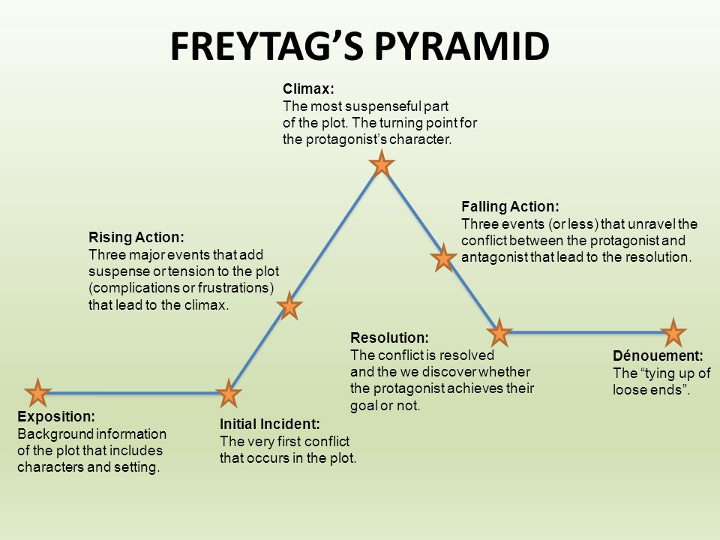

Slide 16
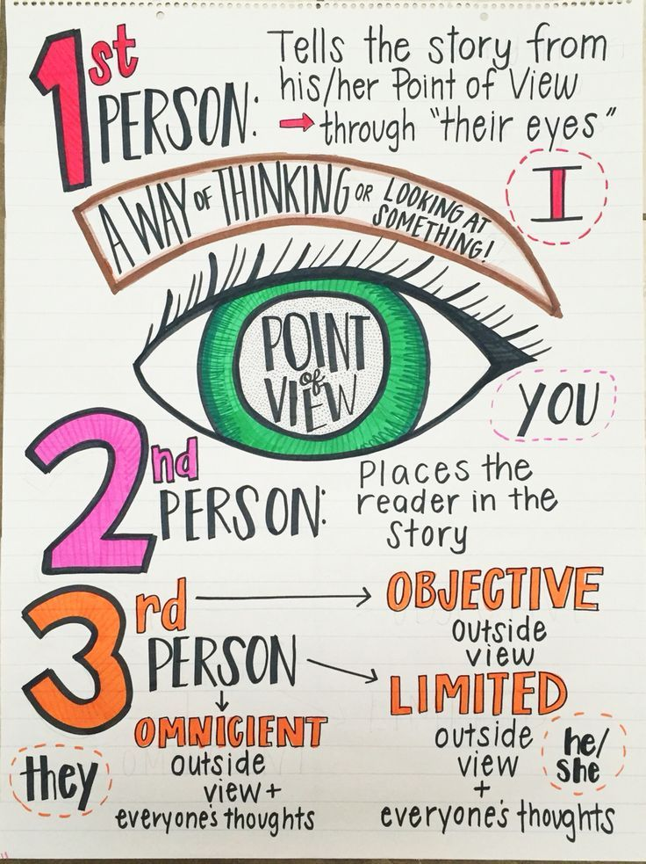
Narrator & Point of View
Even more important than what is being told in a story is who is telling it, how they are telling it, and who they are telling it to.
Understand: truth is relative - it depends on who is telling the story, how they are telling it, and who they are telling it to.
Be able to: describe and analyze the author’s narrative POV choices in a literary work
Need some help w/point of view? https://www.brainpop.com/english/writing/pointofview/
Complete the chart on slide 15 & answer the questions on slide 16.

Slide 17
Point of View:
first person | second person | third person (omniscient, limited, objective)
narration (direct, frame, indirect) | tense (past, present, historical present) | the unreliable narrator

Slide 18
Chart for narration & point of view
Aspect | Type | Example / Evidence | Why did the author choose this?
Point of view (first [major, peripheral], second, third person etc…)
Narration (direct, frame, indirect)
Speech (direct, reported, free indirect)
Tense (past, present, historical present tense)
Other (Objectivity? Reliability? Level of omniscience? Voice? )

Slide 19
Questions for Narration & Point of View
Is the story being interpreted by an external narrator or one of the characters?
If the latter, how must this character’s mind affect the interpretation of the story? (ex. Is the character perceptive or imperceptive? Is the character truthful? (Whether by ignorance, stupidity or self deception.)
Has the character been chosen to conceal information? (Or to reveal it?)
How has the author’s choice of narrator yielded the greatest possible insight into the story?

Slide 20
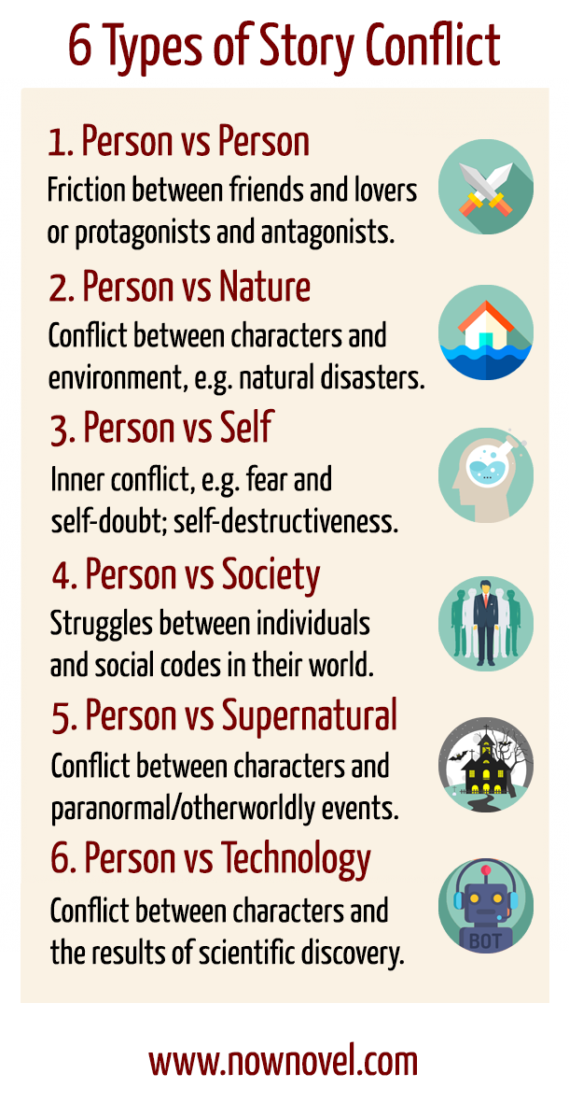
CONFLICT
What conflicts, internal or external, drive the plot?
What are the resolutions?

Slide 21
CHARACTER ANALYSIS
Interpretive fiction stories are usually character-driven rather than plot-driven.
Discuss the characters in your chapter by completing/discussing the following:
S.T.E.A.L the character
flat vs. round characters
static vs. dynamic characters

Slide 22
Character relationships:

Slide 23
ALL LITERARY & RHETORICAL ELEMENTS
Find AT LEAST 7 different examples in your chapter.
Be able to show the class exactly where in the text the example is.
Discuss HOW the device contributes to the text.

Slide 24
THEMATIC CONNECTION
Good literary fiction will always reveal some ‘truth’ about life, and this is commonly referred to as the ‘theme’ or the work.
Theme is the most important consideration when analyzing any piece of interpretive fiction. It is the unifying element and it provides focus for your discussion.
Know: key definitions (motif vs. theme)
Understand: that the ability to state the theme of a story is the ability to truly understand it
Be able to: successfully provide a statement of theme for a novel and support with evidence
How does this chapter contribute to the overall theme of the play?
Look at the following slide for possible themes to discuss.

Slide 25
Themes to discuss:

Slide 26
IMPORTANT QUOTATIONS
Identify & explain at least 5 quotes that are important in your assigned chapter.
Explain the significance of EACH quote using the text to justify your answer (you can pull from other parts of the text to justify your answer).

Slide 27
LEARNING OUTCOMES
Be sure that you are meeting ALL three learning outcomes with your presentation.
1. Explore literary works in detail. - understand the explicit and implicit meanings in a text - identify and situate a text or an extract in the context of a larger work - respond to the key features of texts such as language, characterization and structure 2. Analyze elements such as theme and the ethical stance or moral values of literary texts. Issues to be considered could include: - identify the evidence in the text for a particular stance. - consider point of view in different literary genres 3. Understand and make appropriate use of literary terms.

Slide 28
RUBRIC:
________ (40 pts.): Thoroughly teach the class using ALL of the information on the previous slide [less summary; majority analysis] {In other words, presentation meets all three learning outcomes.}
________ (10 pts.): Presentation is 45 minutes {a2} & 35 minutes {a3} [no more, no less]. ________ (10 pts.): Presentation is free of spelling & grammatical errors, is well organized and displays an obvious amount of effort.
________ (5 pts.): Presentation is entertaining and easy to follow.
________ (20 pts.): Written explanation (500) words detailing how your lesson will help the class towards the IOC. This needs to be submitted individually from each member of the group in his/her own words THE FOLLOWING CLASS PERIOD the presentation. [be very specific]. [INDIVIDUAL]
________ (15 pts.): Reflection [to be completed the night after your presentation] explaining how you felt your presentation went, what you feel the students gained most from your lesson, what you wish you had explained better, and how teaching the class about this chapter allowed you a better understanding of the text. [INDIVIDUAL]

Slide 29
possible presentation format: You can present however you want; this is just here for anyone who is struggling.
Briefly summarize the plot OF YOUR CHAPTER (3-5 min).
You can start off with the END of the chapter before yours, but your summary needs to focus on your chapter.
Explain setting significance (2-3 min.)
Analyze character development (10-12 min.)
Highlight all important quotations that display this.
Discuss any conflict that occurs; what does this conflict mean for the characters/plot/theme/etc.?
Address all literary and rhetorical elements (10-12 min.)
Highlight all important quotations that display each literary/rhetorical element. Be able to tell your class EXACTLY where in the text to find each quote.
Discuss thematic connection (5-7 min.)
Highlight important quotations that display this.
Class discussion? Quick Kahoot? Quick activity?: provide some questions to ensure your audience understood your lesson. This should be fairly brief. (3-4 min.)

Slide 30
Part #2:
The Audience’s Job

Slide 31
During each presentation:
You must have your book out and open.
You must be taking notes directly in your book on everything that is mentioned during the presentation. [Annotations will be checked at the end of each day; 5 presentation days= 20 pts. ea day= 100 pts. total formative!]
You must write the group a “thank you” note explaining what you learned during their presentation and what you found confusing/not fully explained.

Slide 32
Miss something?
Notes:
These can be changed to reflect your school’s specific rules.

Slide 33
If you are absent for any of the presentations:
Check the website! All presentations will be posted there for your convenience.
Link: http://thornezone.weebly.com/part-four-y1-spring.html

