Slide 1
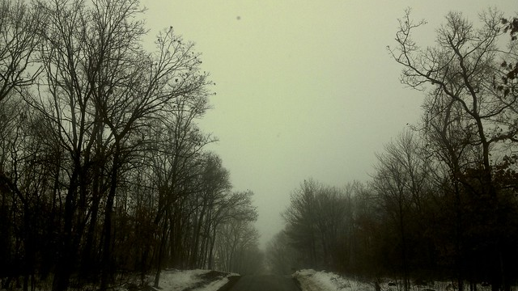
The road
pgs. (144-155)
Francesca McDaniel
This Photo by Unknown Author is licensed under CC BY-NC-ND

Slide 2
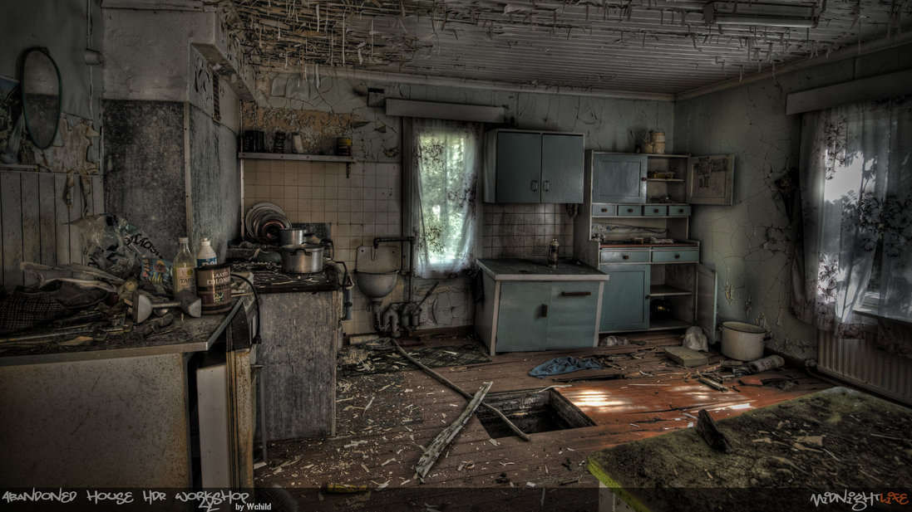
Summary of pages 144-155
While The Man and The Boy were walking The Man came across an abandoned house. They went inside to see if they could find any resources or food. They found a lot of food and supplies in the cellar of the abandoned house. There The Boy and The Man eat and get cleaned up. They also catch up on some much-needed rest before heading out on the road again.

Slide 3
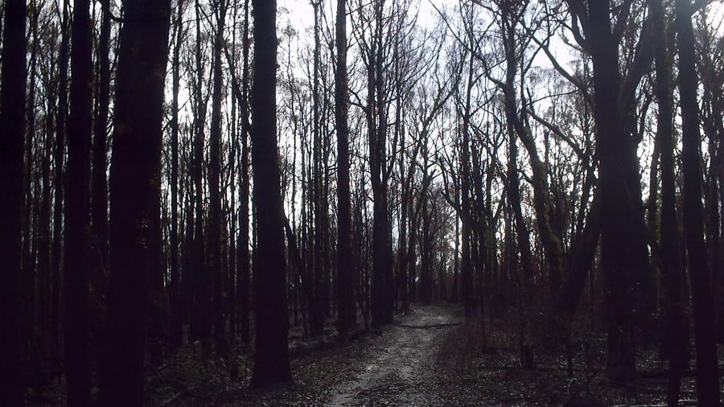
Thematic concepts
Death
Spiritualty
Love
This Photo by Unknown Author is licensed under CC BY-SA-NC

Slide 4
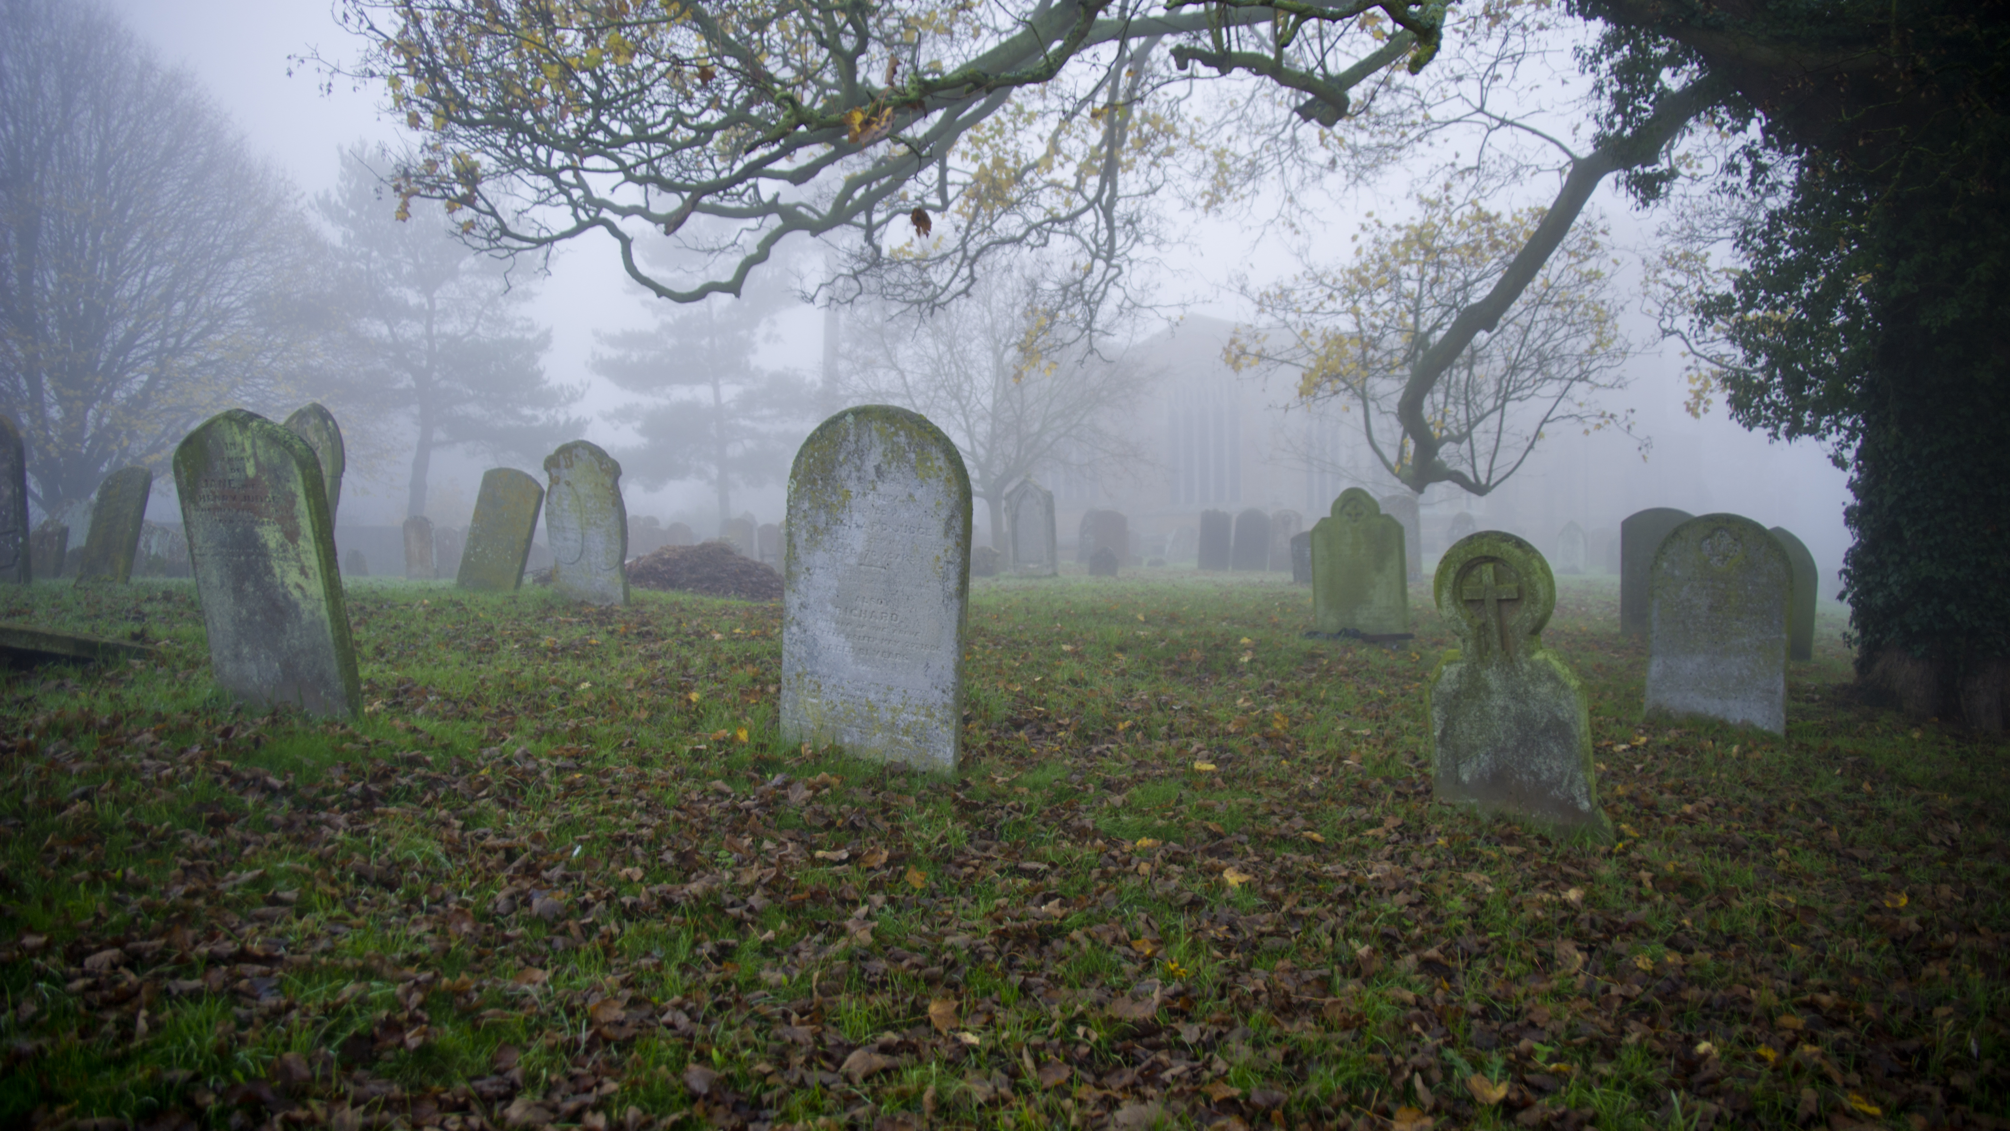
Death
Death is extremely prevalent throughout the whole book. In this specific part of the book The Man and The Boy had lost a lot of their hope. They had not eaten or slept in a while. The Man tried to give The Boy hope, but he felt that their time to die was soon. It was not until they found the abandoned house did they think everything was going to be okay.
Example(s):“He’d been ready to die and now he wasn't going to and he had to think about that” (pg. 144)

Slide 5
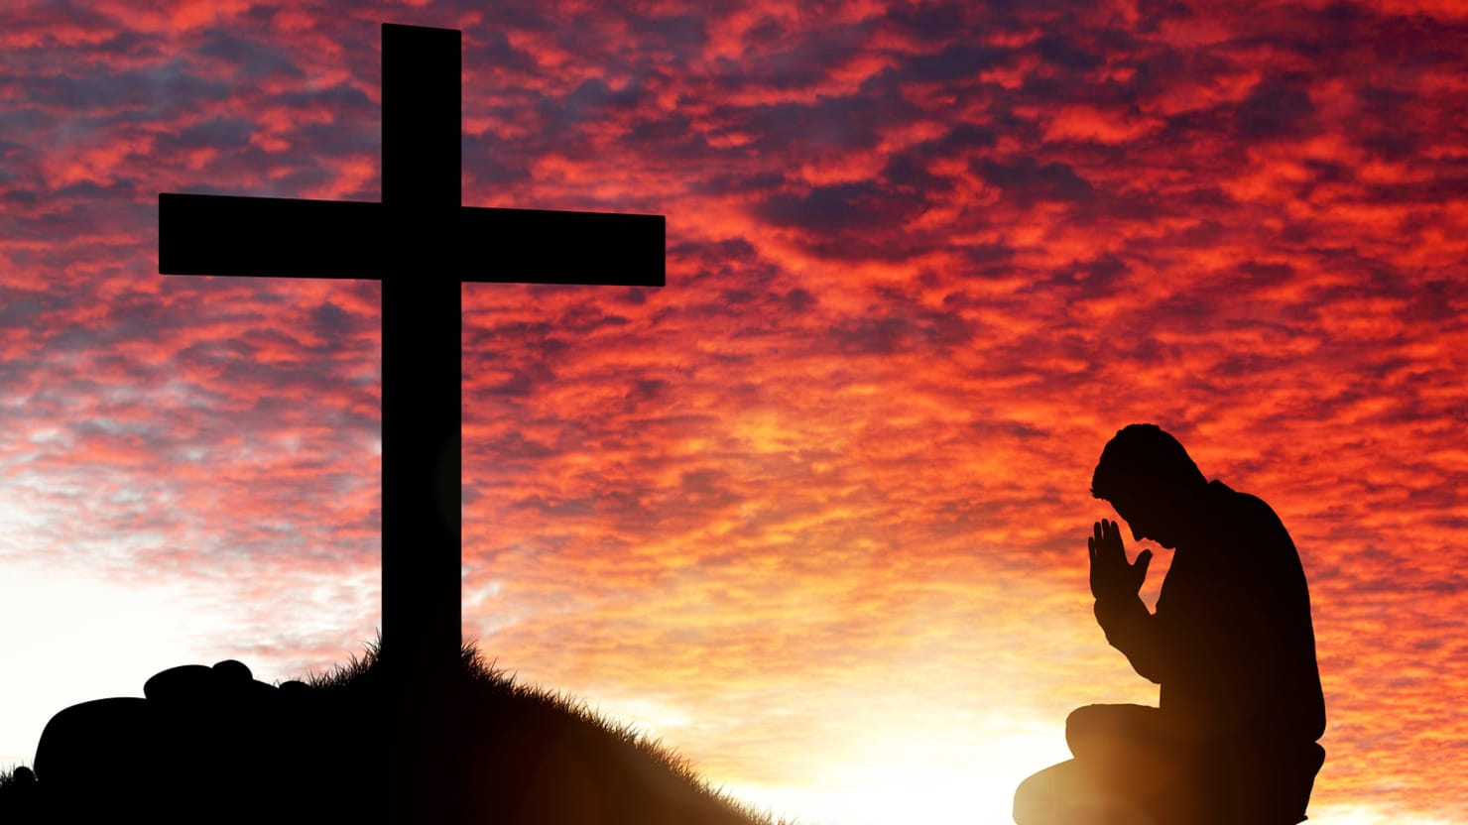
Spiritualty
Throughout the book The Man is not very religious. He’s seems to only be spiritual for his son. The man seems to have a connection with God only because of The Boy. I believe that spirituality also gives people hope. This may be why The Man allows The Boy to pray. The Man also prays which may be because he believes and needs hope. Or it could be because he wants to make his son happy.
Example(s): “Dear people, thank you for all this food and stuff. We know that you saved it for yourself and if you were here we wouldn’t eat it no matter how hungry we were and we’re sorry that you didn’t get to eat it and we hope that you’re safe in heaven with God.

Slide 6
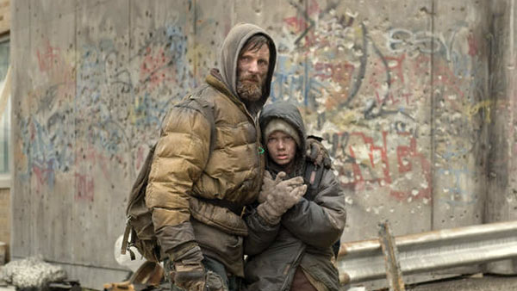
Love
Love is also very prevalent throughout the book. The love that the father and son have for each other is undeniable. When we see love in the book it is often used to make either The Man or The Boy feel better. They constantly reassure each other in a loving way. Love also shows us how strong their relationship is with each other. ** In these examples we see love as a form of reassurance**
Example(s): “Do you think they’ll find us? No. They won’t find us. They might find us. No they won’t. They won’t find us.”
pg. 148
“…he set about cutting his hair. He tried to do a good job and it took some time. When he was done he took the towel from around the boy’s shoulders….You did a good job, Papa.”
- pg. 151

Slide 7
Motif
Dreams
This Photo by Unknown Author is licensed under CC BY-SA-NC

Slide 8
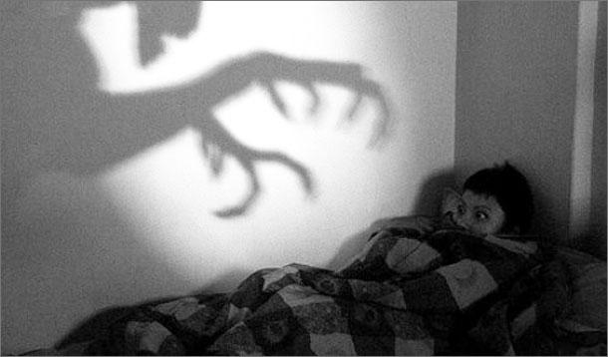
Dreams
The Man and The Boy often dream throughout the novel whether it be figuratively or literally. They are either dreaming of better days and happier times or dreaming about something bad happening to them. The dreams also cause them to have paranoia at times. Specifically The Man. The dreams are reoccurring and gives readers insight on The Boy and The Man’s thoughts.
Example(s): “He’d been visited in a dream by creatures of a kind he’d never seen before. They did not speak. He thought that they’d been crouching by the side of his cot as he slept and then had skulked away on his awakening. He turned and looked at the boy.”
pg. 153

Slide 9
Symbols
The Boy
Food
This Photo by Unknown Author is licensed under CC BY-SA-NC

Slide 10
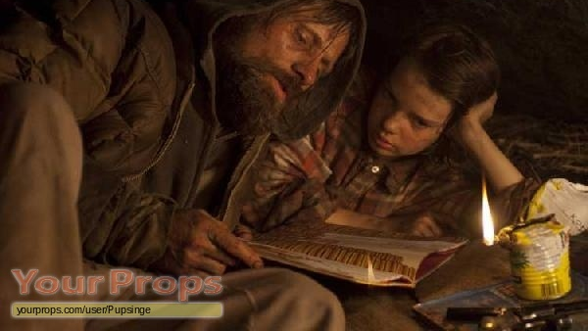
The boy
The Boy symbolizes hope for The Man. It is obvious that the man tries so hard to survive so that he can protect his son. The Boy also symbolizes Jesus. Which goes hand in hand with hope for the man. In the Bible it is stated that when Jesus returns all will be well. This gives people hope for better days. The Boy does the same thing for The Man.
Example(s): “Dear people, thank you for all this food and stuff. We know that you saved it for yourself and if you were here we wouldn’t eat it no matter how hungry we were and we’re sorry that you didn’t get to eat it and we hope that you’re safe in heaven with God. He looked up. Is that okay? he said. Yes. I think that’s okay.”
pg. 146
“If you’re on the lookout all the time does that mean that you’re scared all the time?”
- pg. 151

Slide 11
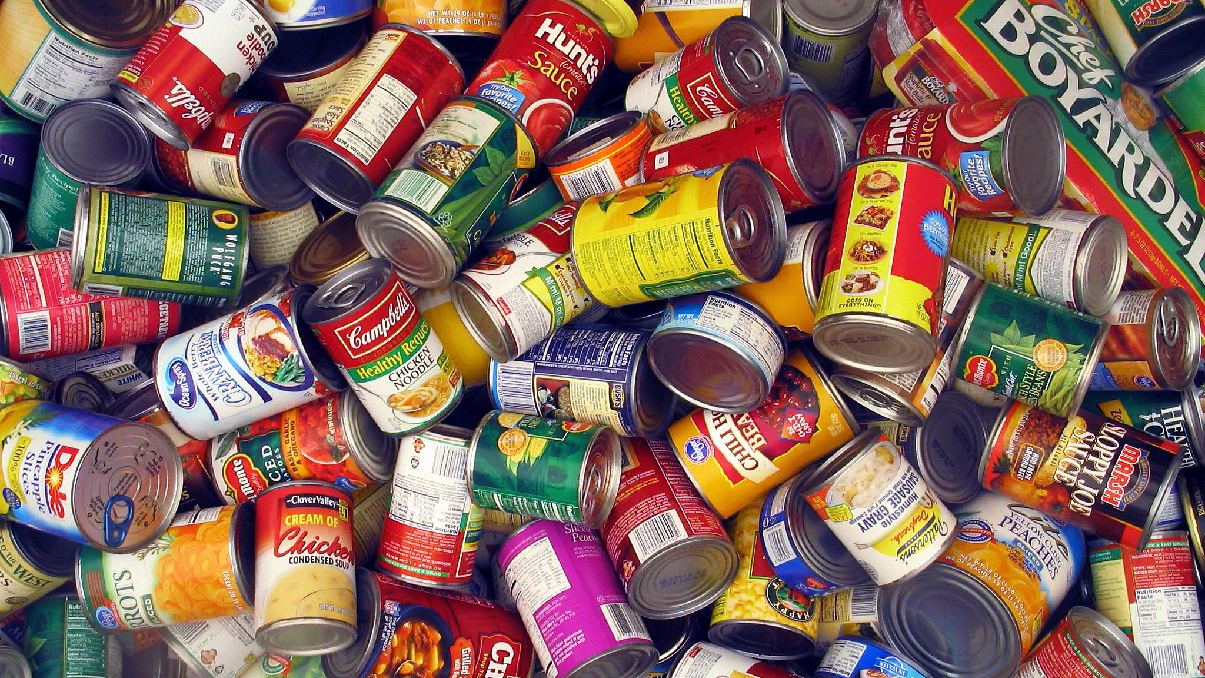
Food
Food is also a symbol of hope. It gives The Man and The Boy hope that they will live and won’t starve. Food is also very important to hem right now and symbolizes happiness. To say they found everything insinuates they found everything they need. This means they’re content.
Example(s): “I found everything. Everything...What is all this stuff papa? ….It’s food” page 149

Slide 12
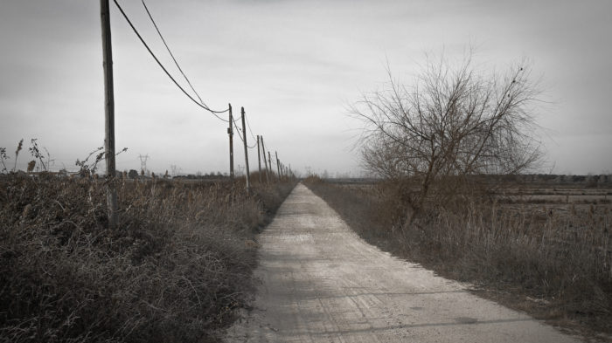
Literary devices
Repetition
Imagery
Simile

Slide 13
Repetition
Repetition is used to emphasize the feelings of The Man and The Boy. They are both happy to finally be somewhere safe and warm. He keeps repeating it because it is surreal to him.
Example(s): “Warm at last. Warm at last? Warm at last.”
pg. 147

Slide 14
Imagery
Imagery is also used as an emphasis. Imagery emphasizes just how bad things were for The Man and The Boy. We also get insight on how The Man and The Boy look. This makes us as readers empathetic for the characters.
Example(s): “He washed his dirty matted hair and bathed him with the soap and sponges. He drained away filthy water he sat in and laved fresh warm water over him from the pan and wrapped him shivering in a towel and wrapped him again in a blanket.”
- pg. 147
“They passed a metal trash dump where someone had once tried to burn bodies. The charred meat and bones under the damp ash might have been anonymous save for the shapes of the skulls.”
pg. 150

Slide 15
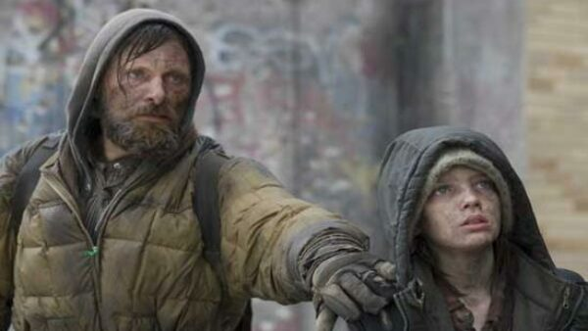
Simile
Used throughout the novel to compare the characters and their circumstances.
Example(s): “The faintly lit hatchway lay in the dark of the yard like a grave yawning at judgement day in some old apocalyptic painting.”
pg. 155
“He looked like one trying to feed a vulture broken in the road. It’s okay, he said.”
- pg. 163
This Photo by Unknown Author is licensed under CC BY-NC-ND

Slide 16
Discussion Questions
Throughout all their circumstances, why doesn’t The Boy lose hope?
Do you think that the love The Man and The Boy has for each other ever gets in the way of their chances to survive?
Why do you think the author writes little parts in the story to give the reader hope of survival even though at the end the man dies?
This Photo by Unknown Author is licensed under CC BY-NC-ND

Slide 17
Paper 2
With regards to at least two literary works, explain how the setting influences the characters and depicts the author’s thinking?
This Photo by Unknown Author is licensed under CC BY-NC

