Slide 1
FOA
IB DP Language & Literature

Slide 2
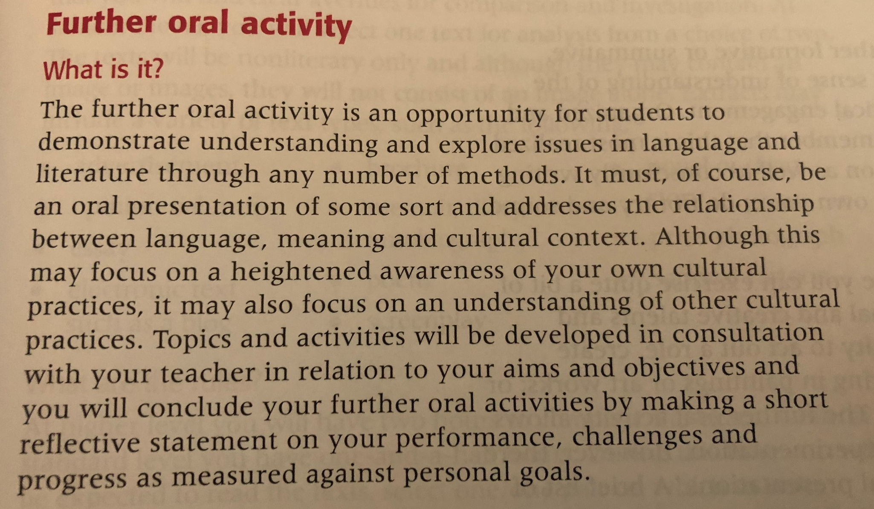
ABOUT THE FOA; What is it?

Slide 3
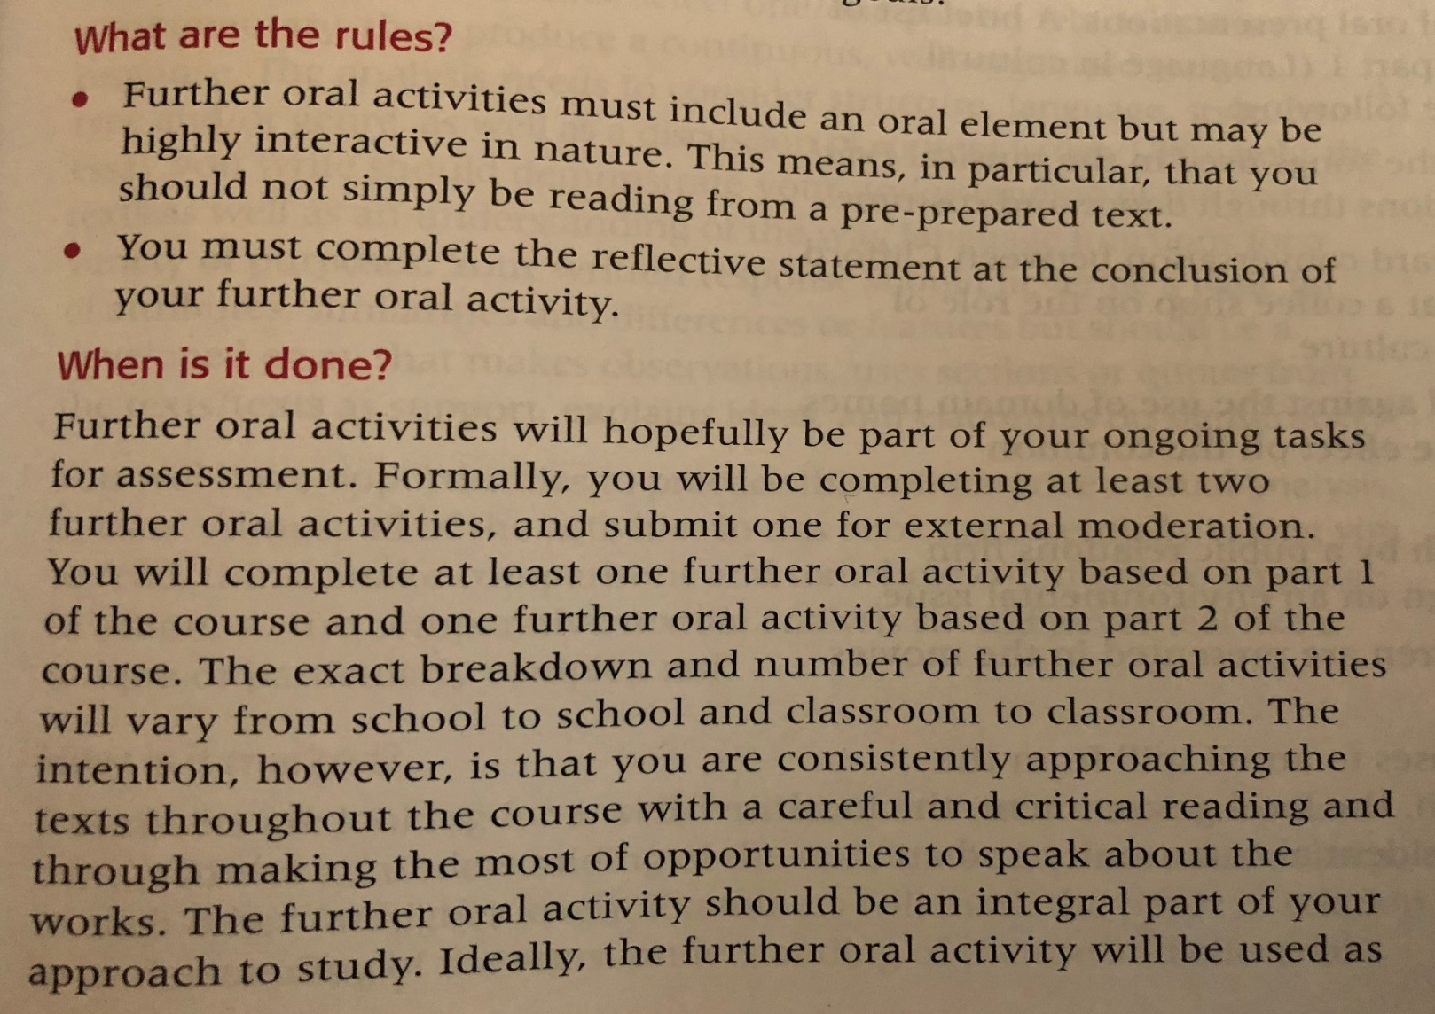
ABOUT THE FOA; What are the rules & when is it done?

Slide 4
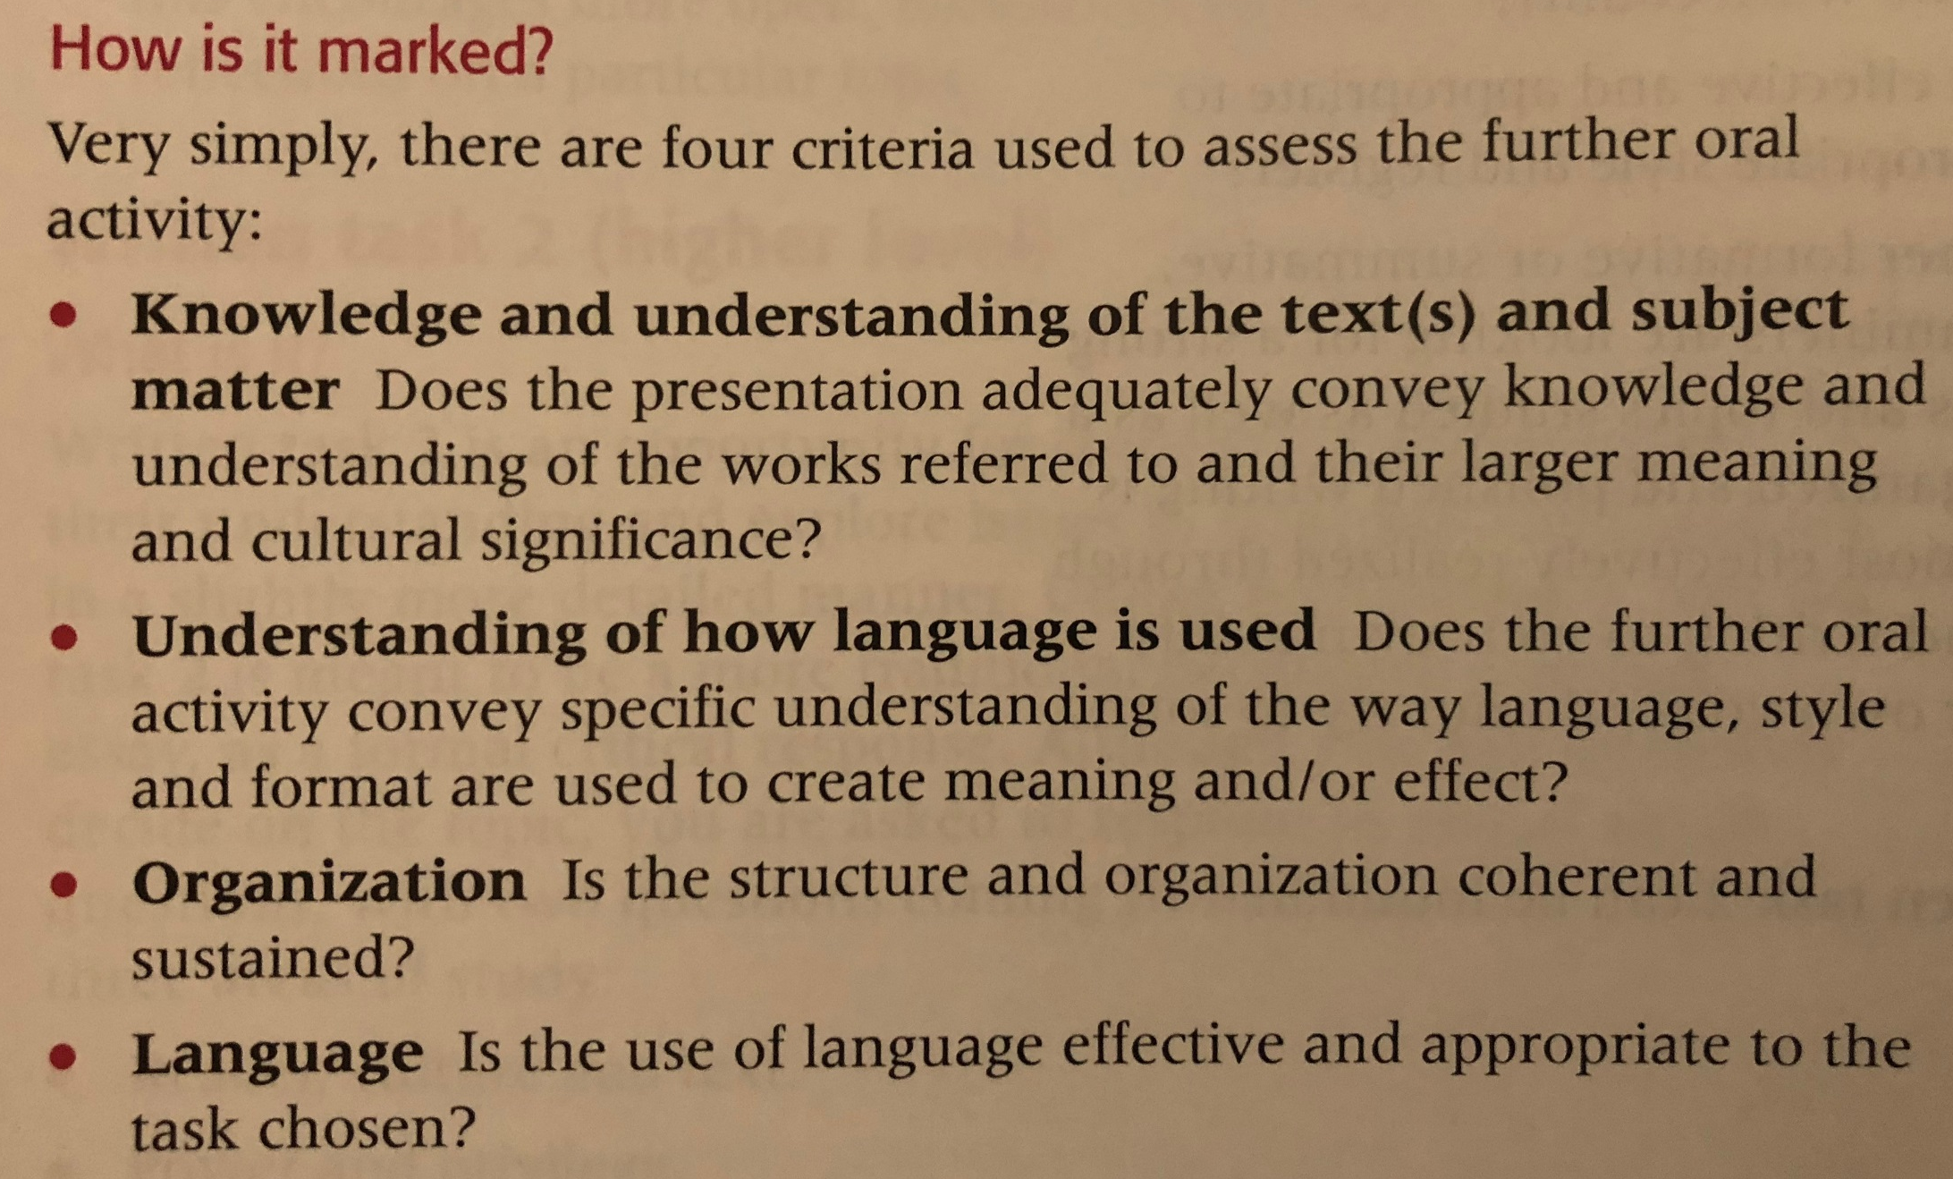
ABOUT THE FOA; How is it marked?

Slide 5
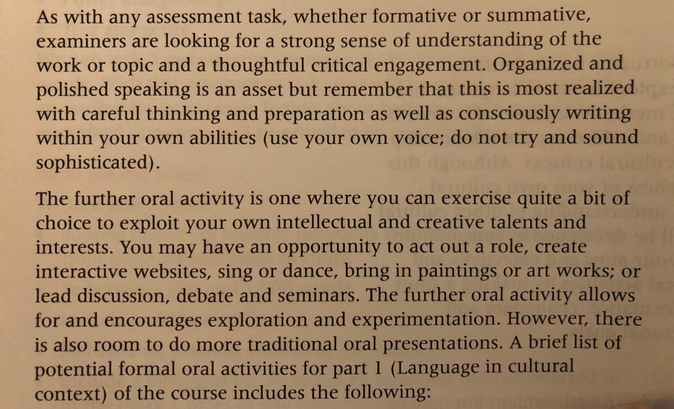
ABOUT THE FOA; How is it marked? (cont.)

Slide 6
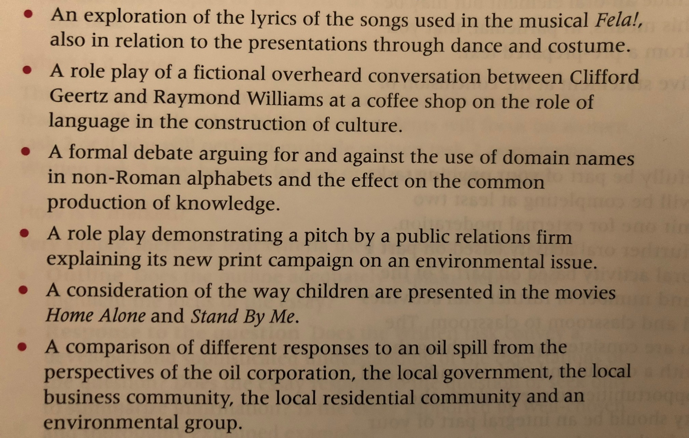
ABOUT THE FOA; How is it marked? (cont.)

