Slide 1
Everything You Need to Know About Shakespeare

Slide 2
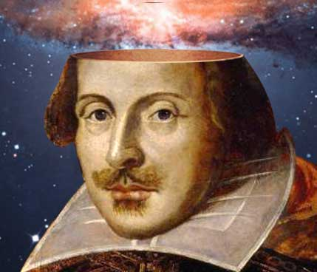
Table of Contents
Part I: MRJ DUE
Part II: All About Shakespeare
Part III: How to Read Shakespeare
Part IV: Review
  Context of Composition
  Context of Interpretation
  Real Macbeth
Part V: Literary Devices & Figurative Language in the text
Part VI: Practice Reading & Analyzing (sonnet 130- my favorite sonnet ☺)
Part VII: Homework DUE 01/09
Part VIII: Unit Assessments

Slide 3
Part 1: MRJ

Slide 4

MRJ Information ☺
(last MRJ ever…)
We will be reading Macbeth together in class.
You will complete your MRJ at home. NO CLASS TIME WILL BE GIVEN FOR THIS ASSIGNMENT.
Your MRJ is due no later than _____________.
The assignment sheet is located here:

Slide 5
Part 2: All About William Shakespeare

Slide 6
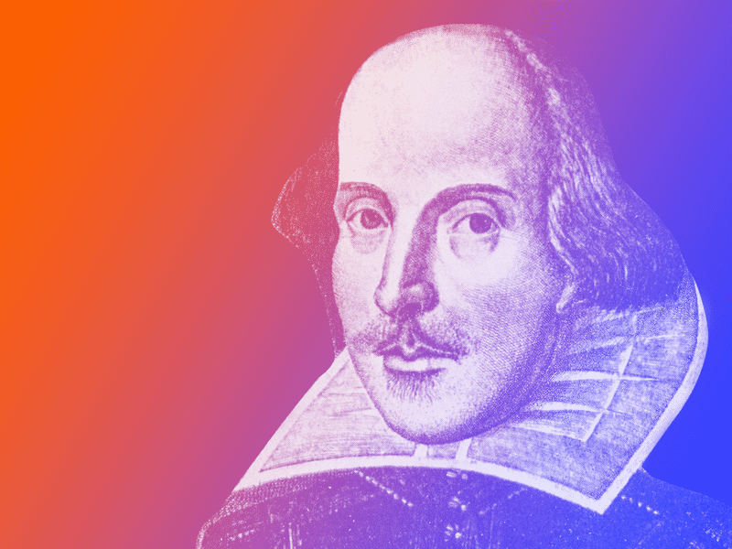
Informative Video

Slide 7
William Shakespeare
William Shakespeare was born on or around April 23, 1564 and grew up in a small town outside of London called Stratford-on-Avon. Although his father was a successful glove maker, at first he could only afford to send Shakespeare to grammar school. There, Shakespeare studied rhetoric, Latin, and the classics. Although his father was elected the High Bailiff of Stratford (what we would consider a mayor today), he accumulated a large amount of debt around the time Shakespeare was a teenager. Eventually Shakespeare had to join his father selling and making gloves, belts, and purses to keep the family business afloat.
Shakespeare never attended university. When he was 18, he married Anne Hathaway, who was 26, and six months later they had their first daughter, Susannah. In 1585 they had twins, Judith and Hamnet. The seven years after the birth of Judith and Hamnet are called Shakespeare’s “lost years,” because information about him is incomplete and contradictory. However, we know that Shakespeare travelled to London in his late twenties, around 1588, to begin pursuing a career as an actor and playwright. In just two years in London, Shakespeare premiered his first play, part one of the Henry VI series. Between 1590 and 1592, he would go on to see the remaining Henry VI plays, as well as Richard III and The Comedy of Errors performed.
In 1593, the plague struck and all the theaters in London were shut down. Shakespeare spent this time writing the narrative poems Venus and Adonis and The Rape of Lucrece and possibly the Sonnets. In 1594, Shakespeare became a shareholder in the Lord Chamberlain’s Men, one of the most popular London acting companies at that time. Shakespeare would work with the company throughout his lifetime, occasionally appearing in small roles, but mostly writing plays for the company to perform. In his later years, Shakespeare returned to Stratford where he continued to write. During his 23 years as a playwright, Shakespeare authored 38 plays, two narrative poems, and 154 sonnets before his death on April 23, 1616 at the age of 52. He is the most performed and read playwright in the world.

Slide 8
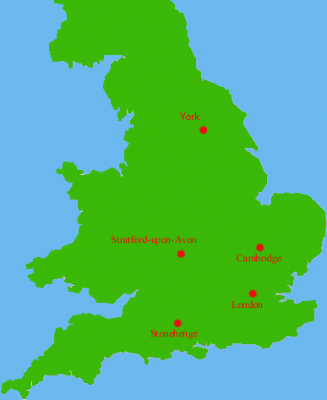
Location of Stratford-upon-Avon

Slide 9
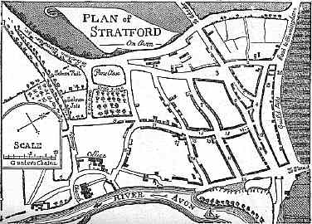
Stratford-upon-Avon in Shakespeare’s Time
As reproduced in William Rolfe, Shakespeare the Boy (1896).

Slide 10
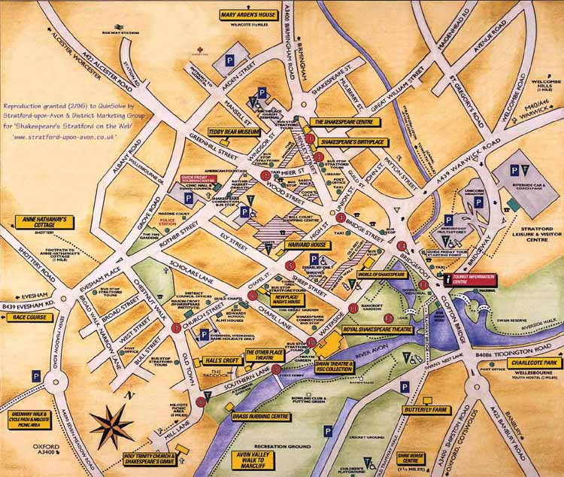
Stratford-upon-Avon Today
From Stratford’s web site: http://www.stratford-upon-avon.co.uk/index.htm

Slide 11
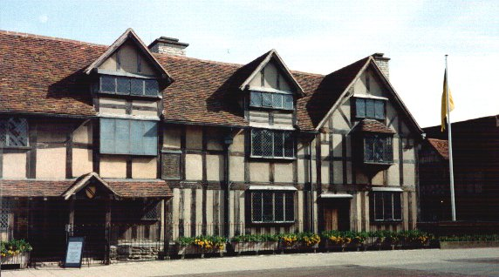
Shakespeare’s Birthplace
From: http://perso.wanadoo.fr/danielle.esposito/

Slide 12
Education
Probably attended King’s New School in Stratford
His school day was long and rigorous
Educated in:
    -Rhetoric
    -Logic
    -History
    -Latin
Shakespeare dropped out of ‘middle school’ when his father lost his fortune

Slide 13
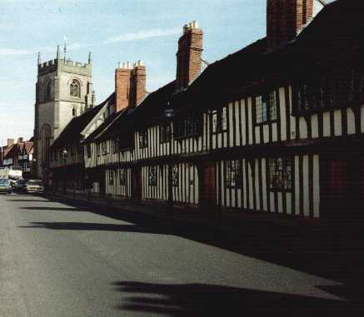
King’s New School
From: http://perso.wanadoo.fr/danielle.esposito/

Slide 14
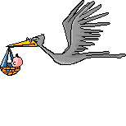
Married Life
Married in 1582 to Anne Hathaway, who was pregnant at the time with their first daughter
Had twins in 1585- Hamnet & Judith
  Hamnet died from the plague at age 11
Sometime between 1583-1592, he moved to London and began working in theatre.
The years 1583-1592 are know as ‘The Lost Years’
  No one knows where he was, or what he was doing during those years

Slide 15
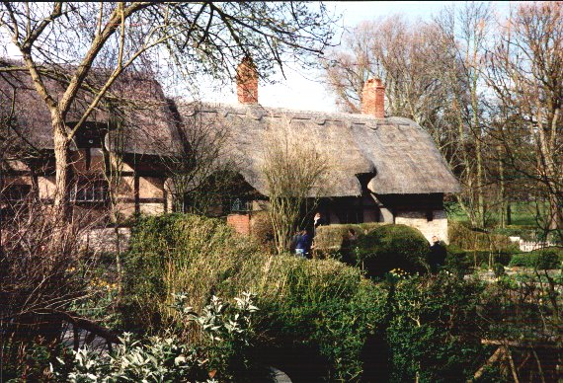
Anne Hathaway’s Cottage
From: http://perso.wanadoo.fr/danielle.esposito/

Slide 16
Shakespeare’s Death
Shakespeare died on April 23rd, 1616
Not exactly sure what he died from
  History says he drank too much wine and ate too many pickled herrings
In his will, Shakespeare left money, horses, stables, etc. to his two sons-in-law
But only left his wife one thing- the “second-best bed”
  Was he trying to make a point?

Slide 17
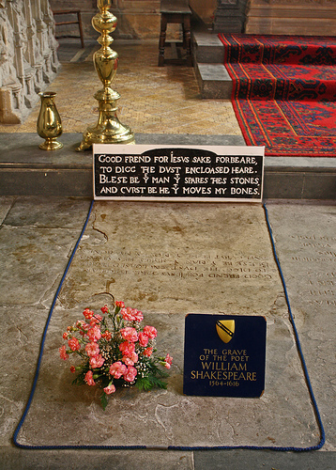
Shakespeare’s Death
Shakespeare is buried in Holy Trinity Church in his birth village of Stratford.
His grave is covered by a flat stone that bears an epitaph warning of a curse to come upon anyone who moves his bones.

Slide 18
Shakespeare’s World
When Shakespeare arrived in London and began writing, England was a powerful nation ruled by Queen Elizabeth I. It was a time of exploration and international expansion. With Queen Elizabeth’s support, this Golden Age in English history ushered in a flowering of poetry, music, literature, and theater. Elizabeth’s successor, James I, was a supporter of the arts, and became a patron of Shakespeare’s theater company (Lord Chamberlain’s Men), which they renamed The King’s Men in honor of James’ patronage.
These were also dangerous times. Multiple outbreaks of the plague, also known as “the Black Death,” closed down theaters and killed tens of thousands. On November 5, 1605, two years after King James I took the throne, a group of religious dissidents planned to blow up Parliament (the British equivalent of Congress) on the opening day of the legislative session.
Their plot was discovered just in time when Guy Fawkes, the man ready to ignite the explosives, was found and captured along with the other conspirators. They were all charged with treason, convicted, and publicly executed.

Slide 19
Shakespeare’s Theater
Theater was the main form of popular entertainment during Shakespeare’s time. People of all classes attended the theater, from beggars to the nobility. Shakespeare’s plays were performed in many different settings: his home theater, the Globe; the indoor Blackfriars Theatre; and for noble audiences, at court.
Most theaters at this time, including the Globe, were round open-air spaces that had seats surrounding the stage. The most expensive seats were in the two to three levels of galleries under a roof. Those with less to spend stood at the foot of the stage for the equivalent of a penny. Because they stood at the ground level they were called “groundlings.” A theater like the Globe could be packed with as many as 3,000 people. The audiences were loud and unruly and it was not uncommon for audience members to shout and interact with the performers, comment loudly on the action to their fellow spectators, or throw things at the actors on the stage.
In 1608, Shakespeare’s company began using the Blackfriars Theater during the winter; a smaller indoor space that was the first theater to use artificial lighting. Ticket prices started at six pence, six times the price of the cheapest seat at the Globe, but with artificial lighting and scenery, audiences gained enough spectacle to justify the higher ticket prices. When performing at court, The King’s Men would set up makeshift theaters at the home of a wealthy host and provide private entertainment for the invited noblemen and women. In Shakespeare’s time, women were forbidden to perform on the public stage, so all the roles in Shakespeare’s plays were played by men and teenage boys!

Slide 20
Theatre Career
Member and later part-owner of the Lord Chamberlain’s Men, later called the King’s Men
Globe Theater built in 1599 with Shakespeare as primary investor
Burned down in 1613 during one of Shakespeare’s plays

Slide 21
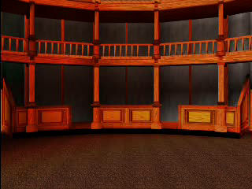
The Globe Theater

Slide 22
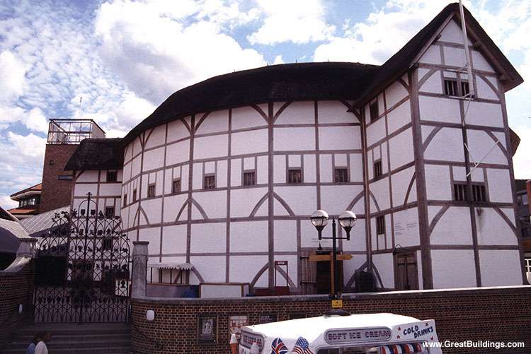
The Rebuilt Globe Theater, London

Slide 23
The Plays
38 plays firmly attributed to Shakespeare
    14 comedies
    10 histories
    10 tragedies
    4 romances
Possibly wrote three others
Collaborated on several others

Slide 24

The Poetry
Two major poems
    Venus and Adonis
    Rape of Lucrece
154 Sonnets
Numerous other poems

Slide 25
Shakespeare’s Language
Shakespeare did NOT write in “Old English.”
Old English is the language of Beowulf:
  Hwaet! We Gardena in geardagum
  Þeodcyninga Þrym gefrunon
  Hu ða æÞelingas ellen fremedon.

Slide 26
Shakespeare’s Language
Shakespeare did not write in “Middle English.”
Middle English is the language of Chaucer, the Gawain-poet, and Malory:
  We redeth oft and findeth y-write—
  And this clerkes wele it wite—
  Layes that ben in harping
  Ben y-founde of ferli thing… (Sir Orfeo)

Slide 27
Shakespeare’s Language
Shakespeare wrote in “Early Modern English.”
EME was not very different from “Modern English,” except that it had some old holdovers.

Slide 28
Shakespeare’s Language
Shakespeare coined many words we still use today:
  Critical
  Majestic
  Dwindle
And quite a few phrases as well:
  One fell swoop
  Flesh and blood
  Vanish into thin air

Slide 29
Shakespeare’s Language
A mix of old and very new
Rural and urban words/images
Understandable by the lowest peasant and the highest noble

Slide 30
Elizabethan Theatrical Conventions

Slide 31
Theatrical Conventions
of Shakespeare's Theatre
A theatrical convention is a
suspension of reality.
No electricity
Women forbidden
to act on stage
Minimal, contemporary
costumes
Minimal scenery
These control the dialogue.

Slide 32

Theatrical Conventions
of Shakespeare's Theatre
Soliloquy
Aside
Types of speech
Audience loves to be scared.
Blood and gore
Use of supernatural

Slide 33

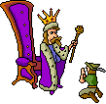
Theatrical Conventions
of Shakespeare's Theatre
Use of disguises/
mistaken identity
Last speaker—highest in
rank (in tragedies)
Multiple murders
(in tragedies)
Multiple marriages
(in comedies)

Slide 34
Part 3: How to Read Shakespeare

Slide 35
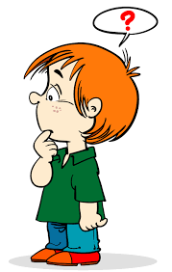
Commonly Asked Question
“Did people really talk like that back then?”

Slide 36
Answer
Short answer: nope
Longer answer: people in England in Shakespeare’s lifetime did not talk like the people in the plays.
Here are 3 things you should know about the language that shows it was not realistic everyday speech:

Slide 37
Unrealistic Language
1.) The plays and sonnets are written in iambic pentameter – this refers to its rhythm or how the syllables sound.
This is a pattern meant to sound like a heart beat, so no people didn’t talk like that and they don’t today either.
Example from Romeo and Juliet (with the stronger syllables emphasized):
  “But soft! What light through yonder window breaks?
  It is the east and Juliet is the sun!”

Slide 38
Unrealistic Language
2.) When a character is exiting the stage (walking off), usually his or her last lines rhyme.
Again, this is not something you see in normal conversations (unless you are a successful freestyle rapper, and you aren’t yet).
Example from Richard III, where Richard is leaving the stage at the end of the first scene and says to himself:
“Clarence still breathes; Edward still lives and reigns:
When they are gone, then must I count my gains.”

Slide 39
Unrealistic Language
3.) The characters are CONSTANTLY making allusions, sometimes to classic mythology and other times to The Bible.
The main reason this was unrealistic for the people in Shakespeare’s time is that most of Shakespeare’s audience was illiterate. So if these people couldn’t even read, there was no way they were walking around making references to The Odyssey and stuff!
Example from Henry VI Part 3:
“Deceive more slyly than Ulysses could”
Ulysses was the Romans’ name for Odysseus so here the character Gloucester is making an allusion to the hero of The Odyssey.

Slide 40
Early Modern English (EME)
Shakespeare writes using words in what is called “Early Modern English.”
(It’s in the middle between Old English and Modern [Today] English.)
These may have been used during his time but that we definitely don’t use them here in 2019 Georgia.
For example, what in the heck is Anne saying in Richard III when she says,
“Lo, in these windows that let forth thy life” ?????????????

Slide 41
Commonly Used EME Words
Thee means you
Thou means you
Thy or Thine means your
Hath means has
Nay means no
Yea (sounds like “yay”) means yes
Aye (sounds like “eye”) means yes

Slide 42
Super Important Tip
A) Read until the end of the sentence – so stop when there is a period. This is the best way to understand the meaning.
B) DO NOT STOP AT THE END OF EACH LINE!
C) It’s OKAY if you don’t understand the meaning of the sentence reading it one time – that’s why we use context clues and footnotes.

Slide 43
The Tip in Action
Use the tip you just wrote down to successfully read this example from The Taming of the Shrew aloud:
Petruchio:
“Verona, for a while I take my leave
To see my friends in Padua, but of all
My best beloved and approved friend, Hortensio.”

Slide 44
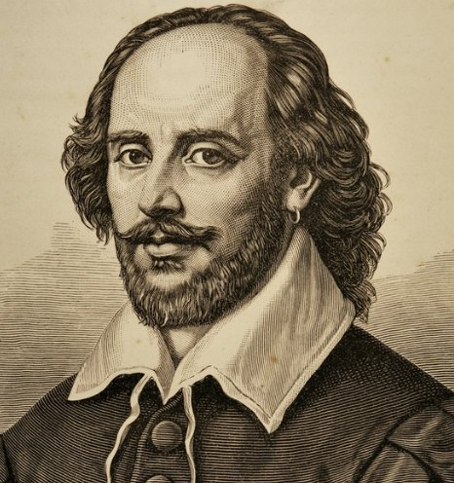
Types of Shakespearean Plays
Shakespeare wrote 3 types of plays:
Histories
Tragedies
Comedies
The one we will read is a TRADEGY.

Slide 45
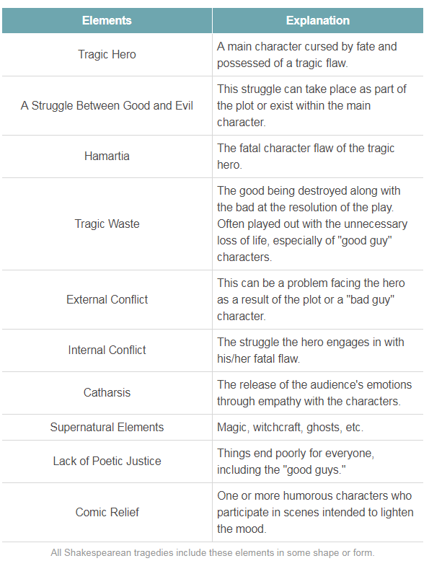
Characteristics of Tragedies:

Slide 46
Asides
Aside - When a character is whispering or talking almost to the audience.
Think of it as they’re talking “off to the side.”
These are intended to be funny because it’s the character/actor LITERALLY making a joke to the audience the other characters can’t hear.

Slide 47
Example of an Aside
In Act III, scene 1 of TTOTS, Lucentio makes a side comment about Hortensio implying that Hortensio’s tuning of his instrument will take forever.
Hortensio: “You’ll leave his lecture when I am in tune?”
Lucentio: [aside] “That will be never.”
Lucentio is throwing shade on Hortensio here so he makes the comment as an aside so Hortensio cannot hear him smack-talking him. This would be something the audience would laugh at.

Slide 48
Soliloquy
Soliloquy (pronounced “suh-lil-lo-qwee”) - when a character has a long speech and is by their self on stage, usually expressing their thoughts aloud.
These are really easy to spot because they ONLY happen when somebody is the only person onstage.
  HINT: Take note of stage directions. The stage directions give very important information.

Slide 49
Example of a Soliloquy
In TTOTS, at the end of Act III, scene 1 Hortensio has discovered Bianca showing affection for Lucentio and not him. He is then left alone onstage and expresses his sadness over this saying:
Hortensio: “But I have cause to pry into this pedant.
Methinks he looks as though he were in love.
Yet if thy thoughts, Bianca, be so humble
To cast thy wand’ring eyes on every stale,
Seize thee that list! If once I find thee ranging,
Hortensio will be quit with thee by changing.”
He HAS TO BE expressing his inner thoughts because nobody else is onstage so he’s talking to himself/the audience.

Slide 50
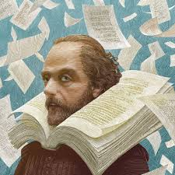
Interested in learning more about Shakespeare?
Click here! https://www.youtube.com/watch?v=qafnuBH8KPs
Extra credit (10 pts.) on Macbeth MRJ if you watch it and take notes! (2 page min.)

Slide 51
Part 4: Review of Context of Composition & Context of Interpretation

Slide 52
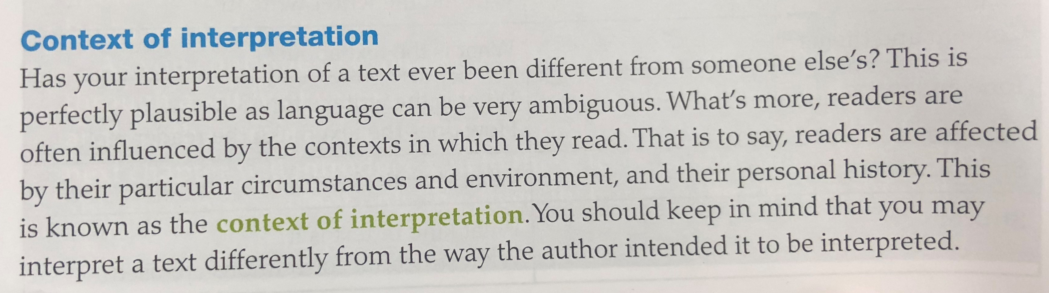

Slide 53
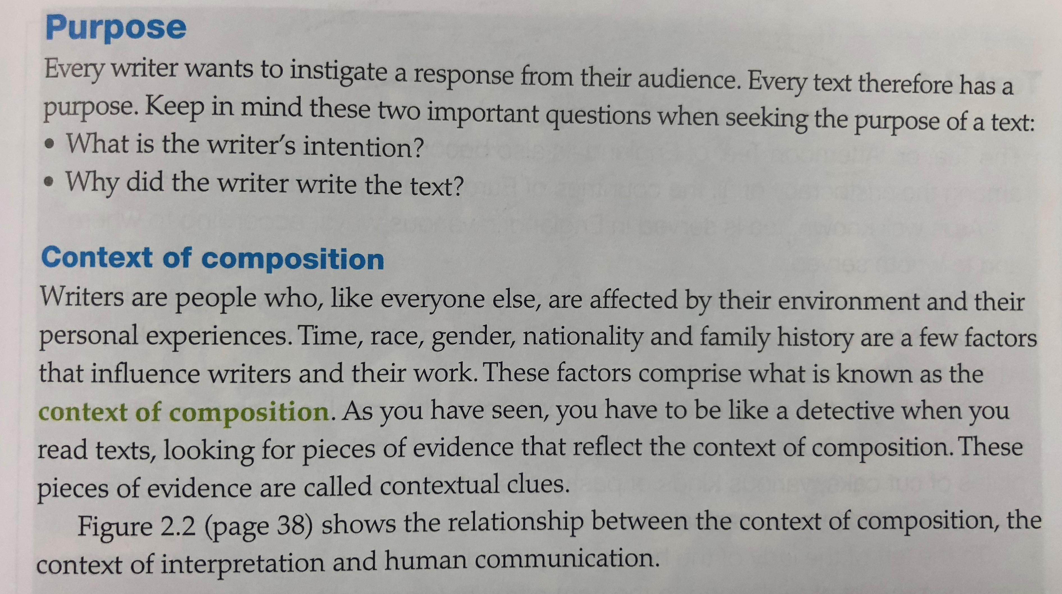

Slide 54
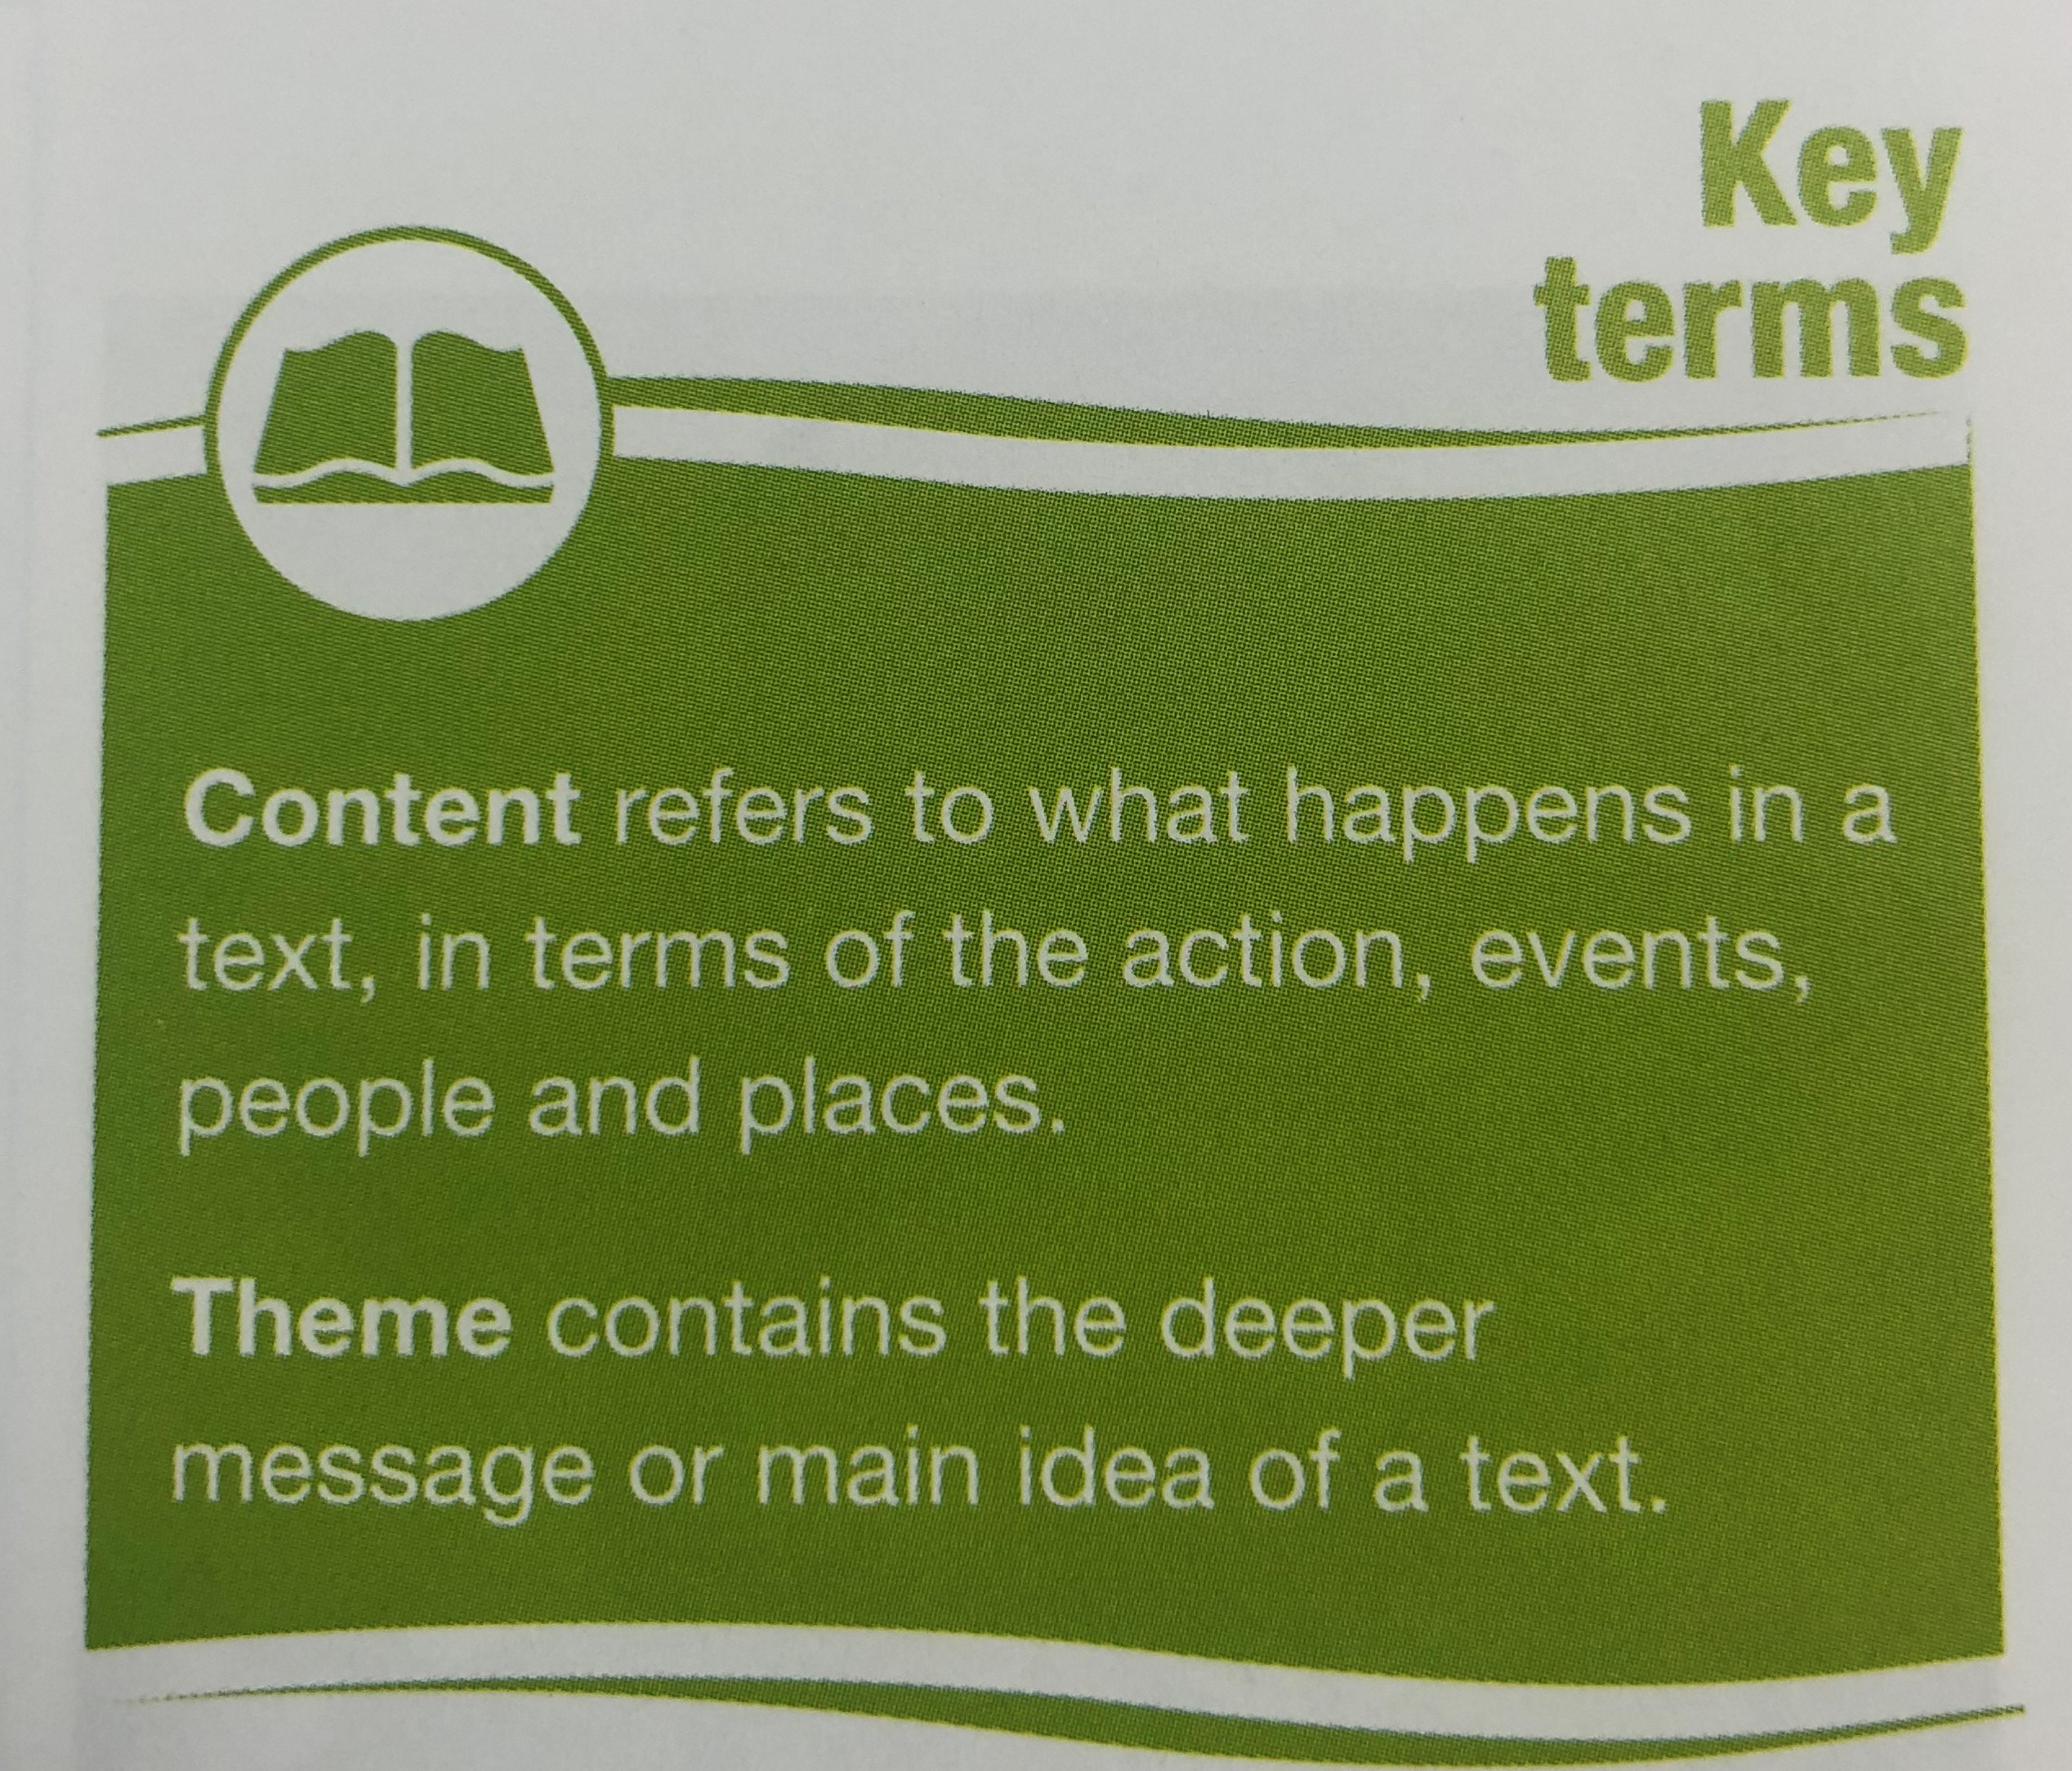

Slide 55
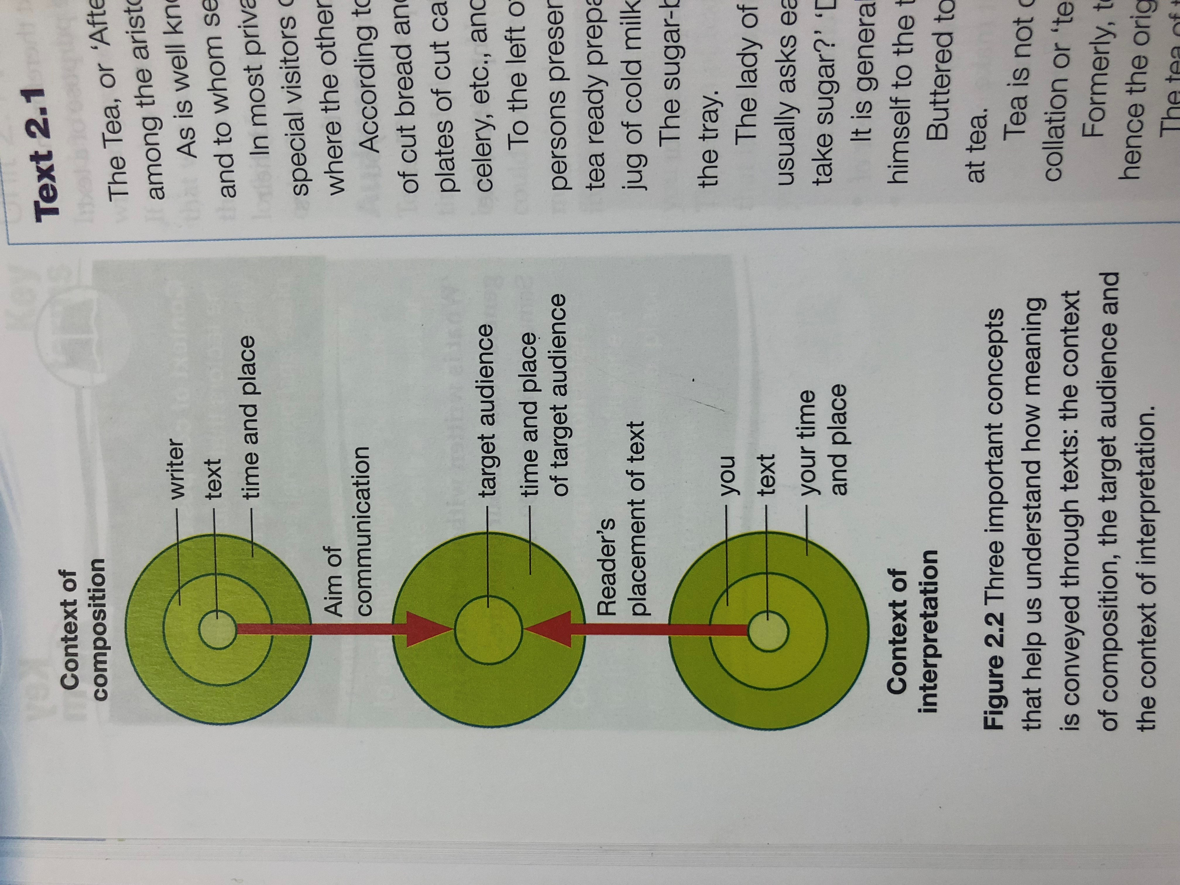
Copy this chart down in your notes! ☺
CONTEXT OF COMPOSITION
TARGET AUDIENCE
CONTEXT OF INTERPRETATION

Slide 56
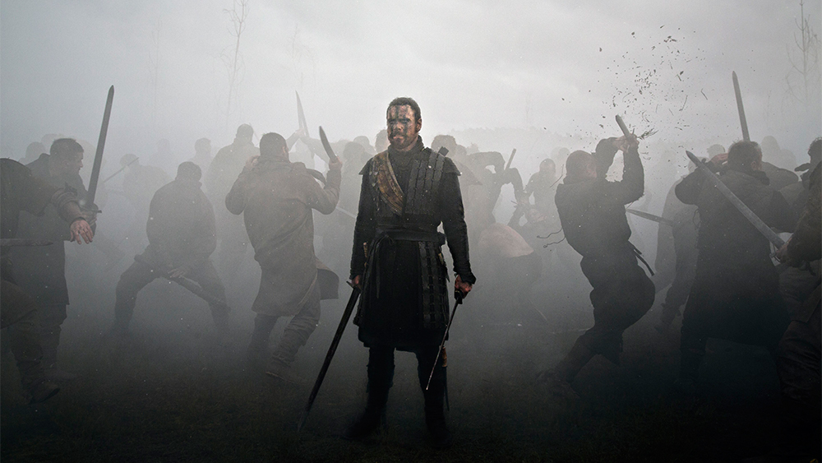
Historical Context of Macbeth
Shakespeare was a playwright, not a historian. However, he knew that history provided great material for plays: war, conflict, ambition, the downfall of great rulers.
Eleventh-Century (1000s) Scotland was a violent and troubled country.
Feuding families and clans fought to control trade and territory.
The castle was the power base of each rival war-lord (thane).
Political murder and revenge killings were commonplace.
Notes:
BEFORE INSERTING THE BULLETS . . .
Can anyone tell me when the action of the play takes place? Where the action takes place?
**Lay out the main characters and the basic plot line without giving too much away**
Bring in the bullets

Slide 57
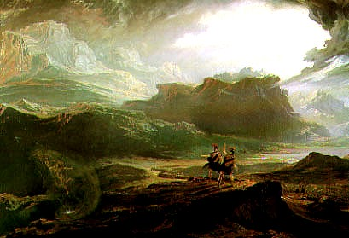
The Real Macbeth
The real Macbeth was born in 1005, the son of a ruling family.
Macbeth’s father was murdered by his cousin.
Macbeth married the granddaughter of the High King of Scotland (Gruach)
Notes:
Lots of politics, intrigue and dirty dealings going on in Scotland at the beginning of the Eleventh Century . . .

Slide 58
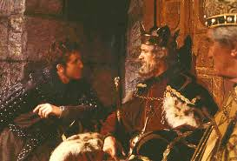
The Real King Duncan and Macbeth
Duncan was the king of Scotland at the time the real Macbeth was born
Duncan was 38 at the time of his murder - a murder possibly committed by the real Macbeth.
Macbeth was elected High King of Scotland in 1040.
Macbeth ruled Scotland for 17 years, during which time Scotland became comparatively peaceful and stable.
Duncan’s son, Malcolm, invaded Scotland in 1054, supported by Edward the Confessor.
Macbeth was killed on August 15, 1057 and buried at Iona, the sacred burial place of the Kings of Scotland.
Notes:
BEFORE BRINGING IN THE BULLETS . . .
Anyone remember who "Duncan" is?
Remember, this play is loosely based on factual information. Where would this factual information be found?
How much to you trust the factual information?
That might be a good project for you - determine the extent to which the play is based on fact or deviates from established fact . . .

Slide 59
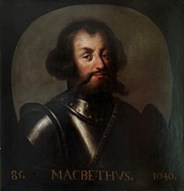
What’s the take-away?
Shakespeare modeled his play after an actual historical figure.
Some of the plot points are the same.
But…the real Macbeth was (almost) universally loved and respected; Shakespeare’s Macbeth wasn’t.

Slide 60
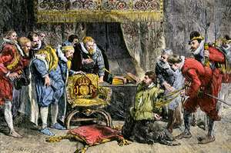
The Gunpowder Plot of 1605
A failed assassination attempt against King James!
Disgruntled Catholics planned to blow up the House of Lords.
Guy Fawkes was discovered guarding their horde of explosives in the basement of the House of Lords on November 5, 1605. (“Remember, remember the 5th of November.”)
The traitors were sentenced to death, and this day is still celebrated in England as Guy Fawkes Day.
Shakespeare weaves references to the Gunpowder Plot into Macbeth. Was this rebellious?

Slide 61
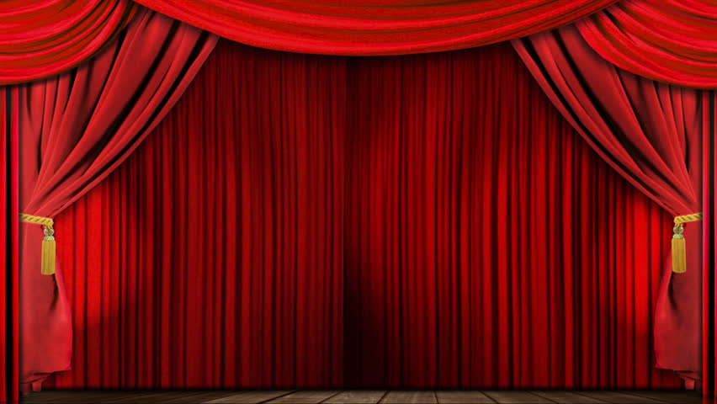
Back to the play…
Before the Curtain Opens:
When the play begins, there are two wars in progress:
Civil War in Scotland- King Duncan vs. Macdonwald’s (a thane’s) rebels
National War - Scotland, led by King Duncan, against invading Norway

Slide 62
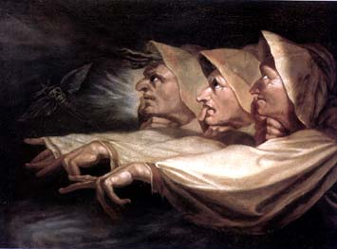
Witches & Witchcraft
Witch-mania in the Elizabethan era.
Most people believed in witches!
Circulating pamphlets containing tales of witches and witchcraft were the equivalent of today’s popular newspapers.
Notes:
Remember that a person is very much a product of their times.
Elizabethan and Renaissance audiences were morbidly fascinated with witches and witchcraft. Persecution of people for the "crime" of witchcraft reached terrifying proportions - between 1560 and 1603, hundreds of people (nearly all of them women) were convicted as witches and executed.
The most popular method of execution?
King James was as fascinated by witchcraft as were his subjects. There is a story that in 1590, a group of witches tried to kill James (before he was king). Their plot was discovered, and they were brought to trial. One of the "witches", Agnes Sampson, claimed that she had collected toad venom to poison the king, christened a cat, tied parts of a dead man's body to it (we don't know which parts), sailed out to sea in a "sieve" and had thrown cat and body-bits overboard in order to raise a storm that would sink James' ship. A bit elaborate . . .
King James personally interrogated one of the three accused witches, "Doctor Fian" - a male. The doctor was tortured during the interrogation: "his nails upon all his fingers were riven and pulled off . . . his legs were crushed and beaten together as small as might be, and the bones and flesh so bruised that the blood and marrow spouted forth in great abundance". Yuck.
So. . . all fired up by his witchy experience, King James personally investigated other cases, and in 1597 he wrote and published "Demonology", a book on witchcraft. When he became king of England in 1603, he ordered its immediate printing in London.

Slide 63
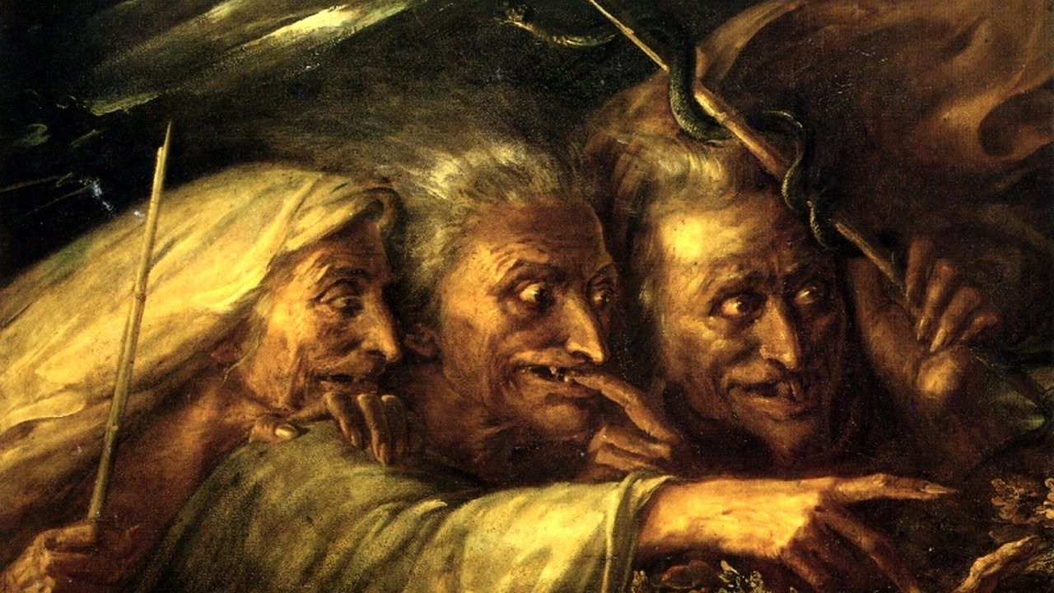
Witches and Witchcraft
Witches were said to have “diabolical” powers. They could:
  predict the future
  bring on night in the daytime
  cause fogs and tempests
  kill animals
  curse enemies with fatal, wasting diseases
  cause nightmares and sterility
  take demonic possession of any individual
  raise evil spirits by concocting a brew
It was believed that witches allowed the devil to suck their blood. Accused witches were examined for the “Devil’s Mark” - a red mark on their body from which the devil had sucked blood.
Notes:
So here's some of the stuff Elizabethans and Renaissance people thought about witches . . .

Slide 64
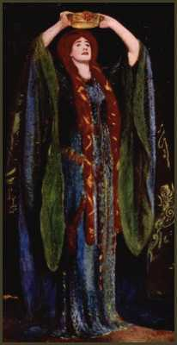
Witches and Witchcraft - Misogyny?
Between 1560 and 1603, hundreds of people, nearly all of them women, were convicted as witches and executed
In 1604 an official Act of Parliament decreed that anyone found guilty of practicing witchcraft should be executed
Those who confessed to being witches did so under torture or because they were in the grip of delusions recognized today as psychiatric disorders.
Notes:
You would think that these "witches" would be pretty powerful people . . .
. . . but it was mostly single, old women who kept cats that were in danger of being accused of witchcraft. Remember, in 1604 an Act of Parliament decreed that if you were convicted, you were to be executed - and with the methods of "information extraction" used by the interrogators, people were likely to "spill their guts" (literally - know where that term comes from?)..
CHECK - does the group want to get into women's rights in the Seventeenth Century?
. . . here's another idea for your project: maybe you could examine Shakespeare's portrayal of women in Macbeth - very interesting topic . . .

Slide 65
Part 5: Literary Devices & Fig Lang in the Text

Slide 66
Devices:
Metaphor
Paradox
Oxymoron
Simile
Alliteration
Analogy
Soliloquy
Monologue
Aside
Foreshadowing
Dramatic Irony
Imagery
Foil
Tragic Hero
Epithet
Repetition

Slide 67
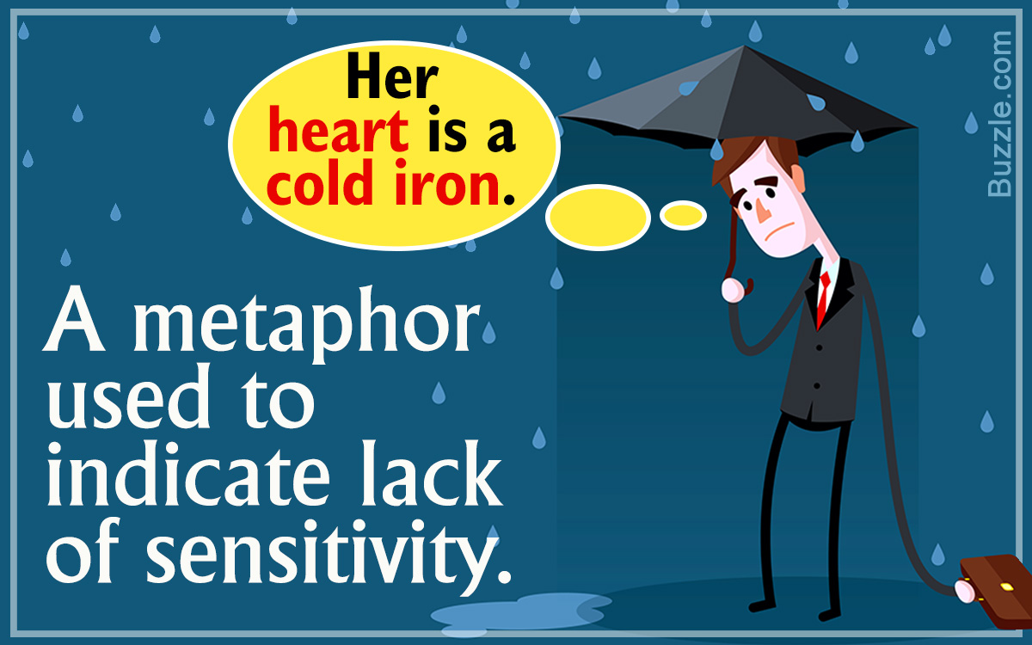
METAPHOR
a figure of speech in which a word or phrase is applied to an object or action to which it is not literally applicable.

Slide 68

PARADOX
a seemingly absurd or self-contradictory statement or proposition that when investigated or explained may prove to be well founded or true.

Slide 69
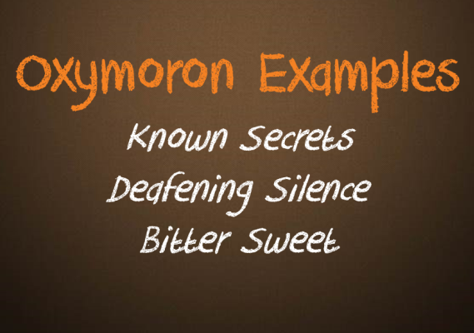
OXYMORON
a figure of speech in which apparently contradictory terms appear in conjunction (e.g., faith unfaithful kept him falsely true ).

Slide 70

SIMILE
a figure of speech involving the comparison of one thing with another thing of a different kind, used to make a description more emphatic or vivid

Slide 71
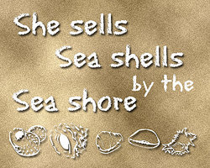
ALLITERATION
the occurrence of the same letter or sound at the beginning of adjacent or closely connected words.

Slide 72
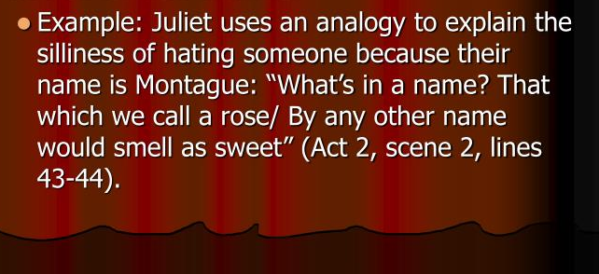
ANALOGY
a comparison between two things, typically for the purpose of explanation or clarification.

Slide 73
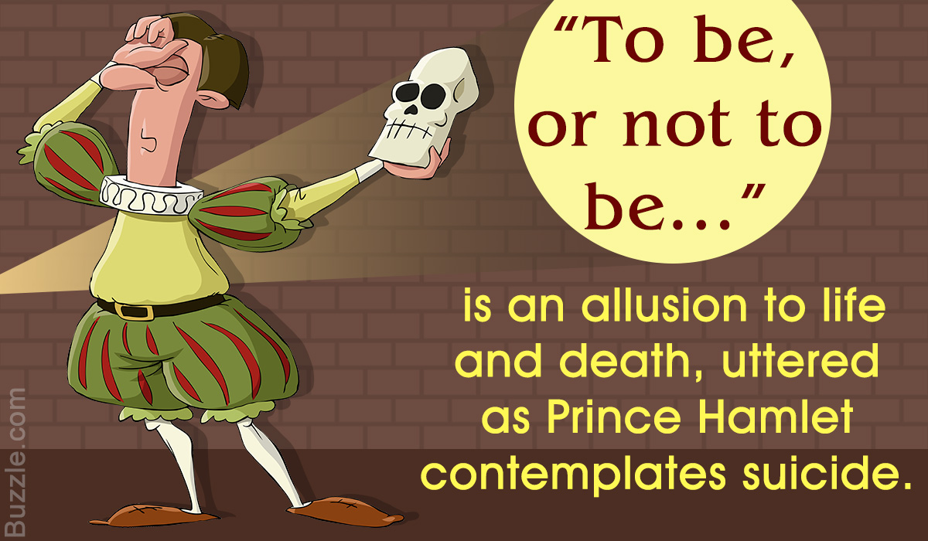
ALLUSION
an expression designed to call something to mind without mentioning it explicitly; an indirect or passing reference.

Slide 74

SOLILOQUY
an act of speaking one's thoughts aloud when by oneself or regardless of any hearers, especially by a character in a play.

Slide 75
MONLOGUE
a long speech by one actor in a play or movie, or as part of a theatrical or broadcast program.

Slide 76
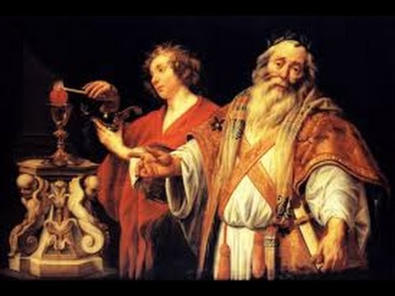
ASIDE
a remark or passage by a character in a play that is intended to be heard by the audience but unheard by the other characters in the play.

Slide 77
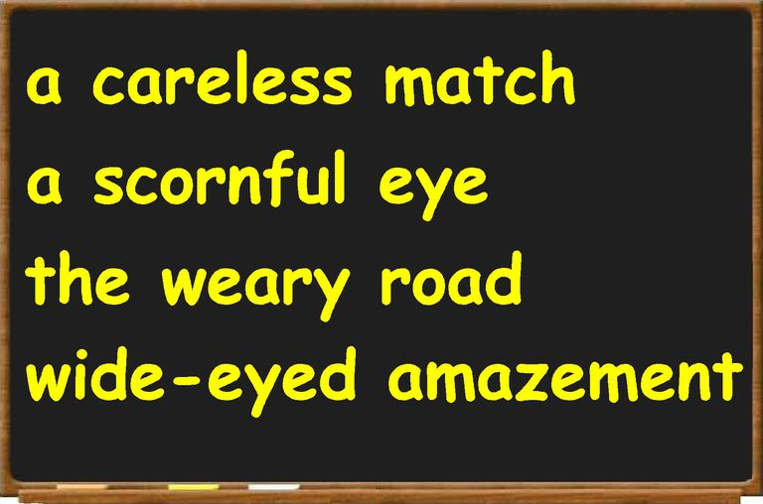
EPITHET
an adjective or descriptive phrase expressing a quality characteristic of the person or thing mentioned.
"old men are often unfairly awarded the epithet “dirty.”

Slide 78

REPETITION
Repetition is a literary device that repeats the same words or phrases a few times to make an idea clearer and more memorable. ... As a rhetorical device, it could be a word, a phrase, or a full sentence, or a poetical line repeated to emphasize its significance in the entire text.

Slide 79

FORESHADOWING
be a warning or indication of (a future event).

Slide 80
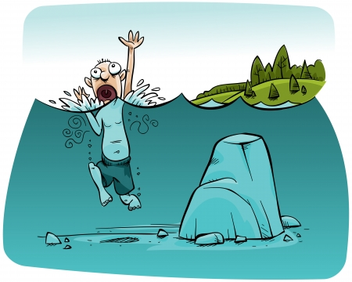
DRAMATIC IRONY
irony that is inherent in speeches or a situation of a drama and is understood by the audience but not grasped by the characters in the play.

Slide 81
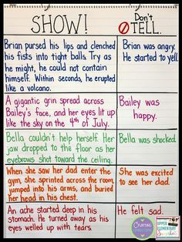
IMAGERY
visually descriptive or figurative language, especially in a literary work.

Slide 82
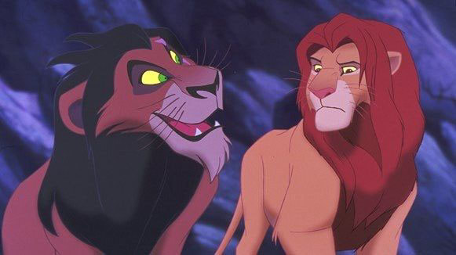
FOIL
In fiction, a foil is a character who contrasts with another character, usually the protagonist, to highlight particular qualities of the other character. In some cases, a subplot can be used as a foil to the main plot.

Slide 83
TRAGIC HERO
A tragic hero is a type of character in a tragedy, and is usually the protagonist. Tragic heroes typically have heroic traits that earn them the sympathy of the audience, but also have flaws or make mistakes that ultimately lead to their own downfall. In Shakespeare's Romeo and Juliet, Romeo is a tragic hero. His reckless passion in love, which makes him a compelling character, also leads directly to the tragedy of his death.

Slide 84

POP QUIZ:
https://create.kahoot.it/details/macbeth-pop-quiz/6004c2cf-ec7c-482c-8cd4-8241edecf655

Slide 85
Part 6: Practice Reading & Analyzing (Sonnet 130)

Slide 86
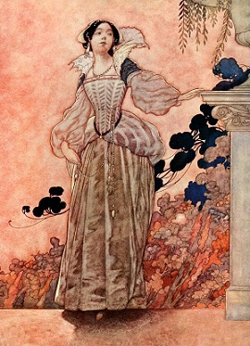
Sonnet 130
My mistress' eyes are nothing like the sun;
Coral is far more red than her lips' red;
If snow be white, why then her breasts are dun;
If hairs be wires, black wires grow on her head.
I have seen roses damasked, red and white,
But no such roses see I in her cheeks;
And in some perfumes is there more delight
Than in the breath that from my mistress reeks.
I love to hear her speak, yet well I know
That music hath a far more pleasing sound;
I grant I never saw a goddess go;
My mistress, when she walks, treads on the ground.
And yet, by heaven, I think my love as rare
As any she belied with false compare.

Slide 87
Part 7: Homework

Slide 88
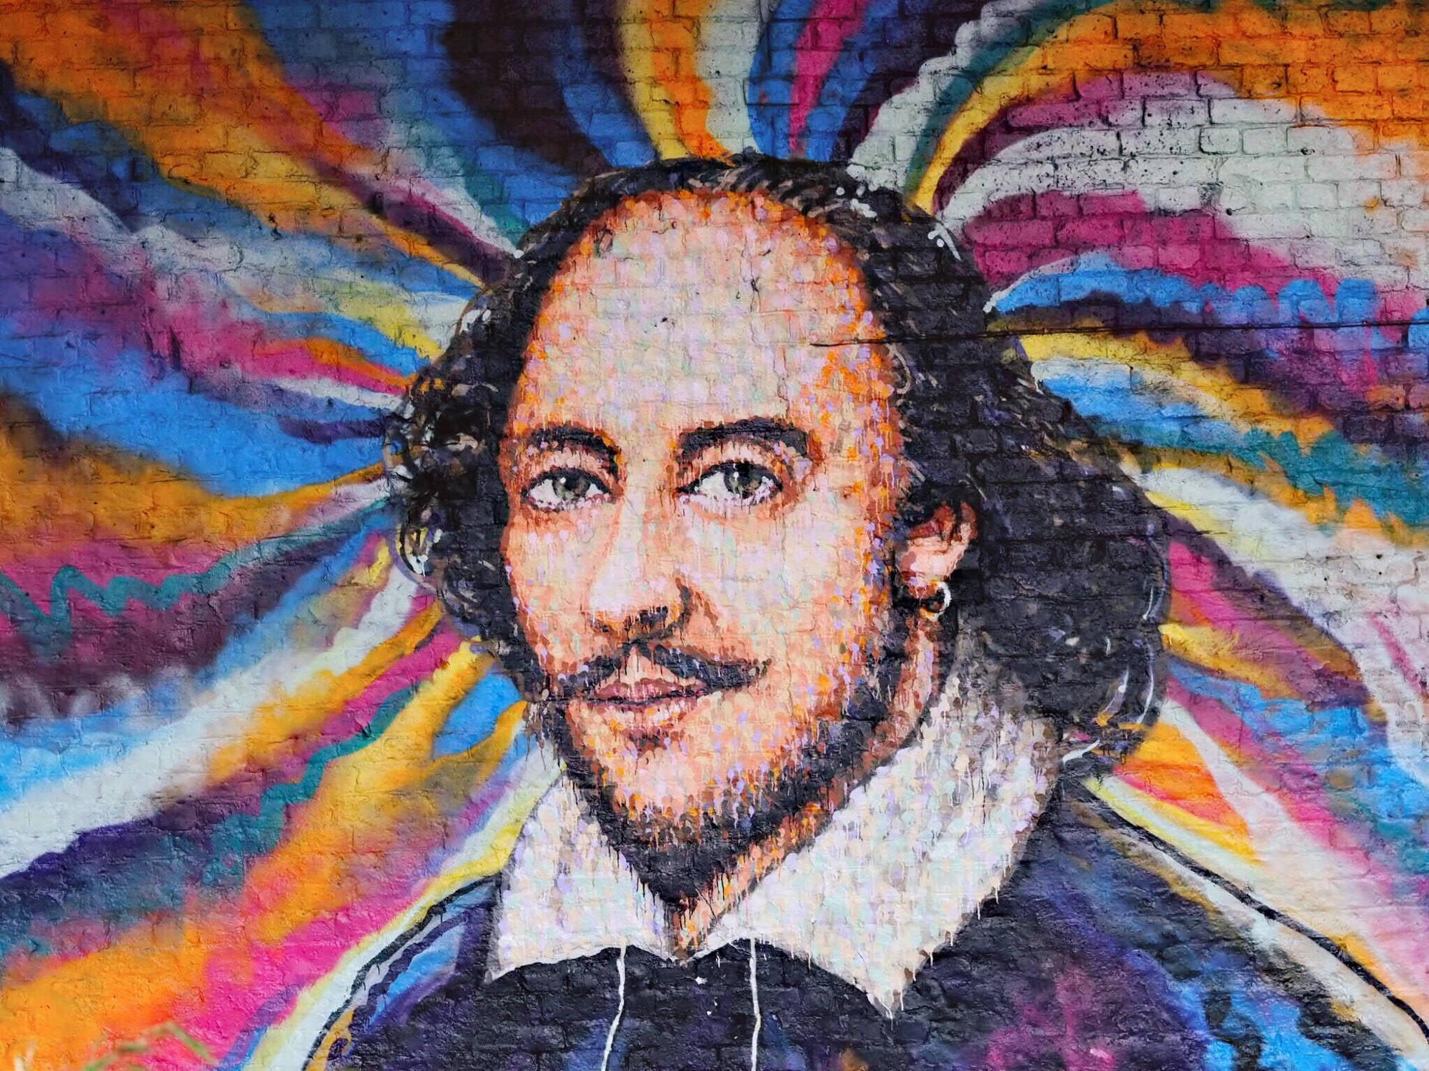
Shakespeare's Timeline
Reference the timeline of Shakespeare’s life found here http://www.nosweatshakespeare.com/resources/ timeline/
Using the internet, find and identify all of the items on the list.
  define them in detail
  identify where they would fit on the timeline (be very specific)
Please write on a separate sheet of paper and be prepared to submit next class period (01/09) @ the beginning of class.

Slide 89
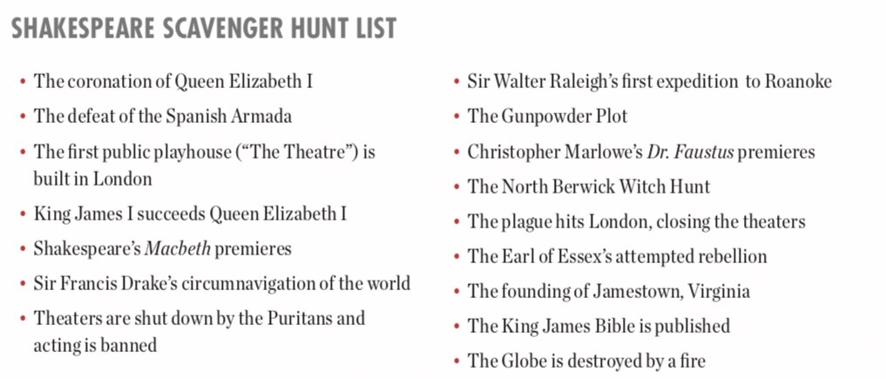

Slide 90
Part 8: What to expect this unit: GRADES

Slide 91

Expected Assignments & Grades for this Unit:
(subject to change…)
Macbeth Timeline HW (due 01/09)
Macbeth MRJ & IOC Notecards (due 02/08)
Macbeth Theme Poster (due TBD)
Macbeth Reading Comp. Test (due TBD)
Macbeth Argumentative Essay (due TBD)

