Slide 1
Agenda:
Survey
[10 min]
Letter to My Future Self
[30 min]

Slide 2
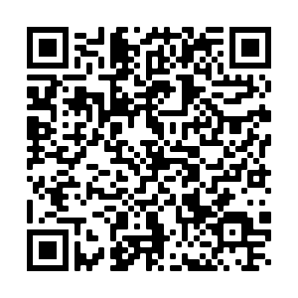
Survey QR Code
https://forms.office.com/Pages/ResponsePage.aspx?id=mLHcDGmBcEu6n9p-O6cAwjIkYrHF7pZLjrmesJuMna5UNERERlMxOFgxUVNMWTRFVFJDN05UUUNFQi4u

