Slide 1
Station Rotation
Instructions: Depending on which station you are at, find the corresponding instructions.

Slide 2
Importance of Setting
Explain the setting of the story.
How does the setting affect the story overall?
How does it affect the characters of the story?
How does it affect the mood of the story?
How does it affect the plot of the story?
Please provide SPECIFIC examples from the story.

Slide 3
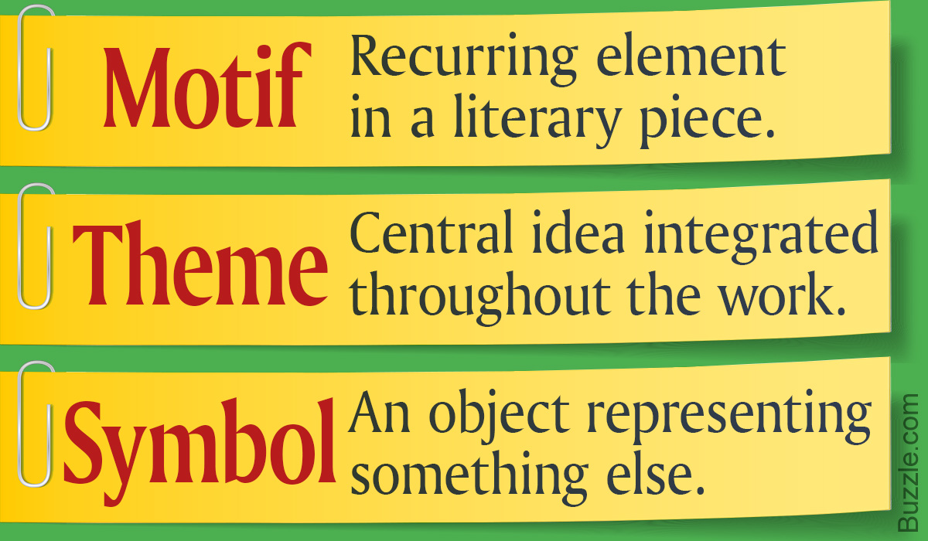
Recurring Elements
Note all recurring ideas, images and/or words in the text.
How might they be important?
Are any of these recurring elements used symbolically? If so, how?
Understanding the author’s message: questions

Slide 4
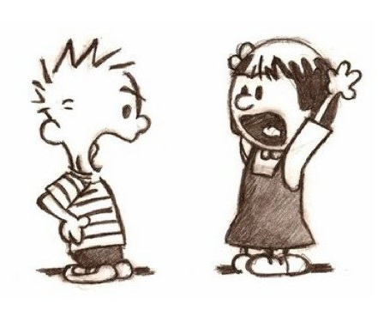
Resolving Conflict
What conflicts exist in the story? What is the main conflict?
How is the conflict resolved? How could the resolution of conflict contribute to the overall message?

Slide 5
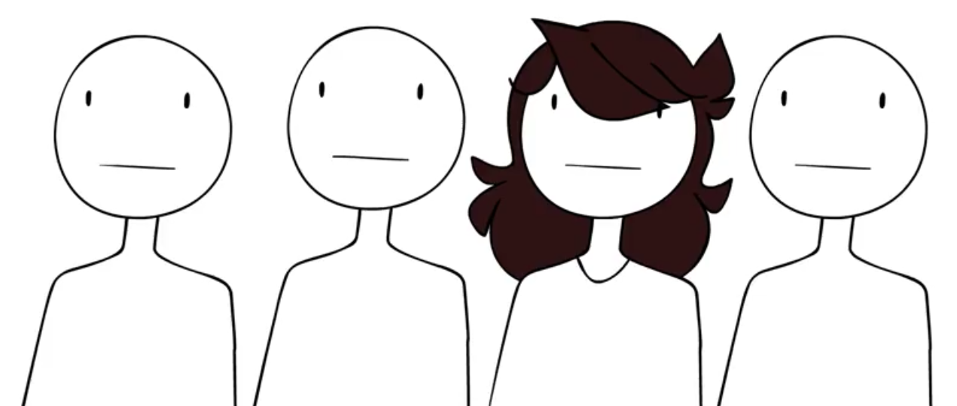
Understanding Character
List the main character traits of the protagonist.
Include support from the story.
How does the main character change and grow throughout the story?
How do minor characters contribute to the story?
How does the antagonist change and grow throughout the story?

Slide 6
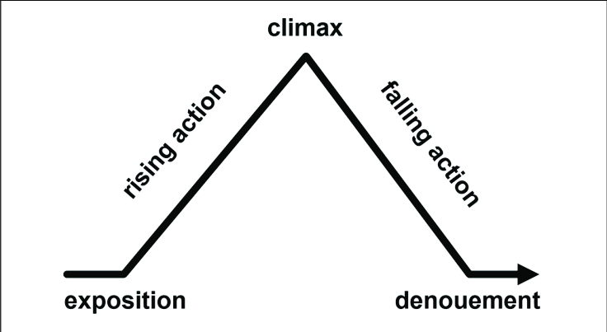
Plot
Create a plot diagram for the story [Freytag’s pyramid].
What are the most important elements of plot?
At what point in the story is the tension the highest?
Why do you think this is the highest point?

Slide 7
Important Quotations
Record quotations that you believe to be significant. Explain WHY.
Of the quotations you recorded, which is the most important from the story? Why?

Slide 8
Title
Note any references to the title in the story.
How are they significant?
How does the title relate to the rest of the piece?

Slide 9
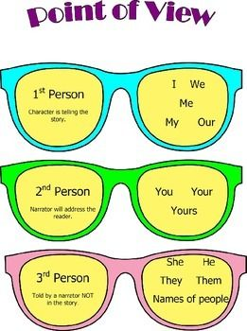
Point of View
What is the point of view?
Explain using specific examples.
How does the point of view affect the story?
Explain using specific examples.

