Slide 1
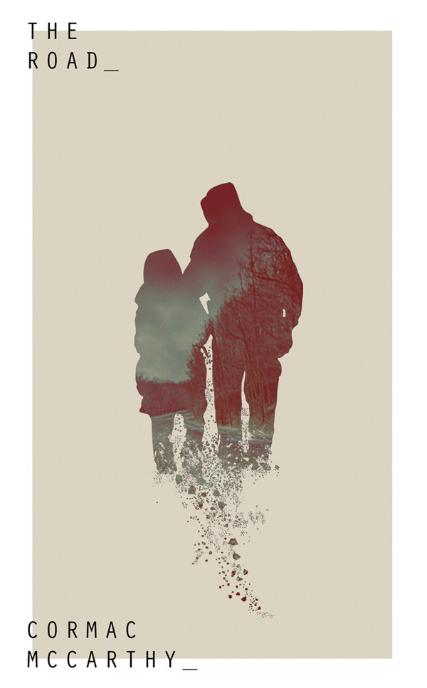
Cormac McCarthy’s The Road
Maximillion Thomas

Slide 2
Thematic Concepts

Slide 3
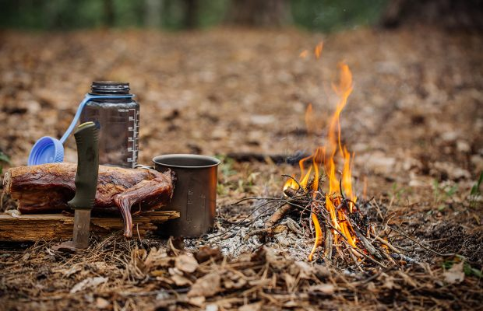
Survival
I view the theme of survival as the most dominant theme in the novel. While temporary threats such as the cannibals and other nomads impede our protagonists, perpetual threats like starvation are a consistent element in the story and must constantly be warded off. The novel also illustrates how human nature can be shaped through their will to survive when placed in dire situations.

Slide 4
Quote #1
“Huddled against the back wall were naked people, male and female, all trying to hide, shielding their faces with their hands. On the mattress lay a man with his legs gone to the hip and the stumps of them blackened and burnt. The smell was hideous.”
Quote #2
They lay in the leaves and the ash with their hearts pounding. He was going to start coughing. He'd have put his hand over his mouth but the boy was holding on to it and would not let go and in the other hand he was holding the pistol. He had to concentrate to stifle the cough and at the same time he was trying to listen.”
Quote #3
“Listen to me, he said. Just stop it. We're starving. Do you understand?”

Slide 5
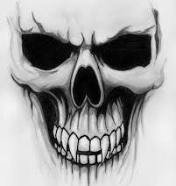
Death
Death is constantly looming within the story. It varies in intensity with subtle details about the once-lively natural environment to the untimely demise of other survivors. While reading the novel, constant remarks about the bleak landscape and withered plant life create an atmosphere of decay making death ever-present throughout.

Slide 6
Quote #1
“In the night he heard hideous shrieks coming from the house and he tried to put his hands over the boy's ears and after a while the screaming stopped.”
Quote #2
“He walked down to the end of the loft and looked out the high gable window at the country below, the pieced land dead and gray, the fence, the road. “
Quote #3
“Dead ivy along a stone wall and a mailbox and a fence along the road and the dead trees beyond. Cold and silent.”

Slide 7
Hope
Hope is another common theme seen through the book. It is a byproduct of disaster and is nurtured through strife. The apocalypse, while undoubtably brought despair, brought hope with it. The father wants his son to be safe and is relying on faith that there will be something at the sea. The boy, being young, has many naïve hopes such as placing his faith within other survivors. Hope can also be unfounded such that it becomes a foolish desire.

Slide 8
Quote #1
“In the floor of this room was a door or hatch and it was locked with a large padlock made of stacked steel plates. He stood looking at it.
Papa, the boy said. We should go. Papa.
There's a reason this is locked.”
Quote #2
“What if it doesnt fire? It has to fire. What if it doesnt fire?”
Quote #3
“Jesus, he whispered. Then one by one they turned and blinked in the pitiful light.
Help us, they whispered. Please help us.
Christ, he said. Oh Christ. He turned and grabbed the boy. Hurry, he said. Hurry. He'd dropped the lighter. No time to look. He pushed the boy up the stairs.
Help us, they called.”

Slide 9
Overall Message
I believe the connection of these different themes create a story that is rawer than anything. We are given miniscule details about the nuances that our characters are going through down to the last drop of water they drink. The consequences of the choices they make directly correlate with the events within the novel. I appreciate this because the causes of events aren’t left up to interpretation and a clear cause and effect relationship is presented by the book. This leads me to believe that the message cannot be derived from finding a deeper meaning in the book because what we are given can be taken at face value. Our characters have been thrust into a survival situation and their goal was set since the very beginning. So, I believe the “message” is about the nature of people when society stops looking which leaves us two groups of people, “the good guys” and “the bad guys”.

Slide 10
Symbols

Slide 11
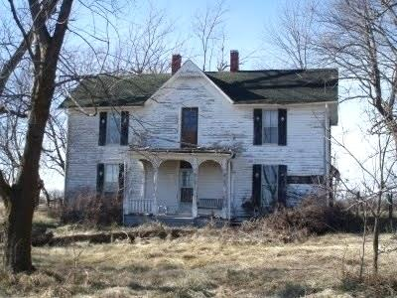
The House
The house is a representation of society within the aftermath of the apocalypse. The house is disgusting and covered in filth. The cannibals are in control of everything and the people who aren’t strong enough to them off die making the house a microcosm of the Earth.

Slide 12
The Gun
Any time the man and the son are placed into a tight situation, the gun is used first for self-defense, then as a way out mainly for the boy. If the son is a representation of hope, then the gun represents despair. A symbol of tragedy and loss that would be carried on by the father alone.

Slide 13
Motifs

Slide 14
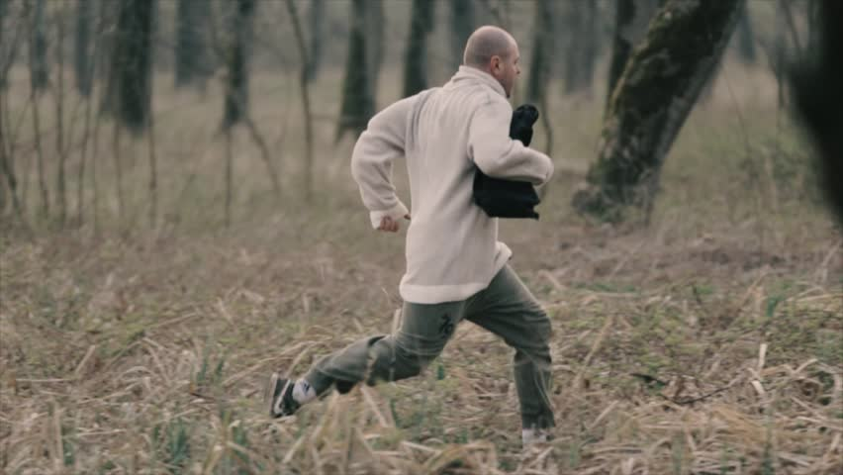
Escape
Fleeing is the main element in this section of the book. The man and the boy run away and spend hours hiding until it is safe to run again. The desire to escape is also seen in the prisoners of the house.

Slide 15
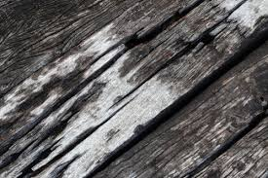
Decay
Decay is another prominent feature in this scene. The father describes parts of the house as “dank” and “hideous”. The people within the cellar are rotting away. Even when they reach safety, the new house is breaking apart and covered in layers of dust.

Slide 16
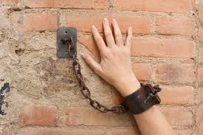
Trapped
Being trapped is a common element in this passage as well. Both literally with the prisoners within the cellar and figuratively by the woods that surround the man and the boy. Despite the trees being completely withered away, the woods have always been around them.

Slide 17
Literary Devices

Slide 18
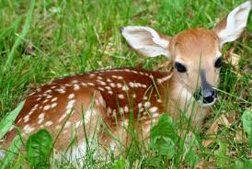
Simile
“He ducked his head and then flicked the lighter and swung the flame out over the darkness like an offering.”
“They staggered on like drunks.”
“He'd trained him to lie in the woods like a fawn.”

Slide 19
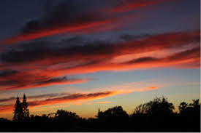
Imagery
“The chary dawn, the cold illucid world. In the distance what looked to be a pine wood, raw and black. A colorless world of wire and crepe.”

Slide 20
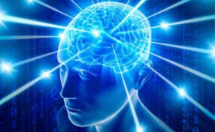
Personification
“The soul is quick.”
“He tried to think but his mind swam.”

Slide 21
Important Subjects

Slide 22
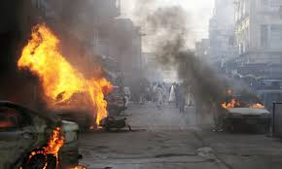
Violence
The violence within this section of the novel is more subtle. We are given details about the before and a clue as to what happened after regarding the people in the basement of the house. There is also the aftermath of the man with no legs.

Slide 23
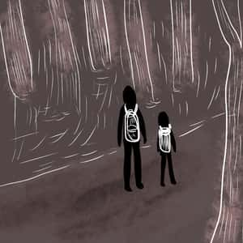
Love
Love’s presence is credited to the story revolving around a father and his son. This creates an implied relationship being the “father-son bond” they are supposed to share. This love is exemplified by the father’s dedication to his son’s safety and the son’s commitment to his father’s well being.

Slide 24
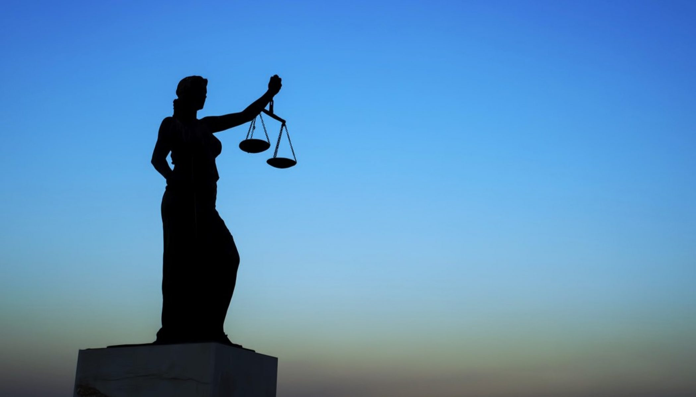
Morality
Morality is a heavy subject in this part of the book. The cannibals, while seemingly in the wrong, should not be scrutinized too much before considering the circumstances. It is unclear as to the motives of their actions and who those people in the cellar are. This puts into question whether cannibalism is morally acceptable given the situation.

Slide 25
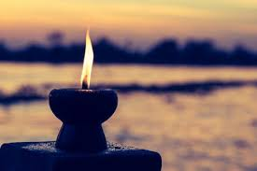
Spirituality
The father is clearly religious as he makes many references to God throughout the novel. One such time happened to be in this portion of the story. He says, “Curse God and die.” This, combined with other instances, reveals how the man’s view of God may have changed after the apocalypse.

Slide 26
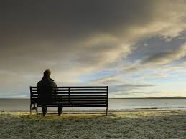
Isolation
Isolation is an element that can have several interpretations in this instance. The father and son are isolated from the cannibalistic communities. They are isolated from the society they are striving for. They are isolated from reality and are following a foolish desire.

Slide 27
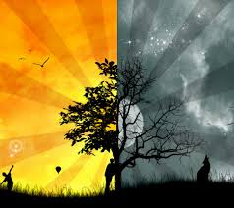
Good vs. Evil
The notion of good and evil is challenged many times by the novel. The author has explicitly stated that the father and son are the “good guys”, but that is a matter of perspective. There are instances such as when they met the old man and left him alone and when they decided against helping the people in the cellar. The only “good” actions seen are the sacrifices that the father makes for his son and the very rare donation of food.

Slide 28
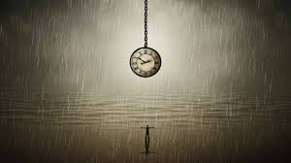
Memory and the Past
The past is brought up towards the end of the passage. The man talks about the old bicycle and how overgrown the plants around the house are. He even picks up a flavor packet that would be alien to the boy considering that he hadn’t had a Coke before.

Slide 29
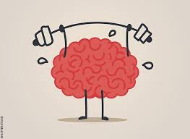
Strengths and Skills
The strengths and skills of the father are showcased here when they flee the house successfully as well as the mental fortitude of the man despite grave situations. This strength is derived from his love for his son who is his sole reason for living.

Slide 30
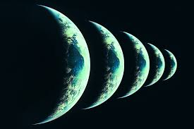
Versions of Reality
The reality of the world for the man and the boy appears to be very nice when compared to the cannibals and their victims. A cannibalistic lifestyle has many drawbacks in terms of mental and physical states. The reality for the victim is that the world is a world where the only time they see light is when they are going to die.

Slide 31
Discussion Questions

Slide 32
Questions
Is it possible to accurately determine whether a character is “good” or “bad” when presented a story from one perspective?
Was there good reason to open the cellar doors?
To what extent could human nature be affected by an apocalyptic event. How much would you change if placed in that circumstance?
What does reality look like to the mother/old man/cannibals?
How does imagery play a role when writing about violence?
Discuss the importance of the journey as an organizing structure in at least two works you have studied.

