Slide 1
Context of Composition & Context of Interpretation

Slide 3
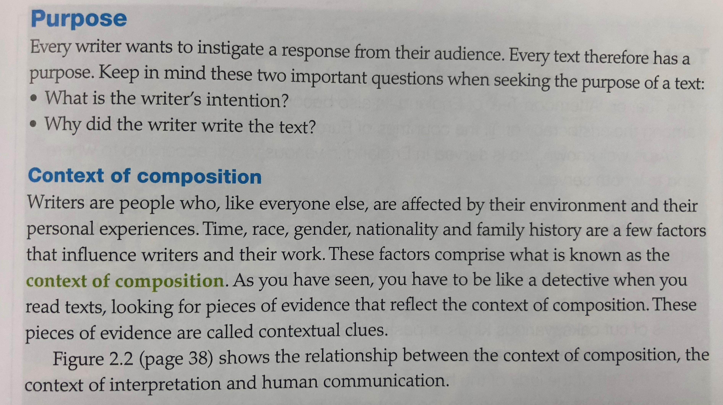

Slide 5
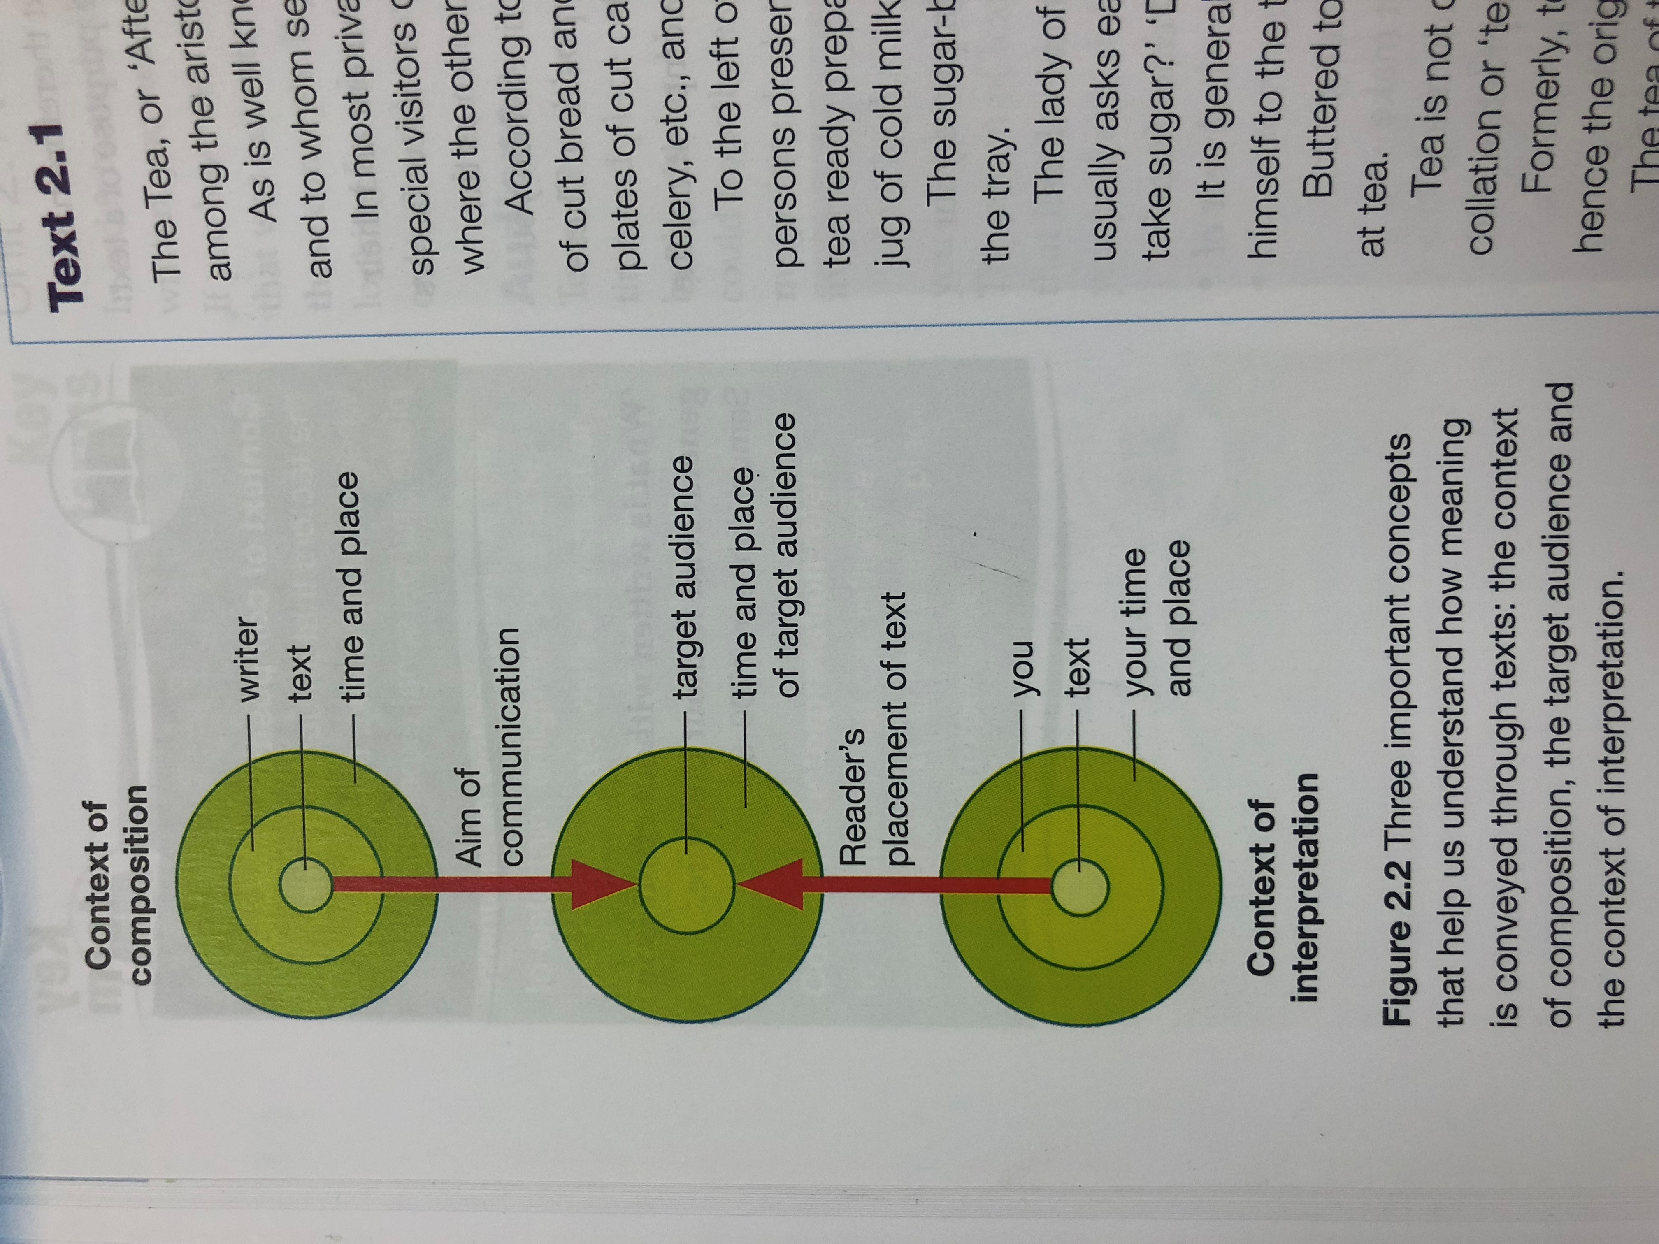
Copy this chart down in your notes! ☺
CONTEXT OF COMPOSITION
TARGET AUDIENCE
CONTEXT OF INTERPRETATION

