Slide 1
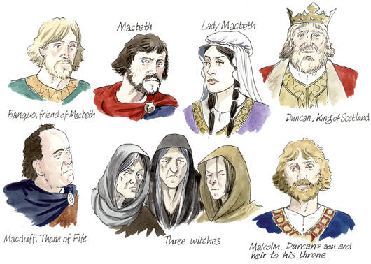
Macbeth: Characterization Project

Slide 2
Overview:
You will create a resume for one of the characters in Macbeth.
First, you will learn how to write a well-written cover letter & resume.
Next, search the internet for historical background information (CONTEXT OF COMPOSOITION).
Explore the play again, looking for both direct and implied information about their characters and note the location of supporting details.
Draft a cover letter & resume for your character.
Finally, search a job listing site for a job for which your character is qualified. When you present your resume, you will explain the job that he/she is applying for. Be prepared to justify why this job is best for him/her.

Slide 3
Goal:
To display your in-depth knowledge of ONE major character in Macbeth through a well-written and historically accurate resume.
To display your knowledge of how to write a well-written resume.
To display your knowledge of the time period.

Slide 4
Step-by-Step Instructions
**This is an individual project. You may confer with student’s around you, but you are responsible for your own original work. ☺ **

Slide 5
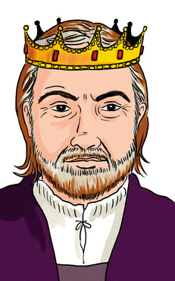
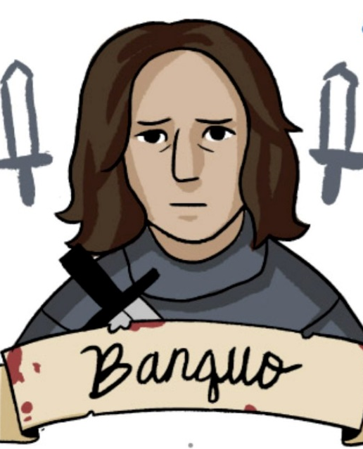
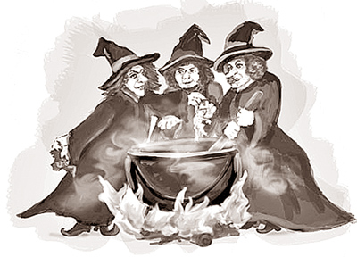
Step #1: Choosing the Character
Choose ONE character from the list below:
Macbeth
Lady Macbeth
Banquo
Duncan
Three witches
Other (must see me for approval)

Slide 6
Step #2: Context of Composition
Directions:
Research the time period (social, cultural, & historical context) in which this play takes place to ensure your resume is RELEVANT.
Important Information:
11th century Scotland
Macbeth reigns over Scotland from 1040-1057

Slide 7
Step #3:
Indirect VS. Direct Characterization
Analyzing the Text
“Characterization is the process by which the writer reveals the personality of a character. Characterization is revealed through direct characterization and indirect characterization.”
Direct Characterization TELLS the audience what the personality of the character is.
Indirect Characterization SHOWS things that reveal the personality of a character. There are five different methods of indirect characterization. (S.T.E.A.L)
Go through the text & highlight important parts.
Where in the text do you learn about the character
Jorden was here ;)

Slide 8
Direct & Indirect Characterization: Examples
Direct Characterization
Indirect Characterization
Example: “The patient boy and quiet girl were both well mannered and did not disobey their mother.”
Explanation: The author is directly telling the audience the personality of these two children. The boy is “patient” and the girl is “quiet.”
Speech What does the character say? How does the character speak?
Thoughts What is revealed through the character’s private thoughts and feelings?
Effect on others toward the character.
What is revealed through the character’s effect on other people? How do
other characters feel or behave in reaction to the character?
Actions What does the character do? How does the character behave?
Looks What does the character look like? How does the character dress?

Slide 9
Step #4: Writing a Cover Letter & Resume
COVER LETTER INFORMATION
WHAT TO INCLUDE:
Try to limit your letter to a single page. Be succinct.
Assess the employer's needs and your skills. Then try to match them in the letter in a way that will appeal to the employer's self-interest.
As much as possible, tailor your letter to each job opportunity. Demonstrate, if possible, some knowledge of the organization to which you are applying.
Write in a style that is mature but clear; avoid long and intricate sentences and paragraphs; avoid jargon. Use action verbs and the active voice; convey confidence, optimism, and enthusiasm coupled with respect and professionalism.
Show some personality, but avoid hard-sell, gimmicky, or unorthodox letters. Start fast; attract interest immediately. For more information see Business Letter Format.
Arrange the points in a logical sequence; organize each paragraph around a main point.
HOW TO ORGANIZE:
Opening Paragraph
State why you are writing.
Establish a point of contact (advertisement in a specific place for a specific position; a particular person's suggestion that you write): give some brief idea of who you are (a Senior engineering student at UW; a recent Ph.D. in History).
Paragraph(s) 2(-3)
Highlight a few of the most salient points from your enclosed resume.
Arouse your reader's curiosity by mentioning points that are likely to be important for the position you are seeking.
Show how your education and experience suit the requirements of the position, and, by elaborating on a few points from your resume, explain what you could contribute to the organization.
(Your letter should complement, not restate, your resume.)
Closing paragraph
Stress action. Politely request an interview at the employer's convenience.
Indicate what supplementary material is being sent under separate cover and offer to provide additional information (a portfolio, a writing sample, a sample publication, a dossier, an audition tape), and explain how it can be obtained.
Thank the reader for his/her consideration and indicate that you are looking forward to hearing from him/her.
HOW TO FORMAT:
Type each letter individually, or use a word processor.
Use good quality bond paper.
Whenever possible, address each employer by name and title.
Each letter should be grammatically correct, properly punctuated, and perfectly spelled. It also should be immaculately clean and free of errors. Proofread carefully!
Use conventional business correspondence form. If you are not certain of how to do this, ask for help at the Writing Center.

Slide 10
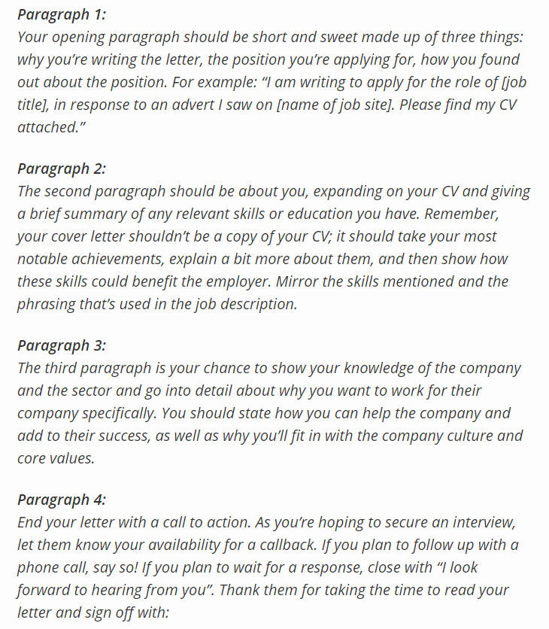
Cover Letter Format:

Slide 11
Step #4: Writing a Cover Letter & Resume
RESUME INFORMATION
Read this: https://www.youthcentral.vic.gov.au/jobs-and-careers/applying-for-a-job/what-is-a-resume/how-to-write-a-resume
Common mistakes: https://cultivatedculture.com/write-a-resume/
Look at this example: http://www.readwritethink.org/files/resources/lesson_images/lesson198/ShakespeareResume.pdf?_ga=2.88247708.664390399.1542303627-2041253772.1524149018

Slide 12
Step #5: Finding the Perfect Job
Using one of the job finder websites below, find a job that your character could apply for.
https://www.careerbuilder.com/
https://www.monster.com/
https://www.indeed.com/
https://www.glassdoor.com/index.htm
Be sure to read the qualifications to see if your character is qualified for the job.
You MUST find a job that fits your character.
On a separate word document, write an expository constructed response (2 paragraph minimum) of the job you found for your character and explain WHY and HOW he/she would be best for the position.

Slide 13
Checklist: Please check off the following before you submit your work.
_____ Resume
_____ Cover letter
_____ Find a job appropriate for your character.
_____ 2 paragraph explanation detailing WHY and HOW this job is right for your character.
***PRINT AND STAPLE IN THIS ORDER.***

Slide 14
Standards Met w/this Activity:
ELAGSE9-10W2: Write informative/explanatory texts to examine and convey complex ideas, concepts, and information clearly and accurately through the effective selection, organization, and analysis of content. a. Introduce a topic; organize complex ideas, concepts, and information to make important connections and distinctions; include formatting (e.g., headings), graphics (e.g., figures, tables), and multimedia when useful to aiding comprehension. b. Develop the topic with well-chosen, relevant, and sufficient facts, extended definitions, concrete details, quotations, or other information and examples appropriate to the audience’s knowledge of the topic. c. Use appropriate and varied transitions to link the major sections of the text, create cohesion, and clarify the relationships among complex ideas and concepts. d. Use precise language and domain-specific vocabulary to manage the complexity of the topic. e. Establish and maintain an appropriate style and objective tone. f. Provide a concluding statement or section that follows from and supports the information or explanation presented (e.g., articulating implications or the significance of the topic).
ELAGSE9-10W4: Produce clear and coherent writing in which the development, organization, and style are appropriate to task, purpose, and audience. (Grade-specific expectations for writing types are defined in standards 1–3 above.)
ELAGSE9-10W5: Develop and strengthen writing as needed by planning, revising, editing, rewriting, or trying a new approach, focusing on addressing what is most significant for a specific purpose and audience. (Editing for conventions should demonstrate command of Language standards 1–3 up to and including grades 9–10.)
ELAGSE9-10RL3: Analyze how complex characters(e.g., those with multiple or conflicting motivations) develop over the course of a text, interact with other characters, and advance the plot or develop the theme.

Slide 15
Rubric:

