Slide 1
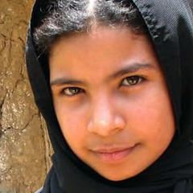
I Am Nujood, Age 10 and Divorced
Chapter Discussion Questions & CEI Review

Slide 2
Standards Met With This Project
ELAGSE9-10RL3: Analyze how complex characters(e.g., those with multiple or conflicting motivations) develop over the course of a text, interact with other characters, and advance the plot or develop the theme.
ELAGSE9-10RL2: Determine a theme and/or central idea of text and closely analyze its development over the course of the text, including how it emerges and is shaped and refined by specific details; provide an objective summary of the text.
ELAGSE9-10RL6: Analyze a particular point of view or cultural experience reflected in a work of literature from outside the United States, drawing on a wide reading of world literature

Slide 3
Discussion Rules
Must refer directly to the text (On page 13 I noticed…)
This is where your annotations will help you!! ☺
Must allow everyone to express their viewpoint before agreeing/disagreeing
We are going to have an open discussion; we will not be raising our hands.
We cannot all speak at once; it is important to wait your turn and allow everyone to speak.
Must accept (not agree, but accept & try to understand) other perspectives that are different from your own

Slide 4
Discussion Question #1
Honor is obviously very important to the men of Nujood’s family. What does the notion of honor mean in rural Yemeni culture, and how does it differ from Western ideas of honor?
When Nujood, Shada, and their allies go to court to seek a divorce for Nujood, what conception of honor are they defending?

Slide 5
Discussion Question #2
Nujood says that when her family was driven from Khardji, they lost “a small corner of paradise.” How do the injustices endured by Nujood’s father and brother, Fares, show that life in a patriarchal society can be hard not just for women, but for male Yemenis, too?
Consider how the actions of Omma, Mona, Nujood’s mother-in-law, Dowla, and Shada reflect differences in their life experiences, personalities, backgrounds, and relationships with Nujood. For example:
What do you think Omma was thinking when Nujood told her about the abuse? Can you understand her lack of action?
Conversely, why was Dowla willing and able to give Nujood the help and advice that no one else was willing to provide?

Slide 6
Discussion Question #3
Nujood’s mother-in-law is a strong personality who treats the young girl harshly and fails to come to her defense on her wedding night. Were you surprised when one of Nujood’s primary oppressors turned out to be a woman?
How does this play, paradoxically, into the idea of Yemen as a highly patriarchal society?

Slide 7
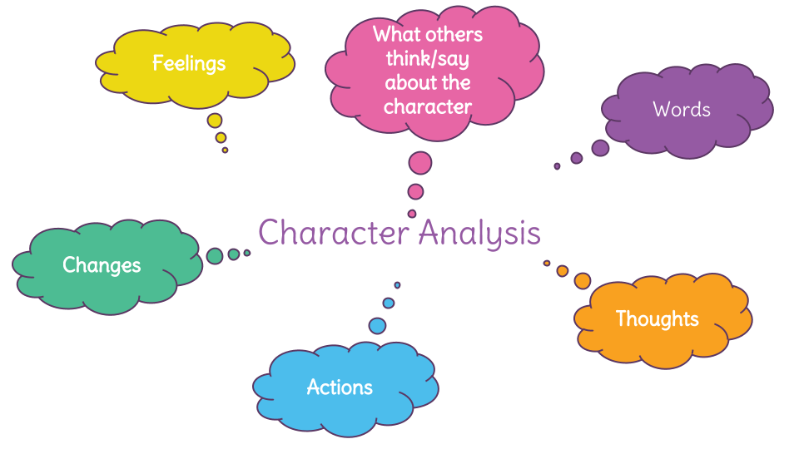
Directions for today:
Today we will be exploring the depth of the characters in the text.
In groups of NO MORE THAN THREE, complete the following:
Read the assignment sheet.
Decide which character(s) your group would like to focus on for this project.
S.T.E.A.L the character(s)
Each member of the group must complete this on his/her own sheet of paper.
Plan out project
How will you display your understanding of the character(s) through symbolism?
What specific lines from the text will you use to display this understanding (you must have AT LEAST 7)?
I would recommend writing these out as you find them.
What materials are needed from home?
Poster board?
Markers?
Colored pencils?
START A ROUGH DRAFT
You must submit a rough draft along with the final draft of your project.
These projects will be displayed! ☺

Slide 8
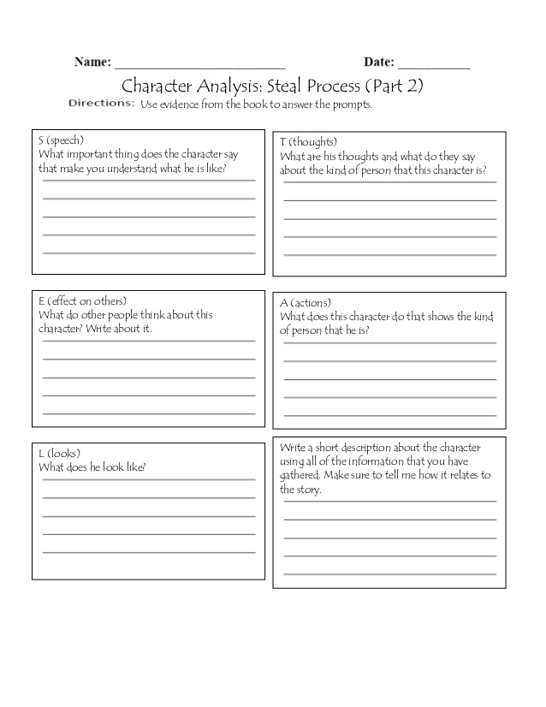
How To: S.T.E.A.L A Character

Slide 9
Exemplar:

