Slide 1
DISCUSSION QUESTIONS, Literary elements questions & WRITING PROMPTS
Macbeth Act 1, Scenes i-vii William Shakespeare

Slide 2
READING PARTS
MACBETH: Bryce
BANQUO: Kendall C.
ROSS: Kelley
ANGUS: Joseph
DUNCAN : Jaytin
MALCOLM: Kenya
LADY MACBETH: Savannah
MESSENGER: Nyasia

Slide 3
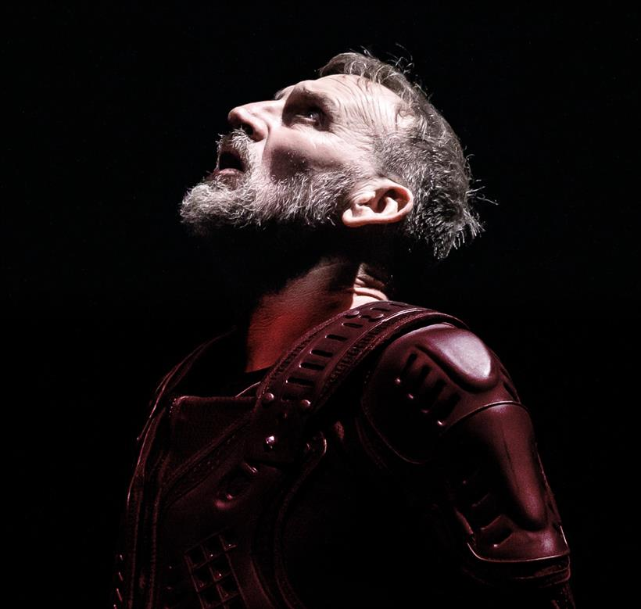
To do after each act:
End of Act Notes
Act I Discussion Questions
Act 1 Literary Elements Questions
Act I Writing Prompts

Slide 4
End of each act notes:
You will be required to submit notes immediately after EACH Act. Each set of notes will be worth 1 quiz grade (formative grade) and will be weighted at 25 points each (amounting to 100 points by the end of the play).
(5 pts.) Summary of the Act with major plot points.
You MUST discuss the importance of stage directions in the age.
Be able to discuss major soliloquies/monologues and their impact.
Soliloquy= an act of speaking one’s thoughts aloud when by oneself or regardless of any hearers.
Monologue=a long speech by one actor in a play
(10 pts.) 10 examples of RHETORICAL DEVICES/FIGURATIVE LANGUAGE: You may not have any more than 2 examples for each rhetorical device (For example, if you choose to discuss similes in the text, you may only document 2 examples from each act.).
You MUST provide page numbers for each example.
You MUST provide an explanation (3 sentences EACH) of how the figurative language/rhetorical device impacts the text (ask yourself “how does the device add meaning to the text?”).
****PLEASE NOTE: no points will be awarded for this section if you do not provide a detailed explanation of HOW the rhetorical device impacts the text.
(10 pts.) Characterization of at least one major character.
Think back to how we discussed Lady Macbeth in ACT I.
While you read, analyze how the author characterizes each character.
Jot down specific examples in the text where the author is displaying WHO the character is.
**You can write your notes however it makes sense to you as long as it is clearly stated. **

Slide 5
Act 1: Discussion Questions
Why do you think Shakespeare used a scene with three witches to begin this play (CONTEXT OF COMPOSITION)? Think about how this beginning might prepare the audience for what is to come.
Contrast the way Banquo and Macbeth react to the witches.
Describe what kind of man King Duncan is. Do you think he is a good leader? Explain.
In your opinion, what is Lady Macbeth’s attitude toward her husband? Give examples from the text to support your answer.
Reread King Duncan’s speech in Act I, Scene iv, lines 13-24, and discuss why you think Shakespeare had Duncan say this just before Macbeth enters. Do you agree with King Duncan that you cannot tell what people are really like just by looking at them?
List the steps of Lady Macbeth’s plan to kill King Duncan and blame it on someone else. Next to each step, write possible things that could go wrong.
What does Macbeth credit with giving him the courage to do the deed?

Slide 6
Act 1 Literary elements
Images of blood and darkness run through the entire play of Macbeth. Find as many examples of this imagery as possible in Act I.
A simile makes a comparison of two unlike things using like or as. Find one or two similes in Act I and explain how each helps to convey the feeling of the play.
Shakespeare allows his characters to reveal their innermost thoughts and feelings to the audience through speeches called soliloquies. What ideas about murdering Duncan does Macbeth express in his soliloquy in Scene vii?
A euphemism is a phrase that softens reality; for example, people often use the phrase “passed away” instead of “died.” Note all the euphemisms Macbeth uses in his soliloquy in Scene vii in place of the words “killing Duncan.” Substitute “killing Duncan” to see what difference it makes.

Slide 7
Act i: writing prompts **Note- In order to get credit for this portion of your quiz, you MUST REFER DIRENTLY TO THE TEXT USING PAGE & LINE #S.
#1. Macbeth might have stopped thinking about killing Duncan if his wife hadn’t urged him on. Write about a time a person convinced you to do something you weren’t sure about. Tell what that person did to persuade you. Then explain if that person’s advice hurt or helped you.
(*3 paragraph minimum; 7 sentences per paragraph minimum)
#2. Act I, Scene V begins with Lady Macbeth reading the ending of a letter from her husband, Macbeth. Keeping true to all of the information you have from the plays so far, write the beginning of the letter. Remember to tell Macbeth about the recent battle.
(*2 paragraph minimum; 7 sentences per paragraph minimum)

