Slide 1
Macbeth Argumentative Essay
Due February 1st via turnitin.com.

Slide 2
Argumentative Essay Directions
The assignment directions & rubric are available on the website (I also sent via Remind101 & email).
Basically,
1. choose ONE prompt from the list
2. complete an OUTLINE using the link provided to you
3. Remember to use C.E.I throughout your entire essay (this is an argumentative essay so you will need to use TEXTUAL EVIDENCE.
ROUGH DRAFT DUE: January 25^{th (MUST} PRINT OUT FOR CLASS FOR CREDIT)
FINAL DRAFT DUE: February 1st (MUST SUBMIT VIA TURNITIN.COM FOR CREDIT)

Slide 3
Macbeth MRJ
Due February 8th in class.

Slide 4
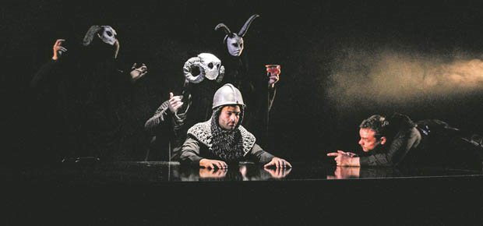
Act III, IV & V
Discussion Questions & Literary Elements Questions

Slide 5
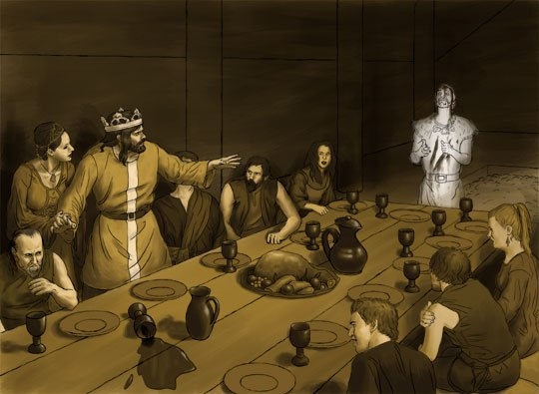
ACT III

Slide 6
Discussion Questions
What is the importance of Fleance’s escape?
What does Macbeth mean when he says “blood will have blood”?
From the point of view of one of their servants, describe how Macbeth and Lady Macbeth’s behaviors have changed since they have become king?
What Macbeth’s attitude toward Macduff show about his state of mind?
Do you think Scene vi is important to the play? Explain why or why not using textual evidence to support your answer.
What kind of ruler has Macbeth become by the end of Act III? Find evidence from the play to support your answer.

Slide 7
Literary Elements Questions
Review Hecate’s speech and compare its verse structure to other speeches in the play. Why do you think critics are so sure that someone other than Shakespeare wrote this speech?
In the banquet scene, Macbeth believes that he can see the ghost of Banquo. Yet, no one else present at the feast sees the apparition. What is the possible implication?
Shakespeare often made ALLUSIONS to figures and stories from ancient Greece and Rome in his writing. In Act III, Scene I, Macbeth says, “My genius is rebuked, as it is said/ Mark Antony’s was by Caesar.” Who is Caesar, and what do you think this reference suggestions? Find AT LEAST 4 OTHER allusions in Macbeth and explain its meaning and how it adds to the play.

Slide 8
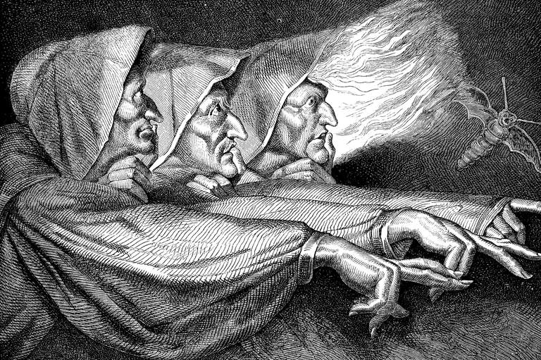
ACT IV

Slide 9
Discussion Questions:
In scene I, why is the witches’ chant given in such detail?
In your opinion, is Macbeth wise to put his faith in what he learns from the witches?
Why does Macbeth decide to kill Macduff’s family? Explain what this shows about Macbeth.
How does Malcolm test Macduff?
Why do you think Shakespeare included the discussion about the King of England and his special talents in Act IV, Scene iii?
Explain your opinion about whether Shakespeare’s use of ghosts and apparitions is effective in this play.
Why do you think Shakespeare chose to write no more scenes between Macbeth and Lady Macbeth during these last two acts? Explain whether you think this was a good decision or a bad decision.

Slide 10
Literary Elements Questions
Review the ingredients that the witches put into their cauldron. What might this repulsive stew symbolize?
What mood is created in Act IV, Scene I? Describe some of the things that contribute to this mood.
Hyperbole means obvious exaggeration. Look at Malcolm’s self-description in Act IV, Scene iii, and see if you can find any examples of hyperbole. What is he trying to impress upon Macduff?
Remember that foreshadowing means the use of hints or clues about what will happen later in the plot. Find at least three times examples of foreshadowing in Act IV?

Slide 11
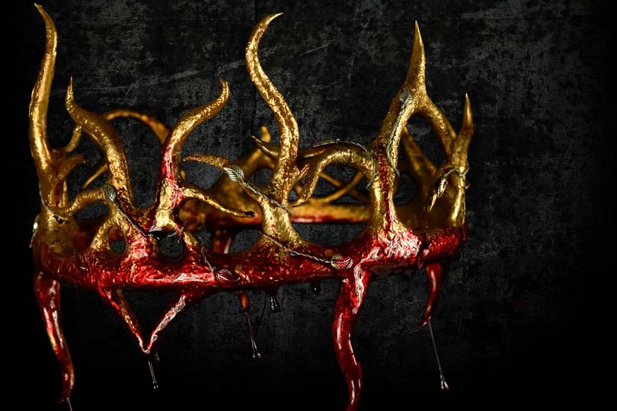
ACT V

Slide 12
Discussion Questions:
Describe Lady Macbeth’s mental state at the beginning of this act. Does this come as a surprise or was this possibility part of her character from the beginning? Explain your answer using textual evidence to support.
In Act V, Macbeth is trapped in his castle in Dunsinane. Discuss some of the ways in which this setting enhances the ideas and actions of the play. Explain your answer using textual evidence to support.
How does Macbeth receive the news of his wife’s death? Explain your answer using textual evidence to support.
What is Macbeth’s attitude toward the final battle? Explain your answer using textual evidence to support.
How does Macduff reveal Macbeth’s doom? Explain your answer using textual evidence to support.
Is there any point in this act in which you feel sympathy for Macbeth? Explain your answer using textual evidence to support.
Explain how the witches’ prophecies were filled. Explain your answer using textual evidence to support.

Slide 13
Literary Elements Questions
PERSONIFICATION: means giving human characteristics to nonhuman things. Look at the doctor’s speech oat the end of Act V, Scene i. What examples of personification do you find? Explain what is gained by this figure of speech using textual evidence to support your findings.
DRAMATIC IRONY: occurs when the audience has important knowledge that the main characters lack. Explain the irony when the soldiers are order to cut down the tree branches.
Macbeth’s SOLILOQUY in Scene v is famous. Reread lines 19-30 again the discuss any phrases you find that are memorable. What do they reveal about Macbeth’s state of mind?

