Slide 1
Macbeth
Act I, Scenes I-VII

Slide 2
Learning Outcomes
NOTE: These are the learning outcomes for the entire semester.
1. Explore literary works in detail
2. Analyze elements such as theme and ethical stance or moral values of literary texts
3. Understand and make appropriate use of literary terms

Slide 3
Important Reminders:
MRJ due February 8th, 2019 @ the beginning of class.
Be sure Written Task #2 rough draft is in turnitin.com.

Slide 4
Parts:
1st witch: Ty; Camille
2nd witch: Fran; Jalyn
3rd witch: Thorne; Taylor G.
Macbeth: Max; Aaron
Banquo: Keyvon; Keith
Duncan: Ayele; Charlese
Ross: Pili; April
Captain: Kelsey; Dom
Malcolm: Noah; Michelle
Lennox: Julia; Cameron
Angus: Jayla; Malana
Lady Macbeth: Chrishya, Jordynn
Messenger: Jasmin; Dereck

Slide 5
Characters Explained
Duncan= King of Scotland
Malcolm= his elder son
Donalbain= Duncan’s younger son
Captain= in the King’s army
Macbeth= Thane of Glamis, then the Thane of Cawdor, then the king of Scotland
Lady Macbeth= Macbeth’s wife
Banquo= a Thane (nobleman of Scotland)
Lennox= Thane (royal official)
Ross= Thane (royal official)
Angus= Thane (royal official)
Witches= from the supernatural world
TIME PERIOD: the 11th century
PLACE: Scotland

Slide 6
Act I, Scene I
Importance of stage directions
Context of composition: the witches
Meeting of the witches
Language of the witches: rhyming couplets
Type of language used & how that affects the character
Noble characters= verse
Less noble characters= prose
Animal imagery [graymalkin & paddock]
Important to understand why Shakespeare structured play this way.

Slide 7
Act I, Scene II
This scene provides important information so that we understand the rest of the play.
Imagery
Introduction to Macbeth
Through the eyes of other→importance
“brave Macbeth”
“…well he deserves that name”
“…smoked with bloody execution”
“…unseam’d him from the nave to th’ chops”
Historical context/sign of the times
“Go pronounce his present death, And with his former titled greet Macbeth.”
Macbeth gets title of “Thane of Cawdor”
Paradox

Slide 8
Act I, scene iii
Note stage directions.
Note text structure:
Scene I
Scene II
Scene III
What are the witches talking about?
What does this tell the reader about the witches?
Language of the witches: rude & vulgar
Animal symbolism
Foreshadowing: line 19 & 20-21
“So foul and fair a day I have not seen.”
Connection to scene I
Line 53-54: interesting structure point
FOIL
“…who neither beg nor fear Your favors nor your hate.”
“Stay, you imperfect speaks, tell me more.”
Macbeth & the prophesies

Slide 9
Act I, scene iv
Dramatic irony
Foreshadowing
Macbeth vs. the rebel
Compare & contrast Duncan vs. Macbeth response
How does Shakespeare use language to show the reader something?
Theme:
Appearance vs. reality

Slide 10
Act I, scene v
Letter from Macbeth to Lady Macbeth
Lady Macbeth soliloquy
Lady Macbeth characterization
Relationship between Macbeth & Lady Macbeth
Use of metaphors

Slide 11
Act I, scene vi
The calm before the storm scene
Irony
Theme: deceit
Duncan characterization
How he treats Macbeth & Lady Macbeth
Dramatic irony example

Slide 12
Act I, scene vii
**very important soliloquy (Macbeth talking by himself on stage- no other character can hear him)
Use of foreshadowing
Lady Macbeth characterization
How does she convince Macbeth to kill Duncan. What does she say?
Context of composition
Theme of:
Deception
Appearance vs reality

Slide 13
To do:
Summarize each scene of the act in your OWN WORDS on a post-it and put it at the start of each scene in your book. **I do not want to see Sparknotes/BookRags/etc.
Complete the DISCUSSION QUESTIONS PART 1 AND 2 & LITERARY ELEMENTS QUESTIONS.
**Due at the end of class! ☺

Slide 14
Discussion Questions:
Why do you think Shakespeare used a scene with three witches to begin this play? Think about how this beginning might prepare the audience for what is to come. Use textual evidence to support your answer.
Contrast the way Banquo and Macbeth react to the witches. Provide textual evidence to support your answer.
Describe what kind of man King Duncan is. Do you think he is a good leader? Explain and provide textual evidence to support your answer.
In your opinion, what is Lady Macbeth’s attitude toward her husband? Provide textual evidence to support your answer.
Reread King Duncan’s speech in Act I, Scene iv, lines 13-24, and discuss why you think Shakespeare had Duncan say this just before Macbeth enters. Do you agree with King Duncan that you cannot tell what people are really like just by looking at them. Provide textual evidence to support your answer.
List the steps of Lady’s Macbeth’s plan to kill Duncan and blame it on someone else. Next to each step, write possible things that could go wrong. How does Shakespeare foreshadow these possibilities? Provide textual evidence to support your answer.
What does Macbeth credit with giving him the courage to do the deed? Provide textual evidence to support your answer.

Slide 15
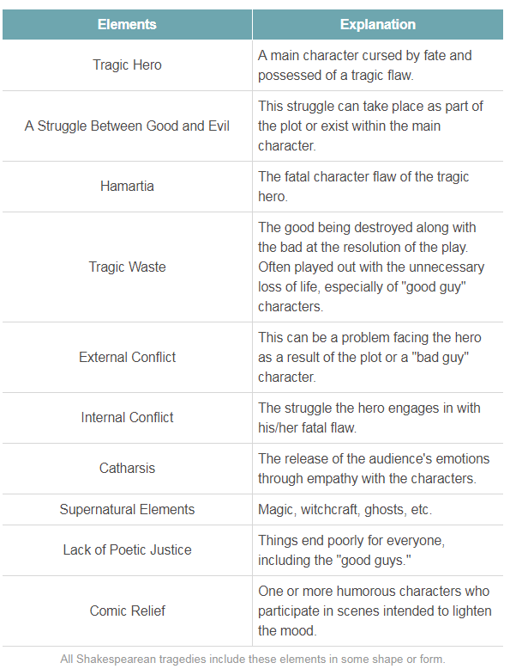
Discussion Questions Part 2
Find an examples of each of the following terms:
You can skip tragic waste, catharsis, lack of poetic justice, and comic relief.
Be sure to provide textual evidence (act #, scene #, and line #).

Slide 16
Literary Elements Questions:
Images of blood and darkness run through the entire play of Macbeth. Find as many examples of this imagery as possible in Act I.
A simile makes a comparison of two unlike things using like or as. Find one or two similes in Act I and explain how each helps to convey the feeling of the play.
Shakespeare allows his characters to reveal their innermost thoughts and feelings to the audience through speeches called soliloquies. What ides about murdering Duncan does Macbeth express in his soliloquy in Scene VII?
A euphemism is a phrase that softens reality; for example, people often use the phrase “passed away” instead of “died.” Note all the euphemisms Macbeth uses in his soliloquy in Scene VII in place of the words “killing Duncan.” Substitute “killing Duncan” to see what difference it makes, if any.

Slide 17
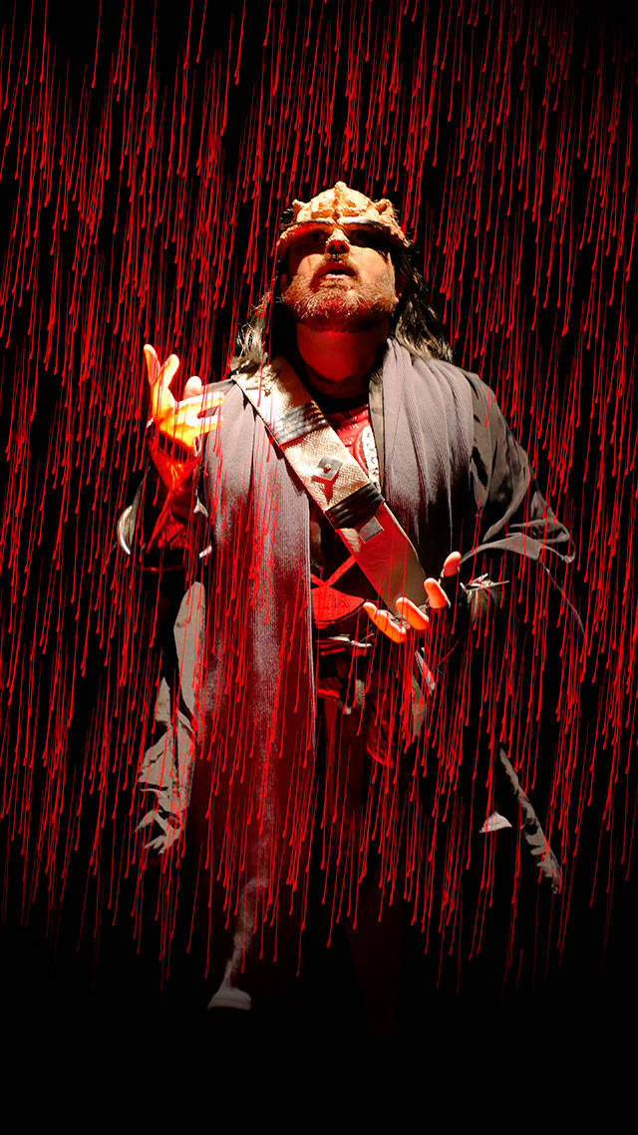
Need some extra help understanding?
Read the act again @ home while watching the video:
https://www.youtube.com/watch?v=IKFLVEI1NBA

