Slide 1
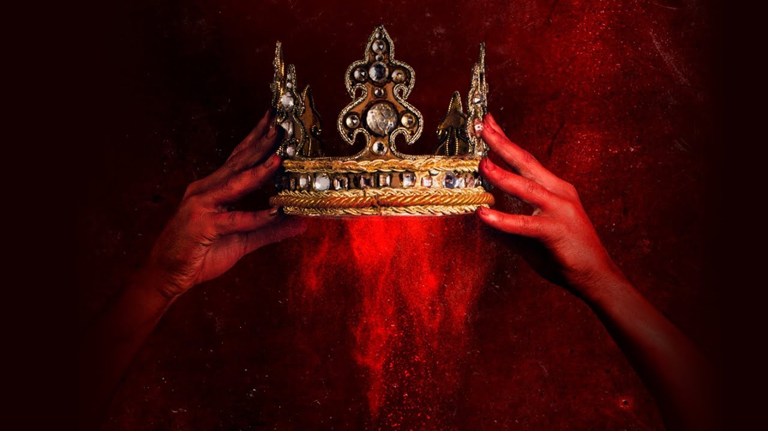
Macbeth
Act 2, Scenes 1-4

Slide 2
Instructions:
ON YOUR OWN:
End of Act Notes (Please read ALL of the instructions!!)
WITH YOUR GROUP:
Discussion Questions
Literary Elements Questions

Slide 3
End of each act notes:
(5 pts.) Summary of the Act with major plot points.
You MUST discuss the importance of stage directions in the age.
Be able to discuss major soliloquies/monologues and their impact.
Soliloquy= an act of speaking one’s thoughts aloud when by oneself or regardless of any hearers.
Monologue=a long speech by one actor in a play
(10 pts.) 10 examples of RHETORICAL DEVICES/FIGURATIVE LANGUAGE: You may not have any more than 2 examples for each rhetorical device (For example, if you choose to discuss similes in the text, you may only document 2 examples from each act.).
You MUST provide page numbers for each example.
You MUST provide an explanation (3 sentences EACH) of how the figurative language/rhetorical device impacts the text (ask yourself “how does the device add meaning to the text?”).
****PLEASE NOTE: no points will be awarded for this section if you do not provide a detailed explanation of HOW the rhetorical device impacts the text.
(10 pts.) Characterization of at least one major character.
Think back to how we discussed Lady Macbeth in ACT I.
While you read, analyze how the author characterizes each character.
Jot down specific examples in the text where the author is displaying WHO the character is.
**You can write your notes however it makes sense to you as long as it is clearly stated. **

Slide 4
Discussion Questions: In order to receive credit, you must provide textual evidence directly from the text WITH PAGE AND LINE # TO SUPPORT EACH ANSWER. You will not receive points if you do not do this.
What is the significance of the dagger in Scene 1? Use textual evidence to support your answer.
Why does Shakespeare begin Scene 1 Act 2 with Banquo and Fleance? Decide what purpose this scene serves dramatically. Use textual evidence to support your answer.
In Act 2 Scene 2, Lady Macbeth says, “The attempt and not the deed” itself will ruin her and Macbeth. What do you think would happen if the attempt to kill Duncan or the cover-up failed? (4 sentence minimum)
What goes wrong with Lady Macbeth’s plan, and how does she fix the situation? Explain why she needs to correct the error. Use textual evidence to support your answer.
The killing of King Duncan does not occur onstage. Why do you think Shakespeare chooses not to show his death? Use textual evidence to support your answer.
Do you think Macbeth would have gone ahead with the murder of Duncan if his wife had not encouraged him to do so? Explain your answer using textual evidence.
Do you think Macduff believes that Malcolm and Donalbain were responsible for the death of their father? Discuss your answer using textual evidence as support.

Slide 5
Literary Elements Questions: In order to receive credit, you must provide textual evidence directly from the text WITH PAGE AND LINE # TO SUPPORT EACH ANSWER. You will not receive points if you do not do this.
Give some reasons why comic relief such as the Porter scene can be found in a tragedy like Macbeth. Use textual evidence to support your answer.
A double entendre is a statement that has two different meanings, one of which is often sexual. Find an example of a double entendre in the Porter’s speech on page 86-88. Use textual evidence to support your answer.
Double entendres can also be used for darker purposes. What two interpretations can you give to the line “Macbeth does murder sleep” (Act 2, Scene 2, Line 45)? Use textual evidence to support your answer.
Good drama has conflict: struggle between opposing forces. External conflict refers to a struggle between individuals and outside forces or other individuals. Internal conflict refers to a mental or emotional struggle within the individual. Find examples of both kinds of conflict in the first two acts. Use textual evidence to support your answer.

